Slide 1
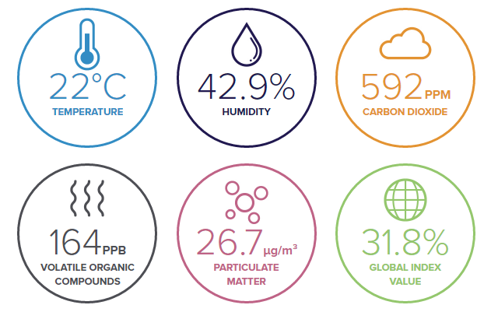
AirSense IoT and AI based Air Quality Monitor - For a more aware public

Slide 2

Big concept
Lets give everyone a breath of purity
This project is not aimed at only visualising the data or extracting and placing the data on a single page, it's more of a driver project to monitor the active hazard level by using AI to counter them easily overtime and make the users engage and be a part of the #AirSense program.

Slide 3
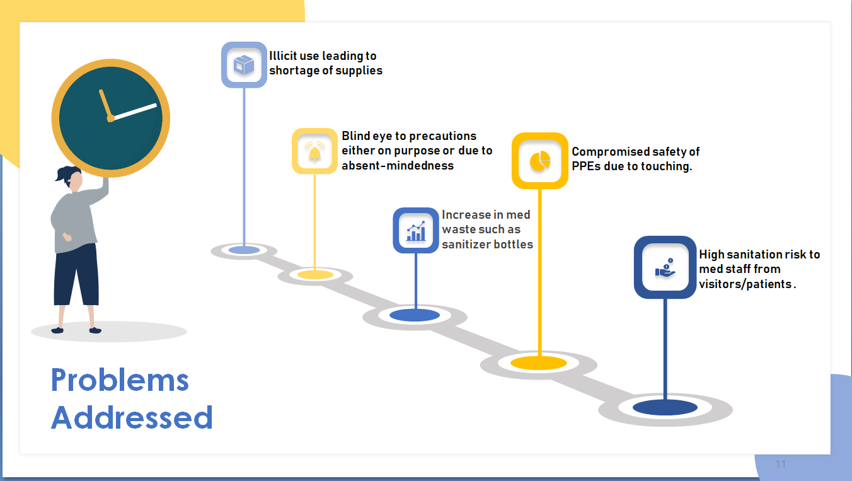
People are detached from the air quality monitoring process
Untimely response to hazards in the environment
Lack of regulatory compliance for industries
Real time data is currently not available
Rise in health problems due to air pollution

Slide 4
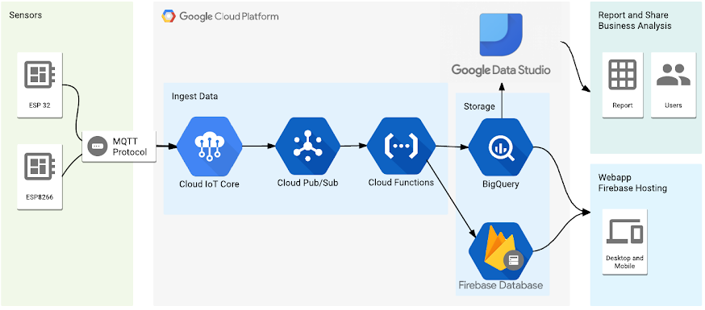


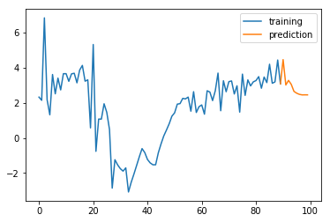





Architecture
User Entry Point
Storing sensor & predicted data in real time database
LSTM model which predicts future values
To constantly monitor our stream of data and detect anomalies such as sudden spikes in CO2

Slide 5
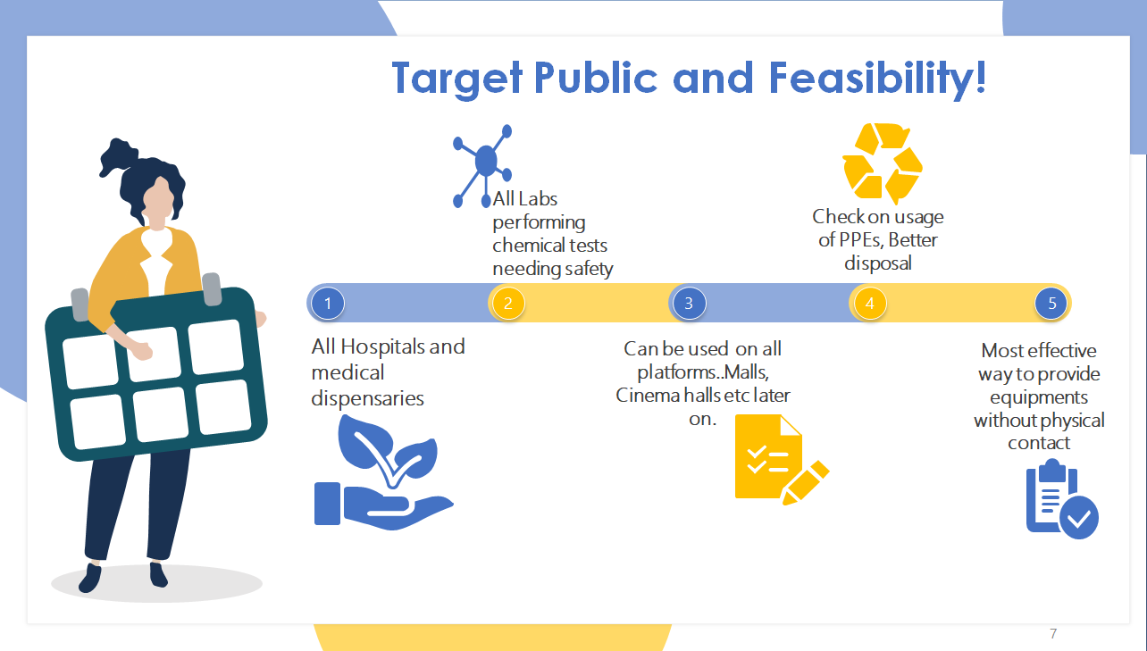
Government Bodies
Avoid fines for poor air quality
Reduced health spending & higher tax revenues
Schools and Education Providers Healthier pupils with improved educational outcomes
Environmental Scientists and Researchers
Access to new data sources, application enablement platforms, analytics capabilities and services
Hospitals and Health Professionals
Reduce hospital admissions & service delivery cost
Regulators Ensure regulatory compliance standards for Oil and gas Industries/Factories
City Administrators Access carbon trading and green bond markets Improved urban planning

Slide 6






We are a group of undergraduate students!
Piyush Maheshwari
Solomon Johnson
Saloni Bhatia
Shivam Patel
Amogha T S

Slide 7
THANK YOU
Efforts by: Saloni Bhatia(Team Leader)
Team name: AirSense
Submitted to: Delhi Hacks

