Slide 1

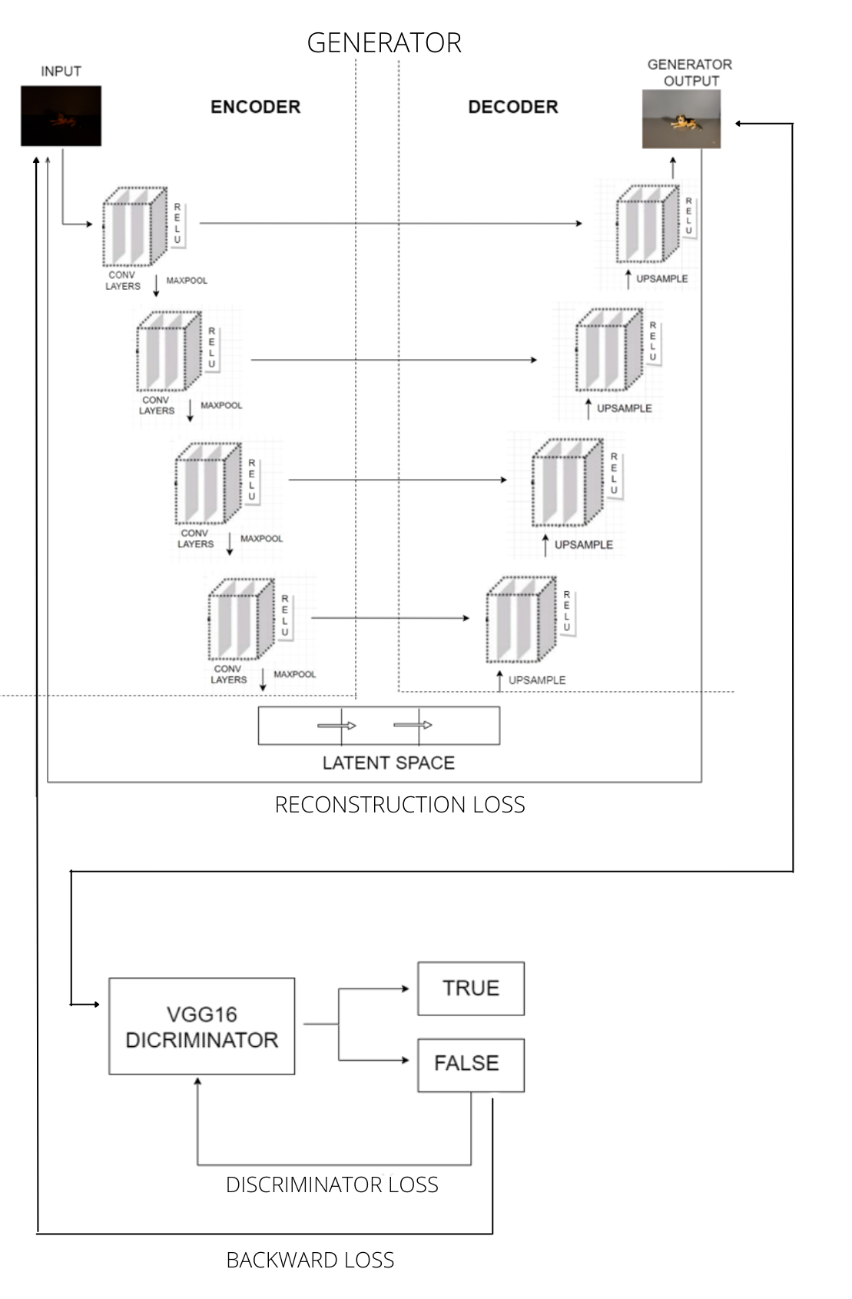
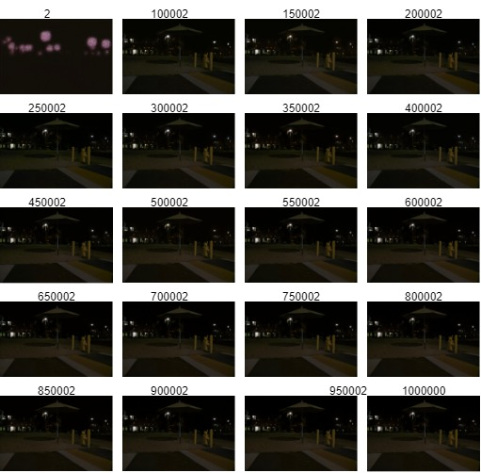
Enhancement of Lowlight images
Chinmayee, Amogh, Sampada, Palavi & Guide: Ujwala Patil
Problem statement
Proposed Framework
Results and Discussion
To propose a Learning based technique for Enhancement of images captured in low light conditions.
Objectives
Experiment on available learning based architectures towards Low light image enhancement.
Develop a learning based technique for enhancement of low light paired images of high ISO, low ISO and high exposure, low exposure.
Propose a learning based architecture to enhance the images captured in low light condition.
Demonstrate the results of the proposed methodology using the available data-set and compare the results with state-of-the-art methods
Contributions
Conclusions
Data-set: We have generated a registered data-set of 3500 .dng and jpeg images manually in a synthetic environment. This data-set varies along ISO 50 to ISO 3200 with the range of exposure 1/125 to 1/6.
UNET Model: On the basis of our learning we have designed a custom UNET based architecture to address the custom data-set.
In conclusion it can be stated that low-light image enhancement project is elite and serves the society from root level to highest level of community.
Mini Project-2020-21

