Slide 1

WINTER
ANALYTICS
BY
AMOGH KAPOOR
23322004
SOCIETY OF BUSINESS

Slide 2
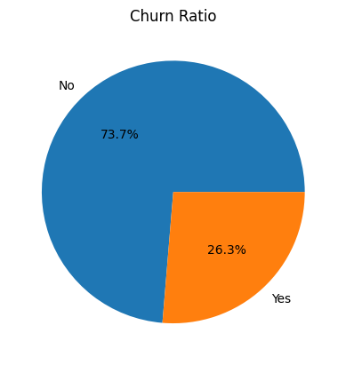
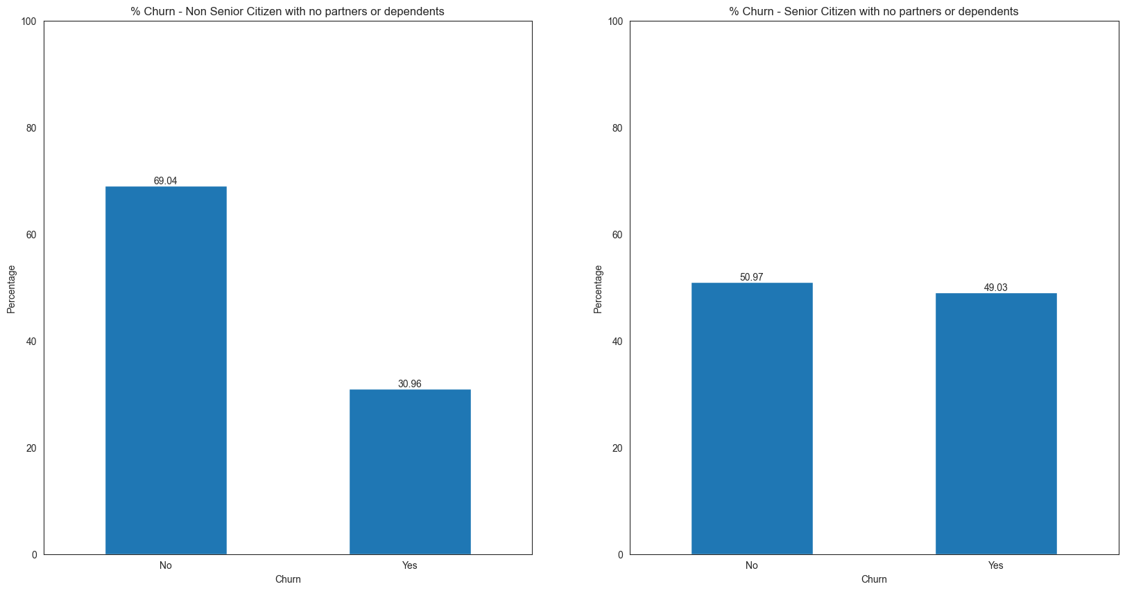
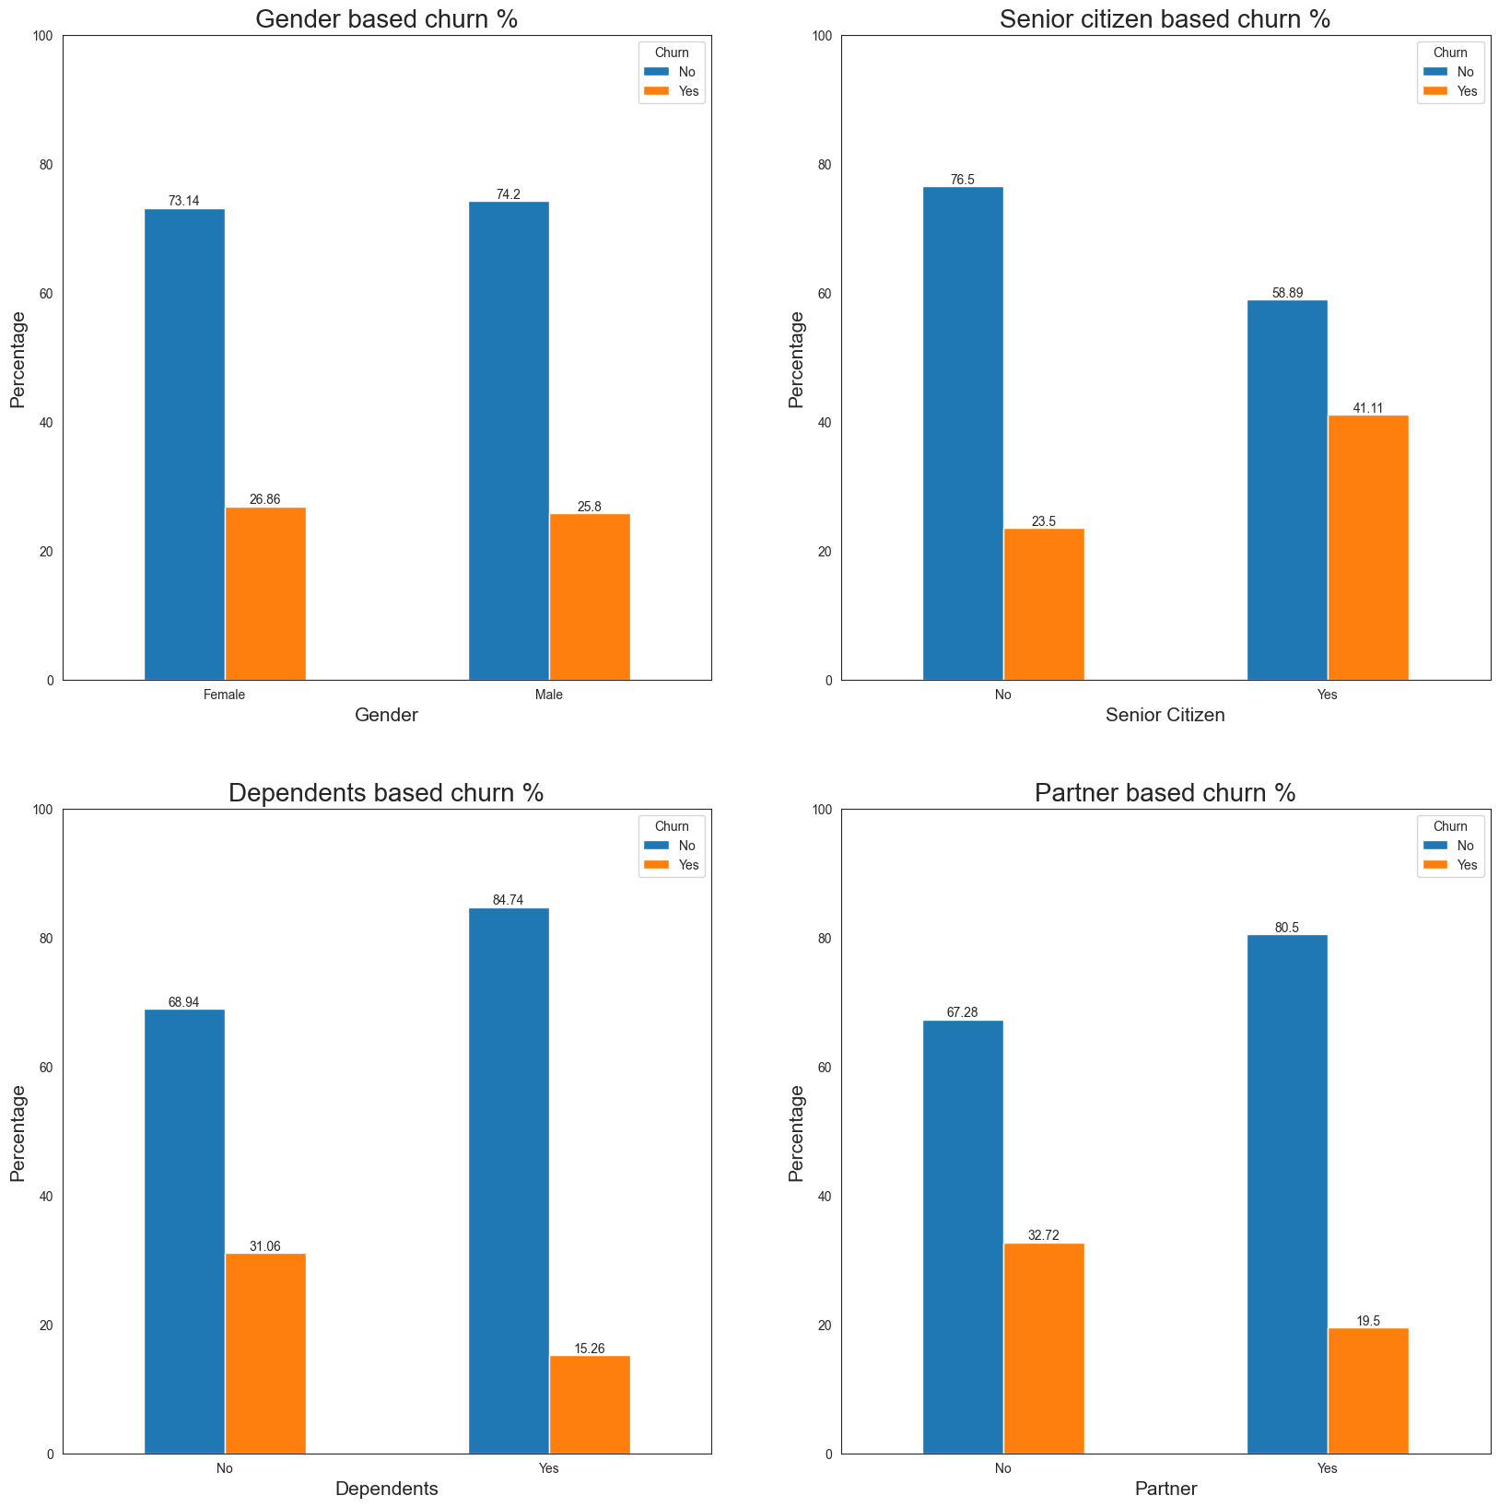
Demographics Analysis
Demographic Split
Male - 51% and Female - 49%
Senior citizen - 16% and balance - 84%
Customer with dependents - 30% and others - 70%
Customers with partners - 52% and others - 48%
Senior citizen with no dependents and with high churn need to be further analysed to identify if churn is during their life cycle or due to deaths.
Approximately 50% of senior citizens having no partner or dependents churn out. This might be due to the fact that they are free to move to other operators without any obligation to others.
01

Slide 3
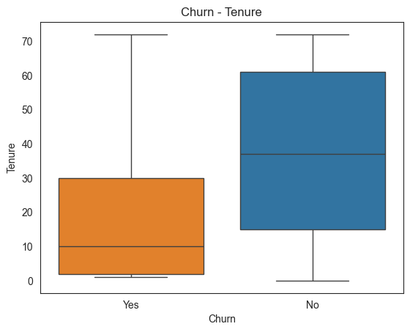
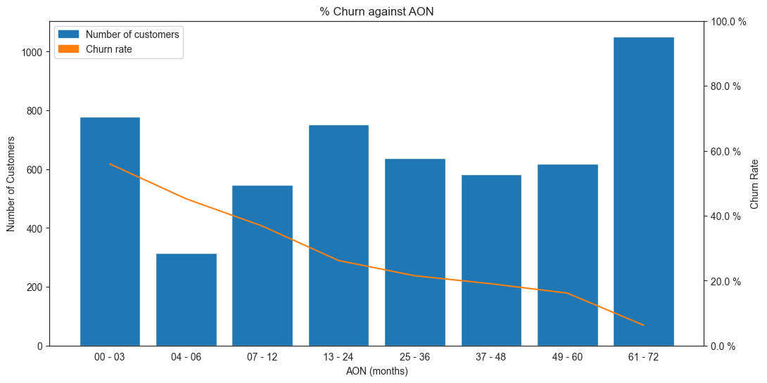
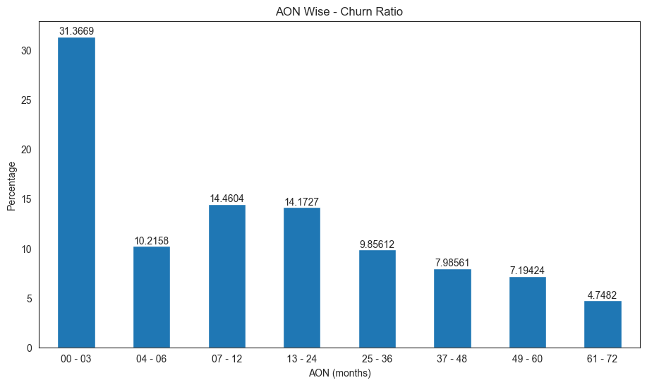
Age On Network Analysis
AON vs Churn
50% of the customers who left the service did so in the first 10 months.
This is probably because the customers are testing out the varied services available to them and hence, in order to save money, 1 month service is tested out.
With increase in tenure, there is a drop in churn rate.
02

Slide 4
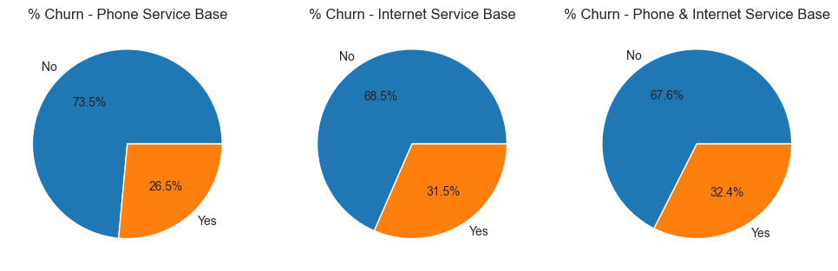
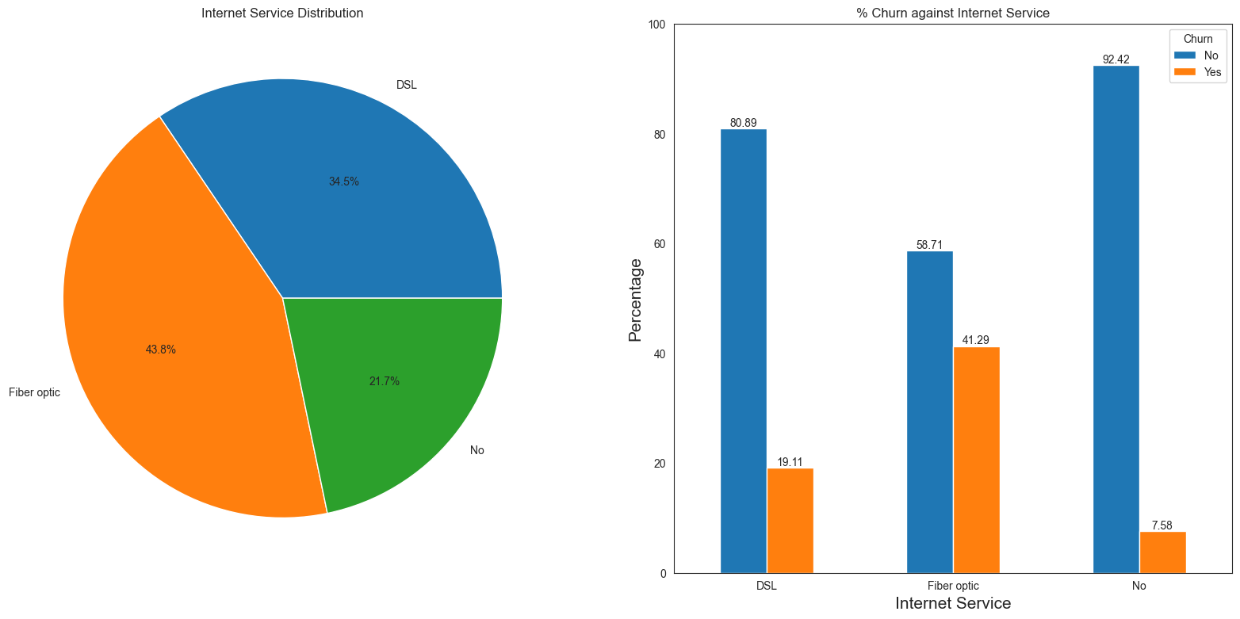
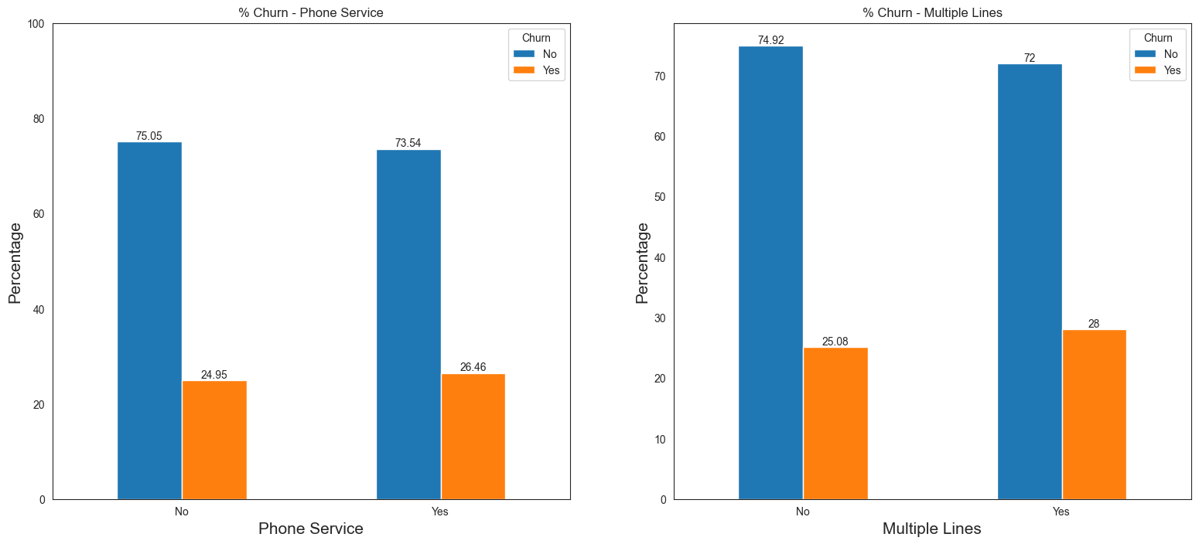
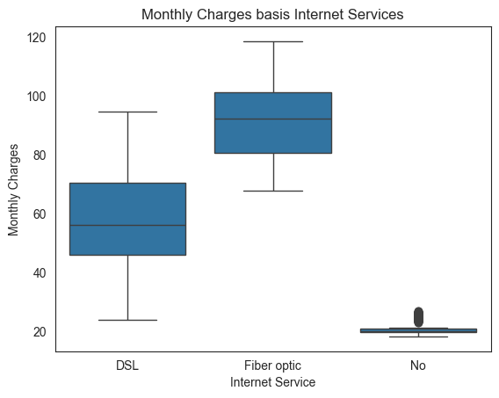
Service Analysis
Customer with internet service have a higher churn percentage as compared to customer with only phone service.
Maximum number of customers have adopted fiber optics as their mode of internet service and also have a high percentage of churn in comparison to DSL service.
There is no significant difference in churn percentage for customers subscribing to phone vs non-subscription.
Multiple line subscription within phone service also have a equal distribution of churn with customers who do not have multiple lines.
Fiber optic service have a higher charge and churn % in comparison to DSL which is in sync to high churn percentage in customers with a high monthly charge.
03

Slide 5
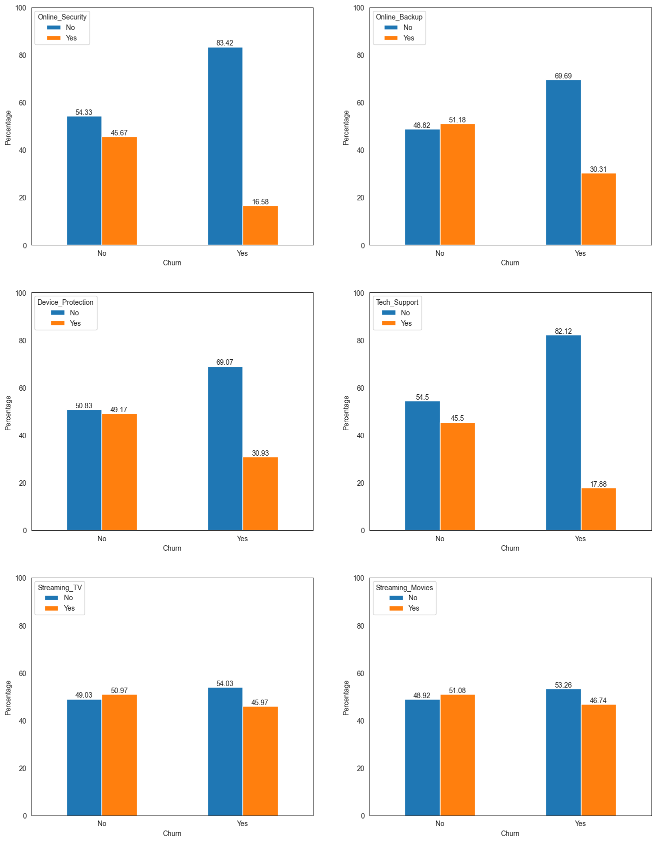
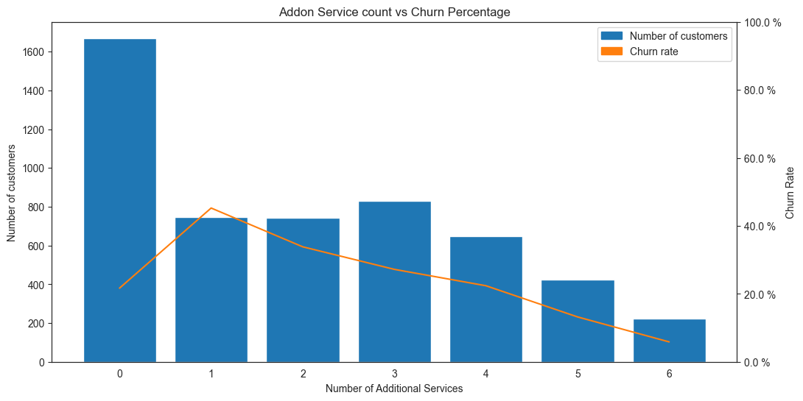
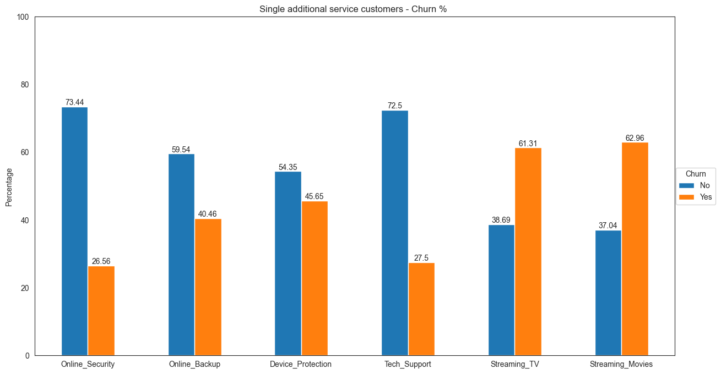
Additional Service Analysis
Additional Service-wise customer churn %
Churn percentage reduces with increase in additional services, highest in customers with only one additional services.
StreamingTV and StreamingMovies display an identical graph. Irrespective of being subscribed to StreamingTV & StreamingMovies, a lot of customers have been churned. Looks like the streaming content was not entirely at fault.
Customers with online security and tech support have a lower churn percentage which could be a strong point of the operator which should be leveraged by the operator to reduce churn.
04

Slide 6
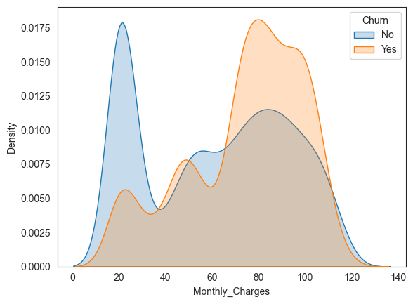
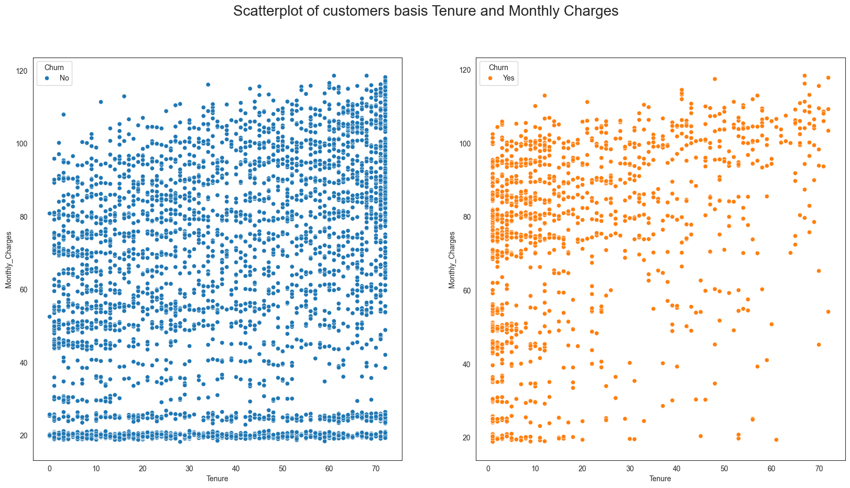
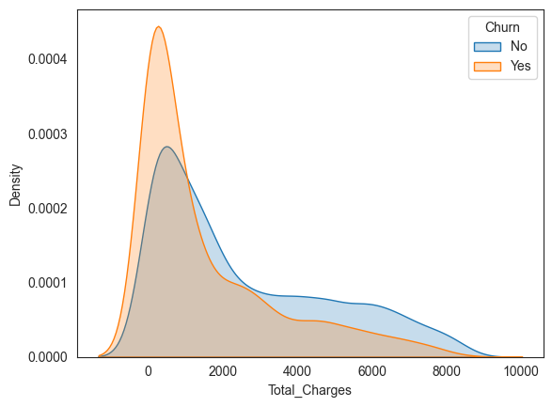
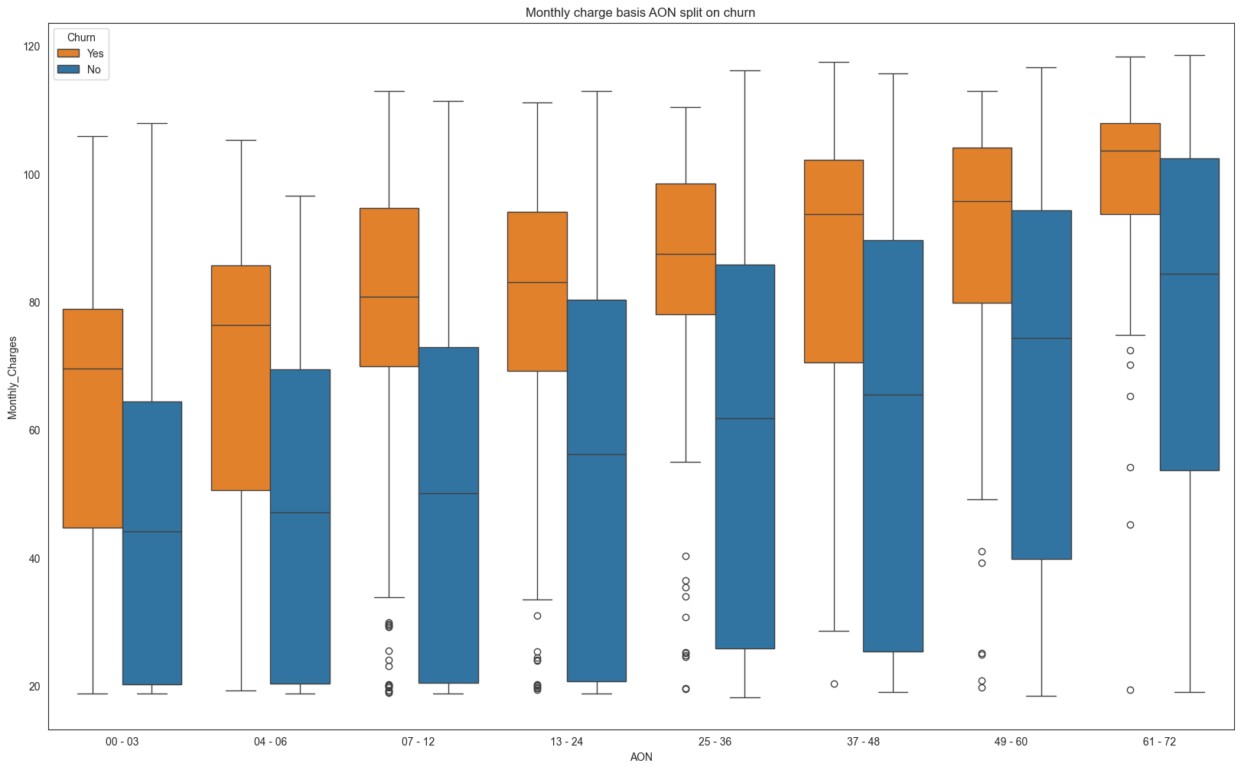
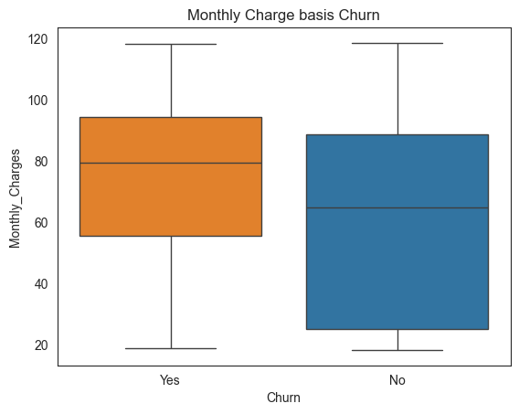
Charge Analysis
Market is price sensitive as there is increase in churn against higher charge.
It is indicative that customers having a high monthly charge during onboarding churn the highest.
Old customers churn rarely and are loyal, but even the few customers that do so have a high monthly charge.
Customers with the base plan(lowest monthly charge) generally do not churn.
The impact of monthly charges can be better analysed if the data was a continuous data, shared data looks to be a total charges divided by tenure, which can be misleading.
05

Slide 7
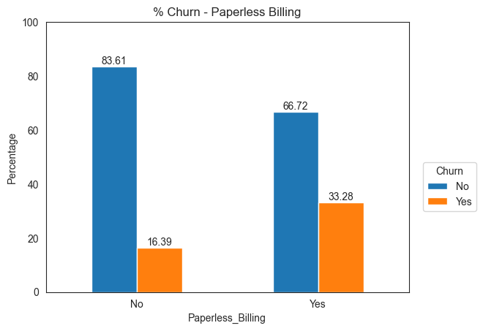
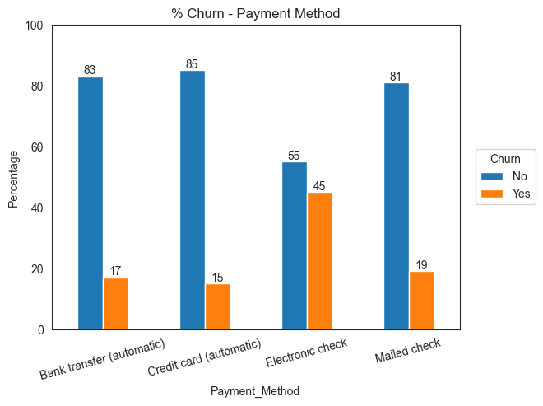
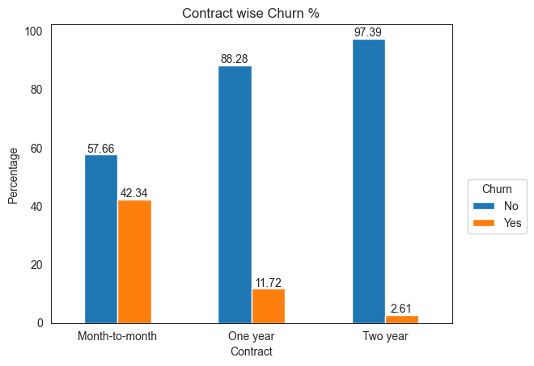
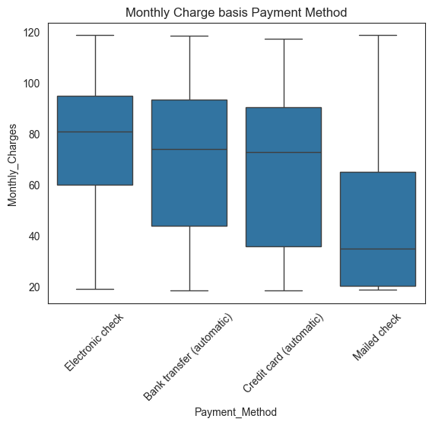
Other Parameters
Operator need to focus on online self service platform to ensure proper bill delivery and receipt of payments as there seems to be an issue with paperless billing and electronic checks which are both done online.
Long term plans to be promoted as there is a lower churn percentage, this can be done by offering a lower rate as compared to the shorter plans.
Depending on the contract, operator can charge an exit levy for customers moving out in a monthly plan.
06

Slide 8
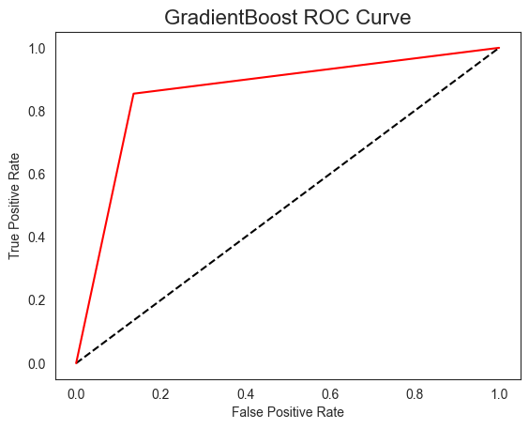
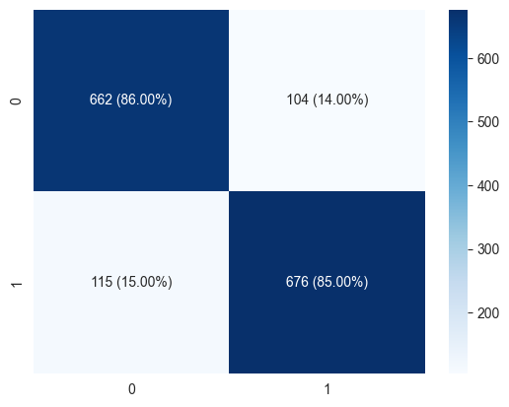
Machine Learning - GradientBoosting
Model | Accuracy | Precision | Recall | F1 Score
Gradient Boosting | 0.859345 | 0.866667 | 0.854614 | 0.860598
LightGBM | 0.856776 | 0.870757 | 0.843236 | 0.856776
CAT Boost | 0.856134 | 0.872536 | 0.839444 | 0.85567
Logistic Regression | 0.856134 | 0.881561 | 0.828066 | 0.853977
Random Forest | 0.852922 | 0.87367 | 0.830594 | 0.851588
ADA Boosting | 0.847784 | 0.850633 | 0.849558 | 0.850095
XGBoost | 0.850353 | 0.870027 | 0.82933 | 0.849191
Support Vector Machine | 0.841362 | 0.875691 | 0.801517 | 0.836964
K-Nearest Neighbors | 0.827874 | 0.82404 | 0.840708 | 0.83229
Decision Tree | 0.815029 | 0.820382 | 0.814159 | 0.817259
Gaussian Naive Bayes | 0.790623 | 0.749731 | 0.882427 | 0.810685
Gradient Boosting
Model accuracy | 85.9345%
Precision | 86.6667%
Recall | 85.4614%
F1 Score | 86.0598%
ROC AUC | 85.9422%
To handle the imbalance in data, SMOTE was applied to improve the model.
Various models were tested, and GradientBoosting has the best combination of both Accuracy and F1 score.
Hypertuning of parameters was done to increase the F1 score.
It is more important for the operator to figure out the customers who are churning, hence recall is a better parameter than precision.
07

Slide 9
THANK YOU

