Slide 1
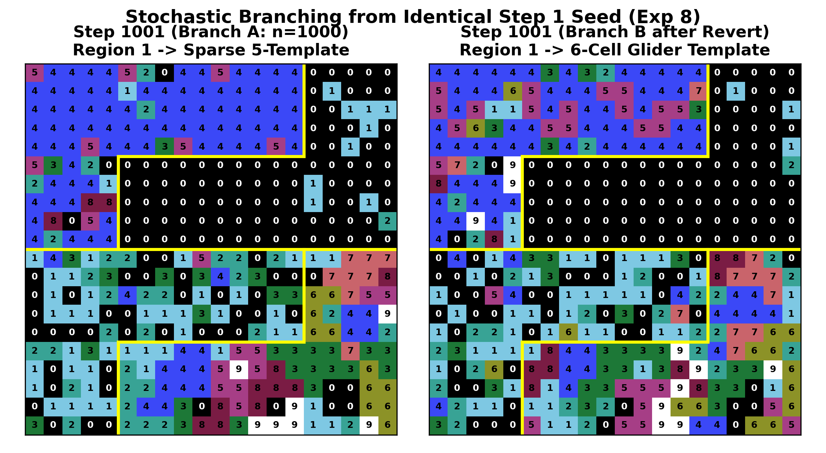
1. Experimental Methodology & Multi-Scale Test Matrix
Methodology (Controlled Perturbation Design):
• Conducted 8 experimental protocols (54 states) from Step 1 to Step 6001.
• Tested micro-steps (n = 1, 10), meso-steps (n = 100, 200, 250, 500), and macro-jumps (n = 1000, 3000, 5050).
• Executed Revert branching tests from identical Step 1 seeds.
Empirical Findings:
• Single steps (n = 1) alter only 2 to 5 cells board-wide (~1 update/region).
• Clicking Revert + Next n Step with identical n (n = 1 or 1000) produces divergent trajectories (Branch A vs. Branch B).
• Daytime (Oct 2) and nighttime (Oct 7) runs follow identical rules.
Reasoning & Conclusion:
• Revert restores X(t) without resetting the random seed: the system is an asynchronous, non-seeded stochastic automaton.

Slide 2
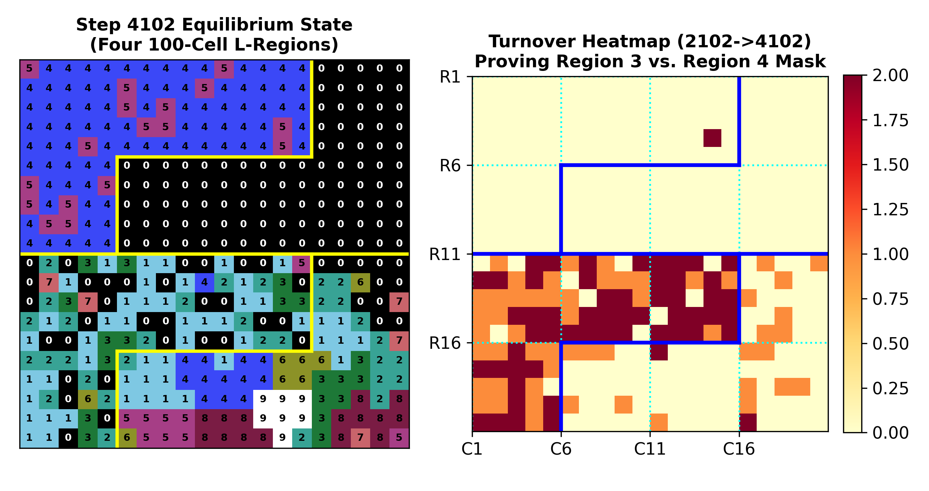
2. Spatial Architecture: Four Symmetric 100-Cell L-Regions
Methodology (Differential Turnover Auditing):
• Mapped cell-by-cell turnover across Step 2102 -> 3102 -> 4102 and Step 4001 -> 4351 rather than single-frame color inspection.
Empirical Findings:
• Step 3102 -> 4102: 73/100 cells changed in Region 3, while 90/100 cells stayed frozen in Region 4.
• Step 4001 -> 4351 (n = 10x5, 100x3): 0 cells changed in Regions 1, 2, and 4 (including R11..15 C16..20 and R16..20 C6..10); 100% of turnover occurred inside Region 3.
Reasoning & Conclusion:
• The 20x20 grid is a 4x4 macro-grid of sixteen 5x5 sub-blocks (25 cells each), partitioned symmetrically into four 100-cell L-regions.

Slide 3
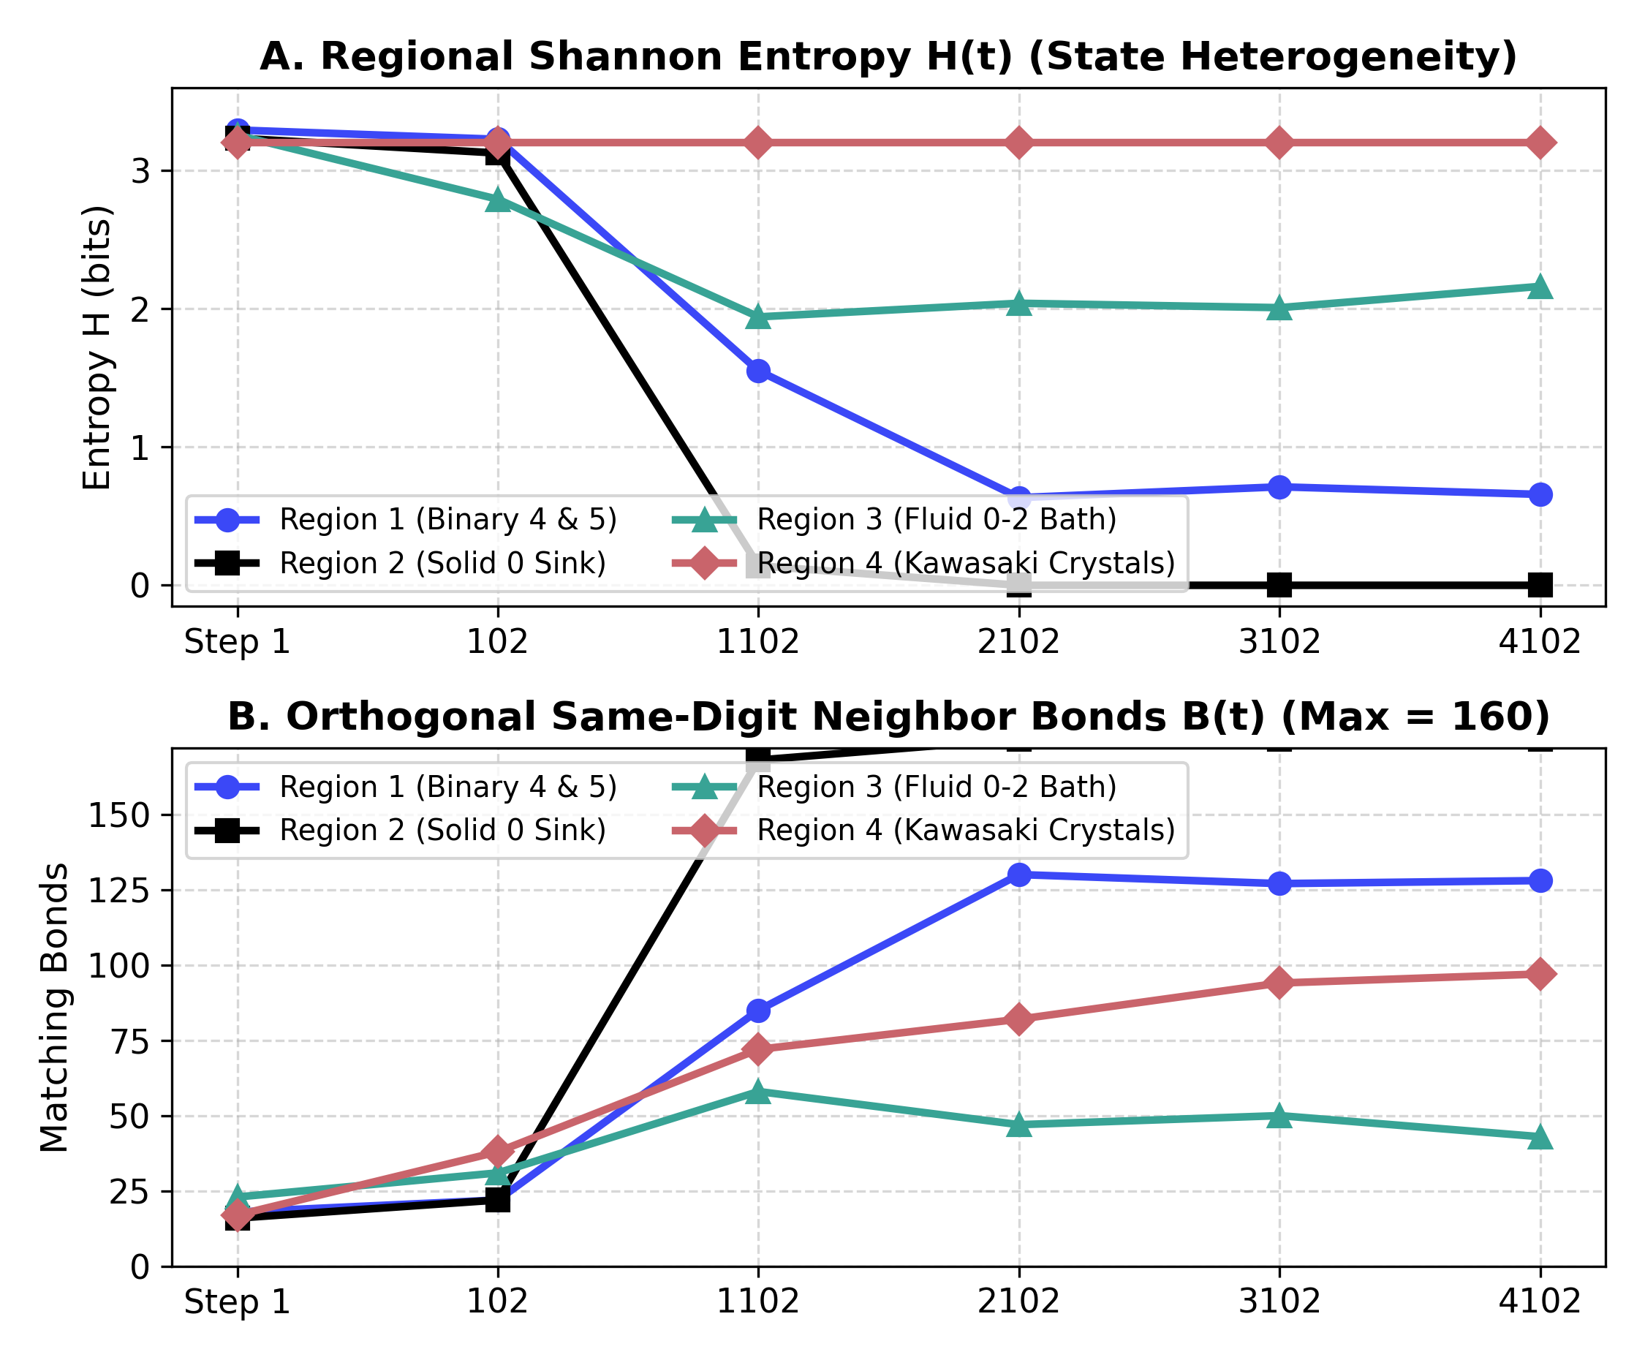
3. Uneven Energy Dissipation & Regional Heterogeneity
Methodology (Information & Bond Metrics):
• Tracked Shannon Entropy H(t) and orthogonal same-digit neighbor bonds B(t) across Step 1 to Step 4102.
Empirical Findings:
• Step 1: All 4 regions start at maximal heterogeneity (H = 3.23-3.28 bits) and random bonding (B = 14-17 bonds).
• By Step 2102-4102: Region 2 drops to H = 0.00 bits (B = 160); Region 1 locks at H = 0.66 bits (B = 108); Region 3 plateaus at H = 1.85 bits; Region 4 preserves H = 3.12 bits while B rises to 92.
Reasoning & Conclusion:
• Energy dissipates unevenly: Regions 1 & 2 freeze into low-entropy attractors, Region 3 stays a thermal bath, and Region 4 minimizes interfacial energy while conserving all 10 digits.

Slide 4
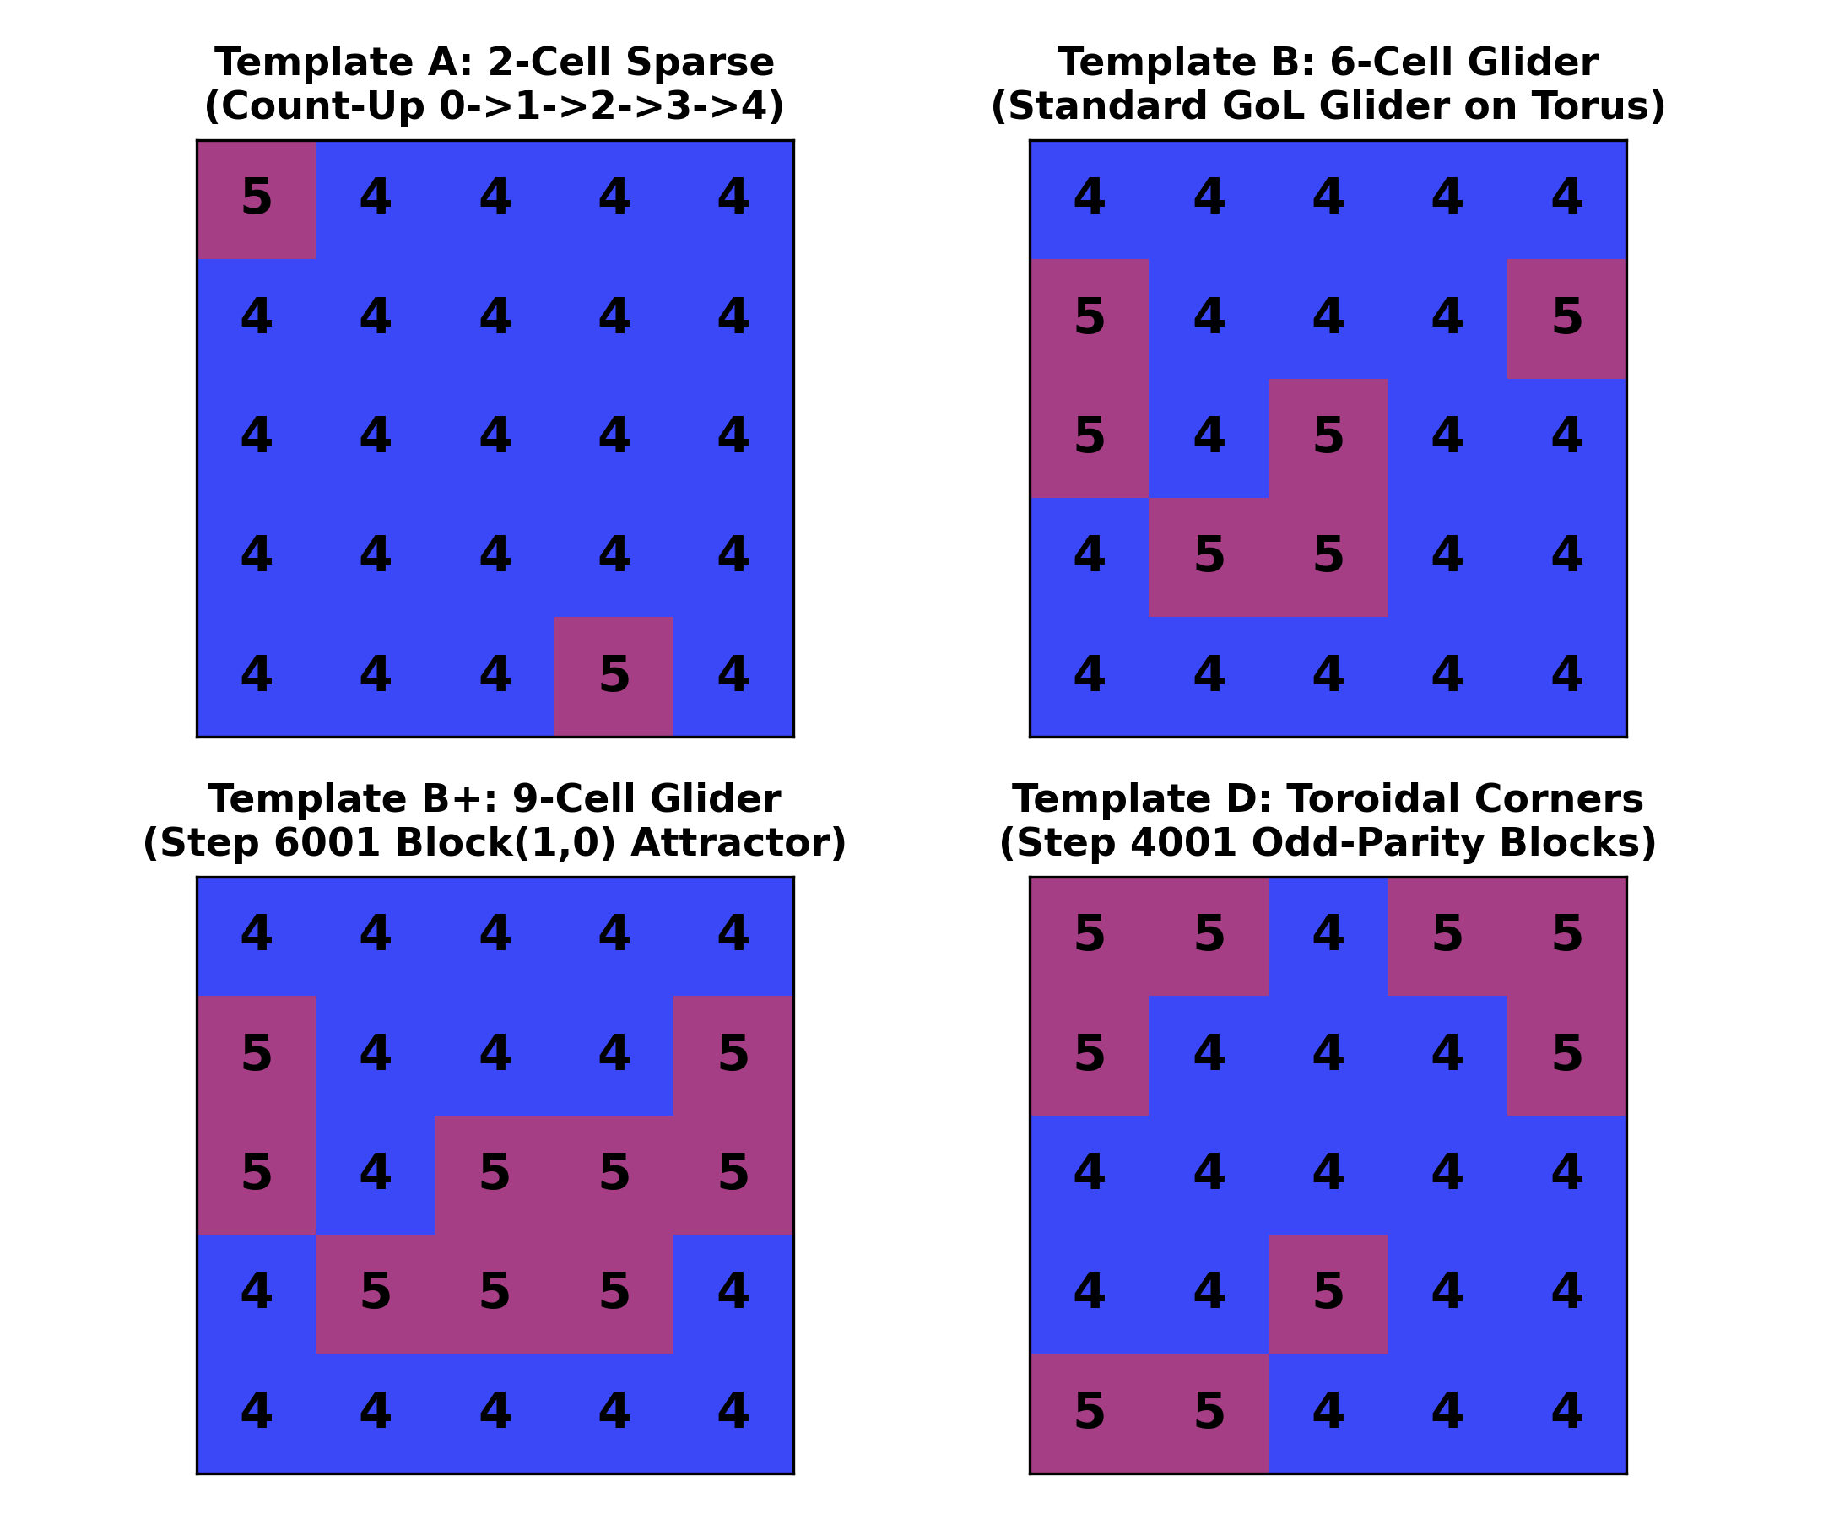
4. Regions 1 & 2: Bidirectional Counting & 5x5 Motifs
Methodology (Single-Cell Trajectory Tracking):
• Traced single-cell transitions across n = 1, 10 steps (Step 1->13) and post-equilibrium jumps (Step 3001->6001).
Empirical Findings:
• Region 1 Target 4 (Count-Up): Cells with X < 4 increment +1 (0->1->2->3->4); X > 4 resets to 0 first.
• Region 1 Target 5 (Countdown): Cells jump to 9 and count down (9->8->7->6->5) into 5x5 Game-of-Life Glider and Toroidal-Corner templates paired by checkerboard parity (br + bc) mod 2.
• Region 2 Sink: Non-zero cells snap or step down monotonically to 0.
Reasoning & Conclusion:
• Region 1 cells do not cluster by neighbor attraction; their target (4 or 5) is fixed by their local (lr, lc) coordinate in their 5x5 sub-block.

Slide 5
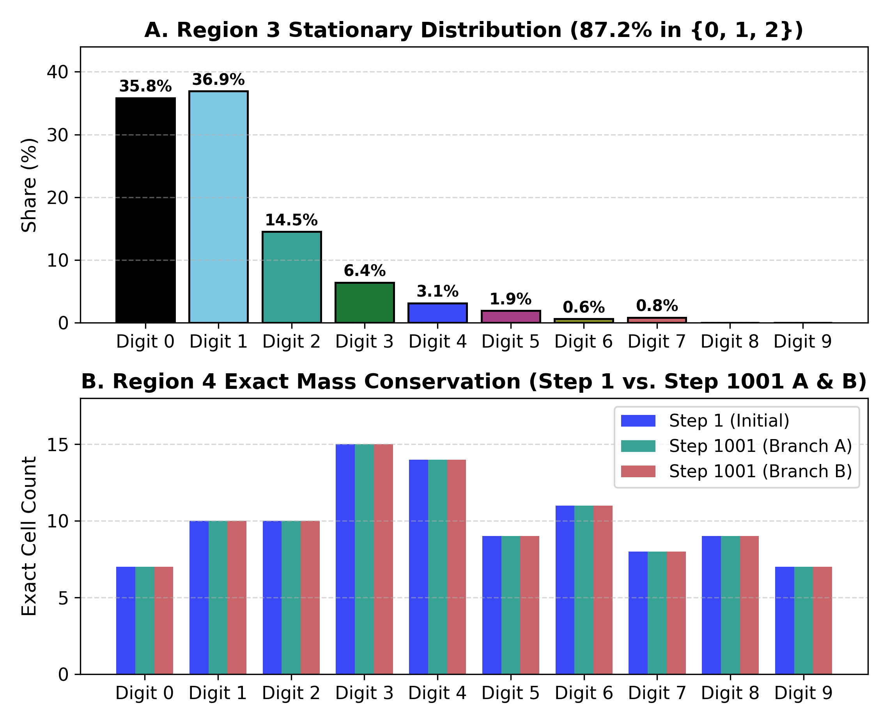
5. Regions 3 & 4: Markov Bath vs. Kawasaki Mass Conservation
Methodology (Complete Regional Census):
• Audited exact 100-cell digit histograms in Regions 3 and 4 from Step 1 to Step 1001 (Exp 8) and Step 3001 to 6001 (Exp 6).
Empirical Findings:
• Region 3 Bath: Resamples ~6.2 cells per 10 steps into 35.8% 0, 36.9% 1, 14.5% 2 (87.2% in {0,1,2}).
• Region 4 Mass Invariance: In Exp 8, Step 1 digit counts in Region 4 (0:7, 1:10, 2:10, 3:15, 4:14, 5:9, 6:11, 7:8, 8:9, 9:7) are 100% identical at Step 1001 (Branches A & B).
Reasoning & Conclusion:
• Global 0 majority (~38%) comes from Region 2 (100% 0) and Region 3 (36% 0), not overwriting. Region 4 is a 100% closed Kawasaki swap subspace where clusters grow via Ostwald ripening.

Slide 6
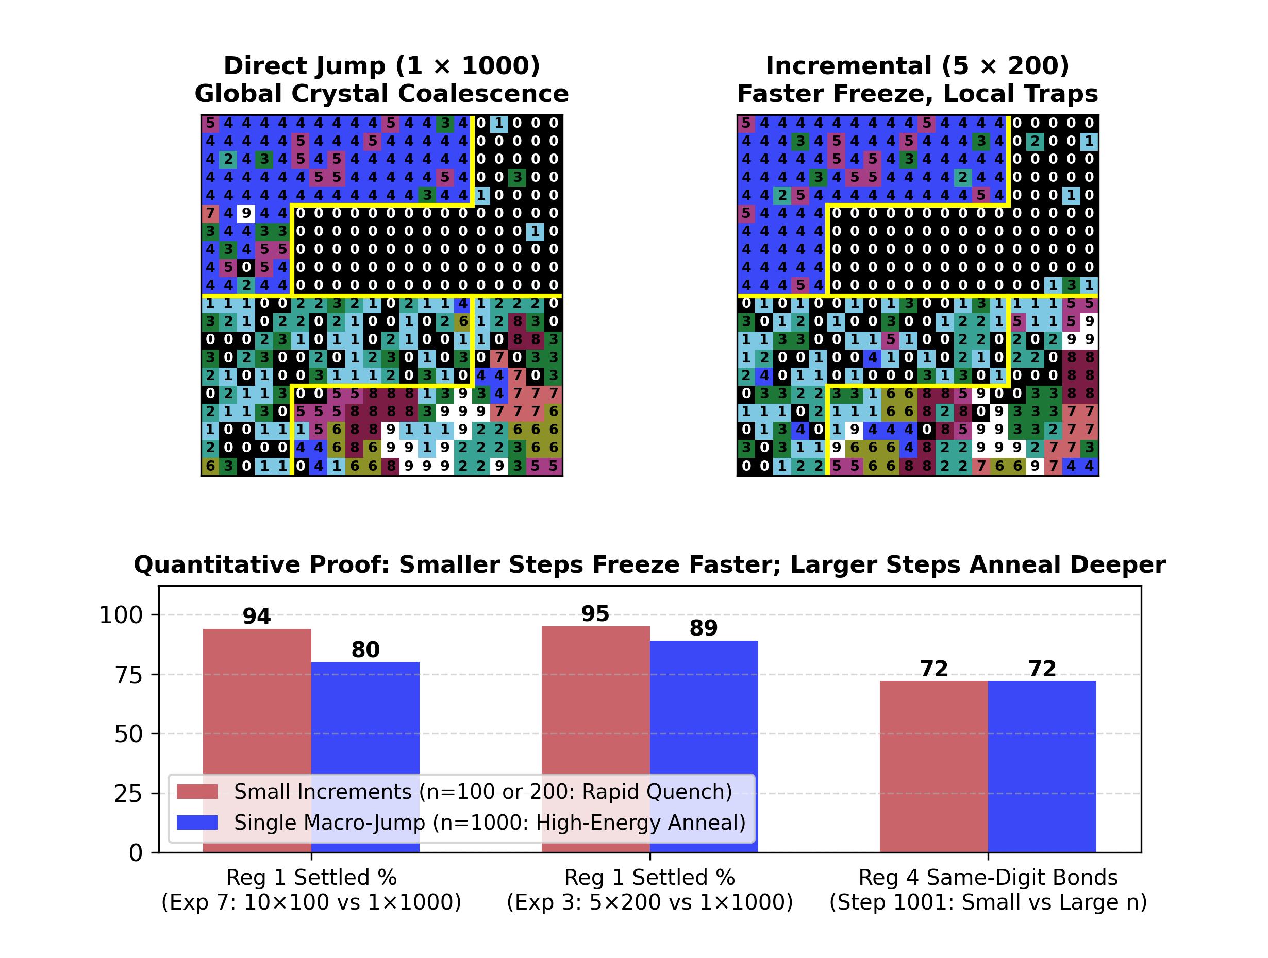
6. Path Divergence (N != 1 x N): Quenching vs. Annealing
Methodology (Split-Path & Threshold Sweep):
• Compared 1x1000 vs. 5x200 and 10x100 from identical Step 1 seeds; swept n = 10 to 1000 from Step 3001.
Empirical Findings:
• Small Steps Freeze Faster: At Step 1001, Region 1 is 94%-95% settled under 10x100 and 5x200 vs. 80%-89% under 1x1000. Region 4 freezes by Step 501 under 10x100 but traps local islands.
• Unfreezing Threshold (n >= 250): At equilibrium, n <= 100 causes 0 swaps in Region 4, whereas n = 250 unbinds 1-bond cells and n = 1000 coalesces each digit into a single crystal.
Reasoning & Conclusion:
• Clicking 'Next n Step' supplies an energy pulse E_pulse(n) that expands swap radius R(n): small n rapidly quenches, while large n anneals.

Slide 7
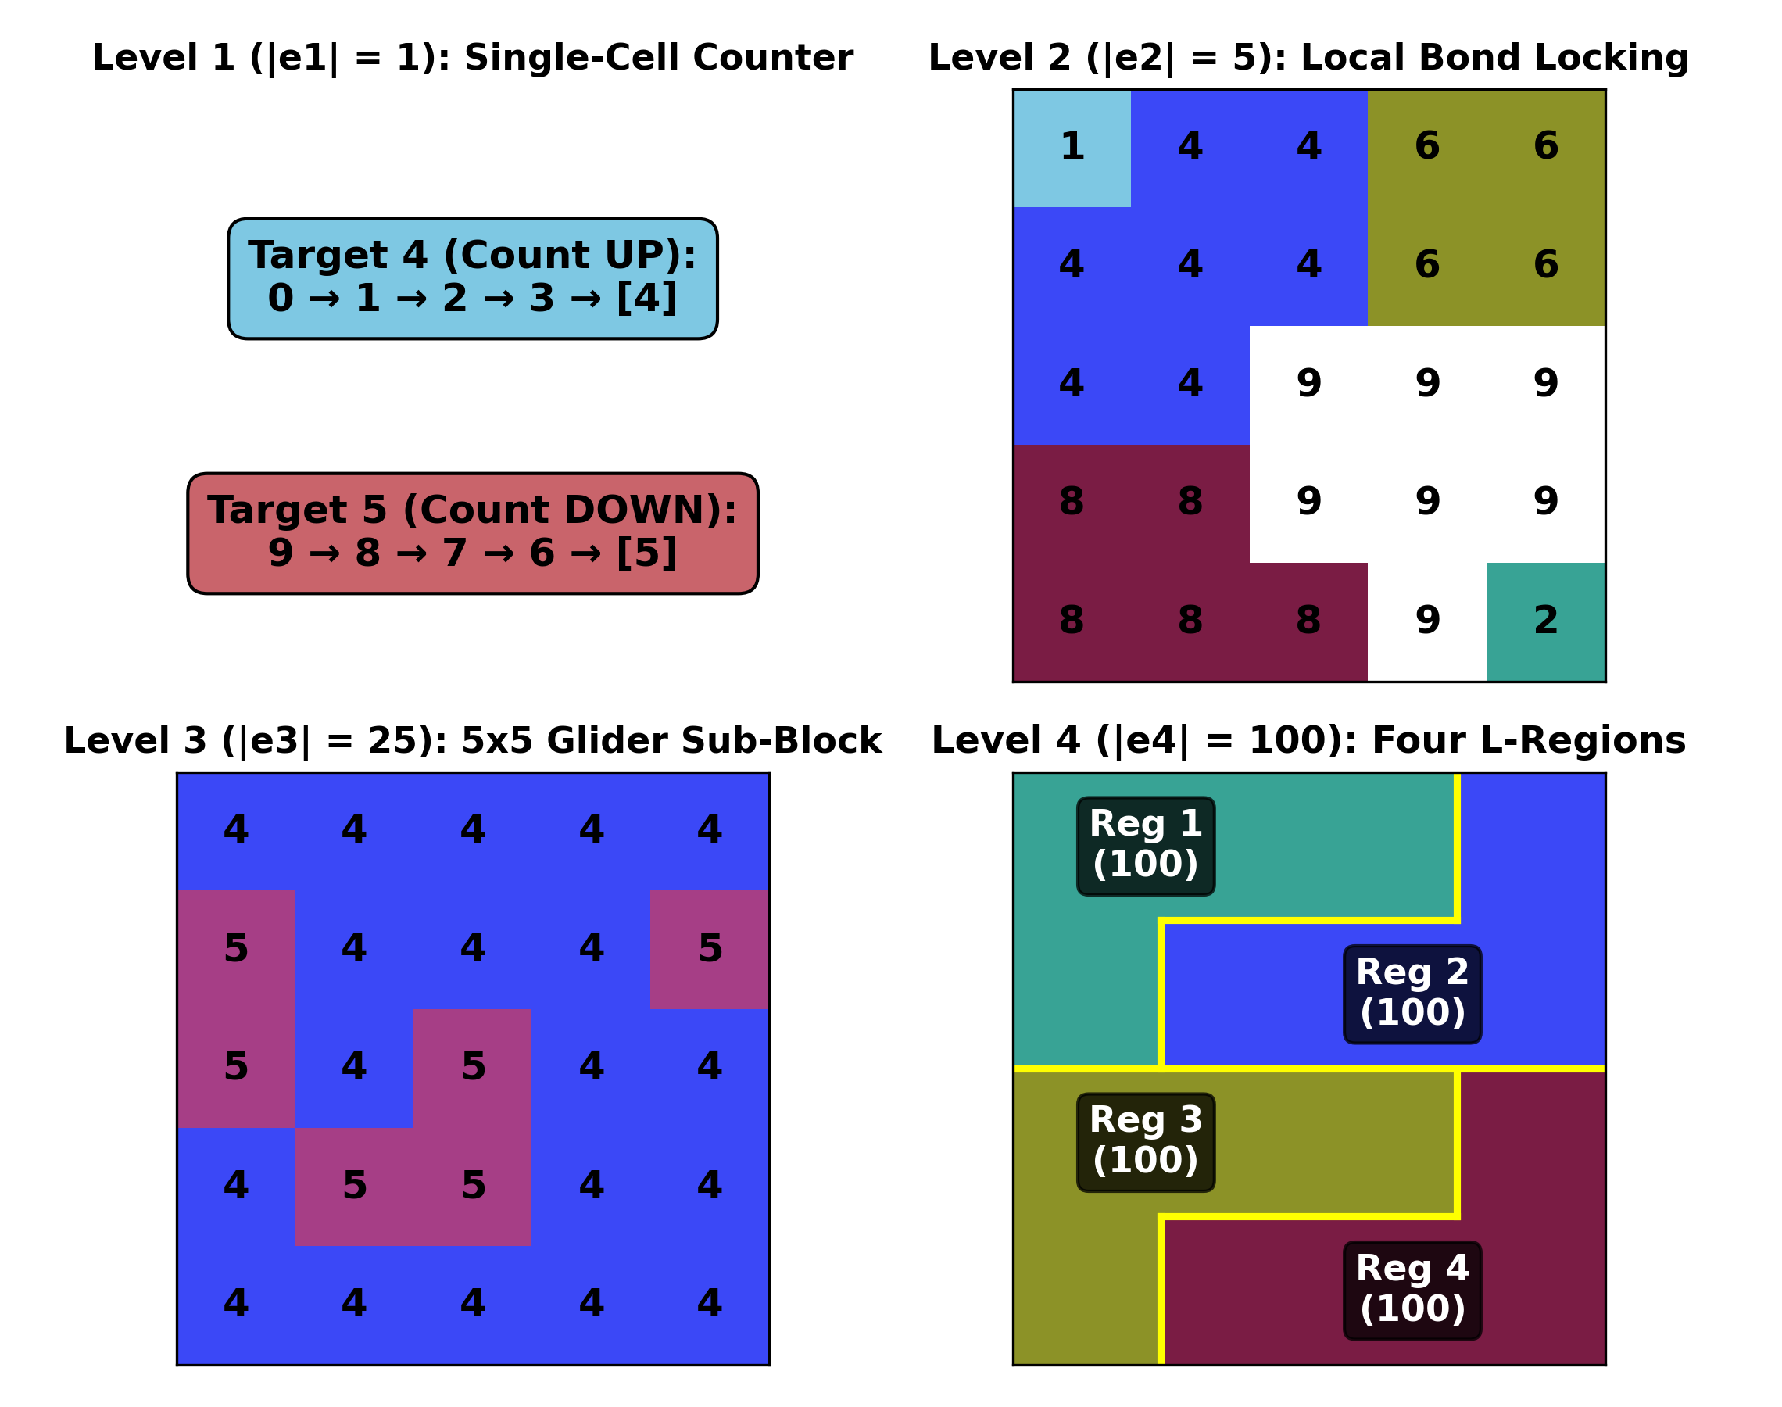
7. Synthesis: 4-Level Nested Hypergraph & Systemhood
Methodology (Multi-Scale Systems Synthesis):
• Integrated micro (1x1), local (3x3), meso (5x5), and macro (100-cell) rules into a 4-level hypergraph H = (V, E1 U E2 U E3 U E4).
Multi-Scale Hypergraph Hierarchy:
• Level 1 (|e1| = 1, Single Cell): Intrinsic 1D counter (+1 / -1).
• Level 2 (|e2| = 5, Von Neumann Neighborhood): Individual mobility (0 bonds) vs. collective crystal locking (>= 2 bonds) in Region 4.
• Level 3 (|e3| = 25, 5x5 Sub-Block): Enforces 5x5 binary Glider/Corner templates in Region 1.
• Level 4 (|e4| = 100, L-Region): Assigns regional physics law and checkerboard block pairing.
Conclusion (Systemhood):
• Cell behavior emerges via downward causation across all 4 spatial scales plus user energy input n.

