Slide 1
Byzantine Fault-Tolerant Intrusion Detection System
Amogh Nellutla
Montclair State University
Master of Science: Cybersecurity
Advisor: Christopher Leberknight

Slide 2
What If Your Security System Lies to You?
Traditional IDS Design Assumptions
Why These Assumptions Fail
Assumption 1: The IDS Is Honest
IDS alerts are treated as ground truth
No mechanism to question or verify detector behavior
Assumption 2: Failures Are Accidental, Not Malicious
Traditional fault tolerance handles crashes
It does not handle intentional deception
Assumption 3: One Detector Is Enough
Centralized or single-decision IDS architectures
Creates a single point of trust
Single Point of Failure
If the IDS is compromised, the entire network becomes blind
No Cross-Verification
Alerts are not validated against independent detectors
No majority or consensus logic
Trust Is Assumed, Not Proven
IDS trusts its own output
Attackers exploit this implicit trust
One Lying Node = System Failure
A malicious detector can:
  Hide real attacks (false negatives)
  Generate fake alerts (false positives)
  Mislead incident response teams

Slide 3
REAL-WORLD FAILURE OF TRUSTED SECURITY SYSTEMS
Documented Security Failures
Modern Network Reality
SolarWinds Supply-Chain Attack (2020)
Monitoring and update mechanisms were compromised
Malicious code distributed through trusted software updates
Intrusions remained undetected for approximately 9 months
Security tools actively reported normal operation while attackers were present
Target Data Breach (2013)
Malware installed inside internal systems
Security alerts were generated but not trusted or correctly interpreted
Resulted in 70 million customer records stolen
Failure was not absence of detection, but failure of trust in detection
Today’s Enterprise Networks
Distributed and decentralized
Cloud-based and hybrid
IoT and edge-device heavy
Composed of heterogeneous trust domains
Modern Adversary Strategy
Attackers no longer only target services
They increasingly target:
  Monitoring systems
  Logging pipelines
  Detection infrastructure
Goal: control what defenders believe

Slide 4
RESEARCH QUESTIONS
RQ1:
Can a distributed Intrusion Detection System maintain correct attack detection and decision-making, when one of its detection nodes behaves maliciously (Byzantine behavior)?
RQ2:
Can majority-based consensus among independent IDS nodes override false positives and false negatives introduced by a Byzantine detector?
RQ3:
Does the system consistently reach correct consensus decisions across multiple attack types and repeated attack instances, despite intermittent Byzantine behavior?

Slide 5
The Byzantine Generals Problem
What is the Byzantine Problem?
Mathematical Guarantee of Byzantine
Imagine a scenario where several Byzantine generals surround an enemy city, each commanding their own army division. To succeed, they must coordinate their attack - either all attack together or all retreat together. The generals can only communicate through messengers, but here's the critical challenge: some generals might be traitors who will deliberately send conflicting messages to different generals, trying to sabotage the coordinated action. How can the loyal generals ensure they reach the same decision despite the presence of these traitors?
Nodes may:
Send false information
Send different messages to different nodes
Act maliciously, not just crash or go offline
Failures are arbitrary and unpredictable
Trust cannot be assumed
To tolerate f Byzantine (malicious) nodes: Total participating nodes ≥ 3f + 1
In this project:
Byzantine nodes tolerated: f = 1
Required nodes: 3(1) + 1 = 4
Implemented:
  3 Detector Nodes (voting participants) (RP6, RP8, RP8-V)
  1 Coordinator Node (consensus arbiter) (RP0)
Byzantine fault tolerance handles:
✅ lies
✅ deception
✅ insider compromise

Slide 6
Byzantine Theory to Intrusion Detection
Byzantine Model
IDS Reality (Security Model)
Byzantine Failure Model
Nodes are not just faulty — they are malicious
A Byzantine node may:
  Lie about the system state
  Send different messages to different nodes
  Cooperate with the attacker
Failures are arbitrary and unpredictable
Trust cannot be assumed
Key Requirement
All honest nodes must reach the same correct decision
Even when some participants actively try to break agreement
Intrusion Detection Failure Model
IDS nodes can be:
  Compromised by malware
  Manipulated by insiders
  Subverted by attackers
A compromised IDS can:
  Suppress real alerts (false negatives)
  Inject false alerts (false positives)
  Report different results to different systems
Key Observation
IDS failures are Byzantine by nature, not crash-only

Slide 7
Why Traditional Intrusion Detection Systems Fail
Assumptions in Traditional IDS
Reality Under Adversarial Conditions
Traditional IDS Design Assumptions
IDS nodes are trusted by default
Alerts from detectors are assumed truthful
Failures are assumed to be:
  Crashes
  Downtime
  Misconfiguration
No mechanism to:
  Verify alerts
  Detect malicious detectors
  Resolve conflicting alerts
Implicit Trust Model
One detector = one source of truth
If the detector lies → system fails silently
What Happens in Real Attacks
IDS nodes can be:
  Compromised by attackers
  Controlled by insiders
  Manipulated through supply-chain attacks
A compromised IDS can:
  Hide real intrusions (false negatives)
  Flood the system with noise (false positives)
  Report different alerts to different systems
Critical Limitation
Traditional IDS cannot distinguish:
  Honest alerts vs malicious alerts
  Faulty behavior vs adversarial behavior

Slide 8
BFT-IDS Model
Traditional IDS Model
BFT-IDS Model
Trust-Based Decision Model
Single detector reports an alert
Alert is accepted as truth
Decision depends entirely on:
  Integrity of that detector
  Assumption that it is uncompromised
Failure Case
If one detector lies → incorrect decision
No way to validate or challenge the alert
Consensus-Based Decision Model
Multiple independent detectors observe the same traffic
Each detector submits its own alert (vote)
A coordinator aggregates all votes
Final decision is based on majority agreement
Key Property
Malicious or lying nodes are outvoted
Honest nodes always reach the same correct decision
Detectors → Independent voters
Coordinator → Consensus arbiter
Decision → Majority-approved alert

Slide 9
SYSTEM ARCHITECTURE OVERVIEW
High-Level Architecture Overview
End-to-End Pipeline
External attacker generates malicious network traffic
Target system runs Suricata IDS
Alerts are distributed to multiple detector nodes
Detectors independently analyze and vote
A coordinator aggregates votes and reaches consensus
Final intrusion decision is produced
Architecture Components
1. Attacker
Kali Linux machine
Generates real attacks:
  Port scans
  SSH brute force
  SYN flood
  Sequential scans
Simulates realistic adversarial behavior
2. Target Node
Raspberry Pi running Suricata IDS
Observes live network traffic
Generates raw alerts in real time
No trust placed in a single alert
3 Detector Nodes
RP6 → Honest detector
RP8 → Honest detector
RP8-V → Byzantine (malicious) detector
Each detector:
Receives the same alert
Performs independent analysis
Submits its own classification (vote)
3.Coordinator Node
RP0 (Consensus Arbiter)
Responsibilities:
  Collect votes from all detectors
  Apply Byzantine-fault-tolerant threshold
  Resolve conflicting reports
  Produce final intrusion decision

Slide 10
Attack to Consensus: End-to-End Detection Workflow
End-to-End Detection Pipeline
Attack Initiation
  External attacker launches a network attack
  Examples: Port scan, SSH brute force, SYN flood
Local Detection (Suricata IDS)
  Target Raspberry Pi analyzes live network traffic
  Suricata generates structured alerts (JSON format)
  Detection is signature-based and real-time
Alert Distribution
  Alerts are broadcast via UDP syslog
  Delivered simultaneously to all detector nodes
  No detector depends on another detector’s output
4.Independent Detector Voting
  Each detector independently analyzes the same alert
  Each node submits its own decision (vote)
    Attack type
    Confidence level
  Byzantine node may lie or misclassify intentionally
5.Consensus Aggregation
  Coordinator collects all detector votes
  Votes are grouped by attack type
  Majority threshold applied (≥ 66.7%)
6.Final Decision
  If threshold is met → consensus achieved
  Malicious or lying nodes are outvoted
  Final alert is confirmed and logged

Slide 11
Honest Detector vs Byzantine Detector Behavior
Honest Detector Node (RP6 / RP8)
Analyzes the alert exactly as received
Reports the true attack type
Sends consistent alerts to the coordinator
Behavior is:
  Deterministic
  Repeatable
  Aligned with actual traffic
Example Behavior
Port scan → reports Port Scan
SSH brute force → reports SSH Brute Force
SYN flood → reports Possible SYN Flood
Property
✔ Accuracy
✔ Consistency
✔ Trustworthy behavior
Byzantine Detector Node (RP8-Virtual)
Intentionally behaves maliciously
May lie, misclassify, or inject false alerts
Can send different results at different times
Behavior is:
  Arbitrary
  Unpredictable
  Adversarial
Example Behavior
Port scan → reports No Attack
SSH brute force → reports Port Scan
SYN flood → reports SQL Injection
Same alert → different response each time
Property
✘ Unreliable
✘ Deceptive
✘ Actively harmful

Slide 12
How the System(Consensus) Decides What is True
Why 3 Detectors in This Project
• Total detector nodes: 3
• Byzantine nodes tolerated: 1
• Consensus rule applied: 2 out of 3 must agree (66.7%)
Mathematical Basis:
n ≥ 3f + 1
n = total nodes
f = Byzantine nodes
For this project:
• f = 1
• n = 3(1) + 1 = 4 logical participants
• Implemented as:
3 detector nodes (voters)
1 coordinator (decision arbiter)
Why This Is Still Valid and Realistic
• Insider compromise is rare but catastrophic
• Attacks typically affect a minority of systems first
• The model protects against:
Lying detectors
False negatives
False positives
Insider manipulation
Step 1: Independent Votes
All detectors observe the same alert
Each detector independently reports:
  What attack it thinks occurred
Detectors do not coordinate with each other
Step 2: Possible Behaviors
Honest detectors:
  Report the real attack
Byzantine detector:
  May lie
  May report a wrong attack
  May change its answer randomly
Step 3: Majority Decision
Votes are counted by attack type
If 2 out of 3 detectors agree:
  That attack is accepted as the truth
Any conflicting or minority vote is ignored

Slide 13
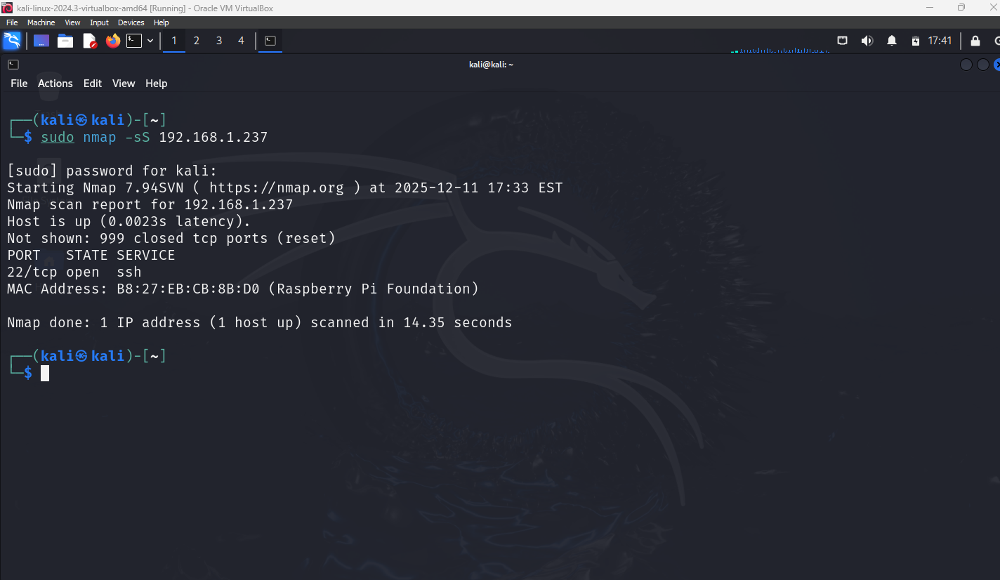
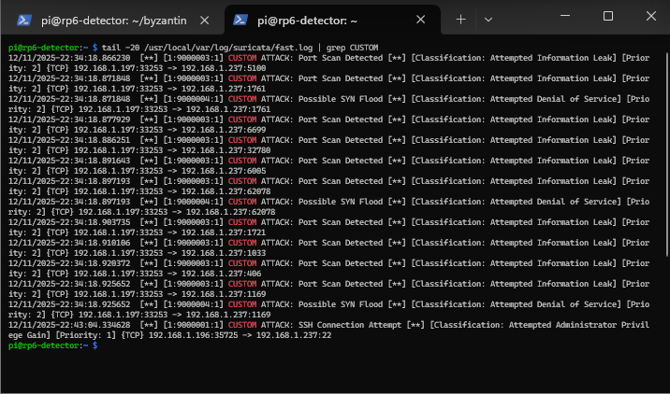
Attack 1 Port Scan Attack & Detection Evidence

Slide 14
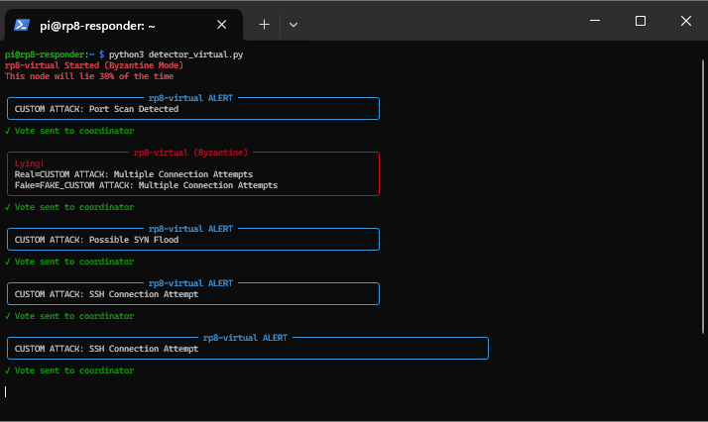
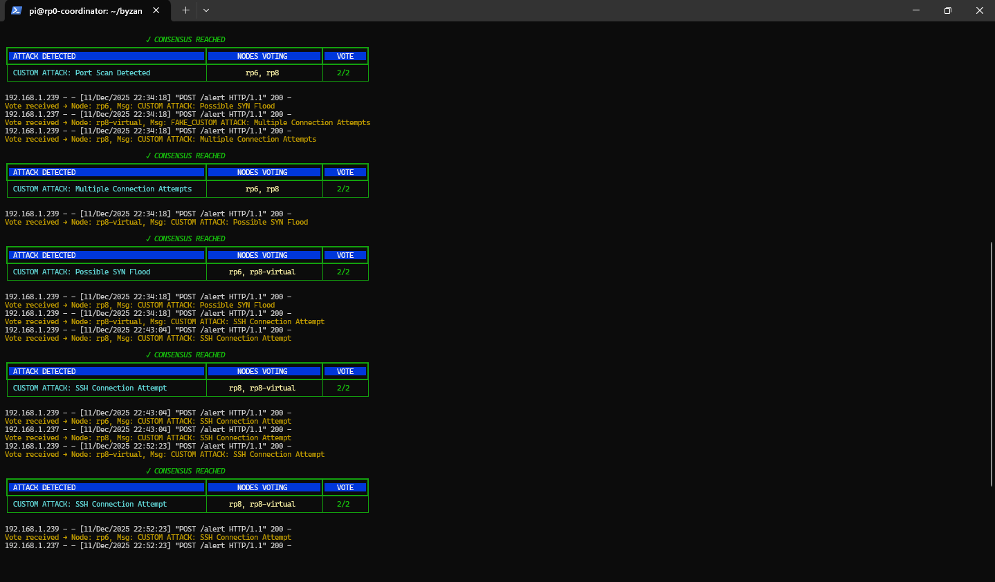
Attack-1 Byzantine Behavior & Consensus Outcome

Slide 15
Attack-1 Summary Port Scan Under Byzantine Conditions
What Happened (Ground Truth)
External attacker performed a Port Scan
Target Raspberry Pi generated real Suricata alerts
All detectors observed the same raw network evidence
Detector Behavior Observed
Honest Detectors (RP6, RP8):
  Correctly identified Port Scan
  Reported consistent results
Byzantine Detector (RP8-Virtual):
  Intentionally lied or misclassified
  Sent conflicting or false attack labels
Consensus Outcome
Votes were aggregated by the coordinator
2 out of 3 detectors agreed
Correct attack (Port Scan) was accepted
Byzantine vote was outvoted and ignored
Key Insight from Attack-1
The system remained correct even when one detector actively lied
✔ No single detector controlled the outcome
✔ Trust was verified, not assumed
✔ Byzantine behavior did not break detection

Slide 16
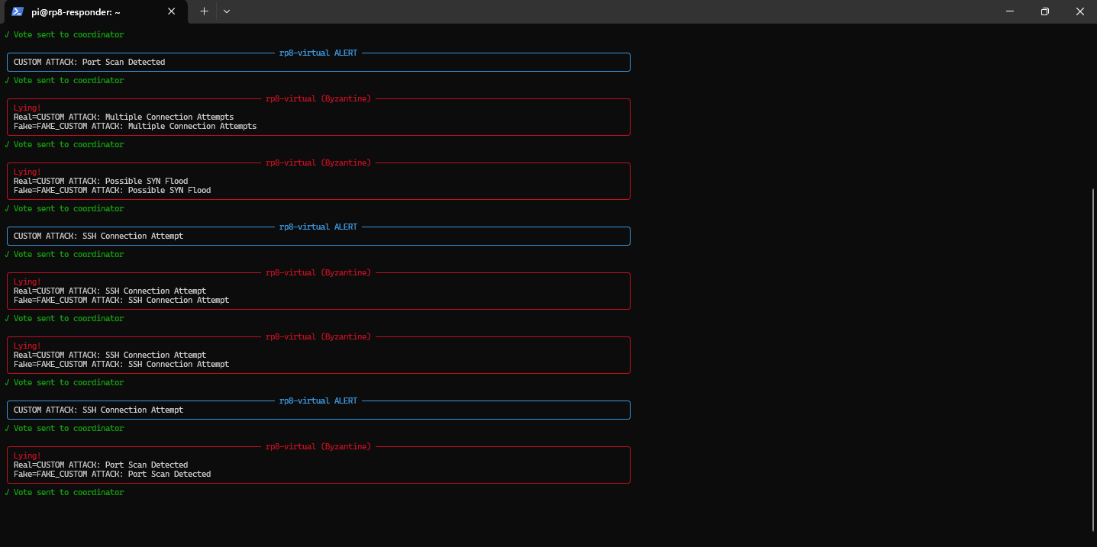
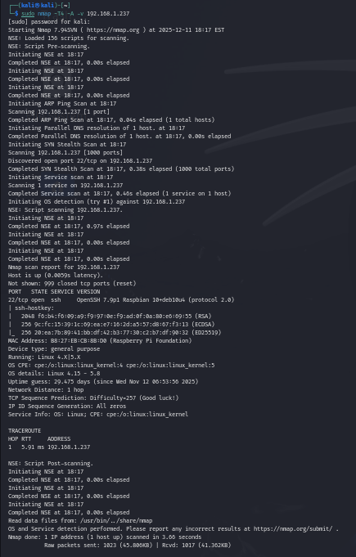
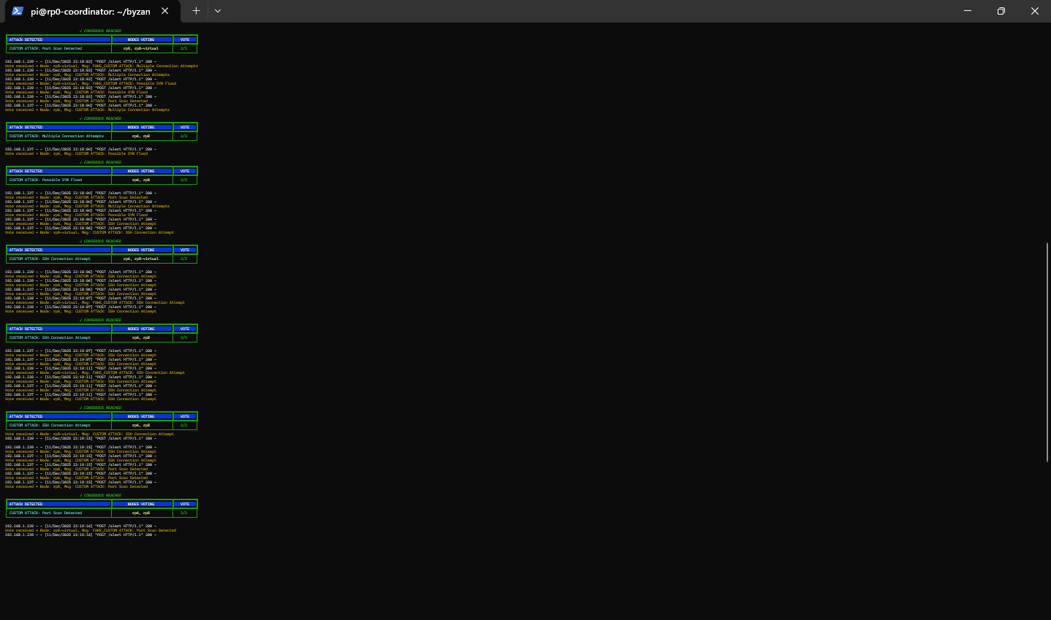
Attack-2: SSH Brute Force Attack & Detection Evidence

Slide 17
Attack-2: Byzantine Behavior & Consensus Reasoning
What Happened (Ground Truth)
External attacker launched SSH brute-force attempts
Target Raspberry Pi generated real Suricata alerts
All detectors received identical alert evidence
Detector Behavior Observed
Honest Detectors (RP6, RP8)
Correctly classified:
  SSH Connection Attempt
  Multiple Connection Attempts
Sent consistent votes to coordinator
Byzantine Detector (RP8-Virtual)
Intentionally misclassified the attack
Examples:
  Reported Port Scan
  Reported unrelated attack types
Behavior was:
  Arbitrary
  Inconsistent
  Adversarial
Consensus Decision
Votes were grouped by attack type
2 out of 3 detectors agreed
Correct attack (SSH Brute Force) was accepted
Byzantine vote was outvoted and ignored
Key Insight from Attack-2
✔ The system remained correct despite deliberate deception
✔ No single detector controlled the decision
✔ Trust was verified through consensus, not assumed
Even when a detector lies about authentication attacks, majority agreement preserves correctness.

Slide 18
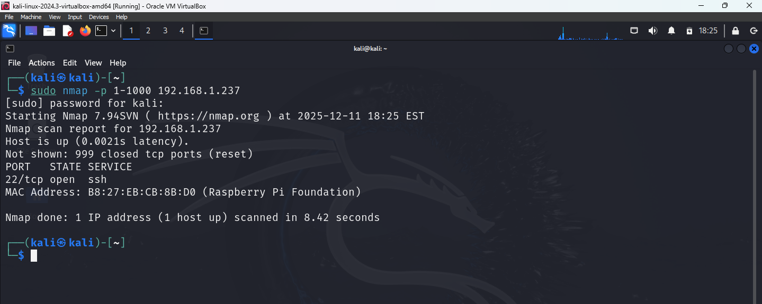
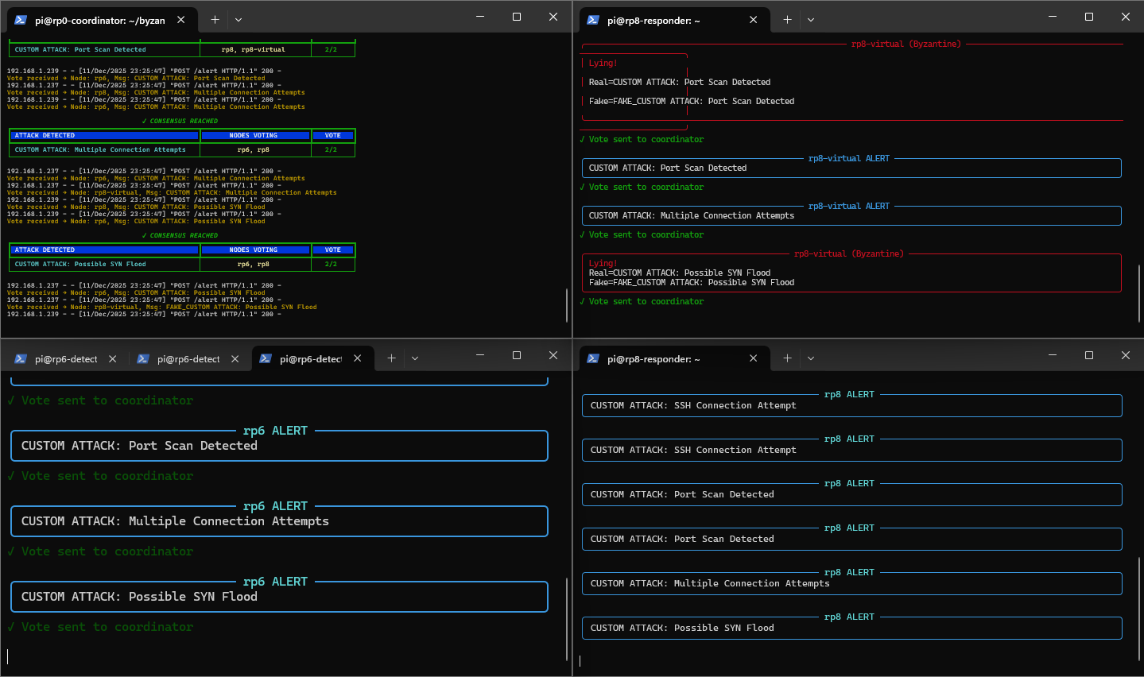
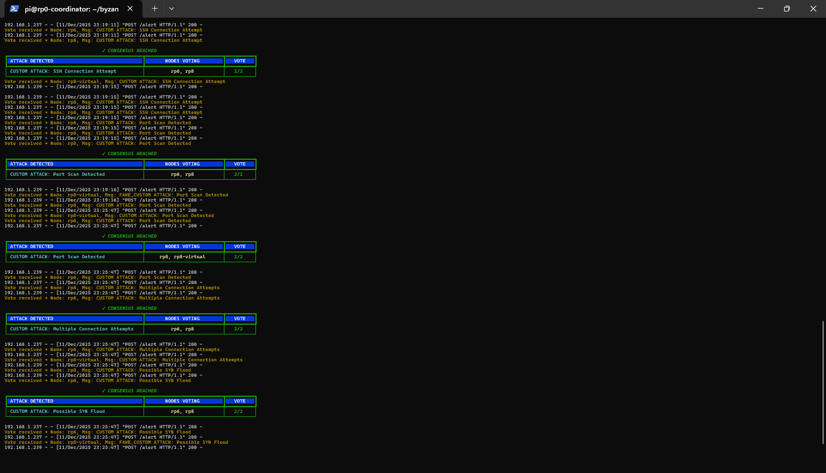
Attack-3: Port Range Scan & Detection Evidence

Slide 19
Attack-3: Byzantine Behavior & Consensus Outcome
Detector Behavior Observed
Honest Detectors (RP6, RP8)
Correctly classified the activity as:
  Port Scan
  Multiple Connection Attempts
Sent consistent votes to coordinator
Behavior:
  Deterministic
  Repeatable
  Aligned with ground truth
Byzantine Detector (RP8-Virtual)
Intentionally misclassified the attack
Examples of false reports:
  Reported unrelated attack types
  Randomized labels across alerts
Behavior:
  Arbitrary
  Inconsistent
  Adversarial
Consensus Decision
Consensus Processing
Votes grouped by attack type
Threshold applied: 2 out of 3 (66.7%)
Honest detectors formed majority
Final Outcome
✅ Correct attack (Port Range Scan) accepted
❌ Byzantine vote ignored
✅ Consensus reached successfully

Slide 20
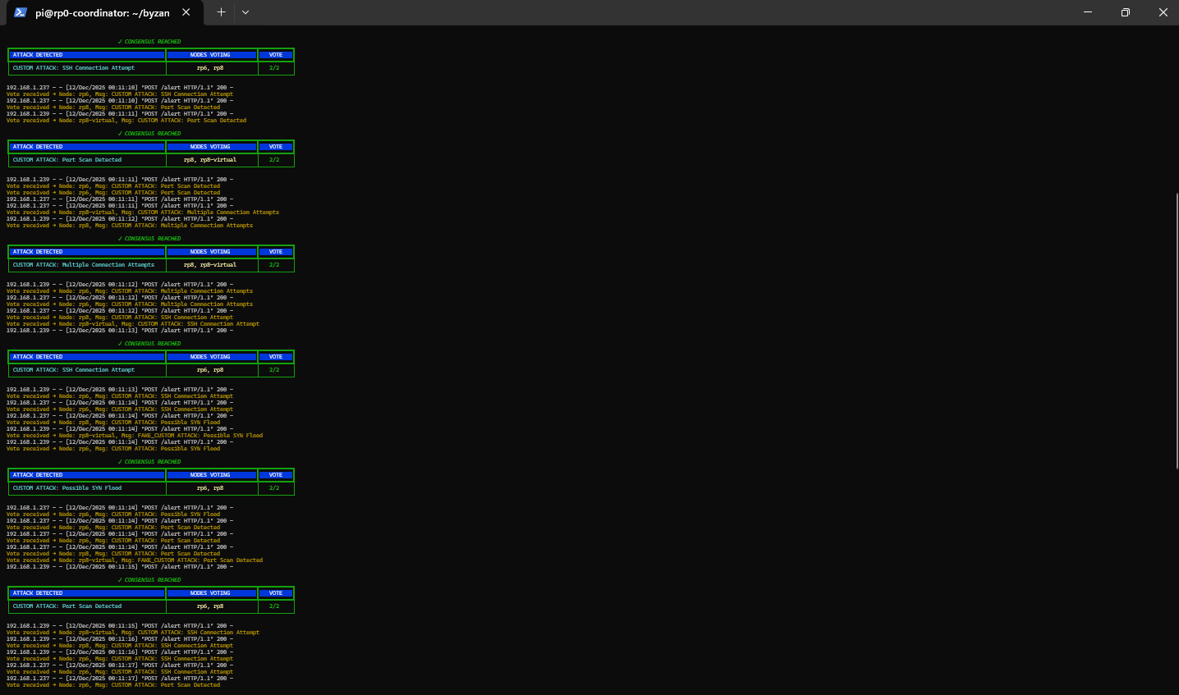
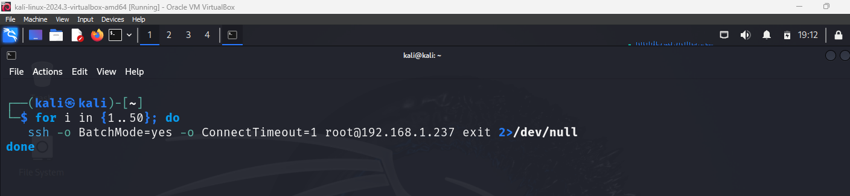
Attack-4: SSH Brute Force Attack & Detection Evidence
Attack Description
External attacker launched high-frequency SSH authentication attempts
Target: Raspberry Pi running SSH service on port 22
Objective:
  Guess credentials
  Abuse authentication mechanisms
  Blend malicious attempts with normal login traffic
Why This Attack Is Important
SSH brute force attacks are:
  Extremely common in real networks
  Often dismissed as “normal login noise”
  Dangerous when IDS decisions are blindly trusted
Detection depends on pattern recognition over time, not single packets
Detection Evidence Observed
Suricata generated multiple SSH-related alerts, including:
  SSH Connection Attempt
  Multiple Connection Attempts
Alerts included:
  Source IP
  Destination port (22) (Each attempt triggered TCP connections to port 22
  Repeated timestamps indicating brute-force behavior
Identical alert evidence was distributed to:
  RP6 (Honest)
  RP8 (Honest)
  RP8-Virtual (Byzantine)

Slide 21
Attack-4: Byzantine Behavior & Consensus Outcome
Detector Behavior Observed
Honest Detectors (RP6, RP8)
Correctly classified the activity as:
  SSH Brute Force
  Multiple Connection Attempts
Behavior characteristics:
  Deterministic
  Consistent across alerts
  Aligned with ground truth
Sent matching votes to the coordinator
Byzantine Detector (RP8-Virtual)
Intentionally misclassified authentication attacks
Examples of false reports:
  Reported Port Scan
  Reported unrelated attack types
Behavior characteristics:
  Arbitrary
  Inconsistent
  Adversarial
Attempted to confuse consensus by changing labels
Consensus Processing
Coordinator grouped votes by attack type
Majority rule applied:
  2 out of 3 detectors required (66.7%)
Honest detectors formed the majority
Byzantine vote was treated as minority input
Final Outcome
✅ Correct attack (SSH Brute Force) accepted
❌ Byzantine vote ignored
✅ Consensus reached successfully
Key Insight from Attack-4
Even during authentication abuse — where attacks are subtle and temporal —
majority agreement preserved correctness despite deliberate deception
✔ No single detector controlled the outcome
✔ Trust was verified, not assumed
✔ Byzantine behavior did not break detection

Slide 22
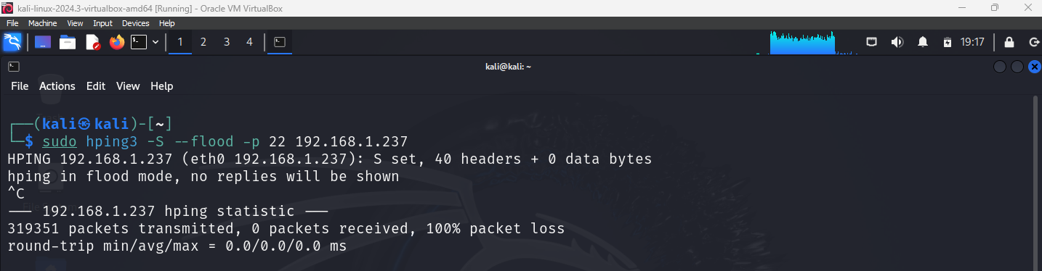
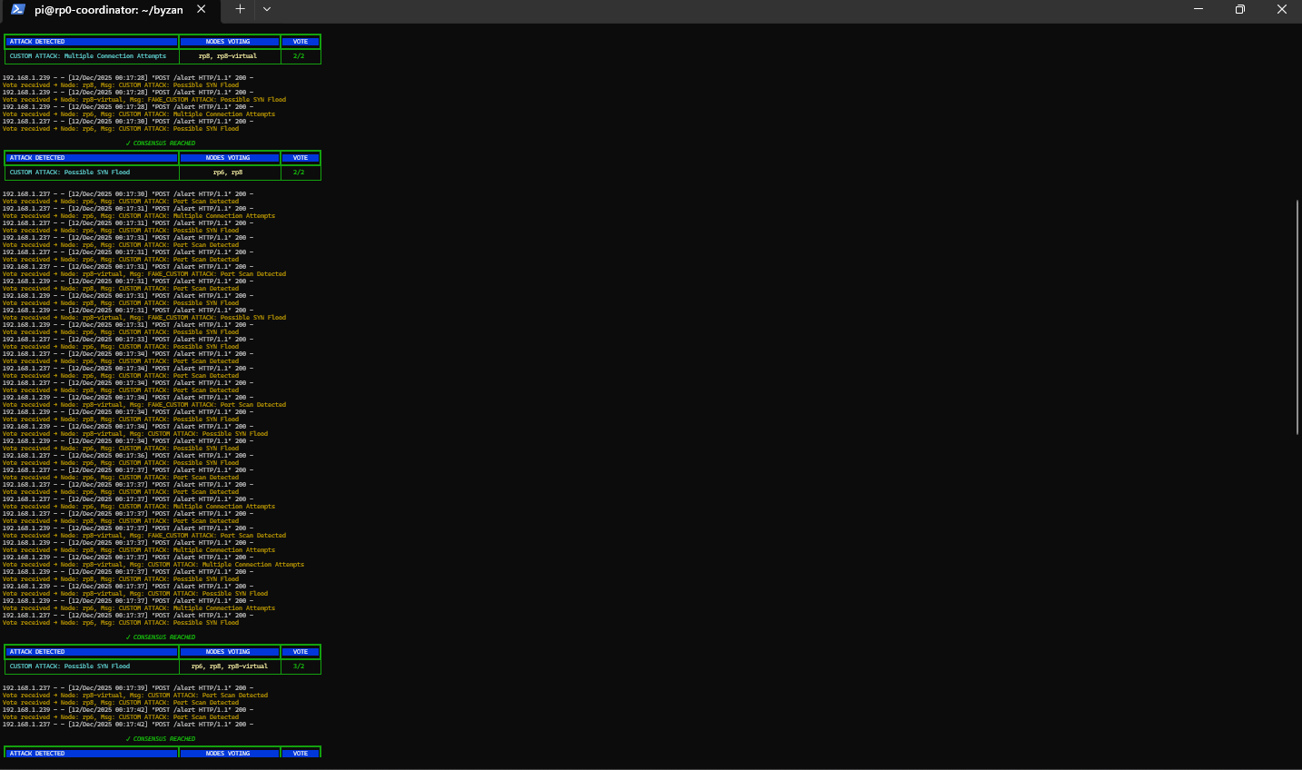
Attack-5: SYN Flood (High-Intensity Stress Test)
External attacker launched TCP SYN flood
Target: Raspberry Pi IDS node (SSH port 22)
Attack goal:
Exhaust server resources
Overwhelm connection table
Detection characteristics:
Extremely high SYN rate
Incomplete TCP handshakes
Time-correlated packet bursts

Slide 23
Attack-5: Byzantine Behavior & Consensus Outcome
Detector Behavior
Honest detectors (rp6, rp8):
  Correctly reported Possible SYN Flood
  Consistent across alerts
Byzantine detector (rp8-virtual):
  Misclassified alerts
  Changed labels (Port Scan / SSH)
  Inconsistent voting during flood
Consensus Processing
Coordinator applied 2/3 majority rule
Honest detectors formed majority
Byzantine vote ignored
Final Outcome (clear checkmarks):
✅ SYN Flood correctly detected
❌ Byzantine misinformation rejected
✅ System remained stable under load
Key Insight:
Even under extreme traffic pressure, majority consensus preserved correctness.

Slide 24
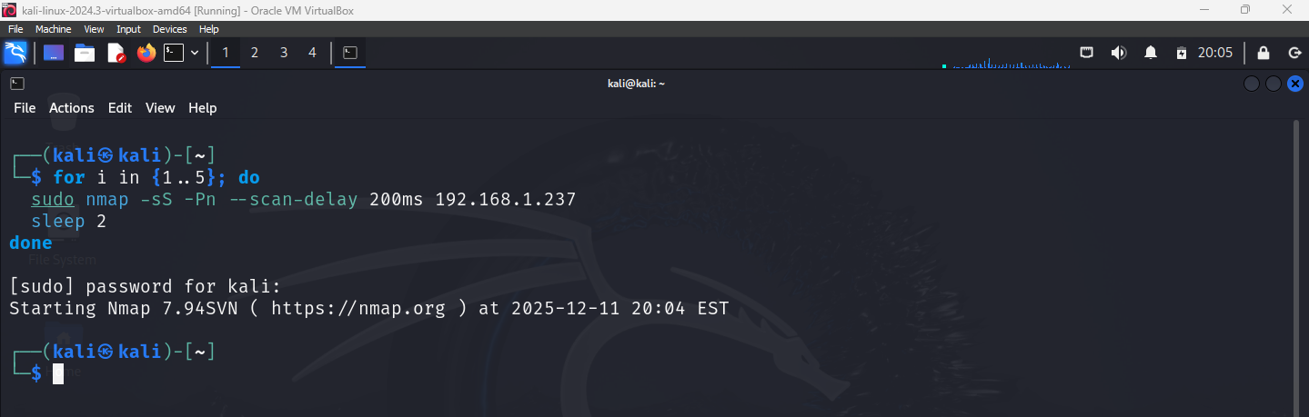
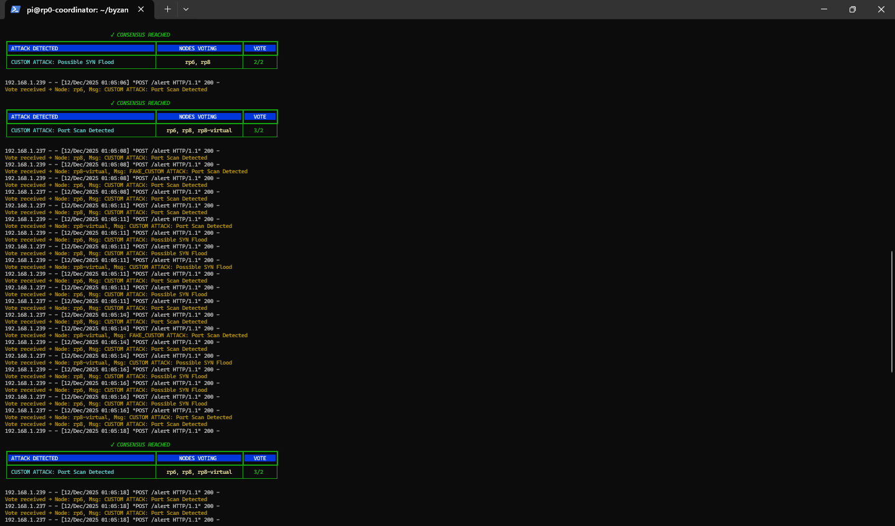
Attack-6: Multi-Vector Attack & Detection Evidence
Attack Description
External attacker launched overlapping attack behaviors:
  Port Scanning
  SSH Authentication Abuse
  SYN Flood–like traffic bursts
Attacks occurred within the same time window
Designed to confuse rule-based IDS decisions
Why This Attack Is Critical
Real attackers rarely use a single technique
IDS alerts often overlap and compete
A single detector can:
  Focus on the wrong dominant signal
  Misclassify the primary attack
➡️ This is where Byzantine behavior becomes dangerous
Purpose of This Attack (One-liner)
Simulate a realistic scenario where multiple attack patterns overlap, stressing IDS classification and trust assumptions.

Slide 25
Attack-6: Byzantine Behavior & Consensus Outcome
Detector Behavior Observed
Honest Detectors (RP6, RP8)
Correctly identified dominant attack pattern
Reported:
  High-frequency SSH attempts
  SYN anomalies
Maintained consistent labeling across alerts
Votes aligned over time
Byzantine Detector (RP8-Virtual)
Intentionally behaved adversarially:
  Switched labels across alerts
  Reported unrelated attack types
  Changed classification mid-stream
Attempted to:
  Split honest votes
  Create ambiguity in coordinator
Consensus Processing
Votes grouped by attack category
Majority threshold applied:
  2 out of 3 (66.7%)
Honest detectors formed majority
Byzantine votes treated as minority noise
Final Outcome
✅ Correct dominant attack identified
❌ Byzantine misinformation ignored
✅ Consensus reached despite overlapping signals
Key Insight from Attack-6
Even under multi-vector attack pressure,
Byzantine-tolerant consensus preserved correctness.
✔ No single detector controlled the outcome
✔ Trust was earned through agreement, not assumed
✔ System scaled from simple to complex attacks

Slide 26
Cross-Attack Observations & System Behavior
Patterns Observed Across All Attacks
Observed Across All 6 Attacks
Same evidence, different interpretations
  All detectors received the same Suricata alerts
  No detector had privileged or extra information
Byzantine behavior followed patterns
  Changed labels intentionally
  Reported unrelated attack types
  Switched classifications mid-stream
  Attempted to split honest votes
Attack complexity increased gradually
  Attack-1 → Single vector
  Attack-5 → High-intensity stress
  Attack-6 → Multi-vector overlap
What the Consensus Layer Did
Consensus behavior across attacks:
Majority rule applied consistently
  2 out of 3 detectors required
  Byzantine votes always remained minority
No false consensus observed
  Incorrect labels were never finalized
  Final decision always matched ground truth
Coordinator remained neutral
  No trust in individual detectors
  Decisions based only on vote counts
System-Level Guarantees Demonstrated
✅ Fault tolerance with 1 Byzantine detector
✅ Trust established through agreement
✅ Robustness under increasing attack complexity
✅ Adversarial noise treated as minority input
Even when detectors lie, consensus preserves truth — as long as honest nodes remain the majority.

Slide 27
System Limitations & Assumptions
Assumptions of the Model
Assumption 1: Majority of detectors are honest
The system assumes more than half of detectors behave correctly
In this project:
  3 detectors total
  1 Byzantine detector tolerated
  2 honest detectors form the majority
Assumption 2: Identical evidence distribution
All detectors receive the same Suricata alerts
No detector has privileged access or extra context
Assumption 3: Byzantine behavior is independent
Byzantine detector acts independently
No collusion between multiple malicious detectors
Known Limitations
Limitation 1: Multiple Byzantine detectors
If 2 out of 3 detectors become Byzantine:
  Majority rule breaks
  Incorrect consensus may be reached
Limitation 2: Rule-based IDS dependency
Detection quality depends on:
  Suricata rule accuracy
  Correct alert generation
Consensus cannot fix bad input from all detectors
Limitation 3: No reputation or weighting
All detector votes are treated equally
No historical trust score or confidence weighting applied
This system is Byzantine-tolerant, not Byzantine-proof.

Slide 28
Why Consensus-Based IDS? (Why This Design Matters)
Problem with Traditional IDS
Single IDS systems assume trust
One compromised or faulty IDS:
  Can misclassify attacks
  Can suppress alerts
  Can generate false positives
Real-world issues
IDS software can be:
  Misconfigured
  Outdated
  Compromised internally
Security teams often blindly trust alerts
What Consensus Fixes
Consensus removes blind trust
Decisions are based on agreement, not authority
No single detector controls the outcome
Byzantine tolerance
Malicious or faulty detectors:
  Can lie
  Can misclassify
  But cannot override majority truth
What this project demonstrates
Trust is verified, not assumed
Correct decisions emerge even under:
  Deception
  High traffic
  Multi-vector attacks
Core Idea
Security decisions should be collective, not individual.

Slide 29
Conclusion & Future Work
Conclusion (What This Project Achieved)
What was built
A Byzantine Fault Tolerant IDS framework
Multiple independent Suricata-based detectors
A consensus coordinator using majority voting (2 out of 3)
What was tested
6 real-world attack scenarios, including:
  Port Scan
  SSH Brute Force
  Port Range Scan
  High-frequency authentication abuse
  SYN Flood (high-intensity stress)
  Multi-vector overlapping attacks
What was proven
All detectors received the same evidence
One detector behaved maliciously (Byzantine)
Despite deception:
  ✔ Correct attack was always identified
  ✔ False labels were outvoted
  ✔ No single detector controlled the decision
Core conclusion
Intrusion detection decisions are more reliable when trust is verified through consensus, not assumed.
Future Work (How This Can Be Extended)
1. Scaling the consensus
Increase detector count:
  From 3 → 5, 7, or more nodes
Tolerate multiple Byzantine detectors
(following n ≥ 3f + 1)
2. Confidence-aware voting
Weight detector votes using:
  Historical accuracy
  Alert confidence scores
Reduce impact of noisy detectors automatically
3. Machine-learning assisted detection
Combine rule-based IDS (Suricata) with:
  ML-based anomaly detectors
Use consensus to merge signature + behavior-based alerts
4. Real-world deployment
Deploy across:
  Distributed cloud environments
  Edge devices / IoT networks
Study latency, scalability, and fault recovery
Final takeaway : This project shows that Byzantine-tolerant consensus is a practical and powerful approach for building resilient intrusion detection systems in adversarial environments.

