Slide 1
CanSat 2025 Design Presentation
Team Name: Energygo
Institution: MIT Manipal
Event: CanSat 2025 (IIST)
Date: 12.10.2025

Slide 2
Mission Overview
Goal: Capture stabilized video and environmental data during descent.
Deployment: Drone release from 100 m altitude.
Payload: OV7670 Camera with vibration isolator.
Sensors: DHT22, MPU6050, DS1307 RTC, microSD for logging.
Parachute: 90 cm cotton cloth canopy, 30 cm cords, autonomous servo release.
Mass: 650 g (approx.), within 700 g limit.

Slide 3
System Architecture
Arduino Uno as central MCU controlling:
- DHT22 (Temp/Humidity) through side ventilation holes
- MPU6050 (Accel+Gyro) for release detection and flight dynamics
- DS1307 RTC for timing and failsafe deployment
- OV7670 Camera for video capture
- microSD module for logging data
Power: Li-Po
Servo control signal to parachute section for deployment

Slide 4
Mechanical Design
Body shape: Trapezoidal (frustum) for stability
Top Ø 10 cm, Bottom Ø 8.5 cm, Total height ≈ 200 mm
Material: Styrofoam (lightweight and vibration-absorbing)
Section layout:
- Camera Bay: 49 mm with lens hole
- Electronics Bay: 69 mm, with two DHT22 ventilation holes
- Parachute Bay: 64 mm with servo release mechanism

Slide 5
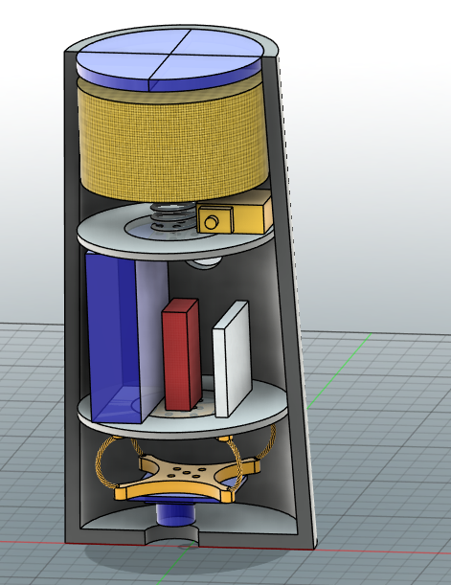
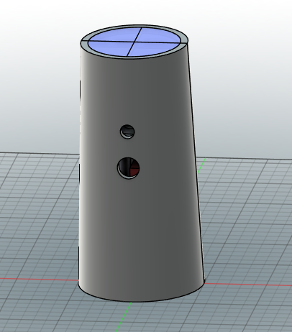
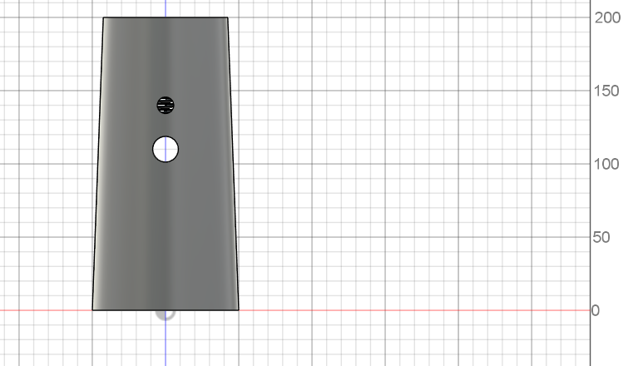
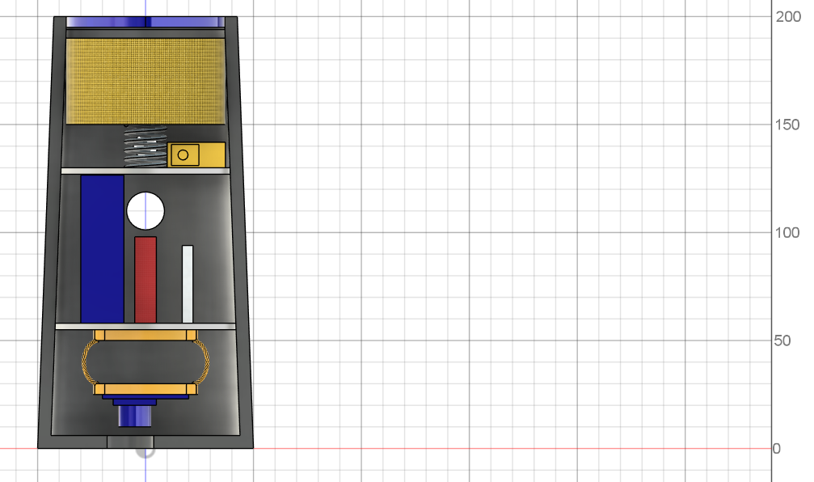

Hole for maintaining the pressure
Retractable cover for parachute
Hole for DHT22 sensor
Parachute packed
Spring for the deployment of parachute
Servo
Bulkhead
Arduino Uno Board
Battery Pack
Breadboard Mini
Bulkhead
Vibration Isolator
Camera Module
Hole for camera

Slide 6
Payload Section - Camera & Isolation
OV7670 Camera mounted at bottom aperture.
Vibration isolation for the camera module.
49 mm chamber reduces transmitted vibrations.
Wiring through central hole to electronics bay.
The camera will capture frames.

Slide 7
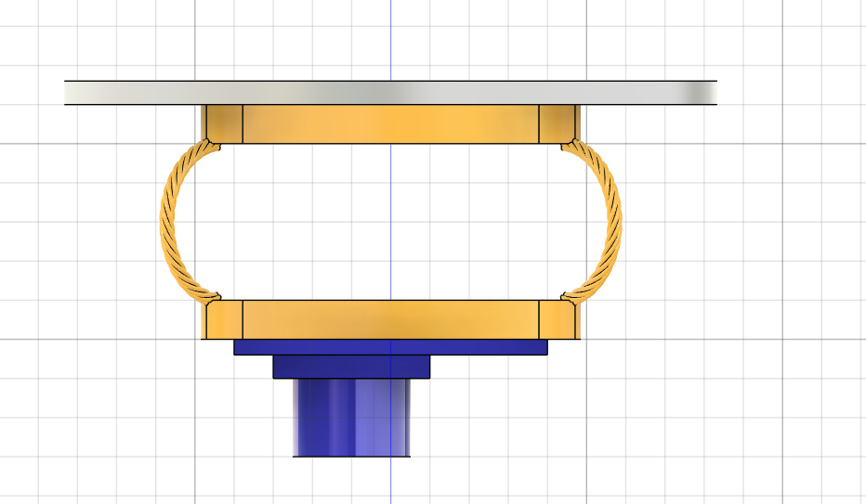
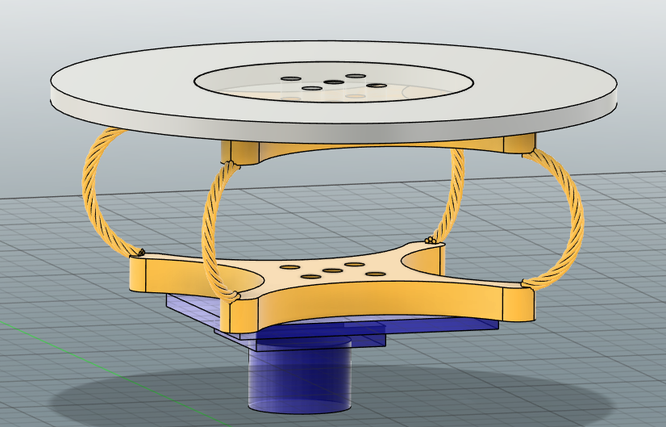
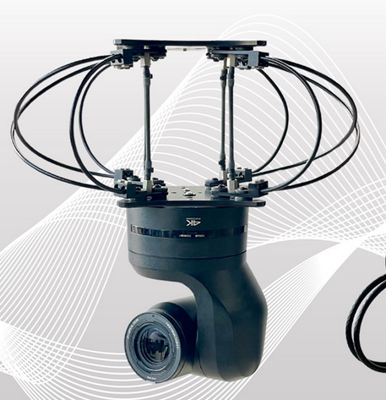
There are holes in the structure for connection with the MCU of the camera module
bulkhead
connector
Vibration absorbing
metal wire
Camera Module
The picture above shows Vibration isolator mount for camera. They can absorb considerable amount of vibrations and provide a stable platform. (This is the CAD)

Slide 8
Electronics Section
Arduino Uno main board controlling sensors and storage.
Modules: DHT22, MPU6050, DS1307 RTC, microSD adapter.
Two side holes for accurate ambient air measurement by DHT22.
Power regulation and servo signal outputs included.
All data logged at 1 Hz sampling frequency.

Slide 9
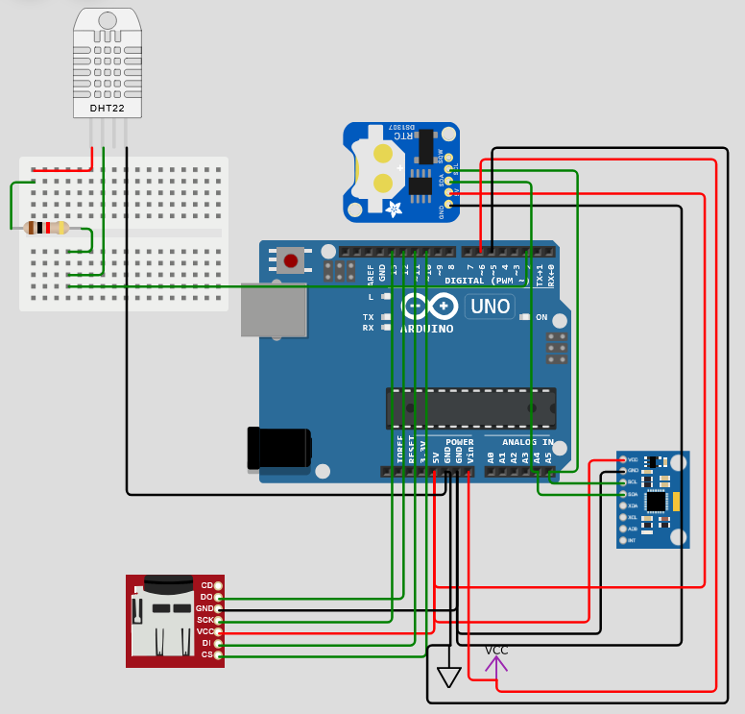
DHT22 (Temperature and Humidity)
RTC (clock)
1K ohm Resistor
Arduino Uno
mpu6050 6-Axis Accel & Gyro Sensor
MicroSD
Pin 6 and 5 are used for the measurement of battery level.
The ADC converter will map input voltages between 0 and 5 volts into integer values between 0 and 1023. So we multiply input Value to (5/1024), then we get the digital value of input voltage.

Slide 10
Parachute Section
Parachute: 90 cm diameter Cotton cloth canopy with 30 cm cords.
Servo latch mechanism inside bay for ejection.
Trigger logic:
- Accelerometer detects >0.3g spike → open parachute.
- Failsafe: RTC timer triggers servo after 2s if not opened.
Clean release design for reliable deployment.

Slide 11
Software Flow
1. Initialization: check sensors and SD readiness.
2. Wait for release detection using MPU6050 (free-fall).
3. Start data logging and camera recording.
4. Deploy parachute if acceleration >0.3g.
5. If not triggered, deploy after 2s (RTC).
6. Continue logging until low acceleration indicates landing.
7. Stop recording and safely close SD file.

Slide 12
Simulation Results (OpenRocket)
Simulated with total mass 650 g and 90 cm parachute.
Predicted vertical descent velocity: ~4.90m/s.(with the extra weight of the motor during the simulation)
Stable vertical descent and upright orientation maintained.

Slide 13
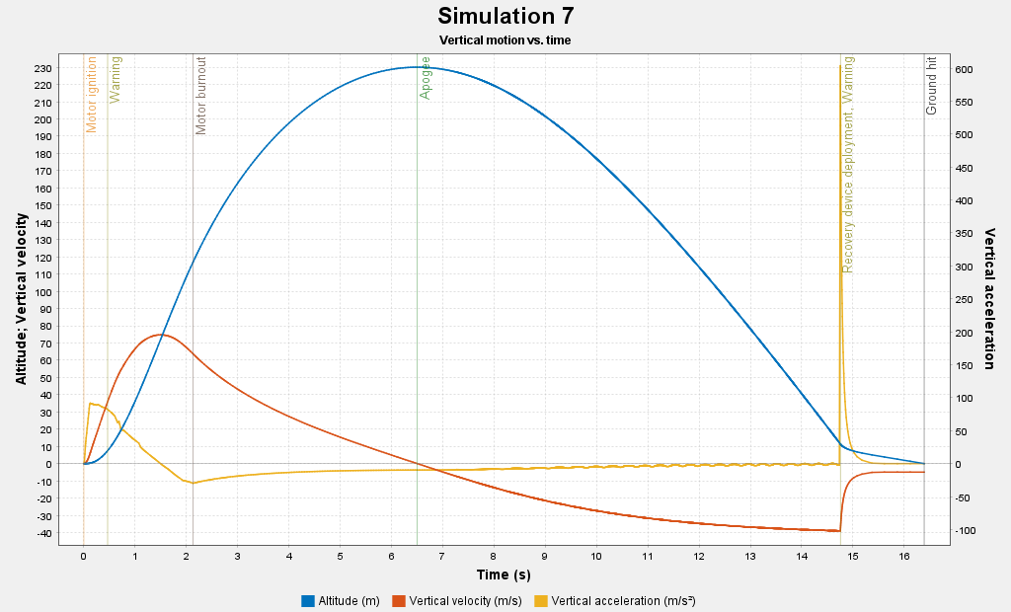
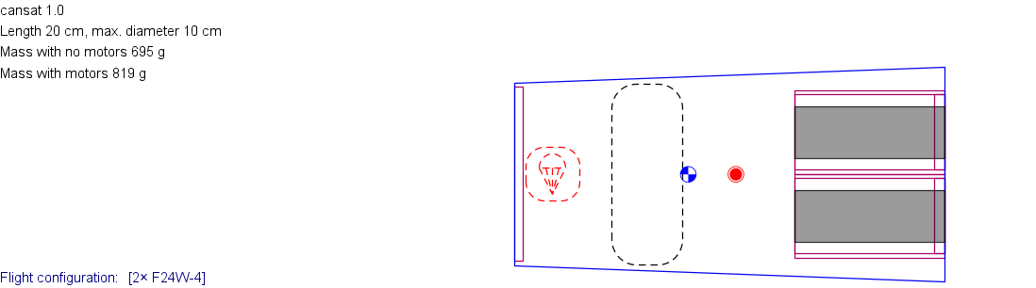

Slide 14
Testing Plan
Ground Tests:
- SD data logging and RTC synchronization verification.
- Servo cycle tests (100+ operations).
- Battery endurance testing (10+ minutes operation).
Mechanical Tests:
- Drop tests from 5–10 m to confirm structure integrity.
- Vibration tests to ensure camera stability.
Parachute Tests:
- Static deployment tests for tangle-free release.
- Drop tests with dummy payloads for descent rate validation.

Slide 15
Risk Analysis & Mitigation
Parachute fails: redundant servo lock + timed failsafe trigger.
SD card errors: use high-quality card, frequent data flushes.
Camera vibration: Isolation mount and space in the camera section for the camera to move relatively.
Power issues: pre-flight voltage check, spare battery.
Weight excess: lightweight Styrofoam and compact components.

Slide 16
Conclusion
Meets all IIST CanSat 2025 constraints and mission goals.
Stable, lightweight, modular, and fully testable design.
Ensures reliable descent, video capture, and data logging.
Next steps: integrate prototype and perform live drop validation.

