Slide 1

Vox AI-powered Voice-to-Catalog Agent
Team Members
AMOGH VIJAY
NAVDEEP R
Notes:
JOURNAL
2023-25
1)IEEE
2)ELS
3_GOOGLE SCHOLAR

Slide 2
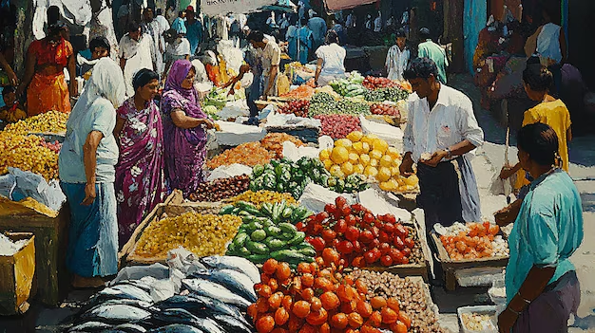
PROBLEM STATEMNT
Small-scale rural vendors struggle to participate in digital marketplaces due to low literacy, language barriers, and unfamiliarity with technology. Existing catalog systems rely on text input and complex interfaces, creating high entry barriers.

Slide 3

AIM AND SCOPE OF WORK
Aim: “To develop an AI-powered Voice-to-Catalog Agent that enables small-scale vendors and informal sellers in rural and underserved regions to create structured, customer-friendly product listings through intuitive voice interactions, overcoming literacy, language, and technical barriers to participate effectively in the digital economy.”
Scope:
Low literacy rates make text-based systems inaccessible. This is addressed by voice-based catalog creation using regional languages.
Vendors operate in noisy market environments. This is addressed by implementing noise-resistant voice recognition for reliable input capture.
Regional vendors use varied product descriptions that don’t fit standard catalogs or customer expectations. This is solved by using NLP to extract key details and generate structured, customer-friendly listings.
Vendors lack expertise in optimizing product listings. This is addressed by providing automatic category tagging and suggesting pricing modifications to improve sales.
Rural vendors are unfamiliar with digital platforms. This is solved by providing a simple interface focused on voice-based listing and multilingual catalog display.
As a potential future feature, offline capability is being explored to address the problem that rural areas often lack reliable internet access.

Slide 4
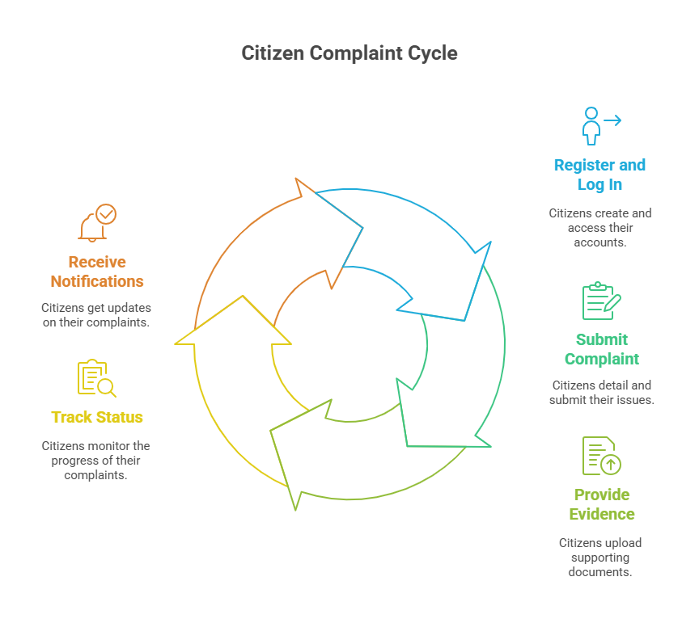
User Complaint Timeline

Slide 5

PROPOSED BLOCK DIAGRAM
Citizens: Register/login, submit complaints, upload proof, track status, and receive notifications.
Chatbot:
Assists with generating a hidden complaint form, allows optional data like geotagging. Ensuring Elegant Interface. Interacts with ticket to track status.
Complaint Submission:
Categorizes (e.g., sanitation, infrastructure, safety) by keywords and AI-assisted tagging. Severity scale (Low / Medium / High / Critical) based on prioritization.
Database:
Stores all unresolved complaint reports and their data. Also stores Historical Data of closed complaints.
Complaint Resolution:
Resolved Complaints are closed. Historical data is saved for recommending optimal solutions
Officials:
Use Dashboard with real-time complaint tracking, prioritization tools, and resolution updates. To effectively divide and assign responsibilities
Dashboard / Tools:
Displays Analysis results using various charts. Helps identify affected zones with heatmaps and severity scale-based color coding
Analytics:
Based on grouped data, analyses the validity, potential impacts of each complaint, and identifies the root cause of grouped complaints.
Administrators: Oversee complaint trends, escalation handling, and performance analytics.

Slide 6
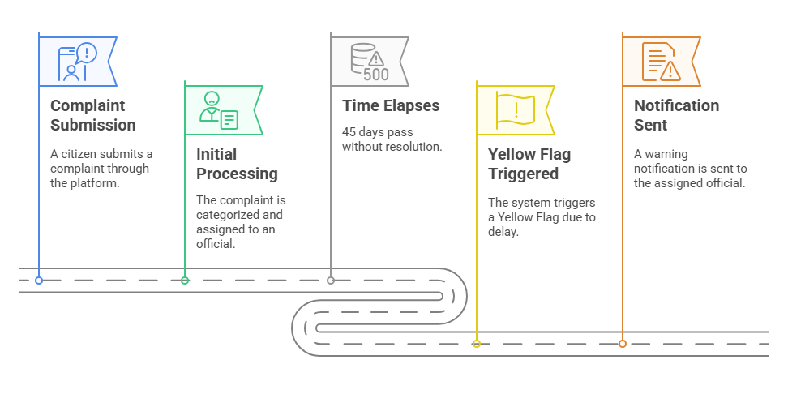
Complaint Escalation Process

Slide 7
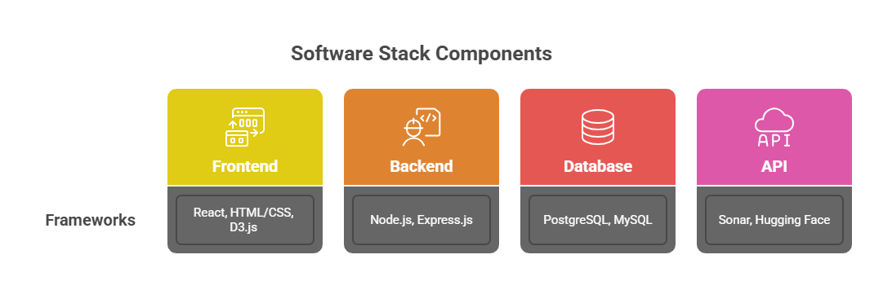
Implementation

Slide 8
