Slide 1
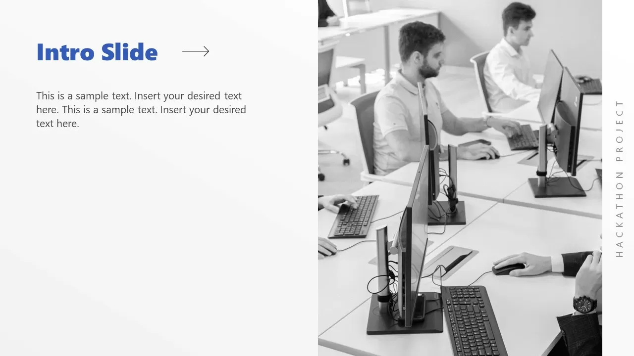

CityView360
CS4306-Core Course Project
Batch Members
1)AMOGH VIJAY-24CS0053
2)NAVDEEP R-24CS0584
Notes:
JOURNAL
2023-25
1)IEEE
2)ELS
3_GOOGLE SCHOLAR

Slide 2

PROBLEM STATEMENT
Urban areas are facing increasing challenges in managing public utilities such as water, electricity, sanitation, and waste disposal. While citizens frequently report issues, these complaints are often scattered across various platforms and go unanalyzed in real time. This leads to delayed responses, inefficient resource allocation, and growing public dissatisfaction.

Slide 3

AIM AND SCOPE OF THE WORK
Our solution is a web-based real-time complaint analysis and resolution platform designed to improve how urban public utility issues are reported, tracked, and resolved. It empowers citizens to easily log complaints using text,images,videos and documents, while allowing them to track progress and receive timely updates. Government officials are equipped with an AI-powered dashboard that helps them prioritize issues based on severity, location, and escalation status. The platform includes smart features such as automated categorization, geo-tagging, predictive analytics, and a dynamic heatmap interface to visualize complaint trends. A smart escalation system ensures that unresolved issues are automatically flagged and escalated to higher authorities. With additional tools like multilingual support, accessibility features, offline mode, and community gamification, this solution creates a transparent, efficient, and citizen-centric ecosystem for managing urban utility complaints

Slide 4
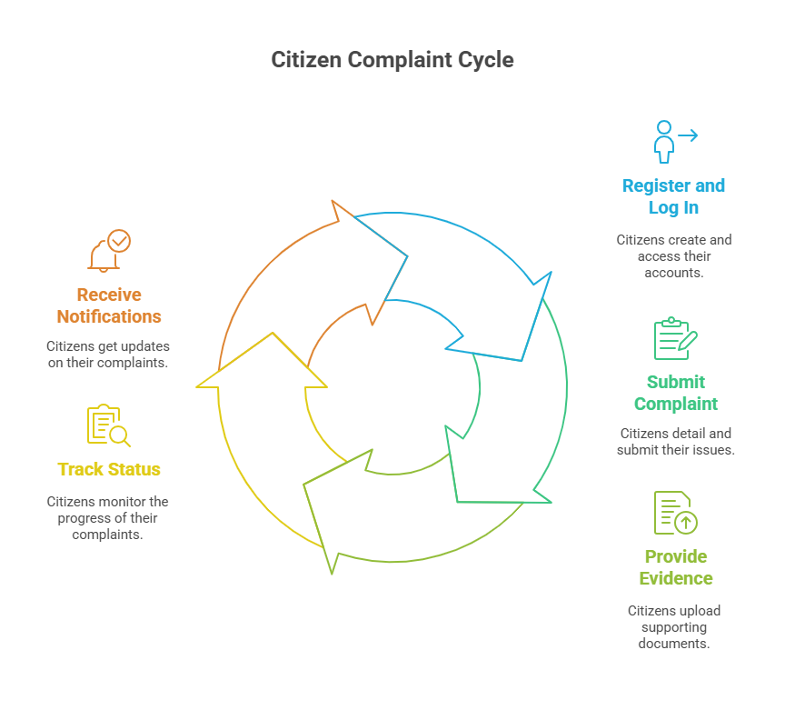

Slide 5
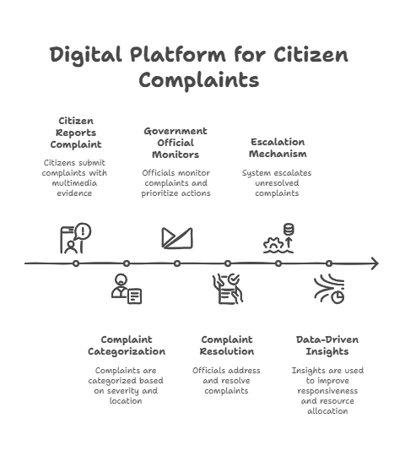


Slide 6
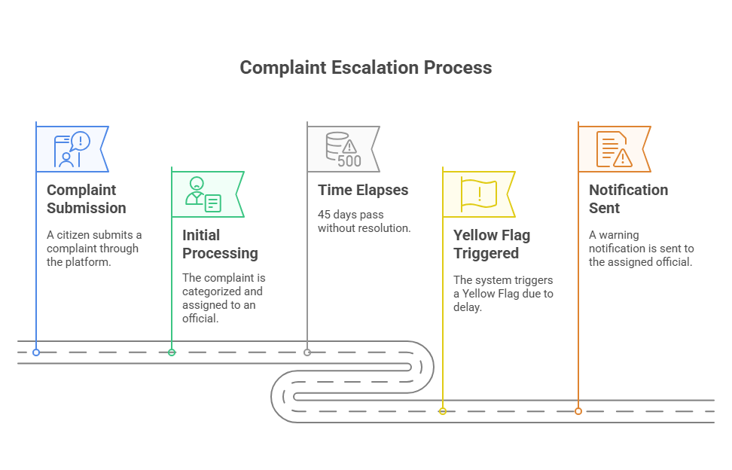

Slide 7
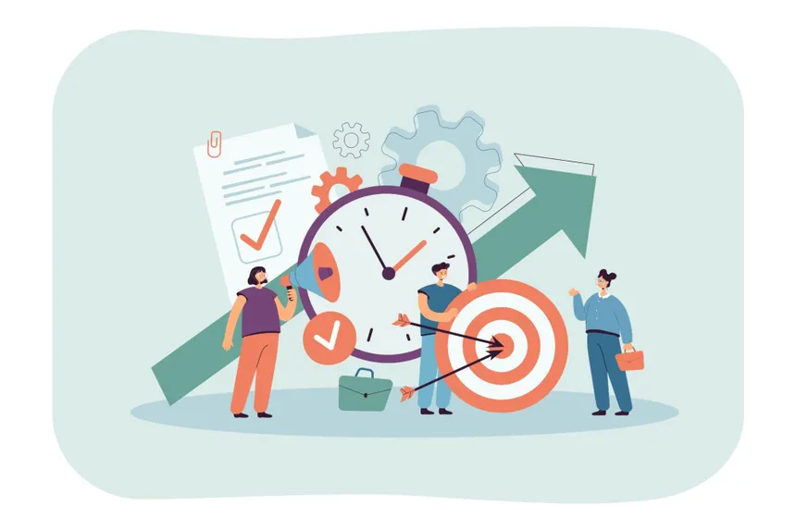
PROPOSED BLOCK DIAGRAM
Citizens: Register/login, submit complaints, upload proof, track status, and receive notifications.
Chatbot:
Assists with generating a hidden complaint form, allows optional data like geotagging. Ensuring Elegant Interface. Interacts with ticket to track status.
Complaint Submission:
Categorizes (e.g., sanitation, infrastructure, safety) by keywords and AI-assisted tagging. Severity scale (Low / Medium / High / Critical) based on prioritization.
Database:
Stores all unresolved complaint reports and their data. Also stores Historical Data of closed complaints.
Complaint Resolution:
Resolved Complaints are closed. Historical data is saved for recommending optimal solutions
Officials:
Use Dashboard with real-time complaint tracking, prioritization tools, and resolution updates. To effectively divide and assign responsibilities
Dashboard / Tools:
Displays Analysis results using various charts. Helps identify affected zones with heatmaps and severity scale-based color coding
Analytics:
Based on grouped data, analyses the validity, potential impacts of each complaint, and identifies the root cause of grouped complaints.
Administrators: Oversee complaint trends, escalation handling, and performance analytics.

Slide 8
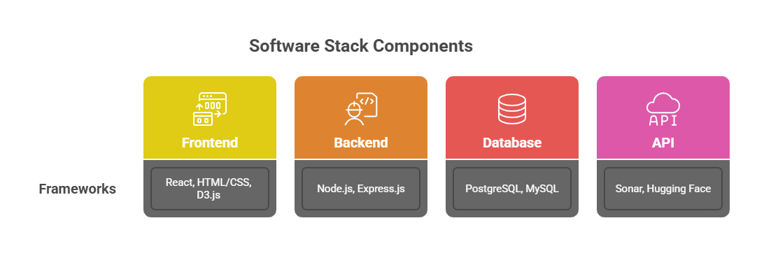

IMPLEMENTATION SETUP

Slide 9
