Slide 1
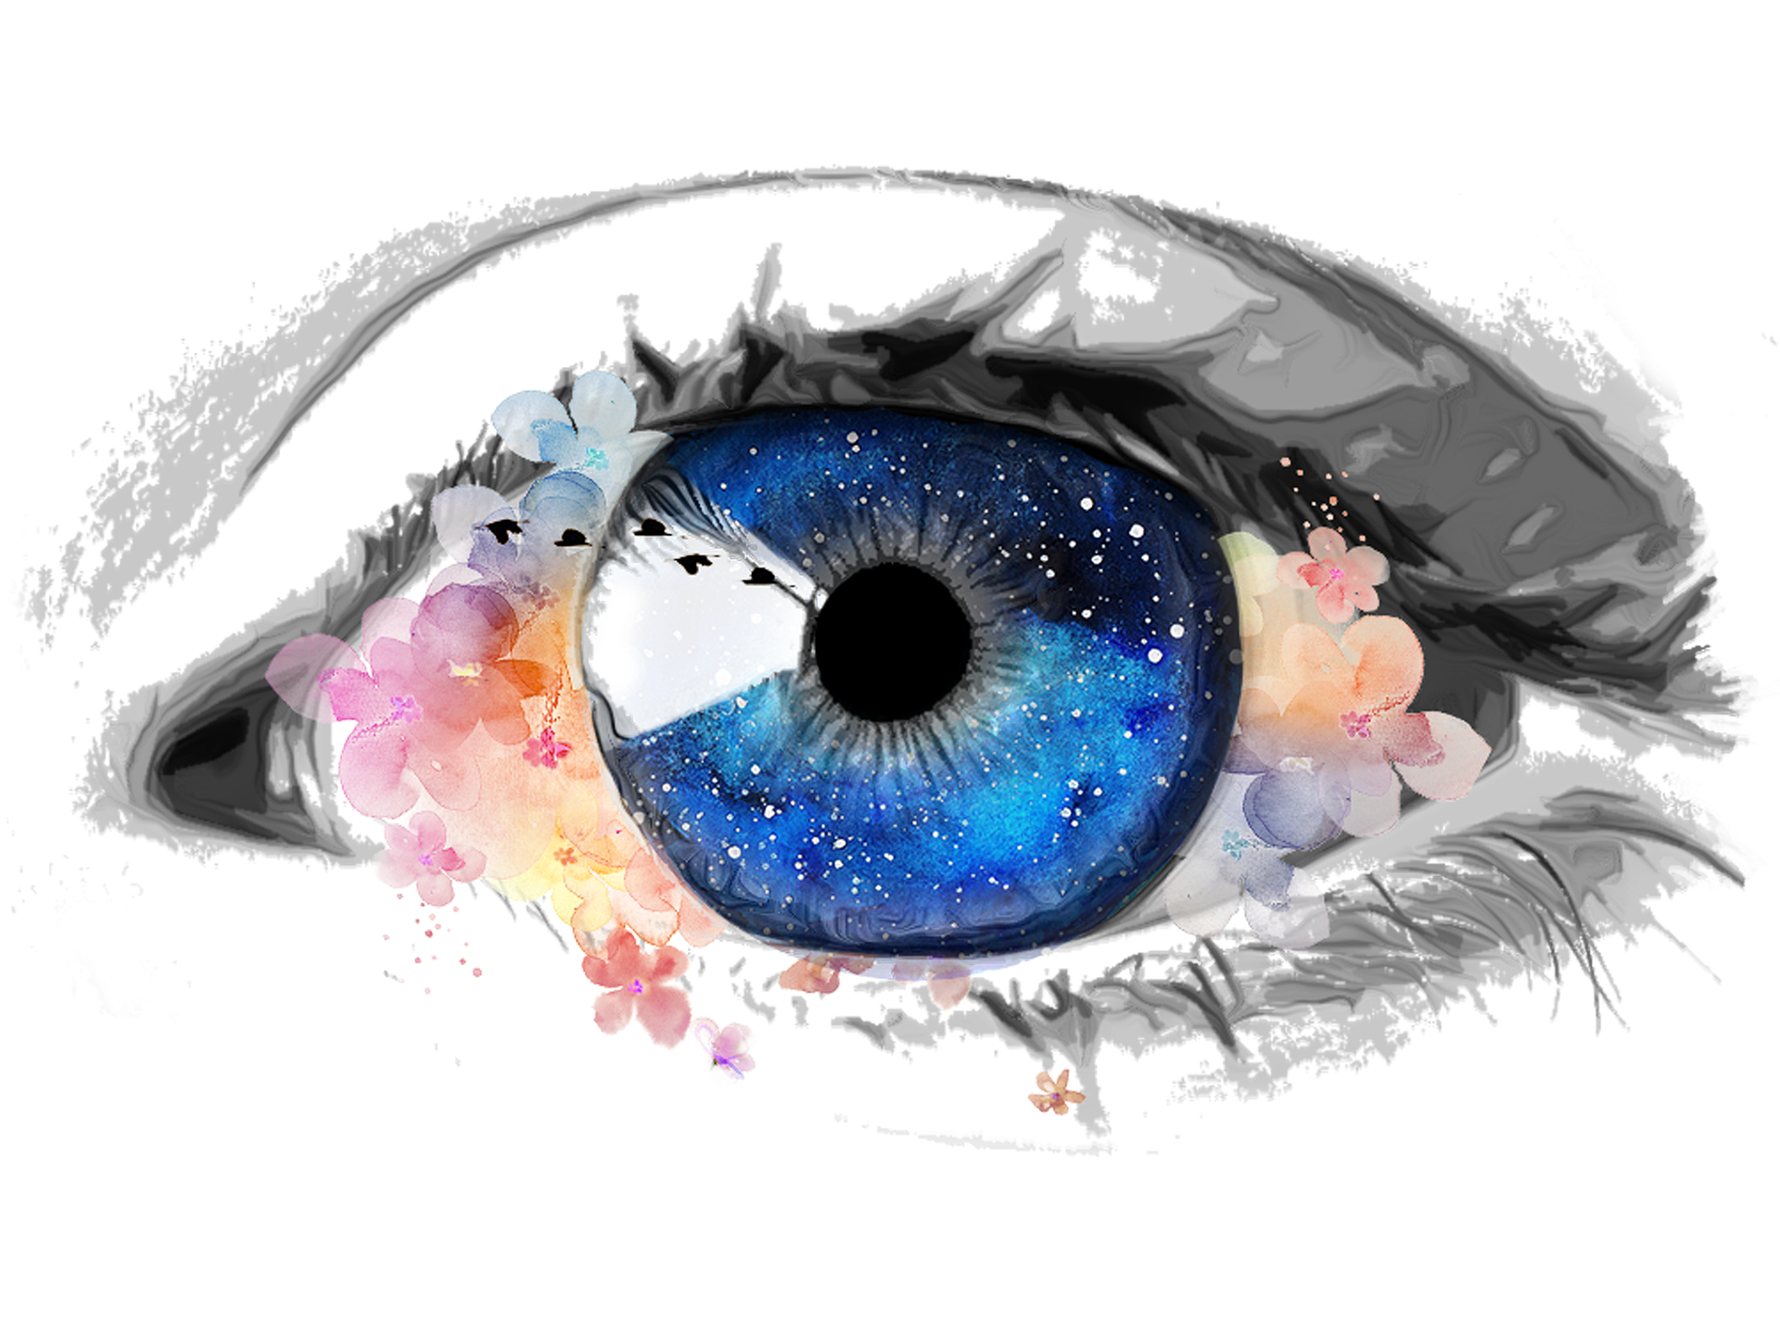
AN OCULAR MALADY
A simple solution to a Perplex Problem

Slide 2
MEET THE TEAM & Roles
TEAM NAME: HIGH FIVE (TEAM-133)
A Mohan Kumar
Designing and Research
Adithya Mathialagan
Data pre-processing and Implementation with proper documentation
Akshay C
Dataset collection and Research
Sathyanarayana R K
Designing, Research and Dataset collection
Suhas T J
Dataset Collection and Data model implementation

Slide 3
Problem Statement
Eye diseases are a significant global health problem, affecting millions of people worldwide.
Imagine a world where eye diseases are diagnosed and treated at an early stage before the symptoms appear, reducing the risk of blindness and improving the patient’s conditions well in advance.

Slide 4
Problem Statement
● Is it possible for any normal user with no medical knowledge to take a picture of his/her eye and ensure their eye is healthy FREE OF COST ?
● Can other diseases like Jaundice be detected using eye images?
● It is difficult for medical professionals to identify
eye diseases at an early stage, which can lead to a
delay in treatment.
Is it possible to speed up this process?

Slide 5
WHY THE PROBLEM OCCURS
unavailability
COSTS
Many people live in remote areas where eye care is not easily accessible, making it difficult for them to seek medical attention.
When it comes to the problem of the eye, sufferers are generally discouraged from seeking medical attention keeping the costs associated with diagnosis and treatment in mind.
NEGLIGANCE
Risk facTOR
Most of the eye diseases often do not have any “serious” symptoms in the early stages. This can make it difficult for people to realize that they actually have a problem.
Many people fail to understand that they are at a risk of developing an eye disease.

Slide 6
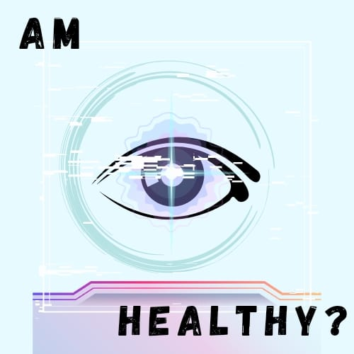
ILL EYE IDENTIFIER
LOGO
● Categorized searching of vision impairment.
Know what you’re headed for with a click of a pic !
One application to detect multiple eye diseases.
A tiny anomaly in your eye could actually turn out to be serious if you don’t figure out what it is.
A Machine Learning model which tells what eye disease you can develop into based on the pic you’ll upload.

Slide 7
THE SOLUTION
AI-powered eye disease classifier that uses deep learning algorithms to analyze images of the eye and accurately classifies as well as detects complex eye diseases.
Dataset Details: We created the dataset on our own by web scraping google images as well as combining some available datasets.
It consists of 10 folders, where each folder contains around 150+ images for each type of eye disease.
The following steps were done to solve the problem mentioned in the previous slides:
Importing Required Modules
Loading the dataset
Understanding the Data
Scaling and Splitting the data into Train and Test
Building the Models (CNN,YOLOv3, ResNet, MobileNet)
Testing the Models
Please look into the Jupyter notebook for complete details.

Slide 8
WOW FACTOR
Many machine learning (ML) based eye disease classifiers created in the past concentrate on helping medical practitioners diagnose and cure eye ONLY ONE SPECIFIC illness.
But our project is tailored for the general public who cannot afford healthcare services or remain unable to visit doctors due to negligence or fear.
Using our solution:
We can detect any disease in the human based on the picture of his/her eye !!
Provide people accurate results of what's wrong with their eye without them having to feel embarrassed in revealing to anyone and detect other diseases like Jaundice using eye images.
Medical professionals can identify eye diseases at an early stage at a much faster speed using our models.
Any normal user with no medical knowledge to be able to take a picture of his/her eye and make sure their eye is healthy at zero costs.

Slide 9
LEARNINGS FROM HACKATHON
● We, as a team learned to work with coordination and learnt technical skills to accomplish the task together.
● Implementing our innovative ideas by coding helped us to enhance our problem-solving skills.
● While presenting the PPT, we became clear how to do it from a user's perspective to make it easier to understand.
● Technologically, explored cutting-edge deep learning methods like YOLOv3, ResNet and MobileNet.
● Contributing to social causes builds our responsibility for those in need.

Slide 10
FUTURE WORK
● Increasing the amount and variety of data collected, such as photographs shot in various lighting situations or from various ethnic groups, can aid in the model's generalisation.
● By adding additional modalities like depth data or thermal imagery, will make the eye disease detection more effective.
● Domain adaptation approaches can be applied to adjust the model to a new environment if the eye detection system is to be deployed in a place that is entirely different from the place it was trained on.
● Building a user-friendly application around this model inclusive of many more features for a wider audience.
Recommending the dietary measures and necessary precautions a person can take to prevent the aggravation of the eye disease’s condition.

Slide 11
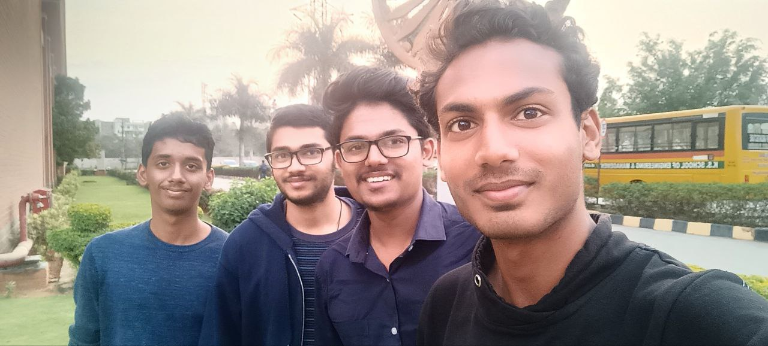
FUN MOMENTS DURING HACKATHON
Overall, the hackathon made us enthusiastic in exploring the various challenges faced by the society and kept us driven in developing easily accessible and meaningful solutions.
As tech students, we felt great joy in serving our society by delivering sophisticated solutions through Code.

Slide 12
THANK YOU

