Slide 1

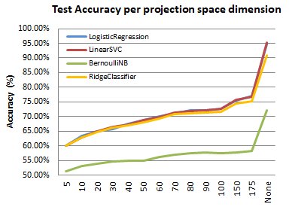
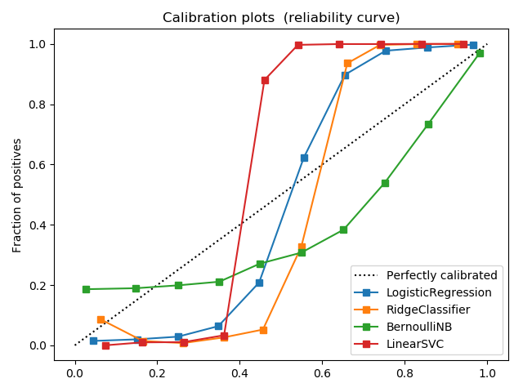
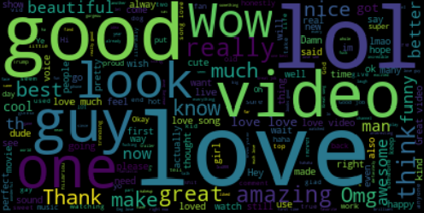
Content Analysis of YouTube Data
CS229 Autumn 2017 Category: Natural Language
Afshin Moin (afshinm) Abhishek Bharani (abharani) Peng Seng Kuok (pkuok)
Motivation
Sentiment Classification
Effect of Dimensionality Reduction
Popularity of social media is increasing rapidly
YouTube is the most popular video sharing website
We do:
Sentiment analysis of the comments
Category prediction based on comments
Investigate the effect of dimensionality reduction
Model | Train Accuracy | Test Accuracy
Logistic Reg. | 95.64 | 94.47
Ridge Classifier | 93.98 | 90.46
Bernoulli NB | 72.15 | 71.53
Linear SVC | 96.89 | 95.14
Data
Calibration Curves
YouTube data acquired from Kaggle competition
Top 200 videos per day along with their comments, category and tags
2354 videos
691408 comments
Feature Extraction
Truncated SVD was used to project TF-IDF feature vectors to lower dimensional spaces
Generate sentiment labels using TextBlob to estimate comment polarity
Comments were vectorized using TF-IDF (Term Frequency – Inverse Document Frequency)
Future Work
Category classification based on tags
Automatic tag generation given category
Automatic comment generation given category, sentiment and comment length
Common Words in Positive Comments
Calibration curve is computed using two categories
Naïve Bayes Model is not well-calibrated in [0,1]
Logistic Regression is well-calibrated in [0,1]
References
Category Classification
YouTube Database For Kaggle Competitions. https://www.kaggle.com/datasnaek/youtube
TextBlob Library For Python. https://textblob.readthedocs.io/en/dev
G. Toderici, H. Aradhye, M. Pasca, L. Sbaiz, and J. Yagnik. Finding meaning on youtube: Tag recommendation and category discovery. In Computer Vision and Pattern Recognition, 2010
Model | Train Accuracy | Test Accuracy
Logistic Reg. | 60.70 | 53.21
Ridge Classifier | 65.77 | 55.91
Bernoulli NB | 45.53 | 41.61
Linear SVC | 68.95 | 57.79

