Slide 1

CARE-LIFE Framework
Internal Operating Model (Draft)
Linking Lifecycle Support, Casework and Data Structure
OPERATIONAL ALIGNMENT FOR SUPPORT CONTINUITY
CaringSG Internal | 2026

Slide 2

Why We Are Structuring This Now
D4GX Compliance
Succession Planning
D4GX requires a structured data model to support advanced analytics and reporting.
Visibility into backup caregivers and future readiness is currently limited.
Data Integration
Signal Tracking
Current member data is fragmented across multiple touchpoints and systems.
Caregiver wellness and engagement signals are not yet systematically tracked.
This framework aligns programme, casework and data structure.
CARE-LIFE Internal | Page 2

Slide 3

Lifecycle Stages vs Caregiving Burden
STAGE 1
STAGE 2
STAGE 3
STAGE 4
Early Years
School Years
Adulthood
Succession
Cradle – 7yr
7 – 19yr
19 – 40yr
40 – Grave
Diagnosis uncertainty
Transition stress
Employment uncertainty
Backup caregiver gaps
Family baseline formation
Therapy coordination
Legal and financial planning
Aging caregiver health decline
Early intervention load
Social integration
Chronic health complexity
Care transition planning
High emotional volatility
Sibling impact
Caregiver fatigue accumulation
Continuity risk
Operational Implication: Data structure must capture evolving burden and continuity risk across lifecycle.
CARE-LIFE Internal | Page 4

Slide 4
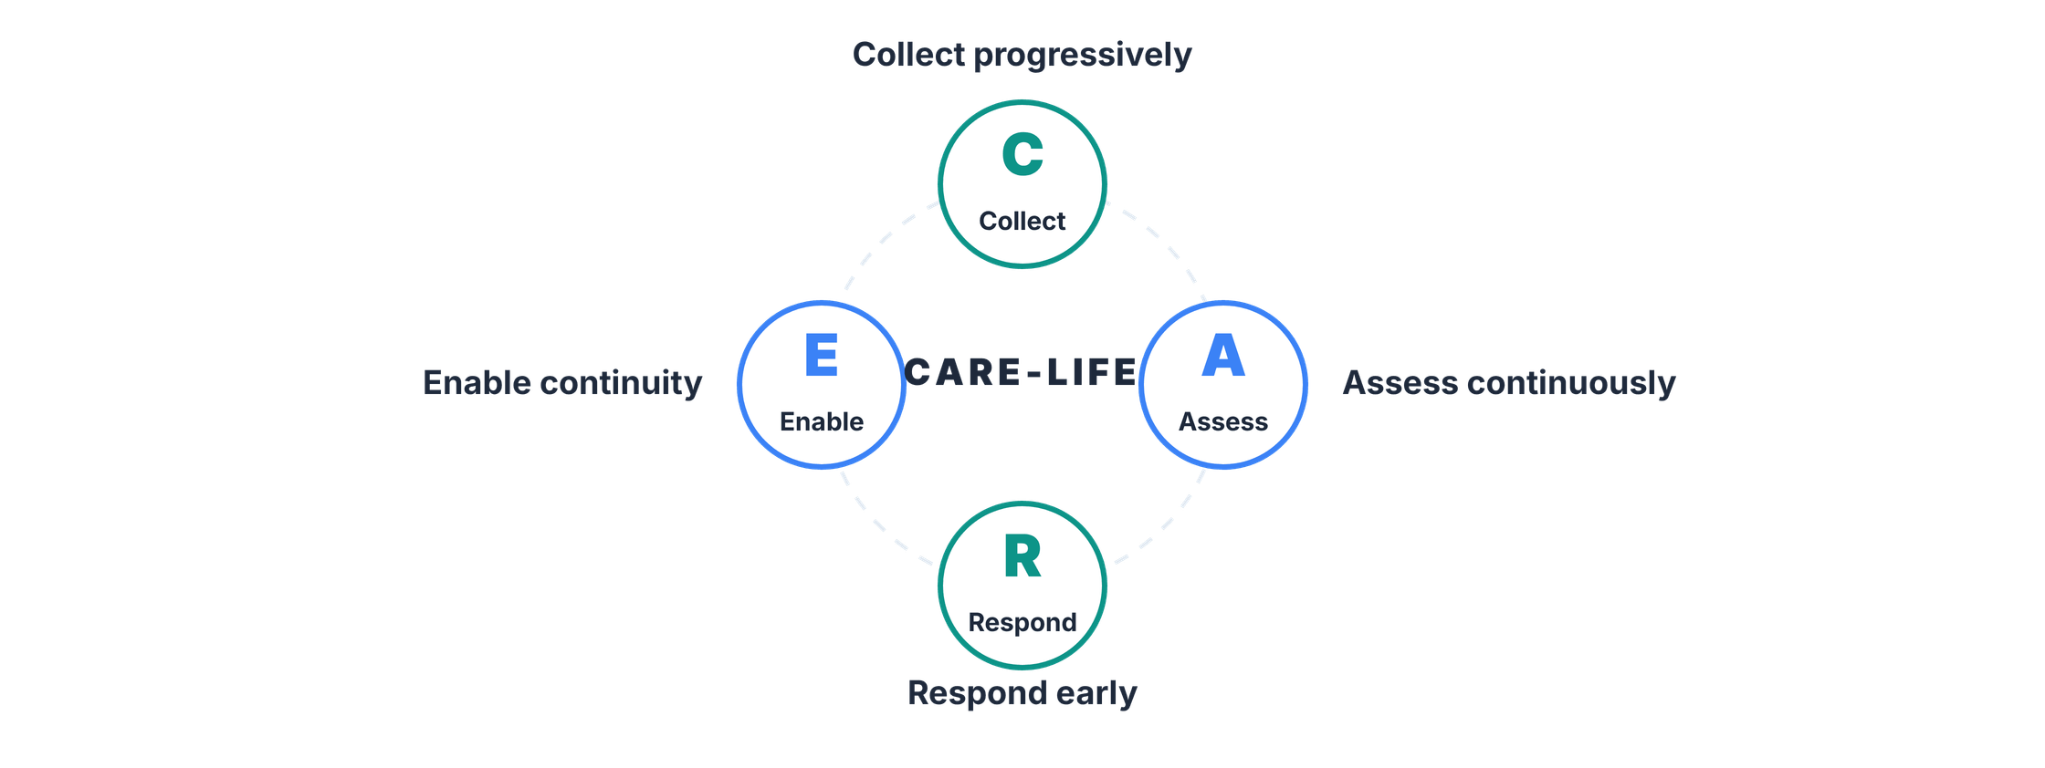
The CARE-LIFE Operational Loop
Collect → Assess → Respond → Enable → Repeat across the caregiver lifecycle.
CARE-LIFE Internal | Page 4

Slide 5

How This Links to the Use Case Diagram
CURRENT WORKFLOW
CARE-LIFE LOGIC
Existing Use Cases
New Use Cases
Onboard caregiver
Provide family information
Submit support request
Update succession plan
Assign key worker
Wellness check-in
Attend programme
The diagram reflects CARE-LIFE logic: Bridging casework and data structure.
CARE-LIFE Internal | Page 5

Slide 6
How This Links to the Data Model (ERD)
FamilyUnit
Adds critical household context, grouping individuals to visualize the broader support environment.
FOUNDATION FOR LIFECYCLE TRACKING
Stable Person Object
PersonRecipientLink
Anchoring on a stable Person object enables longitudinal visibility, allowing us to track the caregiver's journey over time without data fragmentation.
Captures specific caregiving relationships over time, ensuring continuity as needs evolve.
Backup Mapping
Identifies secondary caregivers to enable proactive succession planning and readiness.
The data model enables structured tracking of the caregiver journey across the lifecycle.
CARE-LIFE Internal | Page 6

Slide 7

What Signals Will We Systematically Capture?
ZBI-6 Baseline
Validated caregiver burden scale at intake.
Support Interactions
Frequency and depth of caseworker touchpoints.
These signals form the raw inputs of the CARE-LIFE framework. The task is to structure them into interpretable dimensions as part of the new data model implementation.
Programme Participation
Engagement levels in structured support activities.
Family & Backup Mapping
Completeness and readiness of support network.
Event Attendance
Periodic pulse signals from community interactions.
CARE-LIFE Internal | Page 7

Slide 8
SIGNALS
→
DOMAINS
→
INDICATORS
→
ACTION
Proposed Caregiver Wellbeing & Sustainability Domains
WORKING DISCUSSION
These domains organize systematic signals into dimensions of caregiver burden and continuity risk.
Emotional Health
Physical Well-being
ZBI-6 scores, interaction sentiment
Health self-reports, respite usage
Social Connection
Knowledge & Skills
Event attendance, peer engagement
Workshop participation, resource usage
INTERNAL FEEDBACK
Are these domains sufficient to reflect evolving burden and continuity risk?
Financial Stability
Future Sustainability
Aid referrals, financial mapping
Succession status, legal readiness
Support Network Capacity
Backup caregivers, network depth
CARE-LIFE Internal | Page 8

Slide 9
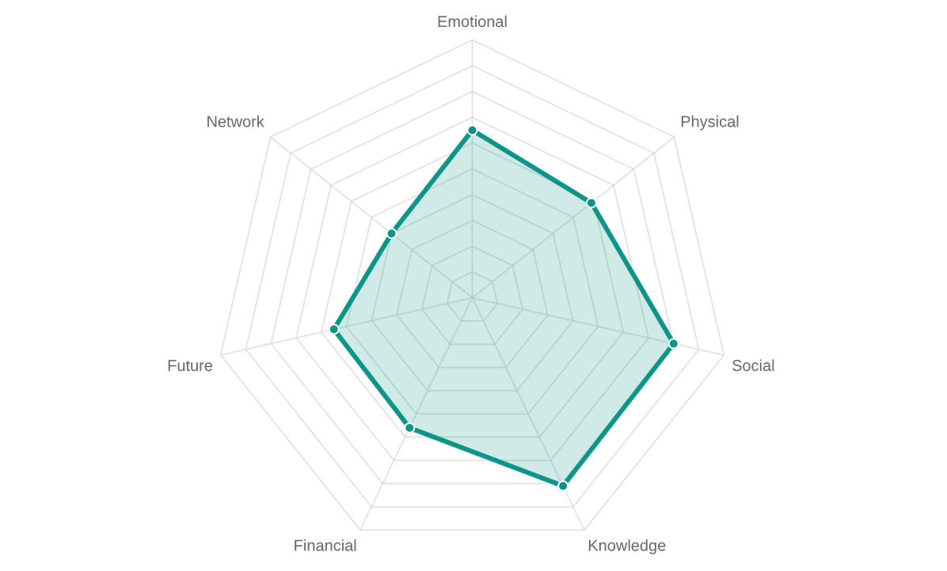
SIGNALS
→
DOMAINS
→
INDICATORS
→
ACTION
Indicator View: Multi-Dimensional Caregiver Burden
This conceptual view shows how caregiver strain can vary across dimensions and shift over time.
Emotional Health
Physical Well-being
Stress, coping, psychological strain
Caregiving load, health strain, respite access
Social Connection
Knowledge & Skills
Peer support, community ties, isolation risk
Caregiving competency, training, resource literacy
Financial Stability
Future Sustainability
Care costs, financial stress, aid access
Succession planning, legal readiness, long-term continuity
Support Network Capacity
Backup caregivers, network depth, shared responsibility
CARE-LIFE Internal | Page 9

Slide 10
SIGNALS
→
DOMAINS
→
INDICATORS
→
ACTION
From Domains to Indicators
This stage explains how structured domains translate into interpretable indicators for family and community visibility.
Individual-Level Visibility
Community-Level Visibility
Tracking domain shifts across time to identify changes in family needs.
Aggregated domain signals by geography to reveal regional support gaps.
Indicators guide prioritisation and resource allocation — not automated labelling.
CARE-LIFE Internal | Page 10

Slide 11

SIGNALS
→
DOMAINS
→
INDICATORS
→
ACTION
Operational Implication
This stage shows how structured visibility translates into coordinated individual and community action.
Individual Action
Community Action
Key worker outreach
Geo-targeted CAREConnect sessions
Geo-matched peer support
Succession planning workshops
Escalated review
Thematic campaigns
External referral
When caregiver burden evolves across life stages, our CARE-LIFE operating model captures that evolution and translates it into earlier, structured continuity action.
CARE-LIFE Internal | Page 11

