Slide 1

Real OR Fake News Analysis GROUP -2
Mentor Name : Hareesh
Trainer Name : Neha Gupta
Group Members :
Mr. Yash Dhoble
Miss. Pallavi Jadhav
Miss. Tejasvita Nale
Mr. Amol Gite
Miss. Kajal Raut

Slide 2
Problem Statement:
The problem at hand is to develop an effective and reliable system for detecting real or fake news using Natural Language Processing (NLP) techniques. Given the exponential growth of online content and the increasing spread of misinformation, it has become crucial to distinguish between trustworthy and deceptive news sources. This problem statement aims to address the challenge of accurately identifying and classifying news articles or information as genuine or fabricated, utilizing advanced NLP algorithms and methodologies.
The proposed system should be capable of analyzing the textual content of news articles, considering various linguistic and contextual features, and assessing their credibility and authenticity. It should be able to differentiate between accurate, fact-based reporting and deceptive, misleading information by leveraging techniques such as text classification, sentiment analysis, semantic understanding, and linguistic pattern recognition.
Ultimately, the goal is to develop an NLP-based solution that aids users, media organizations, and fact-checkers in distinguishing between genuine and fabricated news, contributing to the fight against misinformation and promoting trustworthy sources of information in the digital landscape.

Slide 3
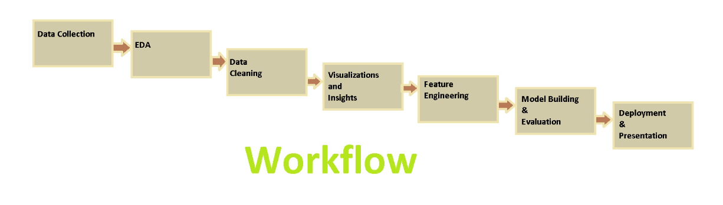
Project Work Flow :
Objective :
The main objective of this project is to develop a robust and accurate system using Natural Language Processing (NLP) techniques to distinguish between real and fake news articles.

Slide 4
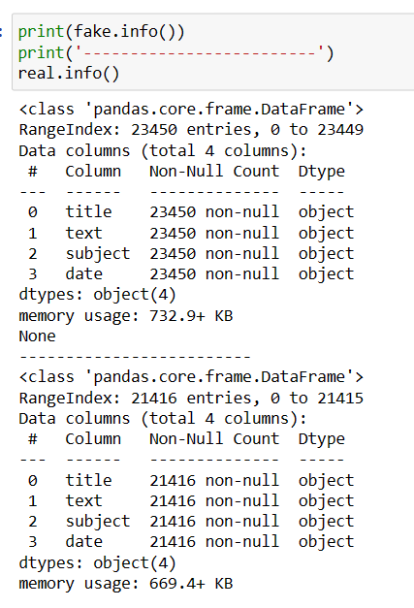
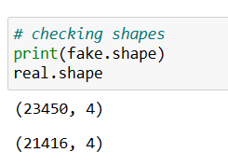
Exploratory Data Analysis:
We will browse through the data and collect some valuable insights with the help of Tables and Visual Plots

Slide 5
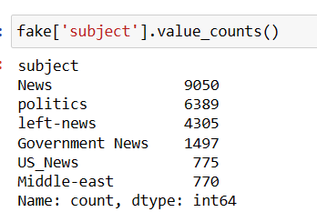
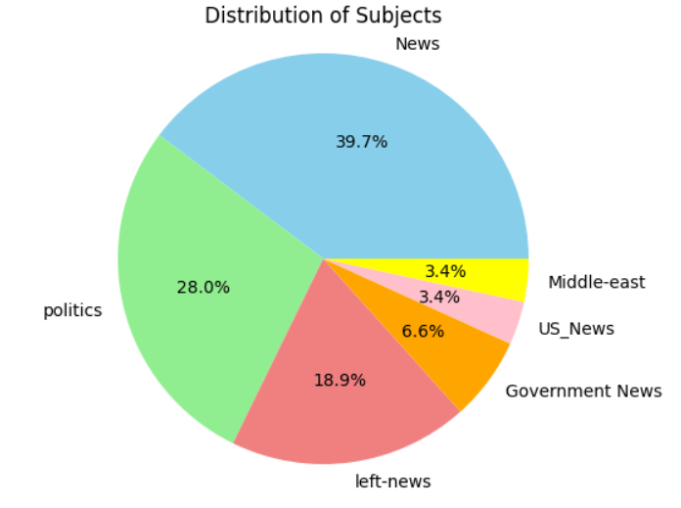
Data visualizations:
For Fake News Dataset
Observations:
Fake news has five subjects in which 'news' subject has high rate of publishing fake news and possibility of publishing fake news from US news & middle east are too low.

Slide 6
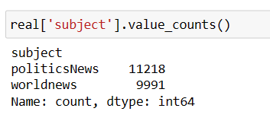
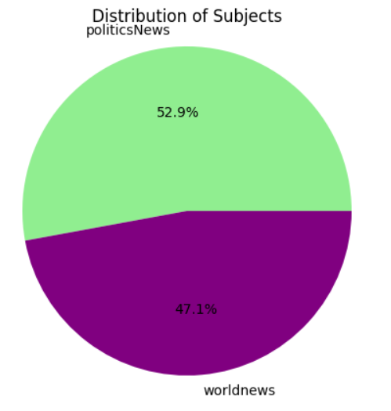
Data visualizations:
For Real News Dataset
Observations:
By comparing fake & real news subjects ,we can conclude that the news related to world news subjects were real news.
Real news articles on 'politics' topic are more than fake news articles.

Slide 7
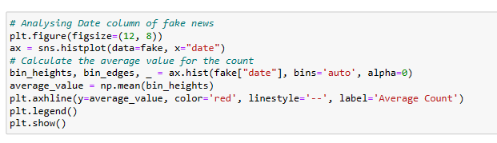
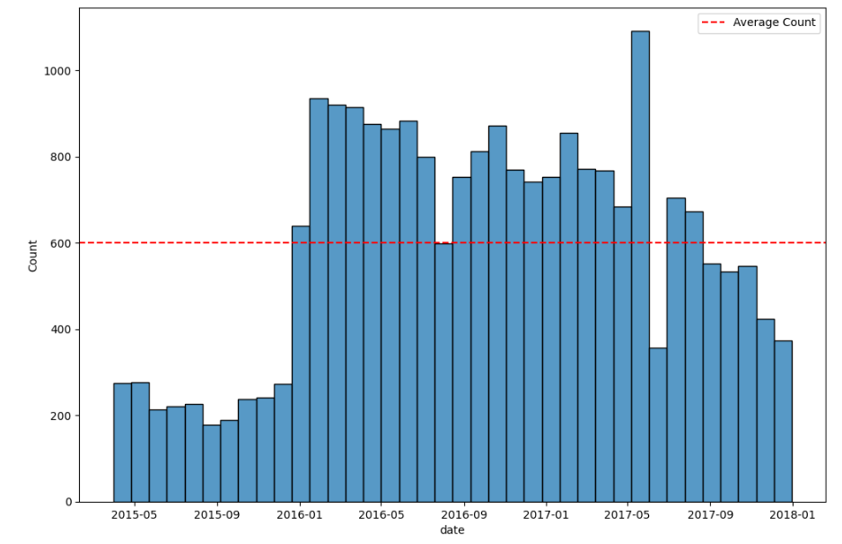
Date column: Fake News
Observations:
average of fake news counts are around 600 per Month

Slide 8
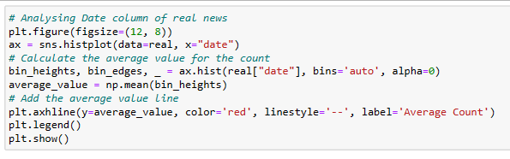
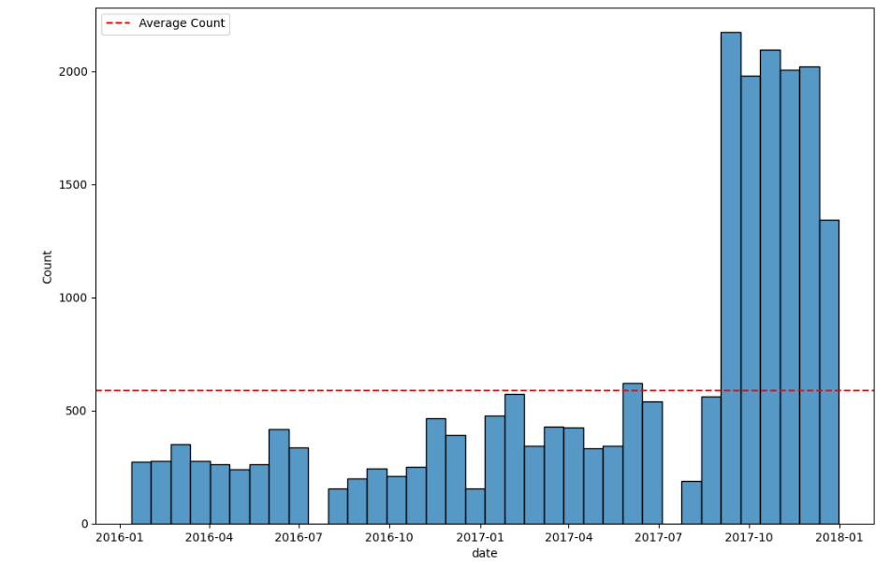
Date column: Real News
Observations:
From above graph we can say that in October, November & December month releasing real news rates were very high and average of real news counts are around 600 per month.
By comparing fake and real news Date column ,news release at end of year were real news.
But we cant interprete insights from date column of fake news. Its need to be further analysis.

Slide 9
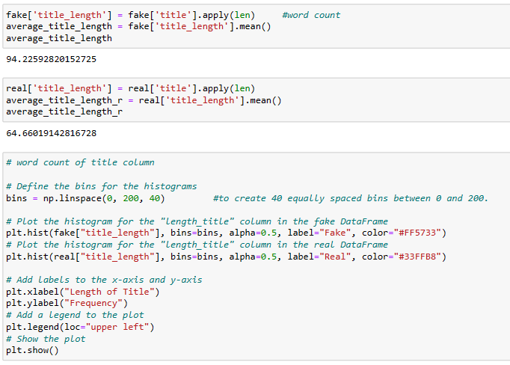
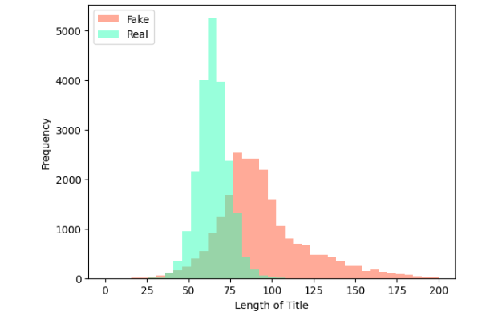
Title column:
Observations:
Real news titles tend to have shorter lengths, primarily up to 100 characters, while fake news titles can be longer, reaching up to 200 characters.
The "length of title" can be considered as a potentially important feature for model building, as it appears to show some differences between real and fake news. The fact that real news titles are generally shorter could be a useful characteristic for classification purposes.

Slide 10
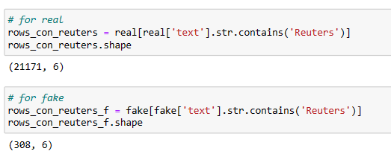
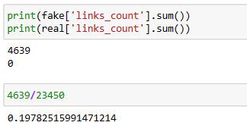
Reuters word analysis:
Observations:
The word "Reuters," which is a well-known US news agency, is commonly found in the real news dataset, appearing in 21,171 out of 21,210 rows. In contrast, it appears only 308 times out of 23,447 rows in the fake news dataset.
This is important feature for identifying real and fake news.
URL
Observations:
As % of URL present in fake dataset is 20% & in real news it is zero ,so it will be important feature to identify real and fake news.

Slide 11
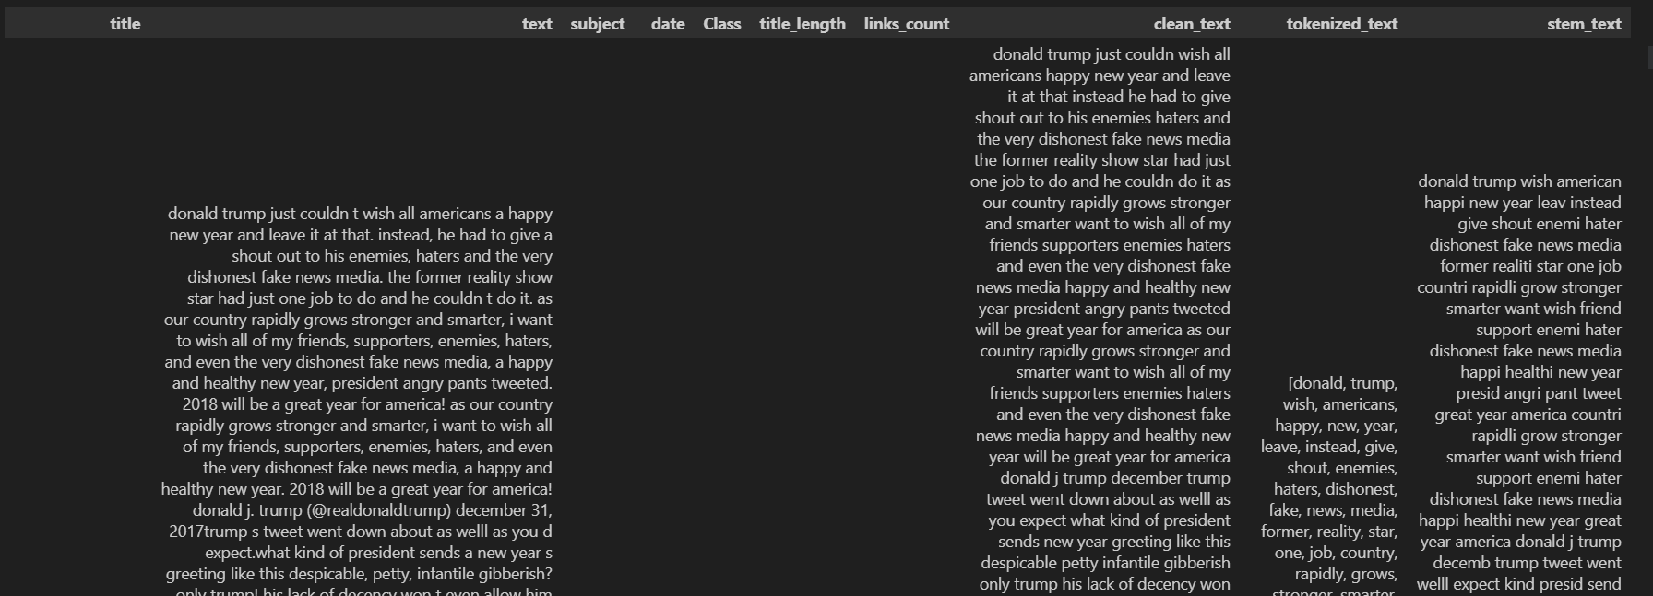
Data-Preprocessing :
Clean and preprocess the text data to remove noise, irrelevant information, and formatting inconsistencies.
•Tokenization : The tokenization stage involves converting a sentence into a stream of words.
•Stop-Words : Stopwords are frequently occurring words used to construct sentences.
•Stemming : Stemming is the process of converting all words to their base form, or stem.
•Lemmatization : Lemmatization is a more advanced form of stemming and involves converting all words to their corresponding root form.
Final Fake Dataset :

Slide 12
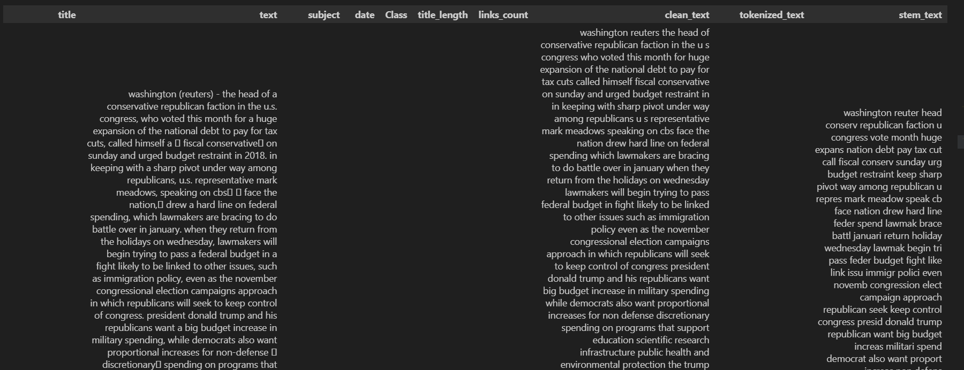
Data-Preprocessing :
Final Real Dataset :

Slide 13
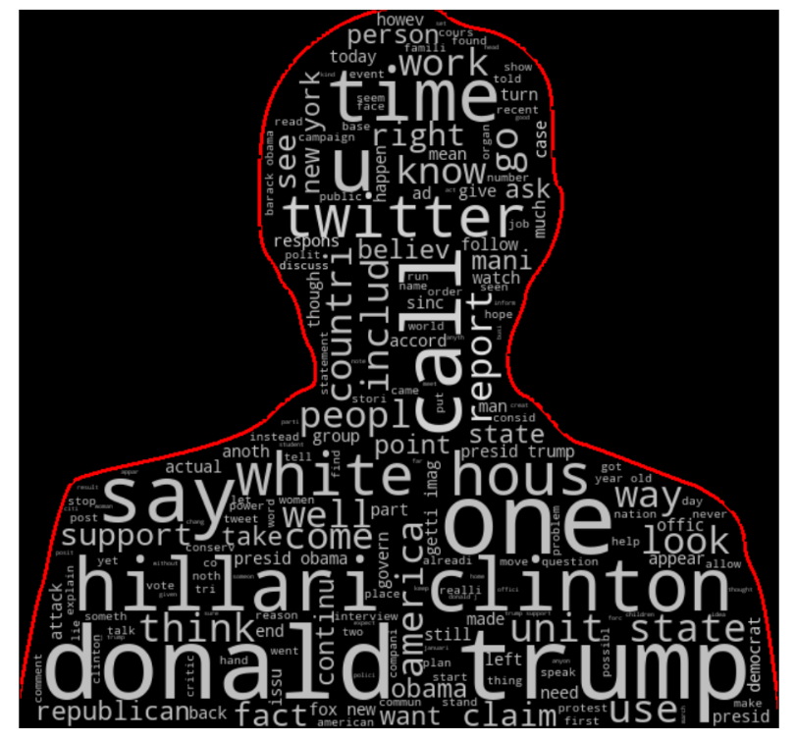
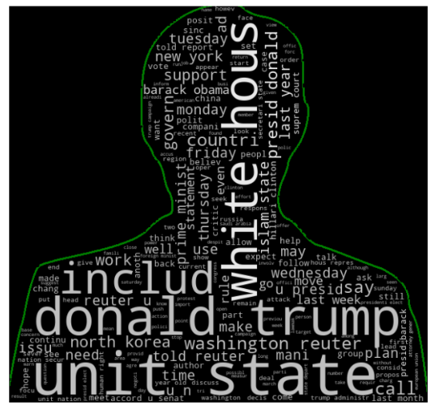
Word Cloud
Word Cloud For Fake Dataset
Word Cloud For Real Dataset
Observations:
The word cloud for fake news reveals mentions of prominent figures like Donald Trump, Hillary Clinton, and Barack Obama. Political party names like the Republican Party and terms like "said" (indicating statements) are also prevalent. Additionally, the word "Twitter" indicates a common source for spreading fake news.
Observations:
The word cloud for real news depicts mentions of weekdays, months, and social issues like racism and the Islamic State. The news agency "Reuters," White House, and Donald Trump are also commonly referenced in true news articles.
If we observe there are some words in the real which are not in fake like there are many fake news about Cliton.

Slide 14
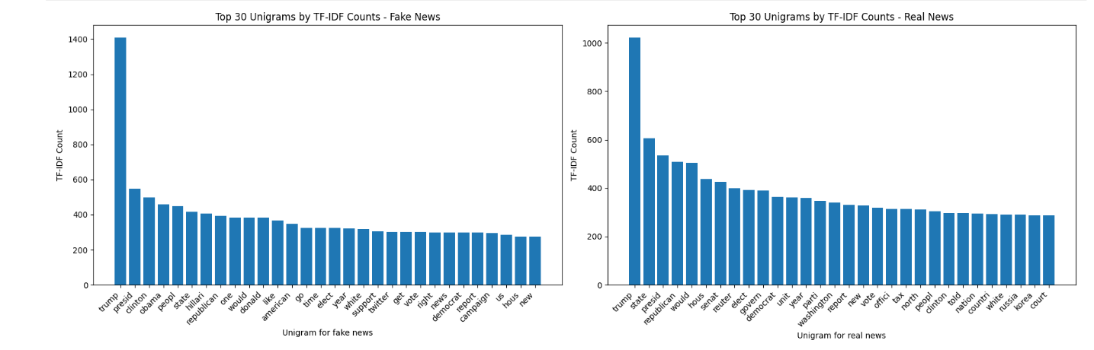
Top 30 N-gram Analysis
Unigrams :

Slide 15
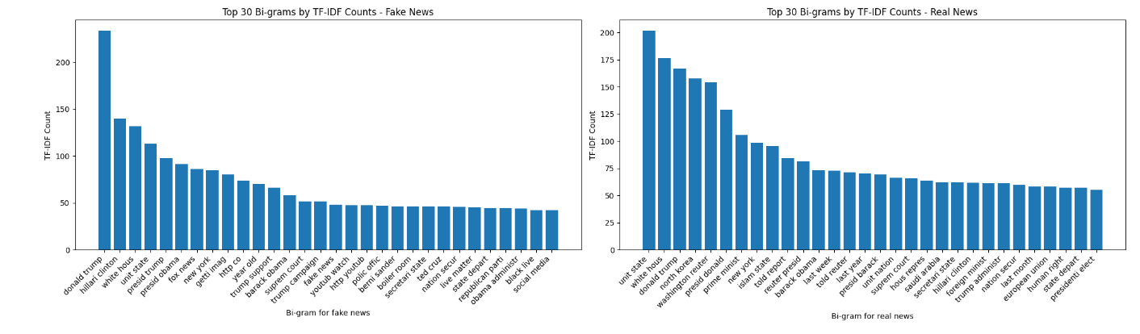
Top 30 N-gram Analysis
Bigrams :

Slide 16
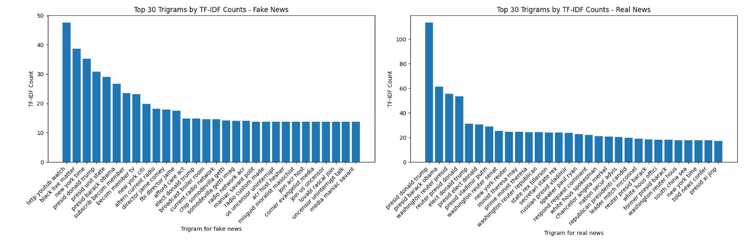
Top 30 N-gram Analysis
Trigrams :

Slide 17
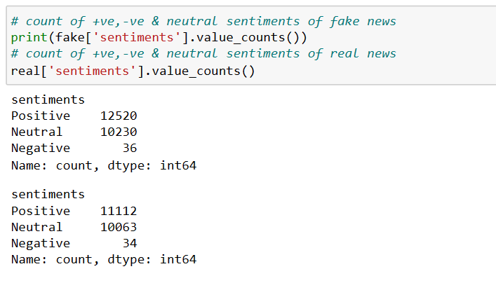
Observations of Unique words :
Top unique words in Trigrams for Fake News:
'black live matter', 'presid unit state', 'new york time', 'paul joseph watson', 'fox news host', 'support donald trump', 'white hous press' etc
Top unique words in Trigrams for Real News:
'presid donald trump', 'reuter presid donald', 'presid barack obama', 'washington reuter senat', 'presid vladimir putin', 'presid elect donald', 'secretari state rex' etc
From Uni ,Bi and trigram we can clearly observed that trigram gives more meaningful information about text.
Sentiment analysis:

Slide 18
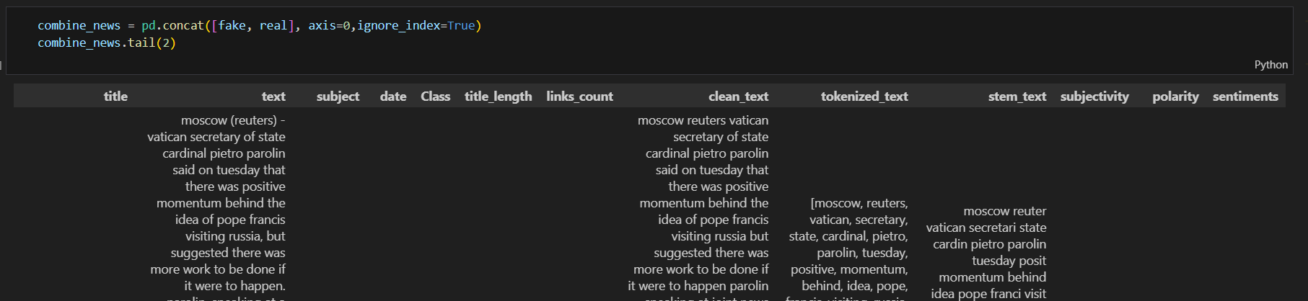
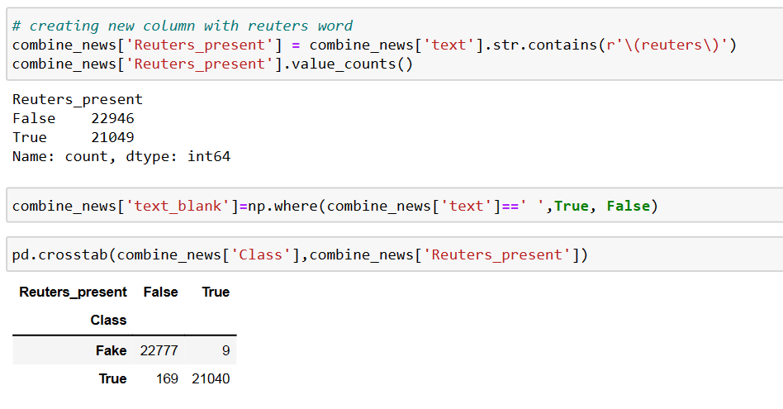
Feature Engineering :
Based on the insights and findings from the EDA and plots we are going to derive some important features so that it becomes an important feature for model building

Slide 19
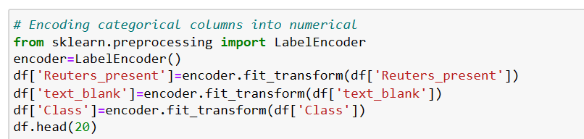
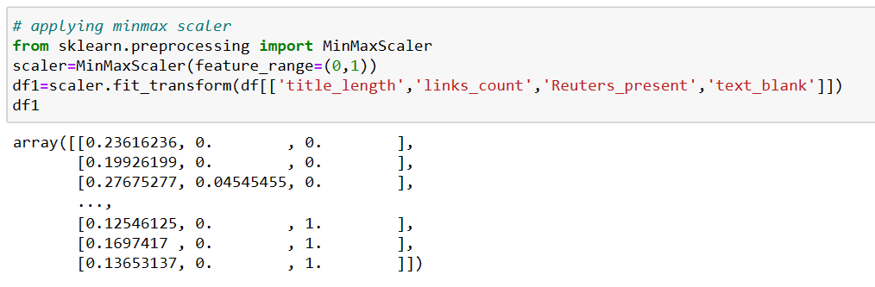
Label Encoding And Scaler :

Slide 20
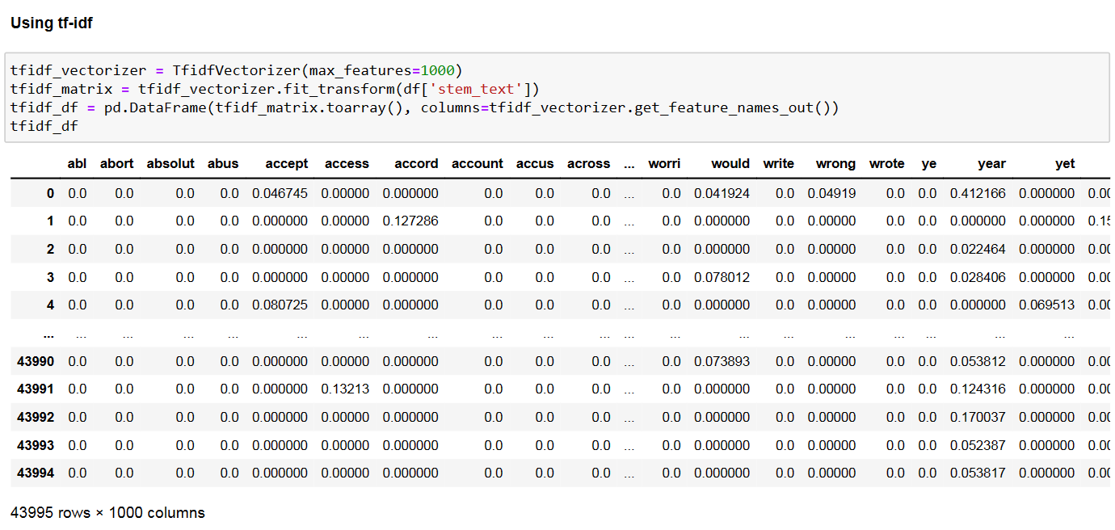
Word Embedding/Vectorization:
-Word embeddings is a technique where individual words are transformed into a numerical representation of the word (a vector). Where each word is mapped to one vector.there are 2 type of WE,
1.Frequncy Based Embedding
i) CV
ii) TF-IDF
2.Prediction based embedding
i) Word2Vec

Slide 21
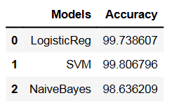
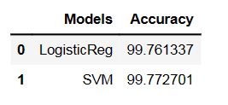
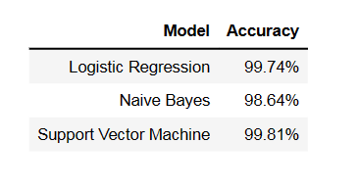
Model Building
Model building for TF-IDF
Model building with Word2Vec
Accuracy Table for TF-IDF
Using LogisticReg,
SVM,
NaiveBayes models
Accuracy Table for TF-IDF
Using LogisticReg,
SVM
Model Comparison
Conclusion:
All three models performed exceptionally well in classifying news articles as real or fake.
The Support Vector Machine (SVM) achieved the highest accuracy of 99.81%, indicating its effectiveness for this particular task.
Logistic Regression also performed impressively with an accuracy of 99.74%.
Naive Bayes achieved a respectable accuracy of 98.64%.
Based on accuracy alone, the Support Vector Machine is the best-performing model for this real/fake news classification task.

Slide 22
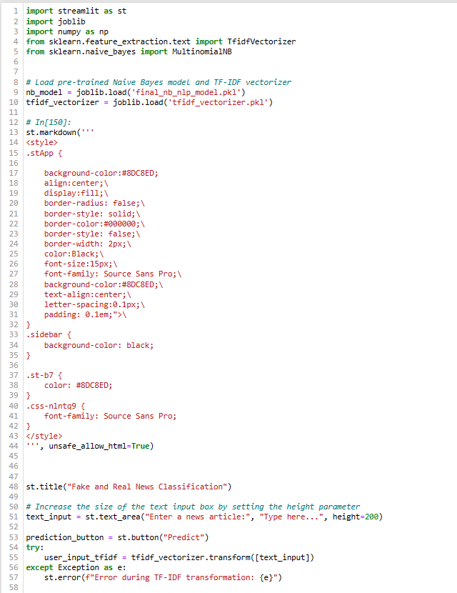
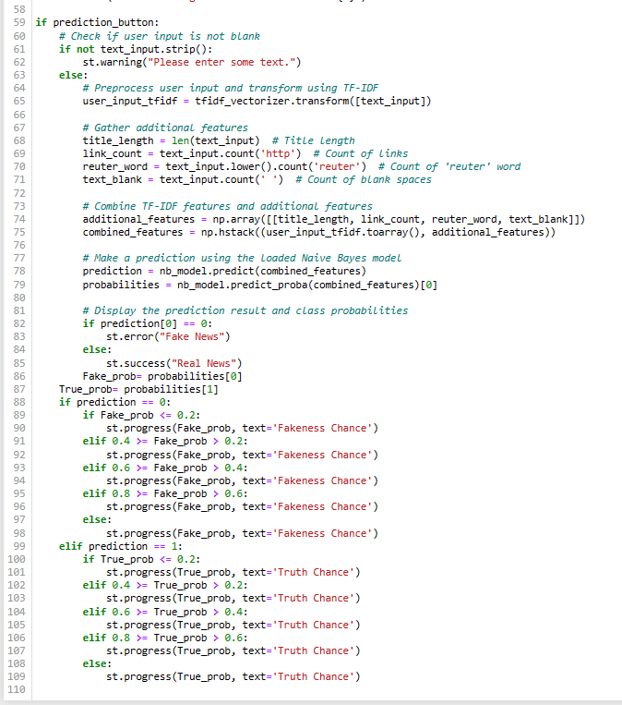
Deployment Code
We deployed our project with Naïve baye model.

Slide 23
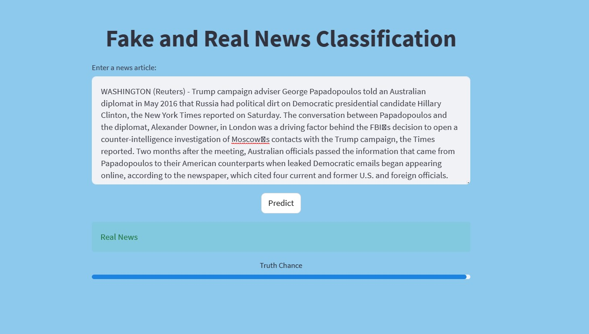
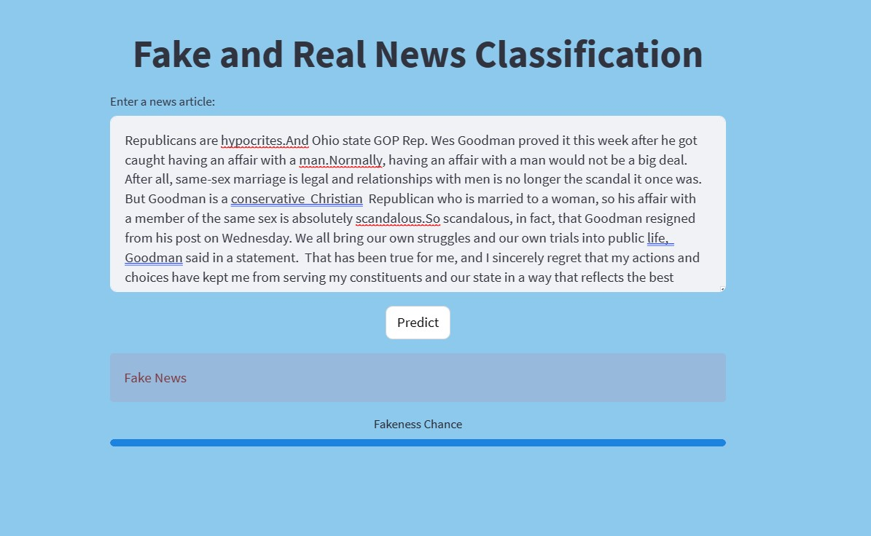
Deployment Output on Streamlit
It shows Real News For news which have high chance to real.
It shows Fake News For news which have high chance to fake.

Slide 24
Thank You

