Slide 1
Marketing Solution

Slide 2
Above table with Predicted and actual values: No-No = 7126 No-Yes = 495 yes-No = 216 Yes-Yes = 396 No-No & Yes-Yes shows same predicted and Actual values. No-Yes & Yes-no values show difference means we missed some prediction
Confusion Matrix
 | No | Yes
No | 7126 | 495
Yes | 216 | 396

Slide 3
Accuracy Score
Accuracy score – 91.36%
Score range – 0 to 100%
Means, Our model has higher prediction accuracy.

Slide 4
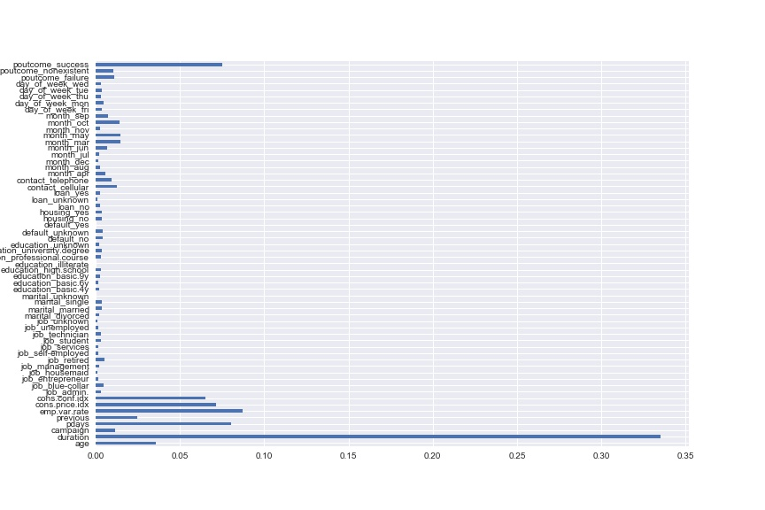
Important Features

Slide 5
From Above image we can say that
Duration of call
Employment variation rate
Consumer price index
Number of days that passed by after the client was last contacted
Consumer confidence index
Number of contacts performed before this campaign and for this client
Age
are few of the most important features available with us.
And for Marketing purpose we must use them intensively to increase banks profit.

Slide 6
Inference
Though, Call Duration showing most significant variable for sales point of view. We need to find more information about the successful calls. Like the recorded conversation and sales representative, in order to create strategies to make calls successful.
Also check the age of the positive customer and we can make strategies according to their age group. So that more customer will come to banks product.
How many times bank makes contact with the customer before campaign, is also the important thing, because they must hear repetitively about banks product.

Slide 7
Feature Improvement –
Neural network can be used to improve the model performance
‘Unkown’ values did not handle.
which can be handle to make the model more reliable.

