Slide 1
Marketing Solution

Slide 2
Above table with Predicted and actual values: No-No = 7126 No-Yes = 495 yes-No = 216 Yes-Yes = 396 No-No & Yes-Yes shows same predicted and Actual values. No-Yes & Yes-no values show difference means we missed some prediction
Confusion Matrix
 | No | Yes
No | 7126 | 495
Yes | 216 | 396

Slide 3
Accuracy Score
Accuracy score – 91.36%
Score range – 0 to 100%
Means, Our model has higher prediction accuracy.

Slide 4
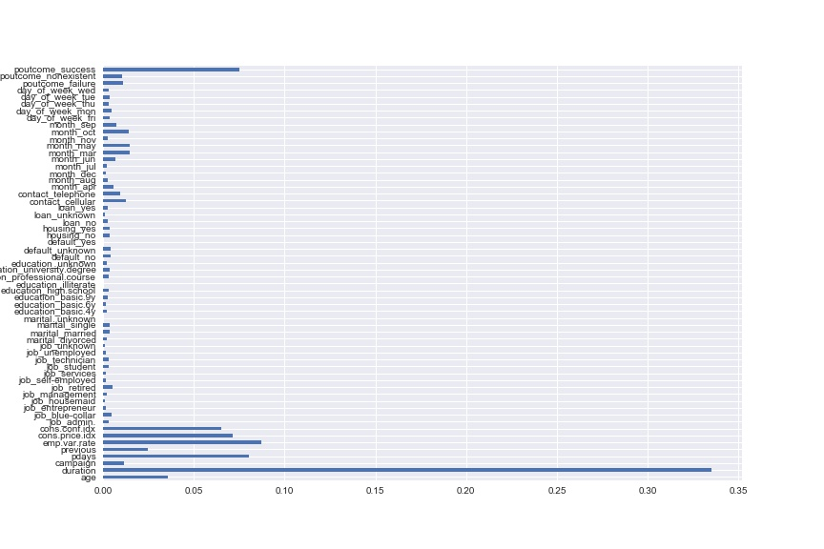
Important Features

Slide 5
From Above image we can say that
Duration of call
Employment variation rate
Consumer price index
Number of days that passed by after the client was last contacted
Consumer confidence index
Number of contacts performed before this campaign and for this client
Age
are few of the most important features available with us.
And for Marketing purpose we must use them intensively to increase banks profit.

Slide 6
Feature Improvement –
Neural network can be used to improve the model performance
‘Unkown’ values did not handle.
which can be handle to make the model more reliable.

