Slide 1

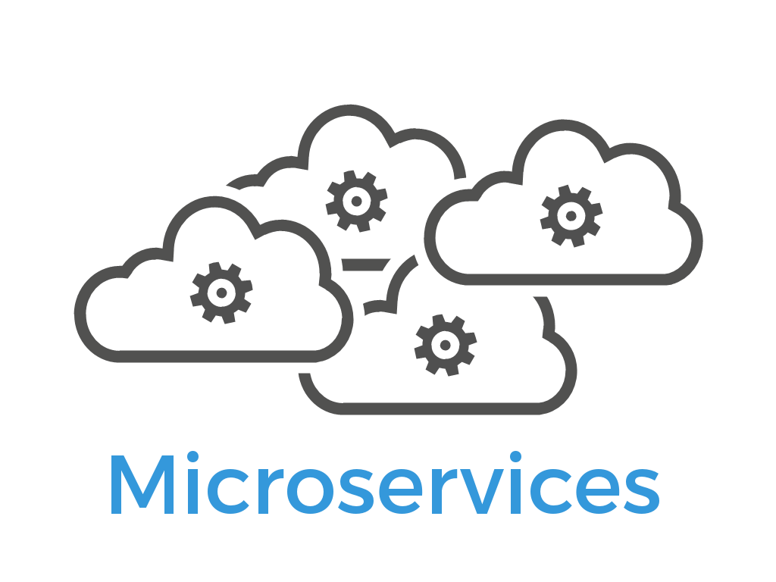

Microservices on Azure
Nikhil Shah

Slide 2
Agenda
Principles of Microservices
Azure Container Service
Azure Service Fabric
Demo

Slide 3


Slide 4


Slide 5
With increasing business demands, we now develop very large and complex projects that take more time to build and deploy.
Whenever QA reports any issue, we need to debug or fix it and then deploy the whole code.
To reduce these complexities, most organizations are moving towards Microservices development and Docker for easy deployment and smooth service running.

Slide 6
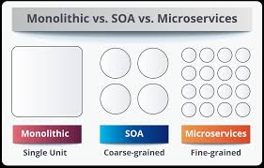

Slide 7


Slide 8
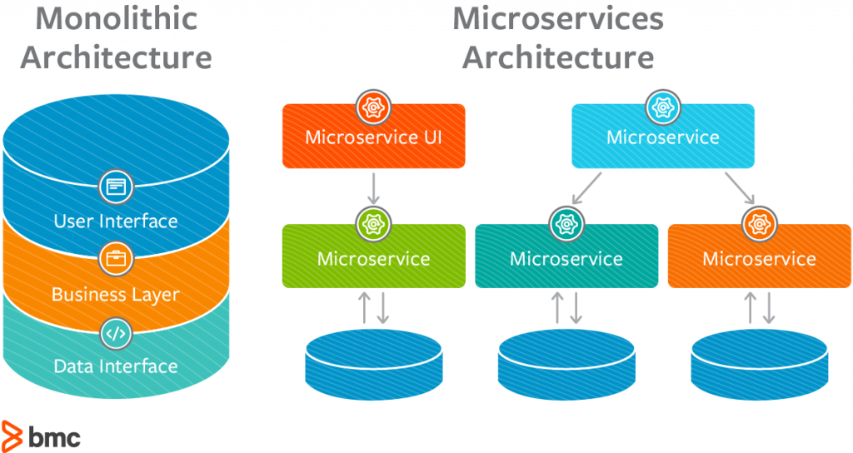

Slide 9
WHY SHOULD WE USE MICROSERVICES INSTEAD OF A MONOLITHIC APPROACH?
Microservices are smaller in size
Microservices are easier to develop, deploy, and debug, because a fix only needs to be deployed onto the microservice with the bug, instead of across the board
Microservices can be scaled quickly and can be reused among different projects
Microservices work well with containers like Docker
Microservices are independent of each other, meaning that if one of the microservices goes down, there is little risk of the full application shutting down

Slide 10
WHY SHOULD WE USE .NET CORE
.NET Core is a great development tool for many reasons, including that it’s open source and is very helpful in developing high-performance and scalable systems.
It supports cross-platform runtime, so if you create a service using .NET Core, it can be run on any platform.
.NET Core is also helpful for faster development, as well as supporting built-in dependency injection and a cloud-based environment configuration. .

Slide 11
WHY SHOULD WE USE DOCKER?
Docker is a tool that makes it easier to create, deploy, and run applications by using a containerization approach.
These containers are lightweight and take less time to start than traditional servers.
These containers also increase performance and lower cost, while offering proper resource management.
Another benefit to using Docker is that you no longer need to pre-allocate RAM to each container.

Slide 12
Definition
A microservices architecture consists of a collection of small, autonomous services. Each service is self-contained and should implement a single business capability.

Slide 13
Characteristics of a Microservice
Services are small, independent, and loosely coupled.
Each service is a separate codebase.
Services can be deployed independently.
Services are responsible for persisting their own data or external state.
Services communicate with each other by using well-defined APIs.
Services don't need to share the same technology stack, libraries, or frameworks.
Notes:
In a microservices architecture, services are small, independent, and loosely coupled.
Each service is a separate codebase, which can be managed by a small development team.
Services can be deployed independently. A team can update an existing service without rebuilding and redeploying the entire application.
Services are responsible for persisting their own data or external state. This differs from the traditional model, where a separate data layer handles data persistence.
Services communicate with each other by using well-defined APIs. Internal implementation details of each service are hidden from other services.
Services don't need to share the same technology stack, libraries, or frameworks.

Slide 14
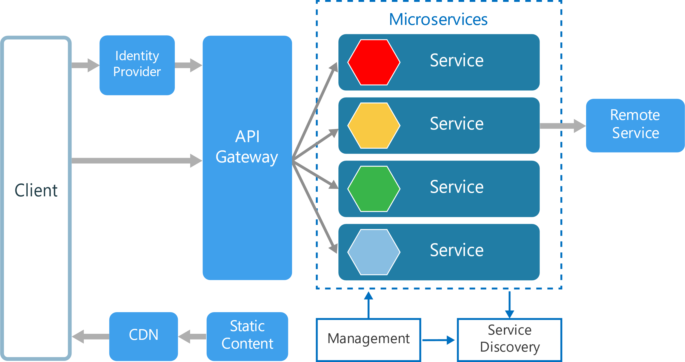
Microservices Overview

Slide 15
Other Components in a Typical Microservices Architecture
Management
Service Discovery
API Gateway
Notes:
Management. The management component is responsible for placing services on nodes, identifying failures, rebalancing services across nodes, and so forth.+
Service Discovery. Maintains a list of services and which nodes they are located on. Enables service lookup to find the endpoint for a service.
API Gateway. The API gateway is the entry point for clients. Clients don't call services directly. Instead, they call the API gateway, which forwards the call to the appropriate services on the back end. The API gateway might aggregate the responses from several services and return the aggregated response.

Slide 16
Microservices Management Options in Azure
Azure Container Service (AKS)
Service Fabric
Notes:
Management. The management component is responsible for placing services on nodes, identifying failures, rebalancing services across nodes, and so forth.+
Service Discovery. Maintains a list of services and which nodes they are located on. Enables service lookup to find the endpoint for a service.
API Gateway. The API gateway is the entry point for clients. Clients don't call services directly. Instead, they call the API gateway, which forwards the call to the appropriate services on the back end. The API gateway might aggregate the responses from several services and return the aggregated response.

Slide 17
Azure Container Service
Orchestration & Microservices

Slide 18
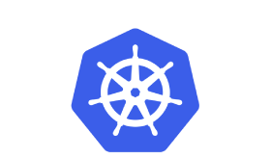
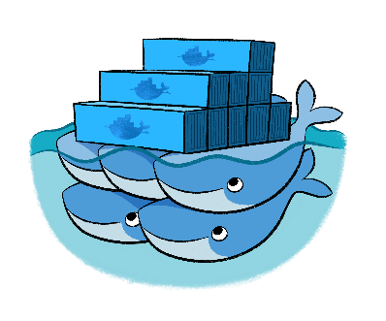
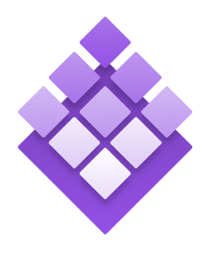
Azure Container Service
Provisioning of DC/OS, Docker, and Kubernetes
Standard Docker tooling and API support
Linux and Windows Server containers
Billed for the compute resource used
Kubernetes
DC/OS
Swarm
Linux: GA Windows: Preview

Slide 19
Azure Container Service
Containers
Orchestrator (Docker Swarm, DC/OS, Kubernetes)
Container Tooling e.g. Docker CLI
Linux
Windows Server
VMs and VM Scale Sets
Service Tooling e.g. ARM Template
Azure Stack
Azure

Slide 20
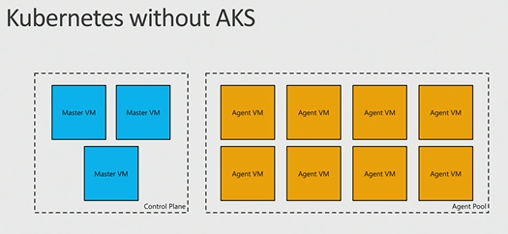
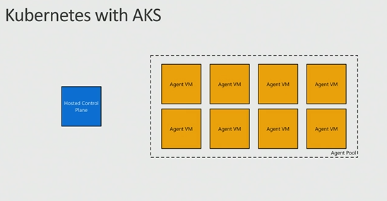
AKS: Managed Kubernetes
Azure-hosted control plane
No master nodes to manage or pay for
Automated upgrades and patching
Easily upgrade control plane and worker nodes to new versions of Kubernetes
Scale agent pool to increase or decrease capacity
Linux: Preview Windows: Not yet
Notes:
Automatic binpacking
Self-healing
Horizontal scaling
Service discovery and load balancing
Automated rollouts and rollbacks
Secret and configuration management
Storage orchestration
Batch execution

Slide 21
Service Fabric
Orchestration, microservices, programming models

Slide 22




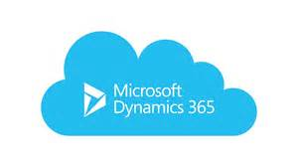




Services Powered by Service Fabric
Cosmos DB
Billions transactions/day
IoT Hub
Millions of messages
Event Hubs
60bn events/day
SQL Database
2.1 million DBs
Skype
Cortana
Intune
Dynamics
Power BI
Windows: GA Linux: Preview

Slide 23



Azure Service Fabric
Any OS, Any Cloud
Lifecycle
Management
Always On Availability
Programming Models
Health & Monitoring
Dev & Ops Tooling
Auto
scaling
Orchestration
Dev Box
Azure
On Premise
Other Clouds
Notes:
Deploy to Azure or to on-premises datacenters that run Windows or Linux with zero code changes. Write once, and then deploy anywhere to any Service Fabric cluster.
Develop scalable applications that are composed of microservices by using the Service Fabric programming models, containers, or any code.
Develop highly reliable stateless and stateful microservices. Simplify the design of your application by using stateful microservices.

Slide 24



Service Fabric Programming Models & CI/CD
Visual
Studio
&
VSTS
Jenkins
&
Eclipse
.NET Core/Full .NET/Java
Reliable Actors
Diagnostics & Monitoring
AppInsights
OMS
ELK
Reliable Services
Guest Executables
Containers
Lifecycle
Management
Auto
scaling
Lifecycle
Management
Always On Availability
Orchestration
Programming Models
Health & Monitoring
Dev & Ops Tooling
Auto
scaling
Dev Box
Azure
On Premise
Other Clouds
Notes:
Use the novel Reliable Actors programming model to create cloud objects with self contained code and state.
Deploy and orchestrate containers that include Windows containers and Linux containers. Service Fabric is a data aware, stateful, container orchestrator.
Deploy applications in seconds, at high density with hundreds or thousands of applications or containers per machine.
Deploy different versions of the same application side by side, and upgrade each application independently.
Manage the lifecycle of your applications without any downtime, including breaking and nonbreaking upgrades.
Scale out or scale in the number of nodes in a cluster. As you scale nodes, your applications automatically scale.
Monitor and diagnose the health of your applications and set policies for performing automatic repairs.
Watch the resource balancer orchestrate the redistribution of applications across the cluster. Service Fabric recovers from failures and optimizes the distribution of load based on available resources.

Slide 25
Advantages of Using an API gateway
It decouples clients from services. Services can be versioned or refactored without needing to update all of the clients.
Services can use messaging protocols that are not web friendly, such as AMQP.
The API Gateway can perform other cross-cutting functions such as authentication, logging, SSL termination, and load balancing.

Slide 26
When to use this architecture
Large applications that require a high release velocity.
Complex applications that need to be highly scalable.
Applications with rich domains or many subdomains.
An organization that consists of small development teams.

Slide 27
Benefits
Independent deployments
Independent development
Small, focused teams
Fault isolation
Mixed technology stacks
Granular scaling
Notes:
Independent deployments. You can update a service without redeploying the entire application, and roll back or roll forward an update if something goes wrong. Bug fixes and feature releases are more manageable and less risky.
Independent development. A single development team can build, test, and deploy a service. The result is continuous innovation and a faster release cadence.
Small, focused teams. Teams can focus on one service. The smaller scope of each service makes the code base easier to understand, and it's easier for new team members to ramp up.
Fault isolation. If a service goes down, it won't take out the entire application. However, that doesn't mean you get resiliency for free. You still need to follow resiliency best practices and design patterns.
Mixed technology stacks. Teams can pick the technology that best fits their service.
Granular scaling. Services can be scaled independently. At the same time, the higher density of services per VM means that VM resources are fully utilized. Using placement constraints, a services can be matched to a VM profile (high CPU, high memory, and so on).

Slide 28
Challenges
Complexity
Development and test
Lack of governance
Network congestion and latency
Data integrity
Management
Versioning
Skillset
Notes:
Independent deployments. You can update a service without redeploying the entire application, and roll back or roll forward an update if something goes wrong. Bug fixes and feature releases are more manageable and less risky.
Independent development. A single development team can build, test, and deploy a service. The result is continuous innovation and a faster release cadence.
Small, focused teams. Teams can focus on one service. The smaller scope of each service makes the code base easier to understand, and it's easier for new team members to ramp up.
Fault isolation. If a service goes down, it won't take out the entire application. However, that doesn't mean you get resiliency for free. You still need to follow resiliency best practices and design patterns.
Mixed technology stacks. Teams can pick the technology that best fits their service.
Granular scaling. Services can be scaled independently. At the same time, the higher density of services per VM means that VM resources are fully utilized. Using placement constraints, a services can be matched to a VM profile (high CPU, high memory, and so on).

Slide 29
Best Practices
Model services around the business domain.
Decentralize everything
Data storage should be private to the service that owns the data
Services communicate through well-designed APIs
Avoid coupling between services
Offload cross-cutting concerns, such as authentication and SSL termination, to the gateway.
Keep domain knowledge out of the gateway
Services should have loose coupling and high functional cohesion
Isolate failures
Notes:
Model services around the business domain.
Decentralize everything. Individual teams are responsible for designing and building services. Avoid sharing code or data schemas.
Data storage should be private to the service that owns the data. Use the best storage for each service and data type.
Services communicate through well-designed APIs. Avoid leaking implementation details. APIs should model the domain, not the internal implementation of the service.
Avoid coupling between services. Causes of coupling include shared database schemas and rigid communication protocols.
Offload cross-cutting concerns, such as authentication and SSL termination, to the gateway.
Keep domain knowledge out of the gateway. The gateway should handle and route client requests without any knowledge of the business rules or domain logic. Otherwise, the gateway becomes a dependency and can cause coupling between services.
Services should have loose coupling and high functional cohesion. Functions that are likely to change together should be packaged and deployed together. If they reside in separate services, those services end up being tightly coupled, because a change in one service will require updating the other service. Overly chatty communication between two services may be a symptom of tight coupling and low cohesion.
Isolate failures. Use resiliency strategies to prevent failures within a service from cascading.

Slide 30
Demo

Slide 31
Additional resources:
Azure.com service overviews https://aka.ms/containersonazure
Microsoft Docs - Documentation for container related services https://aka.ms/containerdocs
MSDN Channel 9 – Videos covering Azure and Containers https://channel9.msdn.com/
Microsoft Virtual academy – online training courses https://mva.microsoft.com/

