Slide 1
Sentiment Analysis
On Cryptocurrencies

Slide 2
Sentiments

Slide 3
Learning
Knowledge
Information
+ve
-ve
neutral

Slide 4
Information
CSV
Tweets
EXCEL
RAW data
Comments and Likes
Datasets

Slide 5
Learning

Slide 6
What comes before it ?

Slide 7
Understanding Data & their relationship

Slide 8
ONTOLOGY
Semantic Relationship among data

Slide 9
Concept
Defined as O={ C, R, I, A }
Concepts
Relation
Instances
Axioms

Slide 10
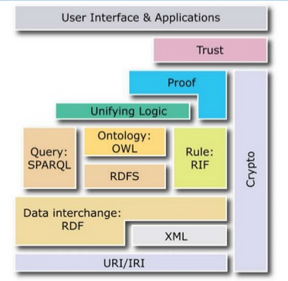

Slide 11
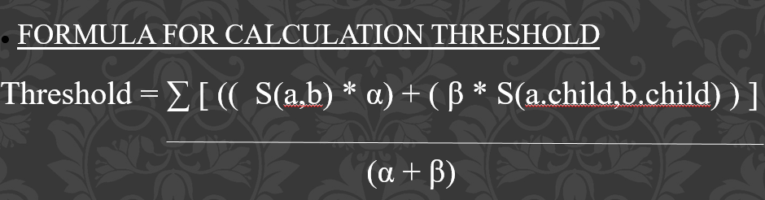
Accuracy

Slide 12
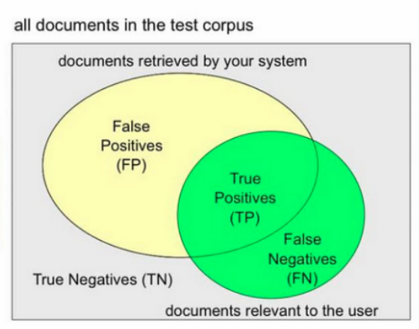
PRECISION AND RECALL

Slide 13
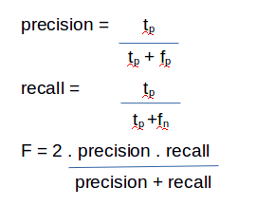
PRECISION AND RECALL
ACTUAL EXPECTED | 0 | 1
0 | TP | FN
1 | TN | TP

Slide 14
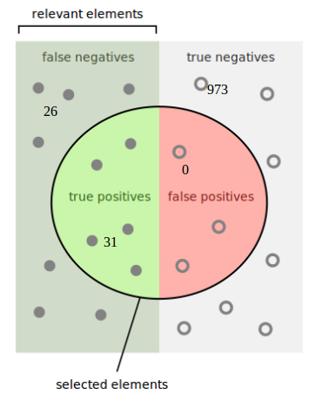
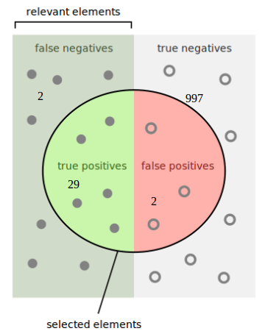
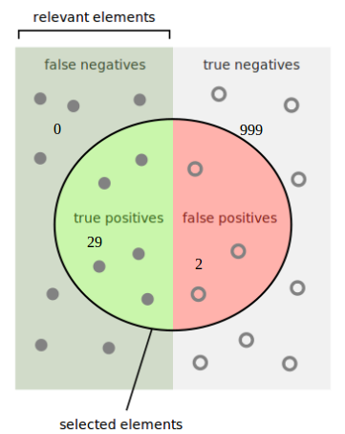
ALGORITHMIC COMPARISONS
WUP
LIN
PATH

Slide 15
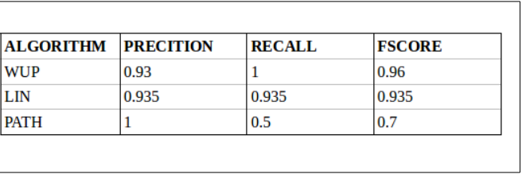
Fscore of Algorithms

Slide 16
