Slide 1




DATA ANALYTICS PROJECT
Retail Customer Shopping Behavior Analysis
Shopping
Apparel
Using Python, SQL, and Power BI to Understand Customer Purchasing Patterns
Footwear
Accessories
Turning Customer Data into Business Insights
Dashboard preview (illustrative)
Amol Chavan
Python | SQL Server | Power BI
Visuals: editable shapes and Font Awesome icons (via react-icons)
Notes:
Introduce yourself and the project: a retail shopping behavior analysis built with Python, SQL Server and Power BI.

Slide 2



Business Problem Statement
A retail company wants to grow sales, satisfaction, and loyalty by understanding how its customers shop.
Understand Customers
Identify Purchasing Patterns
Improve Business Decisions
KEY BUSINESS QUESTION
“How can the company use customer shopping data to understand buying behavior, improve customer engagement, and develop better marketing and product strategies?”
Notes:
The company wants to understand how customers shop so it can improve sales, satisfaction and loyalty.

Slide 3





Project Objectives
Customer Behavior
Product Popularity
Discount Usage
Understand how customers shop and buy.
Find popular products and categories.
Analyze discounts and promo codes.
Ratings & Payments
Repeat Purchases
Loyalty & Marketing
Explore reviews and payment choices.
Study previous purchases and repeat buying.
Spot ways to improve loyalty and marketing.
Notes:
Six objectives, from understanding behavior to improving loyalty and marketing.

Slide 4


Dataset Overview
~3,900
Customers
Products
Discounts
records
demographics
and categories
and promo codes
Fields in the dataset
Sample view (illustrative)
Purchase amounts
Ratings
Customer ID | Age | Category | Purchase Amount | Season | Subscription
Illustrative | Illustrative | Clothing | Illustrative | Winter | Yes
Illustrative | Illustrative | Accessories | Illustrative | Summer | No
Subscription status
Shipping & payment
Previous purchases & frequency
Discounts & promo codes
Size, color & season
Age, gender & location
Illustrative values only – not actual customer records.
Notes:
The dataset has about 3,900 records. The sample table is illustrative, not real customer data.

Slide 5






Data Cleaning and Preparation – Python
Raw Dataset
Data Exploration
Data Quality Checks
Data Preparation
SQL Server
What we did in Python
Loaded and explored the data with Python and Pandas
Checked missing values and duplicate records
Reviewed column data types and consistency
Prepared the dataset for analysis
Loaded the prepared data into SQL Server
Python + Pandas
A simple, repeatable prep workflow
Notes:
Python and Pandas were used to explore, check and prepare the data before loading it into SQL Server.

Slide 6

SQL Analysis – Extracting Insights
query.sql – example (illustrative)
What SQL Server was used for
SELECT category,
COUNT(*) AS purchases,
AVG(purchase_amount) AS avg_amount
FROM shopping_data
GROUP BY category
ORDER BY purchases DESC;
Purchasing patterns by customer group
Popular products and categories
Purchase amount by discount usage
Subscription and payment preferences
Previous purchases and repeat buying
SQL queries to extract insights
Prepared Data
SQL Queries
Aggregated Results
Business Insights
Example query shown for illustration only; no results are reported here.
Notes:
SQL Server was used to group and compare data, then turn it into business insights.

Slide 7
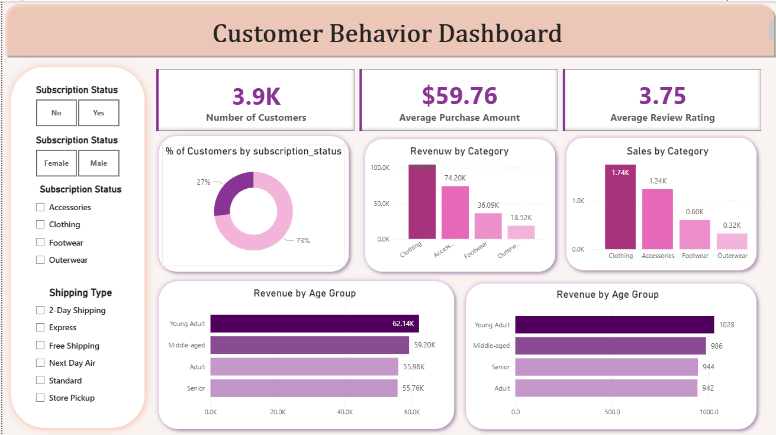
Power BI Dashboard – Customer Behavior
Also covered: demographics, ratings by shipping type, previous purchases, subscription status. All values shown are illustrative.
Notes:
This is a layout mock-up of the Power BI dashboard. All numbers on this slide are illustrative placeholders, not findings.

Slide 8

Key Analysis Areas and Business Insights
Product Performance
Promotions and Discounts
Identify popular products and categories to support product planning.
Explore discount usage and its relationship with purchase amounts.
Customer Behavior
Seasonal Patterns
Understand purchasing history, subscription status, and preferences.
Compare shopping behavior across seasons to plan promotions and inventory.
Analysis areas and potential insights – not verified results.
Notes:
These are the four areas the analysis is designed to explore. They are potential insights, not verified results.

Slide 9


Business Recommendations
RECOMMENDATION
ANALYSIS INPUT
BUSINESS ACTION
Personalized Marketing
Customer preferences and purchasing patterns
Design more relevant promotional campaigns
Product Planning
Product popularity by category
Support inventory and assortment decisions
Discount Optimization
Discount usage patterns
Find where promotions may help most
Customer Loyalty
Previous purchases and frequency
Encourage repeat purchases with relevant offers
Seasonal Planning
Seasonal purchasing patterns
Time campaigns and plan products by season
Recommendations based on the analysis framework – not proven business outcomes.
Notes:
Each recommendation links an analysis input to a business action. These are suggestions to consider, not proven outcomes.

Slide 10
Conclusion and Future Scope
Conclusion
Future Scope
Python explored and prepared the data
SQL Server structured and analyzed it
Power BI visualized purchasing patterns
Helps the business understand customers and decide with confidence
A foundation for marketing, product planning, and engagement
Customer segmentation models
Predictive analytics for purchase behavior
Advanced customer loyalty analysis
Add sales-channel data (online/offline), if available
Automated data refresh and dashboard reporting
Thank You – Turning Data into Better Retail Decisions
Notes:
Summarize the workflow, mention the future scope, and close with the thank-you message.

