Slide 1
Store Sales Data
Prepared by: Amol Crasta
Student ID: ZTS/25/0116
Date: 11/02/2026

Slide 2
Contents / Agenda
Executive Summary – Insights & Recommendations
Business Problem Overview
Solution Approach
Data Dictionary
Solution Design & Methodology
Explanatory Data Analysis (EDA)
Data Preprocessing
Conclusions and Recommendations

Slide 3
Executive Summary : Insights & Recommendations
Key Insights:
The business generated Total Revenue of 1.21M from 5,000 customers, indicating strong overall sales performance.
Electronics is the highest revenue-generating category (~760K), contributing a dominant share compared to other categories.
Seasonal analysis shows relatively balanced sales, with slight peaks across Spring and Winter periods.
Top purchased items include Sandals, Formal Shoes, Sneakers, Yoga Mats, and Dumbbells, highlighting strong demand in lifestyle and fitness products.
Laptops and Mobile Phones as the top revenue drivers among all products.
Recommendations:
Increase inventory, promotions, and supplier partnerships in the Electronics category to maximize high-revenue momentum.
Diversify marketing strategies to boost lower-performing categories such as Beauty, Groceries, and Accessories.
Introduce targeted campaigns for different age groups to improve category penetration.
Use seasonal sales insights for demand forecasting and promotional calendar planning.

Slide 4
Business Problem Overview
Which product categories and individual items contribute the most to total revenue?
How do customer demographics such as gender and age group impact purchasing patterns?
What are the seasonal trends affecting sales performance?
Which products have the highest purchase frequency?
How satisfied are customers based on product/category ratings?
What payment methods are most preferred by customers?

Slide 5
Solution Approach
Objectives / Key Questions
Data Collection & Integration
Ensured data consistency across categories, items, and customer attributes.
Data Cleaning & Transformation
Handled missing and inconsistent values.
Standardized category and product naming.
Created derived fields such as Age Groups
KPI & Measure Creation
Developed key business metrics using DAX, including: Total Revenue
Dashboard Development
Designed an interactive dashboard layout for executive consumption.
Implemented slicers for Gender and Age Group filtering.
Added drill-down visuals for Category and Item analysis.
Visualization & Insights Delivery
Built charts for Revenue by Category, Item, and Season.
Included Top Purchased Items and Payment Method distribution.
Enabled real-time filtering for dynamic business insights.

Slide 6
Data Dictionary
Field Name | Data Type | Summary and Range | Description
CustomerID | Integer | Unique IDs | A unique identifier assigned to each customer.
Age | Integer | 20 — 70 yrs | The age of the customer, useful for demographic segmentation.
Gender | String | Male, Female | The gender of the customer.
Category | String | 10 Categories | The broader classification of the product (e.g., Electronics, Clothing).
ItemPurchased | String | 30+ Items | The specific item bought by the customer.
Amount | Float | $5.00 — $3,000 | The total transaction value in USD.
Season | String | 4 Seasons | The season during which the purchase was made (Spring, Summer, Autumn, Winter).
PaymentMethod | String | Card, Cash | The method used for payment.
ItemRating | Float | 1.0 — 5.0 | A customer satisfaction score for the purchased item.
DiscountApplied(%) | Integer | 0% — 32% | The discount percentage applied to the transaction.
PreviousPurchases | Integer | 0 — 13 | The number of prior purchases made by this customer.

Slide 7
Solution Design & Methodology
Data Collection
Imported sales transaction data
Data Preparation
Handle missing / null values
KPI Development
Total Revenue
Customer Count
Dashboard Design
Create Age Groups
Revenue by Category/Item
Category & Item revenue
Seasonal sales visuals
Top purchased items
Insights & Reporting
Identify top revenue drivers
Evaluate product performance
Support strategic decisions

Slide 8
Exploratory Data Analysis (EDA)

Slide 9
EDA Results: Data at Hand
The dataset contains 5,000 rows. Each row represents an individual customer transaction / purchase record.
The dataset consists of 11 columns grouped into business dimensions: Customer Information, Product Details, Sales Metrics, Customer Experience, Time Dimension, Payment Details.
The primary target variable is Revenue. It represents the sales value generated per transaction, evaluate product performance, category contribution, and overall business growth.
The dataset is balanced across key customer demographics.
Female Customers: 2,504
Male Customers: 2,496
Key aggregated metrics identified:
Total Revenue: 1.21M
Customer Count: 5,000
Overall Rating: 3.78 / 5
Top purchased items include Sandals, Formal Shoes, and Sneakers — indicating strong footwear demand.
High-value items like Laptops and Mobile Phones drive maximum revenue.

Slide 10

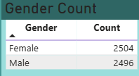
EDA – Univariate Analysis
Data Visualizations
Revenue Distribution
Total Revenue recorded: 1.21M.
Revenue values vary significantly across products and categories.
High Value items (e.g., Electronics) contribute disproportionately higher revenue.
Customer Gender Distribution
The dataset shows a nearly equal gender split, indicating balanced customer representation.

Slide 11
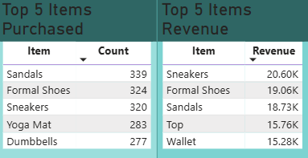
EDA – Univariate Analysis
Item-Level Distribution
Highest revenue items include:
Laptop
Mobile Phon
Headphones
Most frequently purchased items:
Sandals
Formal Shoes
Sneakers
Data Visualization

Slide 12
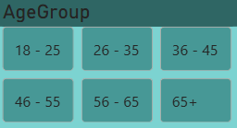

EDA – Univariate Analysis
Data Visualization
Age Group Distribution
Customers segmented into 6 age groups
Major purchasing activity observed in mid-age segments (18–45)
Senior age groups show relatively lower participation
Ratings Distribution
Overall Rating: 3.78 / 5
Ratings range approximately between 3.7 – 3.9
Indicates stable but moderate customer satisfaction

Slide 13
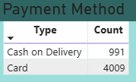
EDA – Univariate Analysis
Data Visualization
Payment Method Distribution
Card Payments dominate transactions (4,009)
Cash on Delivery accounts for a smaller share (991)
Reflects strong digital payment adoption

Slide 14
Results EDA – Univariate Analysis
Business revenue is concentrated rather than evenly distributed.
Category performance varies significantly.
High-value and high-volume products differ.
Customer base is demographically balanced.
Core customers fall within active earning age brackets.
Customer satisfaction is stable but moderate.
Strong preference for digital payments.

Slide 15
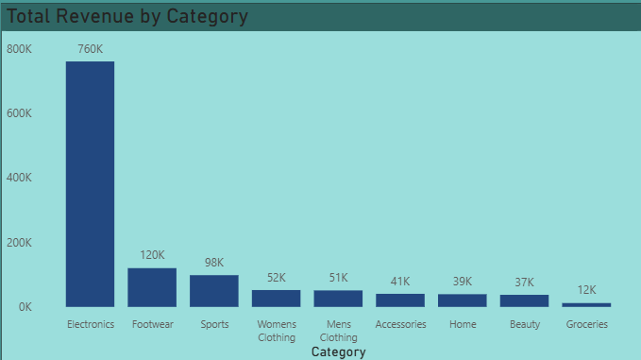
EDA – Bivariate Analysis
Revenue vs Category
Electronics generates the highest revenue among all categories.
Footwear and Sports contribute moderate revenue.
Beauty, Accessories, and Groceries show lower revenue impact.
Insight: Revenue is highly concentrated in specific product categories.
Data Visualization

Slide 16
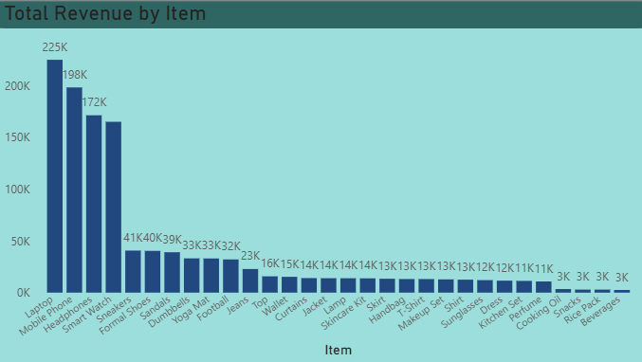
EDA – Bivariate Analysis
Revenue vs Item
High-value items such as Laptops and Mobile Phones generate maximum revenue.
Mid-range revenue items include Headphones and Smart Watches.
Lower-value items contribute smaller revenue shares.
Insight: Premium electronics drive revenue, while lifestyle items drive volume.
Data Visualization

Slide 17
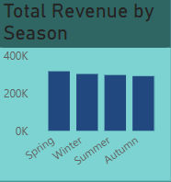
EDA – Bivariate Analysis
Revenue vs Season
Sales fluctuate across seasons.
Spring and Winter show relatively higher revenue peaks.
Summer and Autumn maintain moderate performance.
Insight: Seasonal demand impacts purchasing behavior and sales planning.
Data Visualization

Slide 18
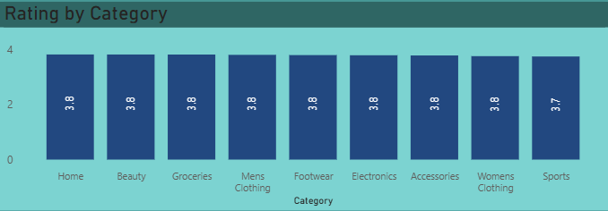
EDA – Bivariate Analysis
Category vs Rating
Ratings remain consistent (~3.7 – 3.9) across categories.
No category shows extremely high or low satisfaction.
Insight: Customer experience is stable but lacks standout excellence.
Data Visualization

Slide 19
Results EDA – Bivariate Analysis
Revenue is heavily concentrated in a few core categories.
Premium electronics drive business value.
Seasonal demand impacts revenue cycles.
Customer purchases are gender-balanced.
Customer experience is uniform across product lines.

Slide 20
Conclusions and Recommendations
Conclusions
The business generated strong overall revenue (1.21M) from a diverse base of 5,000 customers.
Revenue is highly concentrated in the Electronics category, making it the primary business driver.
High-value items such as Laptops and Mobile Phones contribute the largest share of sales value.
Footwear products show high purchase frequency, indicating strong demand in lifestyle segments.
Customer demographics are balanced, with nearly equal participation from Male and Female customers.
Seasonal sales fluctuations exist but remain relatively stable across the year.
Customer satisfaction levels are moderate (average rating ~3.78), indicating scope for service/product improvement.
Digital payments dominate transactions, reflecting customer preference for cashless purchasing.
Recommendations
Expand inventory and marketing investments in high-revenue categories like Electronics.
Introduce cross-selling and bundling strategies for footwear and fitness products to leverage high demand.
Improve low-performing categories through targeted promotions and pricing optimization.
Enhance customer experience initiatives to increase product ratings and loyalty.
Leverage seasonal sales insights for better demand forecasting and promotional planning.
Encourage digital payment adoption further through rewards and cashback programs.
Implement continuous KPI monitoring dashboards for real-time executive decision-making.

Slide 21
Thank You

