Slide 1

ABLE
Awareness & Assistance Portal
Awareness • Accessibility • Inclusion
Community Engagement Project
A centralized digital platform for disability awareness, accessible resource discovery, assistance requests and volunteer-driven community support.
Department of Computer Engineering
Modern College of Engineering, Shivajinagar, Pune
Final Presentation

Slide 2
1. Problem Statement
Why ABLE is needed
The Gap
Essential disability support is available, but it is scattered across schemes, offices, websites, NGOs and local networks. ABLE brings it together in one trusted place.
Information Fragmentation
Physical Barriers
Assistance Gap
Government schemes, accessibility data and rehabilitation resources are difficult to locate quickly.
PwDs may need verified ramps, entrances, parking and other accessible infrastructure details.
On-ground help exists in communities, but there is no simple digital dispatch and volunteer flow.
Need: a community-focused digital platform that connects awareness, verified accessibility information, support resources and participation.
Awareness
Accessibility
Support
Inclusion
ABLE – Awareness & Assistance Portal • 2/12

Slide 3
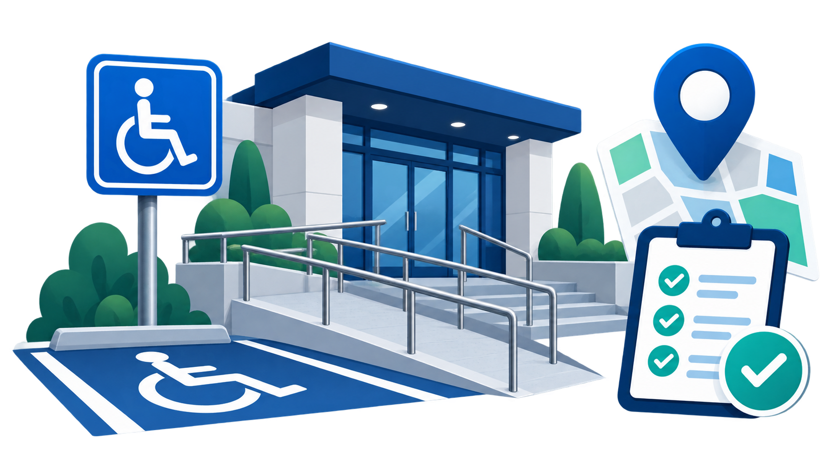
2. Proposed Solution
Centralized community ecosystem
ABLE is designed as a single portal where users can learn, discover resources, request help, report barriers and contribute through volunteering.
Learn
Locate
Awareness modules and disability etiquette.
Accessible facilities and public places.
Request
Report
Assistance flow for community help.
Feedback and barrier reporting.
Core Idea: Technology + verified information + volunteers = inclusive access for daily life.
ABLE – Awareness & Assistance Portal • 3/12

Slide 4
3. Project Objectives
What the portal aims to achieve
To architect and deploy a centralized digital ecosystem that bridges physical and informational accessibility gaps.
Bridge accessibility gaps
Empower independent access
Connect users with reliable information, support resources and community assistance.
Help users locate schemes, educational material and verified accessible spaces.
Mobilize local volunteers
Promote social inclusion
Enable NSS/student volunteers and community members to respond to assistance needs.
Educate the public and support inclusive participation through awareness campaigns.
ABLE focuses on practical, local and action-oriented community engagement.
ABLE – Awareness & Assistance Portal • 4/12

Slide 5
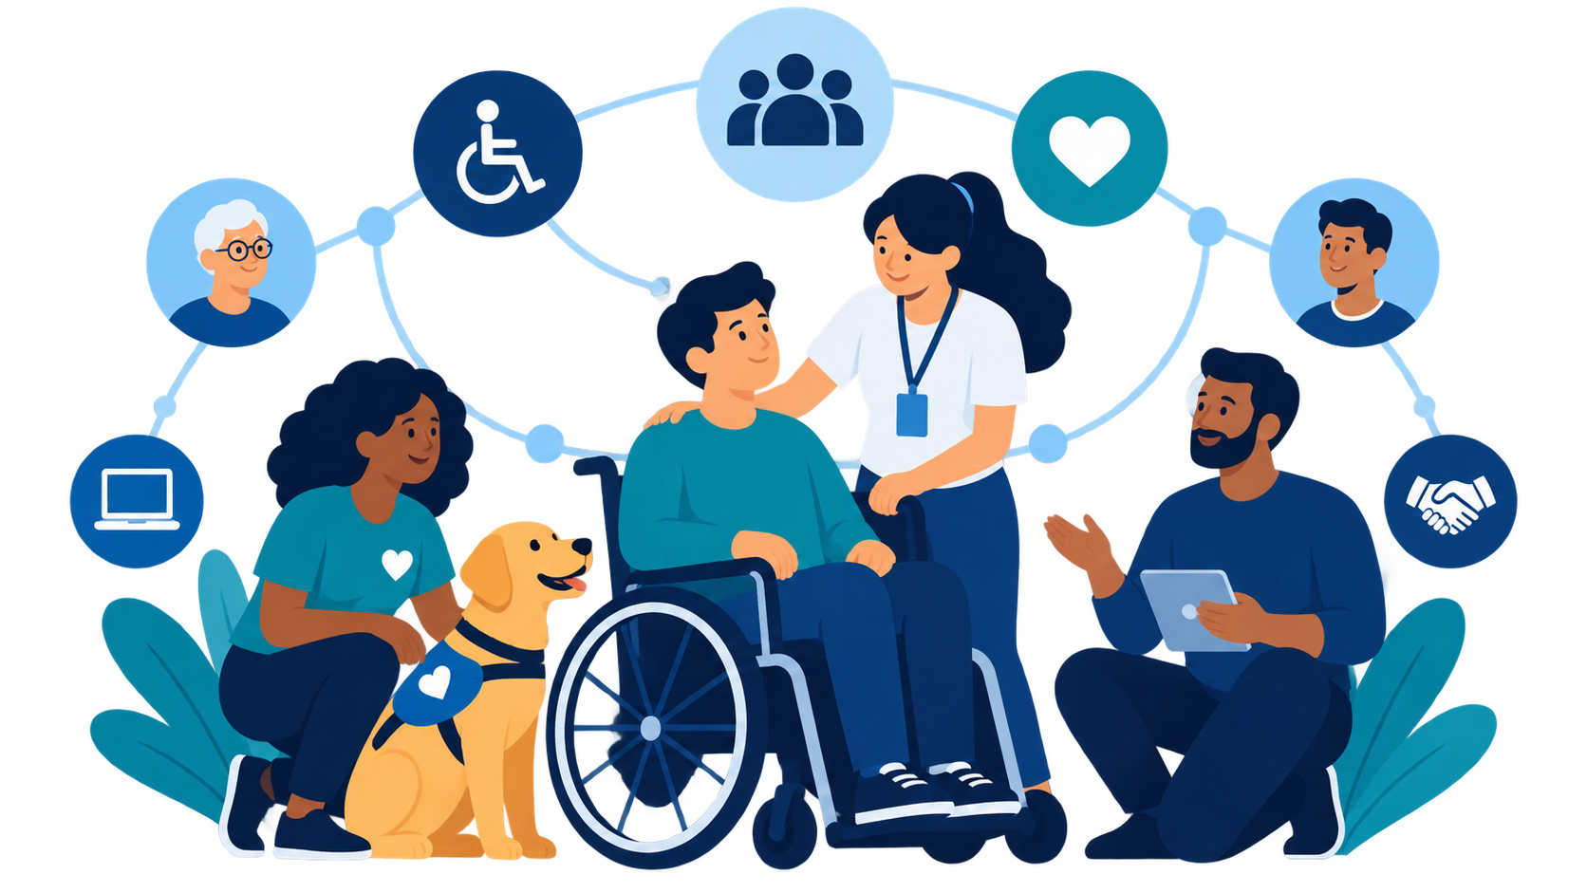
4. Target Users
Four user groups
Persons with Disabilities
Families & Caregivers
Volunteers
General Public
• Locate verified accessible facilities
• Request on-demand assistance
• Access schemes and resources
• Report local barriers
• Rehabilitation/support networks
• Specialized education resources
• Scheme navigation
• Community assistance programs
• Fulfill assistance requests
• Support awareness drives
• Help users facing barriers
• Contribute local skills
• Learn disability etiquette
• Understand access needs
• Report issues
• Join inclusion campaigns
ABLE – Awareness & Assistance Portal • 5/12

Slide 6
5. Website Structure
8 main sections/pages
01
Home
02
About Us
Clear introduction and quick access
Purpose, background and mission
03
Disability Awareness
04
Accessibility
Information across disability categories
Accessible places and facilities
05
Resources & Schemes
06
Assistance
Schemes, education and support resources
Request help from the community
07
Volunteer
08
Report / Feedback
Register and contribute
Report issues and share feedback
Simple navigation ensures every user reaches important services quickly.
ABLE – Awareness & Assistance Portal • 6/12

Slide 7
6. Key Website Features
What users can do
Home Page & Navigation
Quick Access Cards
Home | About | Awareness | Accessibility | Resources | Assistance | Volunteer | Report, with a prominent “Get Assistance” action.
Four high-priority actions: Accessibility, Resources, Get Assistance and Become a Volunteer.
Disability Awareness
Accessibility Around You
Simple cards explaining physical, visual, hearing and intellectual disabilities with etiquette guidelines.
Information about ramps, accessible entrances, designated parking and other verified access features.
Assistance Request Flow
Report & Feedback
Users can request local support, while volunteers can accept and fulfill assistance requests.
Users and the public can report barriers and provide feedback for continuous improvement.
The portal is designed to move users from information → action → community support.
ABLE – Awareness & Assistance Portal • 7/12

Slide 8
7. User Journey & Workflow
From need to support
01
02
03
04
05
User Need
ABLE Portal
Verification
Dispatch
Impact
Awareness, resource search, barrier report or assistance request
Guides user to the correct module with quick actions
Admin/volunteer reviews information and request context
Registered volunteers coordinate on-ground support
Barrier reported, assistance delivered and awareness improved
Every workflow is designed to convert a social accessibility need into a trackable, community-supported action.
ABLE – Awareness & Assistance Portal • 8/12

Slide 9
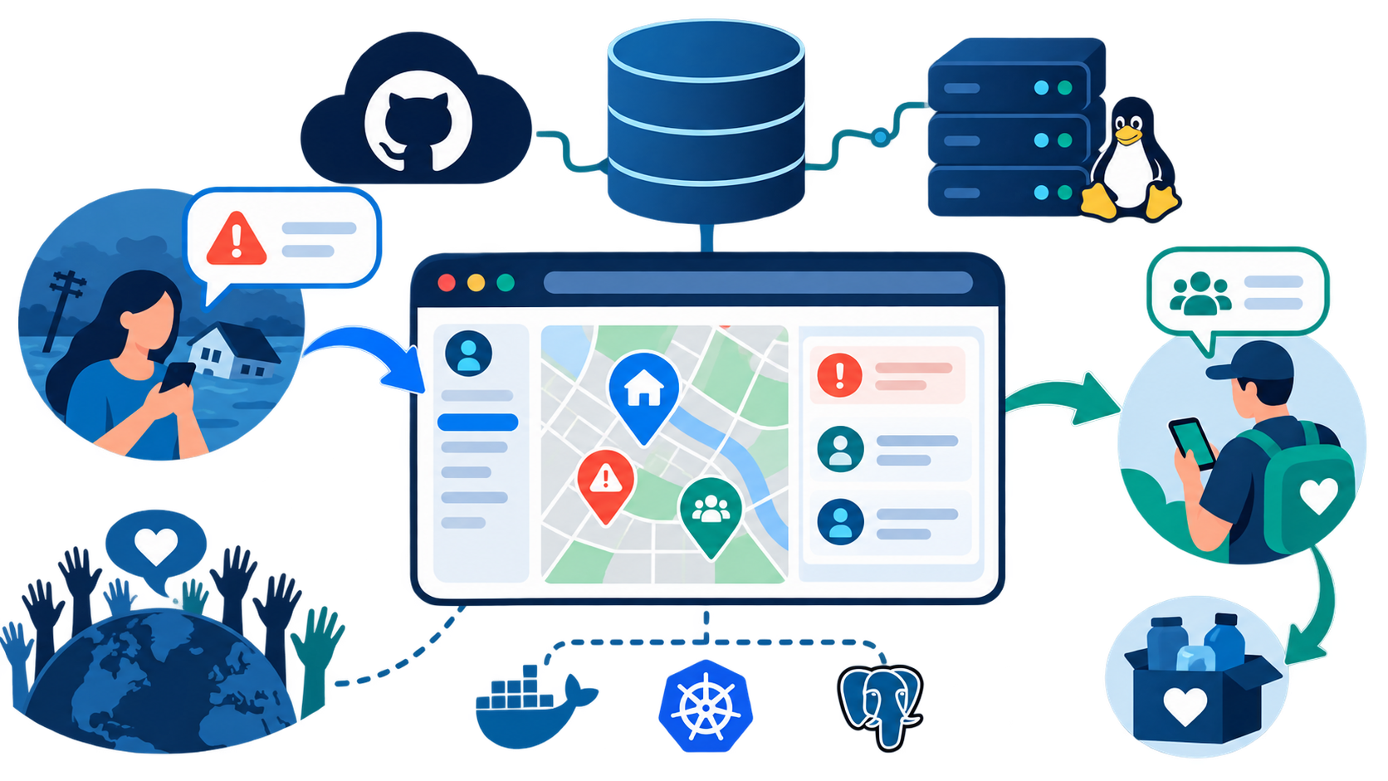
8. Technical Infrastructure & Resources
Zero-budget open-source plan
Technical Stack
Open-source Web Technologies
HTML5, CSS3 and JavaScript for development, designed to run on free institutional/open-source hosting.
Data & Field Tools
Official circulars, UDID/DEPwD resources and standardized accessibility survey checklists.
Administrative Clearances
College permission letters for authorised surveys in nearby transit and public spaces.
Budget Approach: lightweight web application + free tools + student volunteer network.
ABLE – Awareness & Assistance Portal • 9/12

Slide 10
9. Stakeholders & Community Engagement
Who makes ABLE effective
ABLE is not only a website — it is a coordinated community engagement model linking institutions, verified sources and volunteers.
College Support
Permissions and mentoring for authorised accessibility surveys and community work.
Stakeholder Partners
Community Users
ABLE Portal
PMC Social Welfare Department, NGOs and special educators validate schemes and content.
PwDs, caregivers and public use, report, request and improve local accessibility.
Central platform for mapping, awareness, assistance and reports.
NSS / Volunteers
Student volunteers provide on-ground assistance and audit support.
Partnerships keep content verified. Volunteers convert requests into real-world support.
ABLE – Awareness & Assistance Portal • 10/12

Slide 11
10. Expected Outcomes & Impact
Building inclusion
ABLE helps transform fragmented support into simple, visible and actionable community access.
Reliable accessibility directory
Faster assistance dispatch
Crowdsourced and verified public infrastructure details reduce physical barriers.
Urgent accessibility needs are linked to registered volunteers for on-ground support.
Centralized resources
Public inclusion tools
Schemes, education materials and rehabilitation networks become easier to navigate.
Awareness education and audit tools help society normalize inclusive behavior.
ABLE – Awareness & Assistance Portal • 11/12

Slide 12
Thank You
ABLE – Awareness & Assistance Portal
Awareness • Accessibility • Inclusion
Mission
To promote equal opportunities, accessibility and inclusion through information, technology and community participation.
Prepared by: Sanjivani S. Adagale • Vaishnavi S. Angadi • Amol T. Daund • Sarthak B. Gite
Department of Computer Engineering | Modern College of Engineering, Pune
Community Engagement Project

