Slide 1
01 • PROJECT OVERVIEW
Introduction & The Idea
ABLE is an accessibility and inclusion platform designed to help persons with disabilities, the elderly, and injured citizens connect with verified volunteers, report physical barriers, and navigate public spaces with dignity and independence.
The idea is to bring emergency assistance, volunteer dispatch, crowdsourced physical barrier reporting, and verified accessible public transit resources together in one clear, easy-to-navigate experience.
GOAL: MAKE ACCESSIBLE SUPPORT & VOLUNTEERING EASIER TO ACCESS
01 On-Demand Assistance
————————————————————————————
Quick access to verified student & NSS volunteers for immediate on-ground physical guidance and wheelchair navigation.
02 Barrier Reporting
————————————————————————————
Geo-tagged reporting of physical infrastructure barriers like broken ramps, blocked tactile tiles, and out-of-order lifts.
03 Directory & Resources
————————————————————————————
Curated directory of accessible public spots, inclusive transit maps, legal rights awareness, and assistive schemes.
ABLE Platform • Awareness & Assistance
ABLE • 02

Slide 2
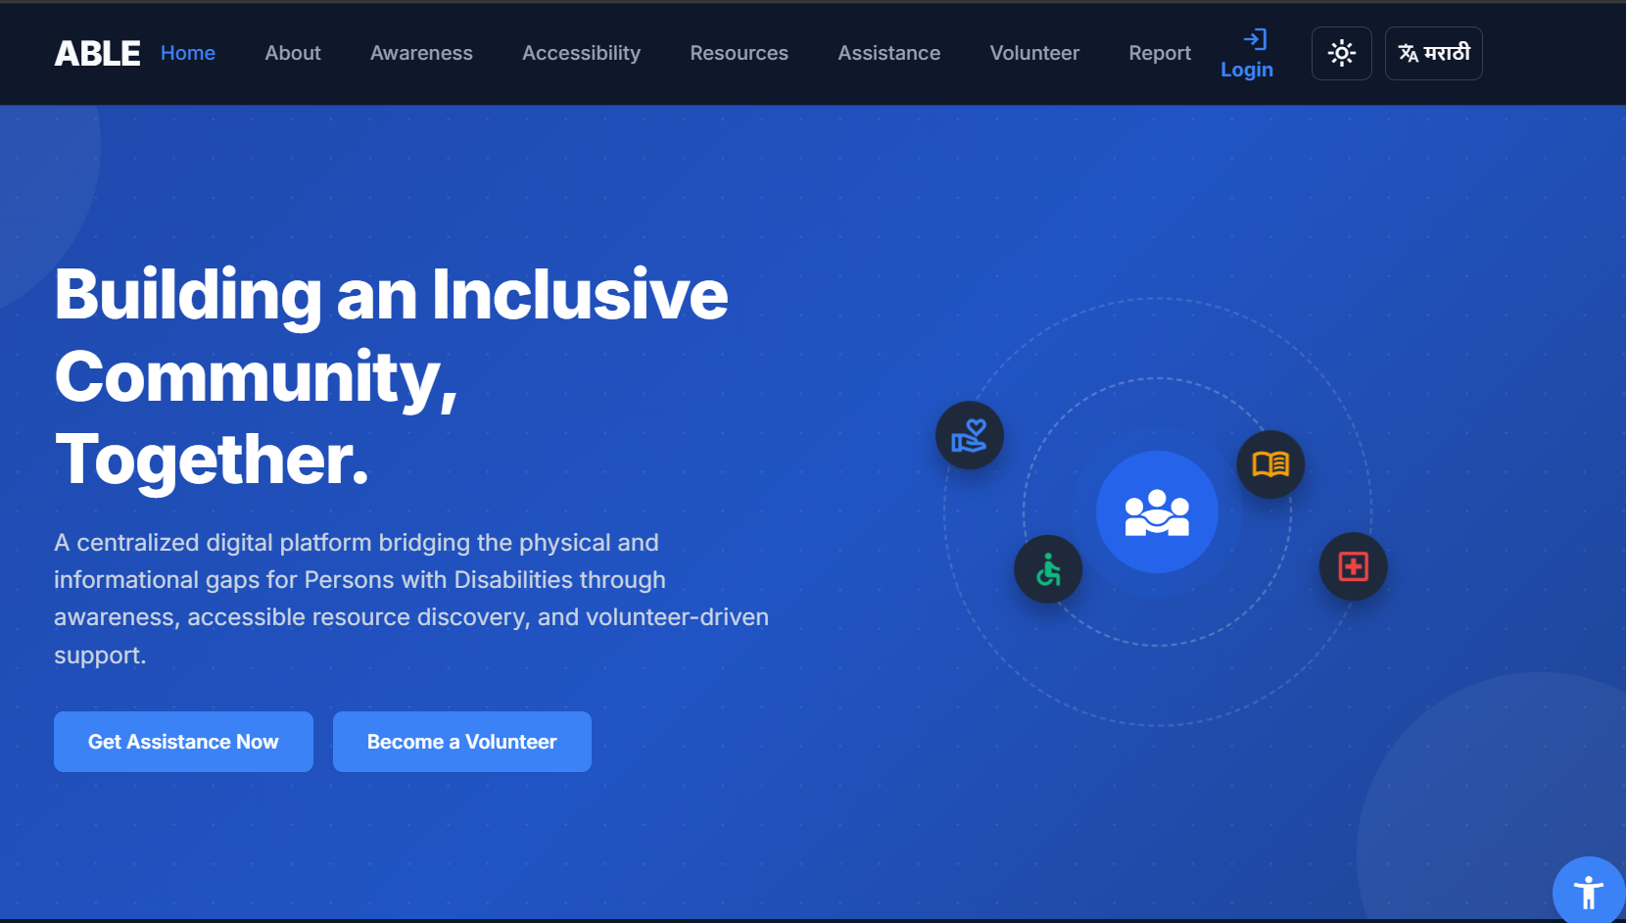
02 • USER-FACING DESIGN
Prototype: Home Screen Concept
PROTOTYPE FOCUS
• Simple navigation and prominent, high-contrast primary actions
• Clear pathways to physical assistance, barrier reporting, and accessible facilities
• Mobile-friendly, responsive layout adhering strictly to WCAG touch standards (44px+)
• Short, accessible labels paired with assistive screen-reader and voice support
• Guides users toward a clear, friction-free next step with zero cognitive overload
• Live volunteer dispatcher with Leaflet.js interactive maps and verified NSS student profiles
Live production interface — ABLE Accessibility & Inclusion Platform.
ABLE Platform • User-Facing Design
ABLE • 08

