Slide 1
RGB, CMY, YIQ, HSV

Slide 2
RGB Color Model
Used in light emitting devices
Color CRT monitors
Additive
Result = individual contributions of each primary color added together
C = rR + gG + bB, where r, g, b ∈ [0, 1]
R = (1, 0, 0)
G = (0, 1, 0)
B = (0, 0, 1)

Slide 3
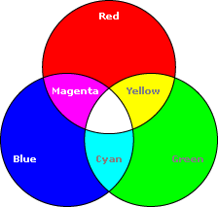
RGB Color Model

Slide 4
RGB Color Model
Color Cube
R + G = (1, 0, 0) + (0, 1, 0) = (1, 1, 0) = Y
R + B = (1, 0, 0) + (0, 0, 1) = (1, 0, 1) = M
B + G = (0, 0, 1) + (0, 1, 0) = (0, 1, 1) = C
R + G + B = (1, 1, 1) = W
1 – W = (0, 0, 0) = BLK
Grays = (x, x, x), where x ∈ (0, 1)

Slide 5
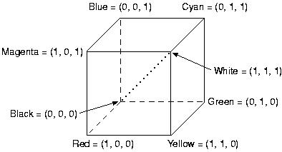
RGB Color Cube

Slide 6
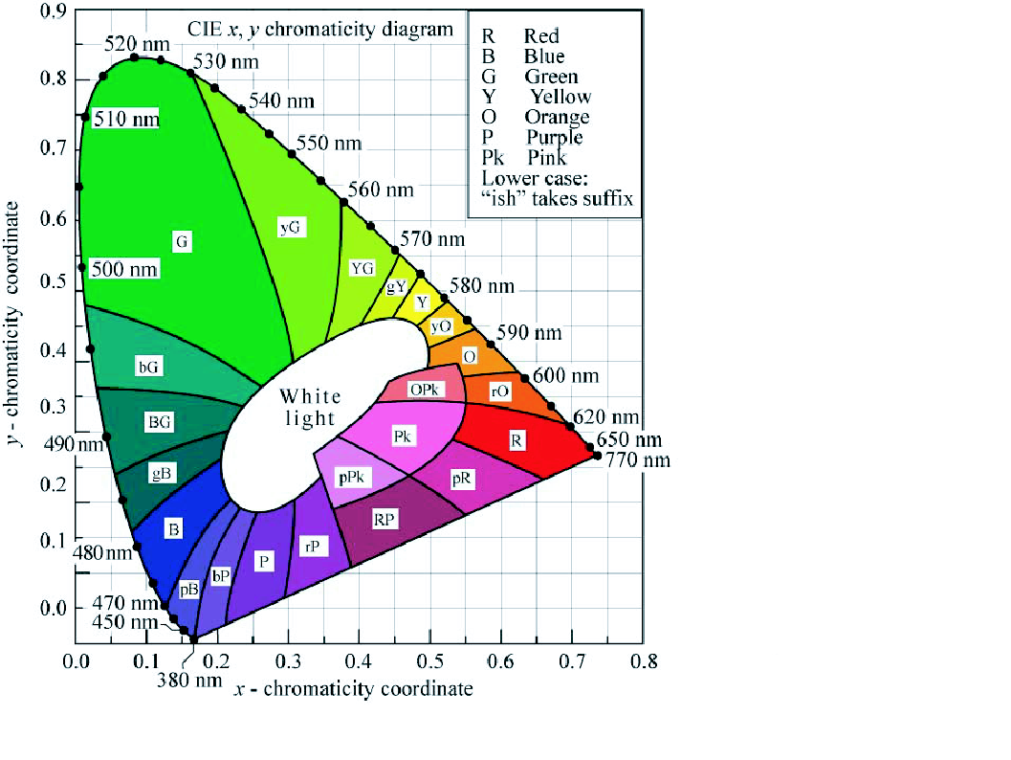
CIE xyY Color Cone

Slide 7
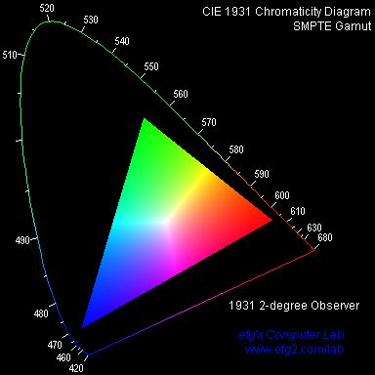
CIE xyY Typical Display Gamut

Slide 8
YIQ model
TV broadcast.
separate chrominance (I and Q) from luminance (Y).
The Y-channel contains luminance
while the I and Q channels carried the color
Notes:
I >> In-Phase
Q >> In-Quadrature

Slide 9
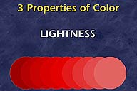
Brightness/Luminance(Y)
Lightness or brightness refers to the amount of light the color reflects or transmits.
intensity is determined by the actual amount of light, with more light corresponding to more intense colors ( the total light across all frequencies).

Slide 10
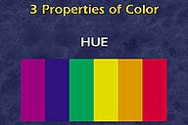
HUE/Dominant Wavelength(I)
The hue is determined by the dominant wavelength.(the apparent color of the light)
.
When we call an object "red," we are referring to its hue. Hue is determined by the dominant wavelength.

Slide 11
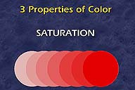
Saturation/Purity(Q)
The saturation of a color ranges from neutral to brilliant. The circle on the right is a more vivid red than the circle on the left although both have the same hue.
The saturation is determined by the excitation purity , and depends on the amount of white light mixed with the hue.

Slide 12
YIQ
Conversion from RGB:

Slide 13
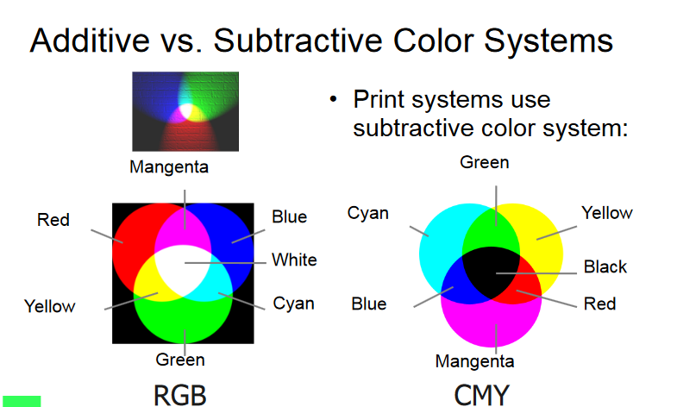

Slide 14
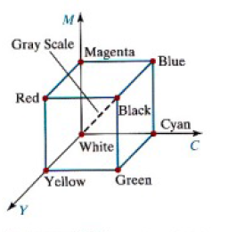
CMY

Slide 15



Slide 16
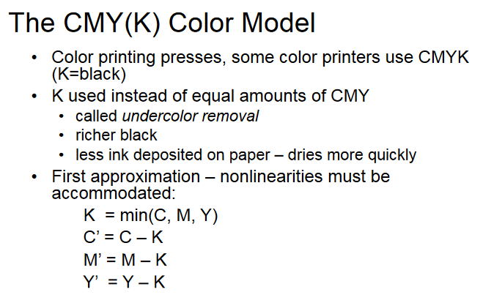

Slide 17
HSV
Hue, saturation, value (brightness)
Hexcone subset of cylindrical (polar) coordinate system
Single hexcone HSV color model.
(The V = 1 plane contains the RGB model’s
R = 1, G = 1, B = 1, in the regions shown):

Slide 18
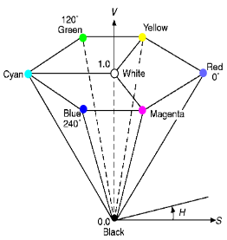

Slide 19
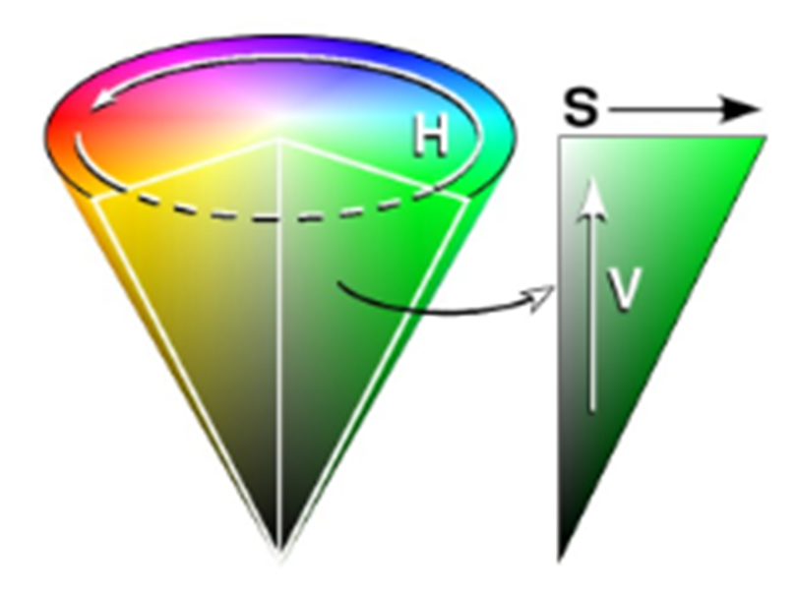
HSV

Slide 20
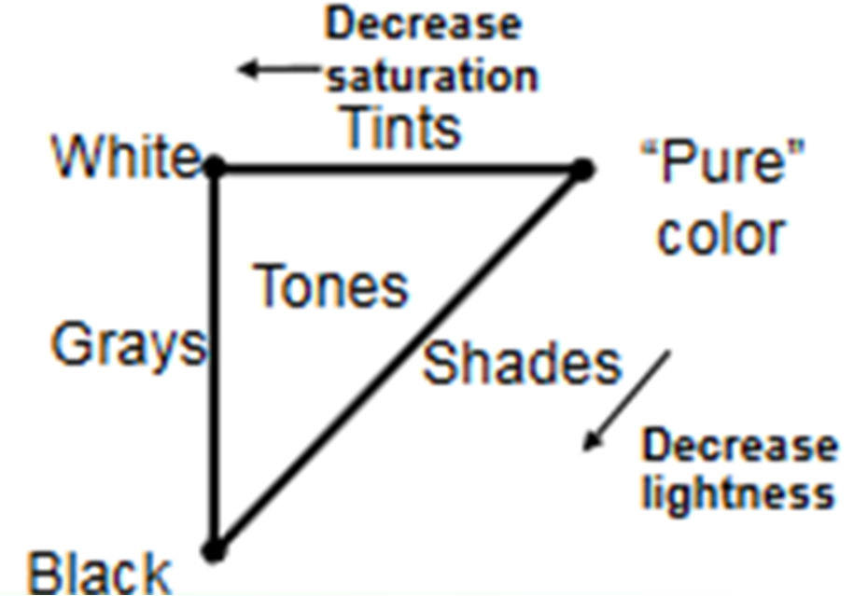
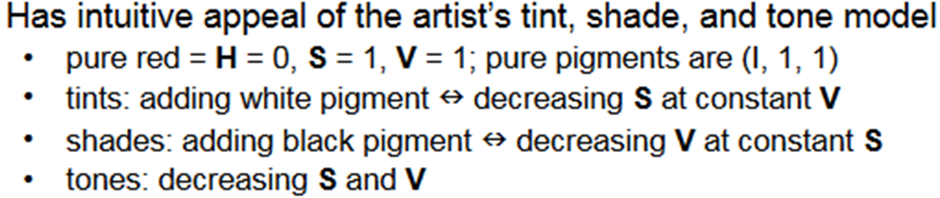

Slide 21
HSV
Eye can See
about 128 different hues, and
about 130 different saturations.
The number of values varies
between 16 (blue) and 23 (yellow)

Slide 22
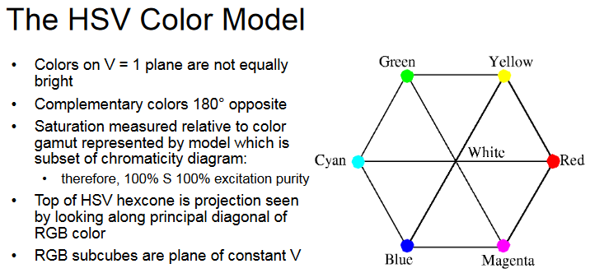

Slide 23
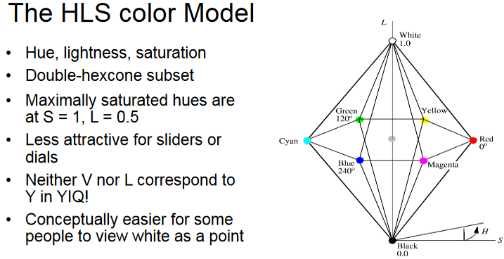

Slide 24
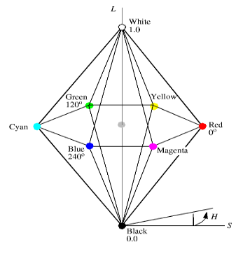

Slide 25
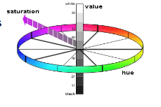

Slide 26
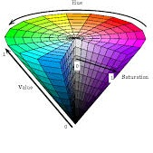
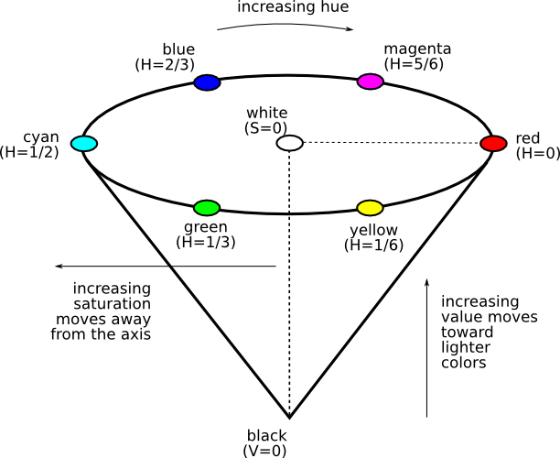
HSV Model
Every color is represented by three components Hue ( H ), Saturation ( S ) and Value ( V )
Notes:
Changing the saturation parameter corresponds to adding or subtracting white and changing the value parameter corresponds to adding or subtracting black.

Slide 27
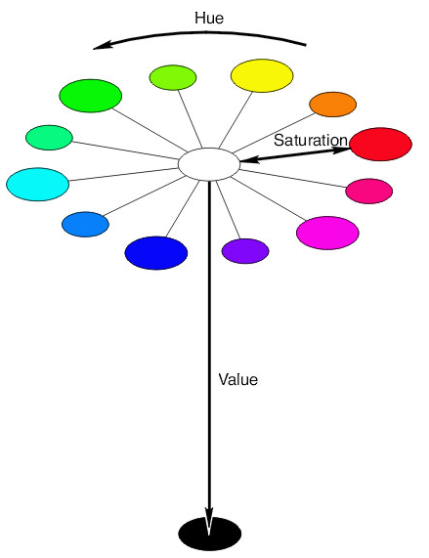
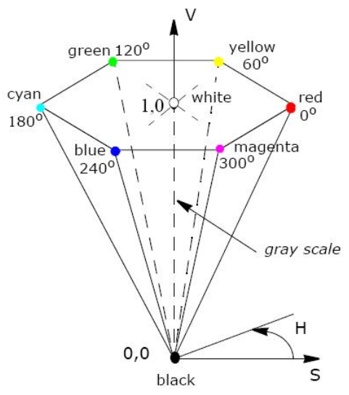
HSV Model
The Hue (H) of a color refers to which pure color it resembles. All tints, tones and shades of red have the same hue. (simply the color we see)

Slide 28
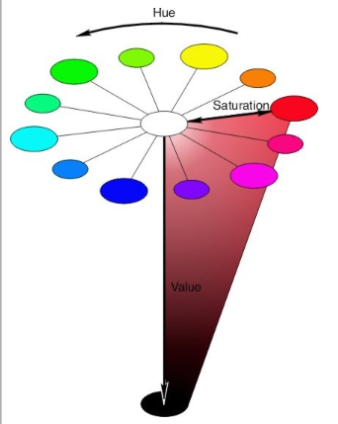
HSV Model
The Saturation (S) of a color describes how white the color is. Or the amount of white added to the color. A pure red is fully saturated (S=1) means no white added

Slide 29
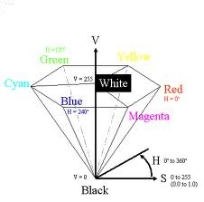
HSV Model
The Value (V) of a color, also called its lightness, describes how dark the color is. A value of 0 is black, with increasing lightness moving away from black.

Slide 30
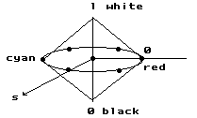
HLS Color Model
Double cones
white
pure
color
h
black

Slide 31
Color Models Applications
Color Model Application Area | Color Model Application Area
RGB | Computer graphics Image processing Image Analysis Image Storage
CMY(K) | Printing
HSV, HSL | Human visual perception Computer graphics processing Computer Vision Image Analysis Design image Human vision Image editing software Video editor
YIQ | TV broadcasting Video system

