Slide 1
AWS CloudFormation

Slide 2
AWS CloudFormation
Simplify infrastructure management
AWS service to automate Infrastructure
Used as IaC (Infrastructure as a Code)
Reliable way to keep Infrastructure in sync
Provide easy way to modify / update infrastructure
Easily control and track changes to your infrastructure

Slide 3
Cloudformation
Templates
An AWS CloudFormation template is a JSON or YAML formatted text file. AWS CloudFormation uses these templates as blueprints for building your AWS resources.
Stacks
When you use AWS CloudFormation, you manage related resources as a single unit called a stack. You create, update, and delete a collection of resources by creating, updating, and deleting stacks. All the resources in a stack are defined by the stack's AWS CloudFormation template.
Change Sets
If you need to make changes to the running resources in a stack, you update the stack. Before making changes to your resources, you can generate a change set, which is a summary of your proposed changes.

Slide 4
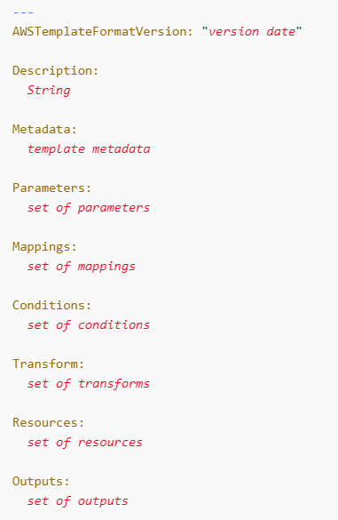
Format Version (optional) The AWS CloudFormation template version that the template conforms to. The template format version is not the same as the API or WSDL version. The template format version can change independently of the API and WSDL versions. Description (optional) A text string that describes the template. This section must always follow the template format version section. Metadata (optional) Objects that provide additional information about the template. Parameters (optional) Values to pass to your template at runtime (when you create or update a stack). You can refer to parameters from the Resources and Outputs sections of the template. Mappings (optional) A mapping of keys and associated values that you can use to specify conditional parameter values, similar to a lookup table. You can match a key to a corresponding value by using the Fn::FindInMap intrinsic function in the Resources and Outputs sections. Conditions (optional) Conditions that control whether certain resources are created or whether certain resource properties are assigned a value during stack creation or update. For example, you could conditionally create a resource that depends on whether the stack is for a production or test environment. Transform (optional) For serverless applications (also referred to as Lambda-based applications), specifies the version of the AWS Serverless Application Model (AWS SAM) to use. When you specify a transform, you can use AWS SAM syntax to declare resources in your template. The model defines the syntax that you can use and how it is processed. You can also use AWS::Include transforms to work with template snippets that are stored separately from the main AWS CloudFormation template. You can store your snippet files in an Amazon S3 bucket and then reuse the functions across multiple templates. Resources (required) Specifies the stack resources and their properties, such as an Amazon Elastic Compute Cloud instance or an Amazon Simple Storage Service bucket. You can refer to resources in the Resources and Outputs sections of the template. Outputs (optional) Describes the values that are returned whenever you view your stack's properties. For example, you can declare an output for an S3 bucket name and then call the aws cloudformation describe-stacks AWS CLI command to view the name.

Slide 5
Fn::Base64
The intrinsic function Fn::Base64 returns the Base64 representation of the input string. This function is typically used to pass encoded data to Amazon EC2 instances by way of the UserData property.
Fn::Cidr
The intrinsic function Fn::Cidr returns an array of CIDR address blocks. The number of CIDR blocks returned is dependent on the count parameter.
Condition functions
You can use intrinsic functions, such as Fn::If, Fn::Equals, and Fn::Not, to conditionally create stack resources. These conditions are evaluated based on input parameters that you declare when you create or update a stack.
Fn::FindInMap
The intrinsic function Fn::FindInMap returns the value corresponding to keys in a two-level map that is declared in the Mappings section.
Fn::GetAtt
The Fn::GetAtt intrinsic function returns the value of an attribute from a resource in the template.
Fn::GetAZs
The intrinsic function Fn::GetAZs returns an array that lists Availability Zones for a specified region in alaphabetical order.
Fn::ImportValue
The intrinsic function Fn::ImportValue returns the value of an output exported by another stack. You typically use this function to create cross-stack references
.

Slide 6
Fn::Join
The intrinsic function Fn::Join appends a set of values into a single value, separated by the specified delimiter. If a delimiter is the empty string, the set of values are concatenated with no delimiter.
Fn::Select
The intrinsic function Fn::Select returns a single object from a list of objects by index.
Fn::Split
To split a string into a list of string values so that you can select an element from the resulting string list, use the Fn::Split intrinsic function. Specify the location of splits with a delimiter, such as , (a comma).
Fn::Sub
The intrinsic function Fn::Sub substitutes variables in an input string with values that you specify. In your templates, you can use this function to construct commands or outputs that include values that aren't available until you create or update a stack.
Fn::Transform
The intrinsic function Fn::Transform specifies a macro to perform custom processing on part of a stack template. Macros enable you to perform custom processing on templates, from simple actions like find-and-replace operations to extensive transformations of entire templates.
Ref
The intrinsic function Ref returns the value of the specified parameter or resource.

