Slide 1


Slide 2
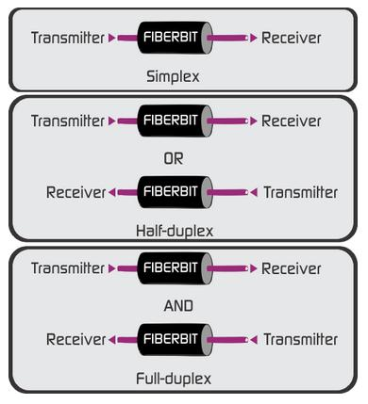
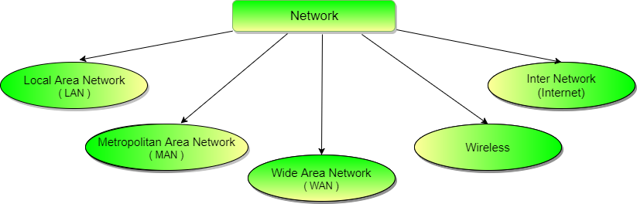
Network and Communication Types
Network Types Communication Types

Slide 3
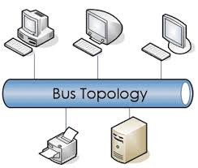
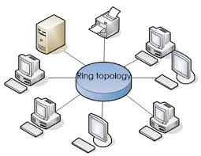
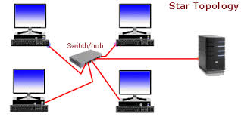
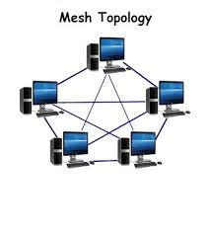
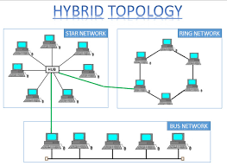
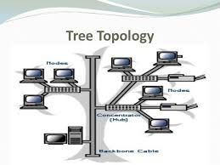
Network Topologies

Slide 4
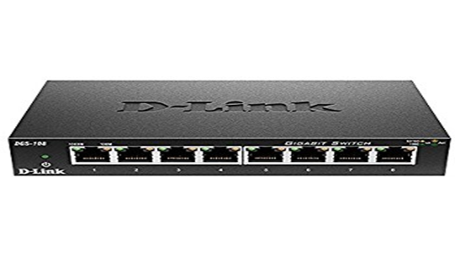
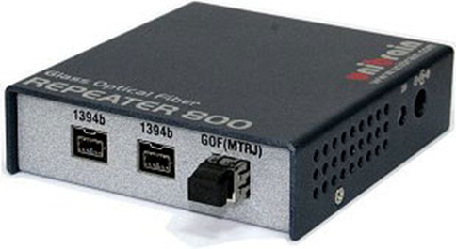
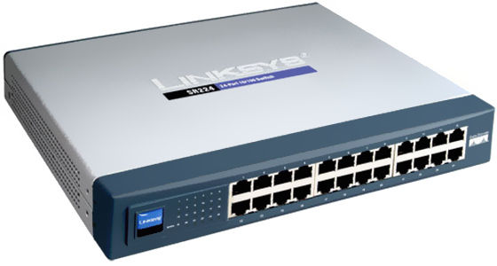
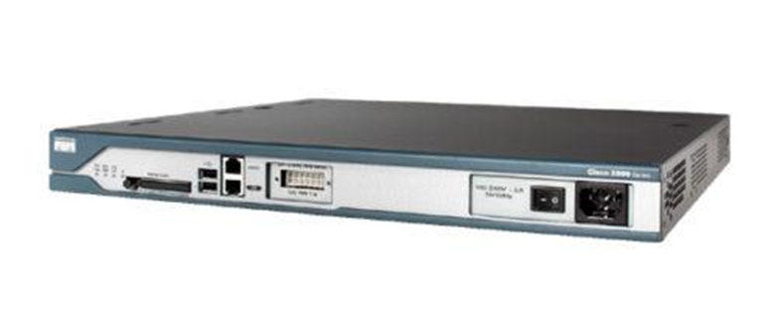
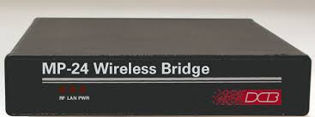
Network Devices
Switch
Repeaters
Hub
Router
Bridge

Slide 5
OSI Model
Networks processes to applications
7
Application
6
Presentation
Data representation
5
Session
Inter host communication
Transport
End-to-end connections
4
Network
Addresses and best path
3
2
Data Link
Access to media
1
Physical
Binary Transmission

Slide 6
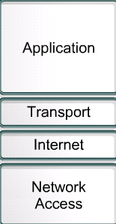
TCP/IP Model
Handles issues of representation, encoding, and dialog control
Handles quality of service issues of reliability, flow control, and error correction.
Divides TCP segments into packets and send them from any network. Best path determination and packet switching
a.k.a host-to-network layer, concerned with all of the components, both physical and logical, that are required to make a physical link.

Slide 7
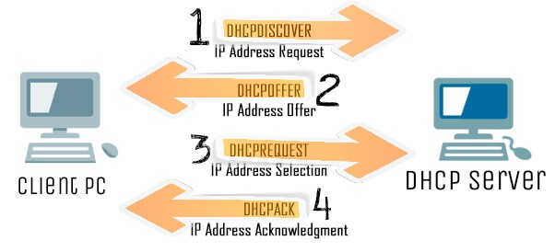
Dynamic Host Configuration Protocol
Logical Address
DHCP Process
ARP
Physical Address
Logical Address
RARP
Physical Address

Slide 8
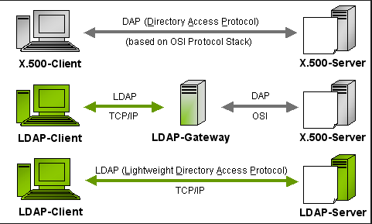
Directory Services
LDAP is an application protocol for querying and modifying items in directory service providers like Active Directory, which supports a form of LDAP.

Slide 9
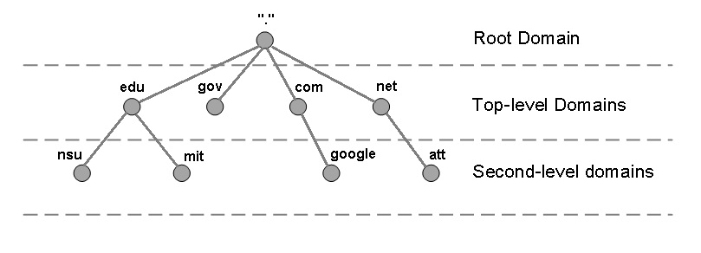

Domain Name Server (DNS)
Translates a domain name into corresponding IP address
DNS Hierarchy
74.125.225.74
192.168.1.2
DNS Query
Recursive Query
Iterative Query
DNS Records
A / AAAA
CNAME
PTR

Slide 10
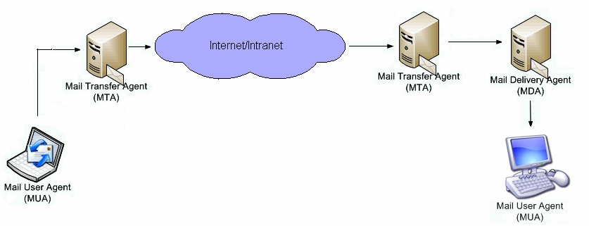
Mail Services

Slide 11
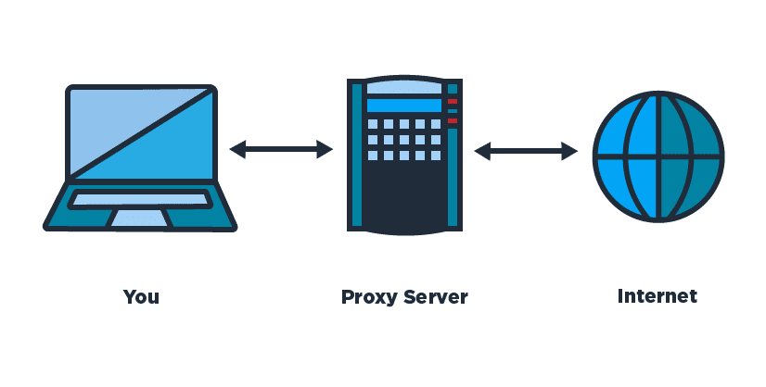
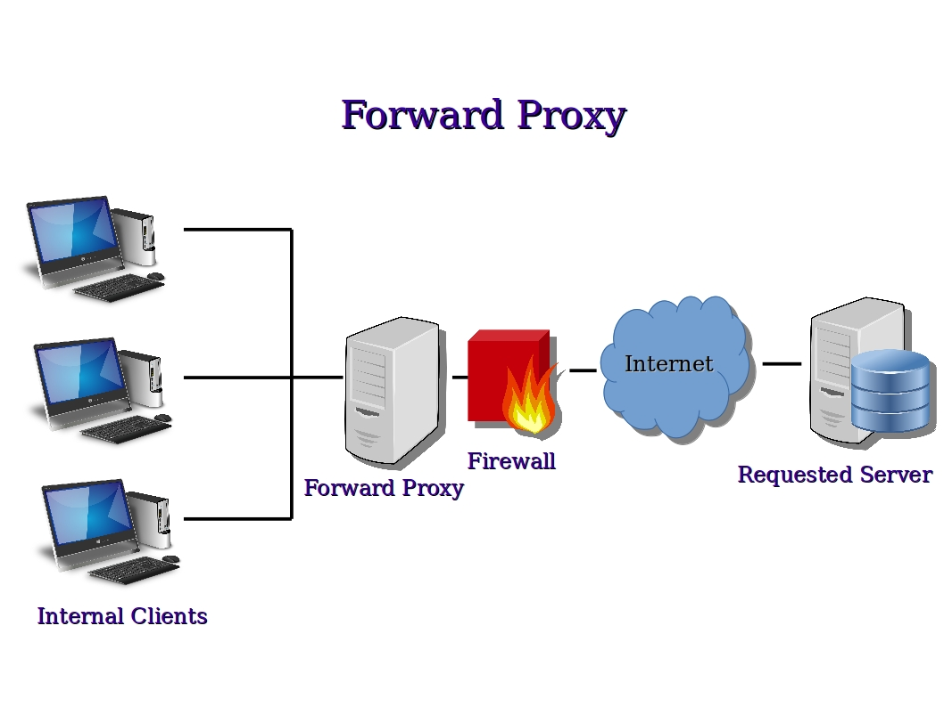
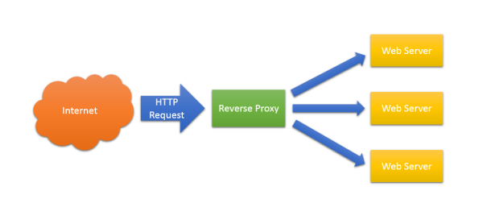
Proxy
Acts as an intermediary between the user's computer and the Internet
Types of Proxy :
Reverse Proxy

