Slide 1
ENTERPRISE APPLICATION
GROUP 6
4/5/2018

Slide 2
GROUP MEMBERS
Bindhu shree -093941
Nandhini -094605
Amol Hadkar -093942
Gaurav mayekar -093955
Raj Subash B -093964

Slide 3
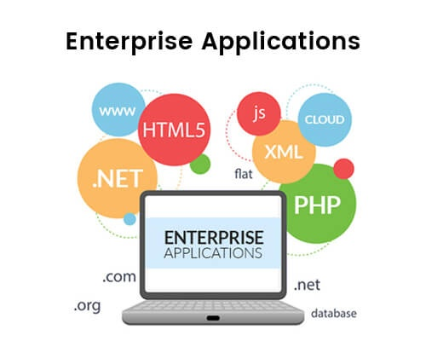
ENTERPRISE APPLICATION

Slide 4
COMMON TYPES OF ENTERPRISE APPLICATIONS
Automated billing systems
Payment processing
Customer relationship management
Enterprise messaging system
Email marketing system

Slide 5
ENTERPRISE ARCHITECTURE
An enterprise architecture includes principles, policies and standards (akin to building codes) that ensure that systems are soundly constructed.
An enterprises architecture is divided into four architecture domains.
Business architecture,
Data architecture,
Applications architecture.
Technology architecture.

Slide 6
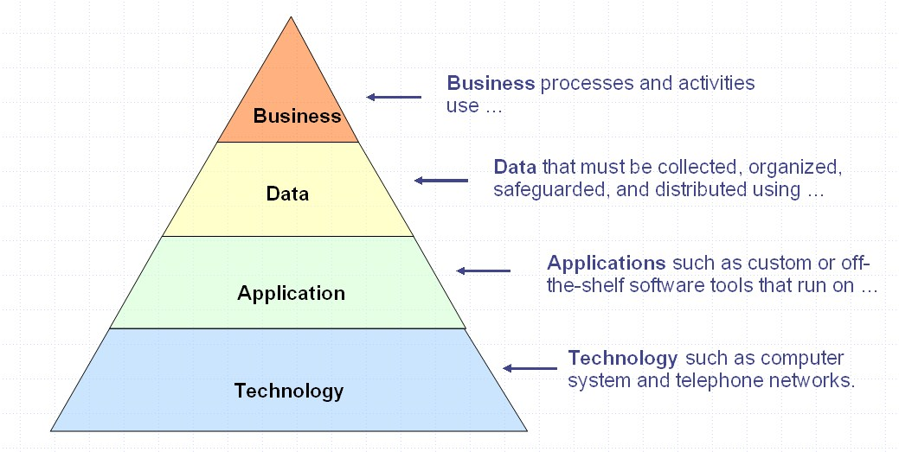
ENTERPRISE ARCHITECTURE

Slide 7
PATTERN
What is pattern?
Each pattern describes a problem that occurs over and over again in our environment and then describes the core of the solution to that problem in such a way that you can use this solution million times.

Slide 8
TYPES OF PATTERNS
Domain Logic Patterns
Data Source Architectural Patterns
Object-Relational Behavioral Patterns
Object-Relational Structural Patterns
Object-Relational Metadata Mapping Patterns
Distribution Patterns
Offline Concurrency Patterns
Session State Patterns
Base Patterns

Slide 9
THANK YOU

