Slide 1
SNMP
Simple Network Management Protocol is a popular protocol for network management.
It is used for collection information from and configuring, network devices such as servers, printers, hubs, switches, and routers on an Internet Protocol network.
Microsoft Windows Server 2003 provides SNMP agent software that works with third-party SNMP management software to monitor the status of managed devices and applications.

Slide 2
SNMP basic components and their functionalities
SNMP consists of
SNMP Manager
Managed devices
SNMP agent
Management Information Database Otherwise called as Management Information Base (MIB)

Slide 3
SNMP Manager:
A manager or management system is a separate entity that is responsible to communicate with the SNMP agent implemented network devices. This is typically a computer that is used to run one or more network management systems.
SNMP Manager’s key functions
Queries agents
Gets responses from agents
Sets variables in agents
Acknowledges asynchronous events from agents

Slide 4
Managed Devices:
A managed device or the network element is a part of the network that requires some form of monitoring and management e.g. routers, switches, servers, workstations, printers, UPSs, etc...

Slide 5
SNMP Agent:
The agent is a program that is packaged within the network element. Enabling the agent allows it to collect the management information database from the device locally and makes it available to the SNMP manager, when it is queried for. These agents could be standard (e.g. Net-SNMP) or specific to a vendor (e.g. HP insight agent)
SNMP agent’s key functions
Collects management information about its local environment
Stores and retrieves management information as defined in the MIB.
Signals an event to the manager.
Acts as a proxy for some non–SNMP manageable network node.

Slide 6
Management Information Database or Management Information Base (MIB)
Every SNMP agent maintains an information database describing the managed device parameters.
The SNMP manager uses this database to request the agent for specific information and further translates the information as needed for the Network Management System (NMS).
This commonly shared database between the Agent and the Manager is called Management Information Base (MIB).

Slide 7
SIP
Session Initiation Protocol (SIP) is one of the most common protocols used in VoIP technology.
It is an application layer protocol that works in conjunction with other application layer protocols to control multimedia communication sessions over the Internet.

Slide 8
SIP Network Agent
There are some entities that help SIP in creating its network. In SIP, every network element is identified by a SIP URI (Uniform Resource Identifier) which is like an address. Following are the network elements −
User Agent
Proxy Server
Registrar Server
Redirect Server
Location Server

Slide 9
User Agent
It is the endpoint and one of the most important network elements of a SIP network. An endpoint can initiate, modify, or terminate a session. User agents are the most intelligent device or network element of a SIP network. It could be a softphone, a mobile, or a laptop.
User agents are logically divided into two parts −
User Agent Client (UAC) − The entity that sends a request and receives a response.
User Agent Server (UAS) − The entity that receives a request and sends a response.

Slide 10
Proxy Server
It is the network element that takes a request from a user agent and forwards it to another user.
There are two types of proxy servers −
Stateless Proxy Server − It simply forwards the message received. This type of server does not store any information of a call or a transaction.
Stateful Proxy Server − This type of proxy server keeps track of every request and response received and can use it in future if required. It can retransmit the request, if there is no response from the other side in time.

Slide 11
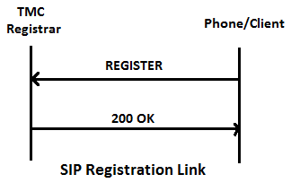
Registrar Server
The registrar server accepts registration requests from user agents. It helps users to authenticate themselves within the network. It stores the URI and the location of users in a database to help other SIP servers within the same domain.

Slide 12
Redirect Server
The redirect server receives requests and looks up the intended recipient of the request in the location database created by the registrar.
The redirect server uses the database for getting location information and responds with 3xx (Redirect response) to the user.

Slide 13
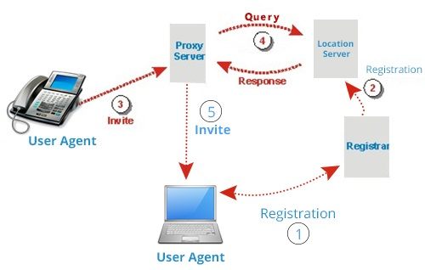
Location Server
The location server provides information about a caller's possible locations to the redirect and proxy servers.

Slide 14
SIP Methods
OPTIONS
Queries a participant about their media capabilities, and finds them, but doesn’t invite
ACK
For reliability and call acceptance
REGISTER
Informs a SIP server about the location of a user
INVITE
Invites a participant to a session
idempotent - reINVITEs for session modification
BYE
Ends a client’s participation in a session
CANCEL
Terminates a search

Slide 15
TLS
Transport layer security (TLS) is a protocol that provides communication security between client/server applications that communicate with each other over the Internet. It enables privacy, integrity and protection for the data that's transmitted between different nodes on the Internet. TLS is a successor to the secure socket layer (SSL) protocol.

Slide 16
Sub Protocols
TLS protocol consists of two different layers of sub-protocols:
TLS Handshake Protocol: Enables the client and server to authenticate each other and select a encryption algorithm prior to sending the data
TLS Record Protocol: It works on top of the standard TCP protocol to ensure that the created connection is secure and reliable. It also provides data encapsulation and data encryption services

