Slide 1
MOTHERBOARD

Slide 2
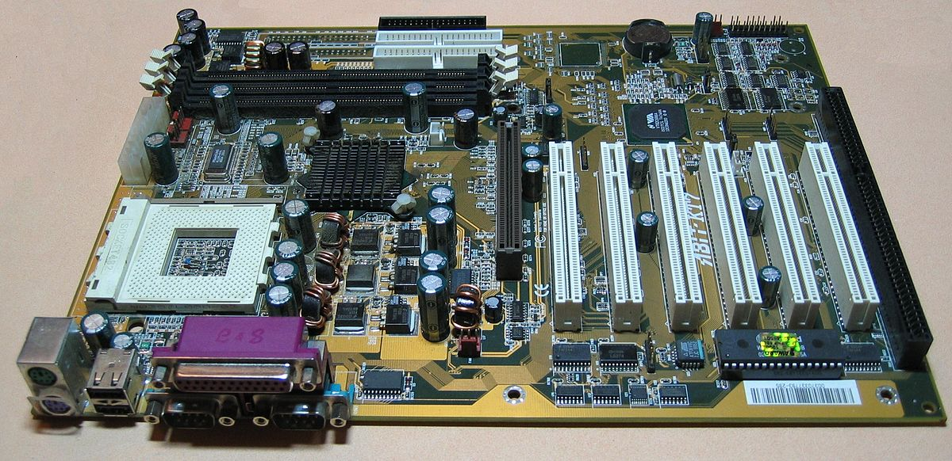

Slide 3
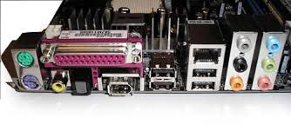
Input/Output Ports
Generally, input and output ports are placed at the very side (back) of computer chassis. In particular, the I/O ports is built to connect the monitor, speakers, a microphone, an Ethernet networking cable and multiple USB devices. At the same time, sometimes you can see the connection with the legacy devices. For example, parallel ports which work with the older printers.

Slide 4
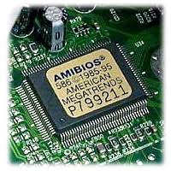
BIOS
BIOS is the short form of “Basic Input Output System.” BIOS is the components of Motherboard, and it is positioned as the Integrated Chip. Important to realize, BIOS contains all the information and settings of the motherboard, and you can update or modify the setting from the BIOS mode.

Slide 5
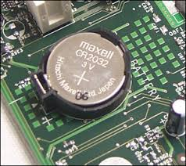
CMOS Battery
“Complementary Metal Oxide Semi-Conductor” is abbreviated as CMOS. It is a battery or cell which is featured with 3.0 Volts lithium type cell. The work of CMOS Battery is – it helps to store or keep the information in the BIOS mode.

Slide 6
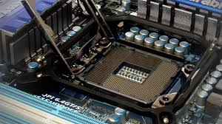
CPU Socket
CPU socket helps to install the processor into the Motherboard. That means the CPU connects to the socket for connecting to the motherboard. On the bottom of the motherboard, the socket carries hundreds of metal connectors for the metal pins or balls. It helps to supply the power to the processor. At the same time, it transports the data among the other parts/components of the computer. You can’t update the computer’s processor without being the same socket types.

Slide 7
TYPES OF CPU SOCKETS
i) Socket7:
ii) Socket370:
iii) Socket 775:
iv) Socket 1156:
v) Socket 1366:

Slide 8
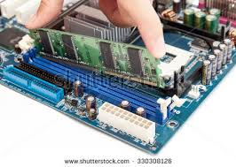
RAM (Memory) Slots
For installing RAM modules, a motherboard may have more than one slots, and it is positioned near the CPU socket. In general, RAM is most needed parts of the motherboard and it refers to Random Access Memory. It is the temporary memory of the computer, but it helps to run the applications and opening the files. Particularly, if the processors have a large amount of RAM, it can operate the computer more smoothly and surely it helps to increase the performance of the computer.

Slide 9
TYPES OF RAM SLOTS
SIMM slot
DIMM slot
RIMM slot

Slide 10
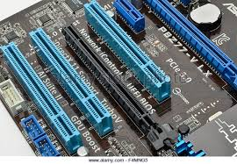
Expansion Card Slots
When you need to add new components to the motherboard or if you want to update any parts of the motherboard, a motherboard’s expansion card slots allow you do that. An expansion card slots help to add external devices to display. For example, a video card needs to connect to the monitor to display the video or 3D or rendering the graphics. Here, expansion card slots can do it. For this reason, it is positioned on the line of the back side of the motherboard.

Slide 11
TYPES OF Expansion Card Slots
i) ISA slots
ii) PCI Slots
iii) PCI Express
iv) AGP slot

Slide 12
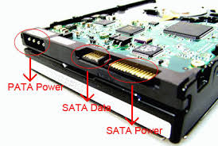
Storage Device Connectors
A computer needs some other types of storage devices to store the data or performing efficiently including hard drives, optical drives, and floppy drives. As it needs to connect to the motherboard, here has the cable which is compatible with the motherboard to transfer the data. In the motherboard, you will find at least two storage device connectors to fulfill the needs of storage components on the computer.

Slide 13
Power Connectors
A Motherboard needs the power to keep running and it gets the power from SMPS. There are connectors to keep the process going on.
i) AT connector: It is one of the connectors which is found on the oldest motherboard and it has 2 number of 6 pin male connectors to make the supplying process.
ii) ATX connector: These types of the connector is found on the latest forms of the motherboard. It consists 20 or 24 pin female connectors and it is considered as the latest power connectors.

Slide 14
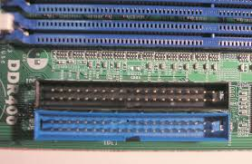
IDE connector
IDE is the short form of “Integrated Drive Electronics” and it is used to connect the disk drives including floppy disk drives and HDD (Hard Disk Drives). Here you will find 40-pin male connector that connects HDD. At the same time, the 34-pin male connector that connects the FDD.

Slide 15
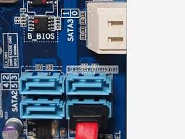
SATA connector
SATA is the abbreviation of “Serial Advanced Technology Attachment.” Important to realize, it is the latest connectors with 7-pin interface. It is used to connect the SATA hard disks or optical drives. It is faster and better than the IDE Connector.

Slide 16
Co-Processor
One of vital parts or components of the motherboard is Co-Processors. It is used to perform mathematical calculations and computer graphics with the main processors.

Slide 17
Cabinet connections
It is the place where the motherboard is installed. It contains many buttons to connect the cabinet with the motherboard. Mostly used cabinet connectors are Power Switch, Reset Switch, Front USB, Front Audio, Power indicator(LED) and HDD LED.

Slide 18
Some other parts/Components of Motherboard and their Functions:

Slide 19
Chipset-North Bridge (CNB)
It is an integrated circuit with two chipsets and performs some particular task.

Slide 20
Firewire header (IEEE 1394)
It is the serial bus which is used to transfer digital and audio data.

Slide 21
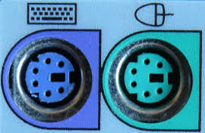
PS/2 Connectors
It is the very common connects and all the motherboard contains two of it’s for connecting the keyboard and mouse.

Slide 22
USB (Universal Serial Bus) Port:
USB port is located on every motherboard for connecting external devices or storages including pen drive or audio jack.

Slide 23
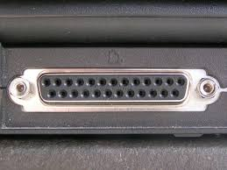
Parallel or (LPT) Port
The port helps to connect the scanners and printers.

Slide 24
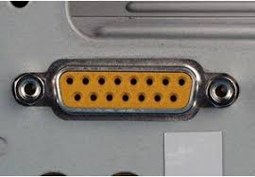
Game Port
The port is used to connect all the gaming devices, for example, a joystick.

Slide 25
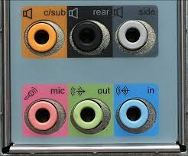
Sound Card Connectors
For connecting audio devices including speakers or headphone this sound card connectors are used.

Slide 26
Display Connector
It helps to connect the monitor to the motherboard.

Slide 27
COM (Communication) Port
This device has been built to connect different devices including mouse, modem.

Slide 28
THANK YOU

