Slide 1

CCNA Guide to Cisco Networking Fundamentals
Fourth Edition
Chapter 9
Network Services

Slide 2
Objectives
Understand the purpose and operation of network address translation (NAT)
Understand and configure static NAT, dynamic NAT, and PAT
Understand and configure Dynamic Host Configuration Protocol (DHCP)
Understand and configure Domain Name Services (DNS)
Configure network services using Cisco’s Security Device Manager (SDM)
CCNA Guide to Cisco Networking Fundamentals, Fourth Edition

Slide 3
Network Address Translation
Network address translation (NAT)
  Defined in RFC 3022
    Describes methods for connecting private (internal) IP addresses to the Internet
NAT uses a one-to-one mapping or one-to-many mapping method
  To allow one or more private IP clients to gain access to the Internet by mapping the private IP addresses to public IP addresses
CCNA Guide to Cisco Networking Fundamentals, Fourth Edition

Slide 4
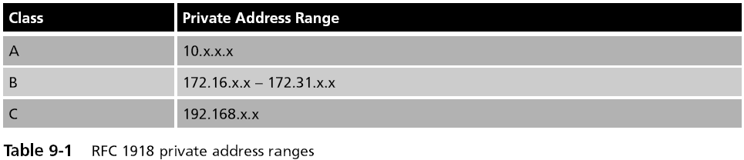
Network Address Translation (continued)
CCNA Guide to Cisco Networking Fundamentals, Fourth Edition

Slide 5
Network Address Translation (continued)
Advantages
  Conserves public IP addresses
  Hides your internal IP addressing scheme from the outside world, greatly enhancing network security
  Allows for easy renumbering of your IP addresses
Disadvantages
  Introduces a small amount of delay into your network
    Because the NAT router has to create and maintain the NAT table
  End-to-end IP traceability is lost
  Some applications fail due to NAT
CCNA Guide to Cisco Networking Fundamentals, Fourth Edition

Slide 6
Network Address Translation (continued)
NAT is available in three forms:
  Static NAT
  Dynamic NAT
  Port address translation (PAT)
CCNA Guide to Cisco Networking Fundamentals, Fourth Edition

Slide 7
Static NAT
Static NAT
  The simplest form of NAT
  A single private IP address is mapped to a single public IP address
NAT router must maintain a table in memory
  Table maps internal IP addresses to addresses presented to the Internet
CCNA Guide to Cisco Networking Fundamentals, Fourth Edition

Slide 8
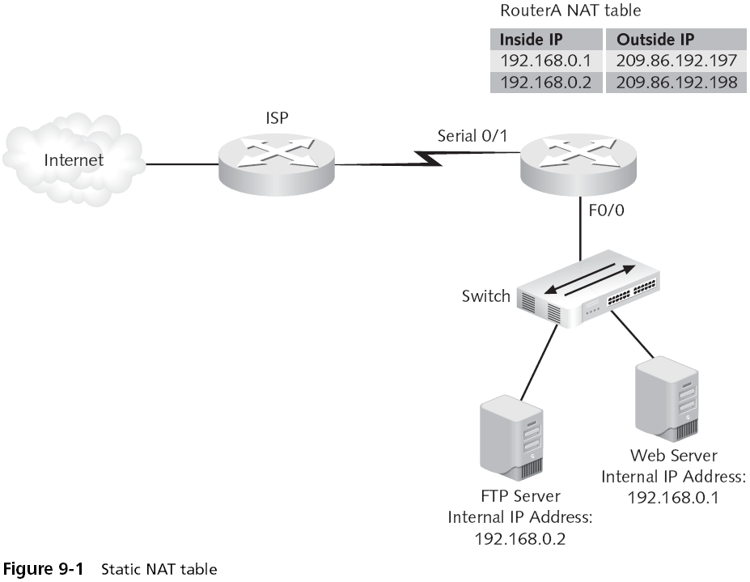
CCNA Guide to Cisco Networking Fundamentals, Fourth Edition

Slide 9
Static NAT (continued)
The network configuration for NAT is quite simple in a small network
  The NAT router will be the default gateway for all clients
In a larger network, the NAT router might be one of many routers
  Routers would have to be configured to use the NAT router for Internet communications
NAT should be configured on the border router of a large network
CCNA Guide to Cisco Networking Fundamentals, Fourth Edition

Slide 10
Dynamic NAT
Dynamic NAT
  The NAT router automatically maps a group of valid local IP addresses to a group of Internet IP addresses, as needed
The network administrator is not concerned about which IP address the internal clients use
Any private IP address will automatically be translated to one of the available Internet IP addresses by the NAT router
  Addresses for dynamic NAT are pulled out of a predefined pool of public addresses
CCNA Guide to Cisco Networking Fundamentals, Fourth Edition

Slide 11
Port Address Translation
Port address translation (PAT)
  Also known as overloading
  Is a special form of dynamic NAT
  Allows multiple internal, private IP addresses to use a single external registered address
To differentiate between the connections, PAT uses multiple public TCP and UDP ports
  To create unique sockets that map to internal IP addresses
CCNA Guide to Cisco Networking Fundamentals, Fourth Edition

Slide 12
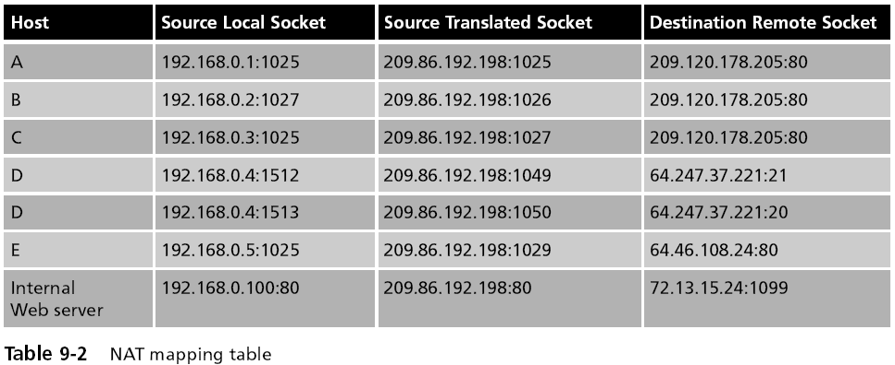
Port Address Translation (continued)
CCNA Guide to Cisco Networking Fundamentals, Fourth Edition

Slide 13
Port Address Translation (continued)
The NAT server uses port forwarding
  To send connections from external clients to the Web server on the internal network
Overlapping
  Occurs when:
    The internal network has been incorrectly configured for an IP range that actually exists on the Internet or
    Two companies merge and each company was using the same private IP address range
  Can be solved using NAT because NAT hides the incorrectly configured internal IP scheme
CCNA Guide to Cisco Networking Fundamentals, Fourth Edition

Slide 14
Configuring Network Address Translation
You can configure NAT as static NAT, dynamic NAT, or PAT
CCNA Guide to Cisco Networking Fundamentals, Fourth Edition

Slide 15
Configuring Static NAT
Configuring static NAT is a two-step process:
  Define the static mapping between the inside address and the outside address
  Define the NAT router’s interfaces as inside or outside
The static mapping is defined with the following command:
  ip nat inside source static [inside ip] [outside ip]
CCNA Guide to Cisco Networking Fundamentals, Fourth Edition

Slide 16
Configuring Dynamic NAT
Steps:
  Configure a standard access control list to define what internal traffic will be translated
  Define a pool of addresses to be used for dynamic NAT allocation
  Link the access list to the NAT pool
  Define interfaces as either inside or outside
To define the standard access list, you must use the following syntax:
  RouterA(config)#access-list [1-99] permit [inside IP network(s)] [wildcard mask]
CCNA Guide to Cisco Networking Fundamentals, Fourth Edition

Slide 17
Configuring Dynamic NAT (continued)
The syntax for defining the NAT pool is:
  ip nat pool [pool name] [start ip] [end ip] netmask [netmask]
The pool must then be linked to the access list with the following command:
  ip nat inside source list [access list number] pool [pool name]
Finally, you must define the interfaces as either inside or outside
CCNA Guide to Cisco Networking Fundamentals, Fourth Edition

Slide 18
Configuring Dynamic NAT (continued)
Steps for configuring PAT:
  Configure a standard access list to define what internal traffic will be translated
  Link the access list to the interface to be used for PAT
  Define interfaces as either inside or outside
CCNA Guide to Cisco Networking Fundamentals, Fourth Edition

Slide 19
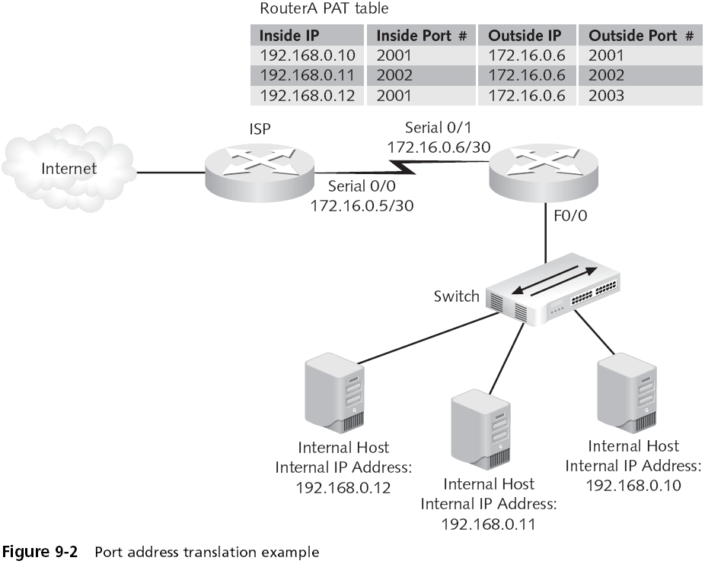
CCNA Guide to Cisco Networking Fundamentals, Fourth Edition

Slide 20
Domain Name Service
Domain Name Service (DNS)
  A popular and important naming service
  Based on the client/server model, DNS translates names into IP addresses
Use the ip host command to manually provide name resolution on a Cisco router
Lookup
  By default, a Cisco router will try several times to find an IP address for a name if you enter one
CCNA Guide to Cisco Networking Fundamentals, Fourth Edition

Slide 21
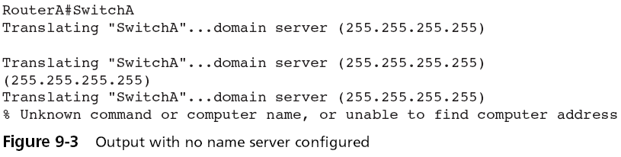
Domain Name Service (continued)
CCNA Guide to Cisco Networking Fundamentals, Fourth Edition

Slide 22
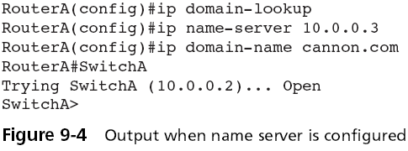
Domain Name Service (continued)
Configuring DNS Lookup
  The command to configure a DNS lookup on a Cisco router is ip name-server
    The ip domain-lookup command enables DNS if it has previously been disabled
CCNA Guide to Cisco Networking Fundamentals, Fourth Edition

Slide 23
Dynamic Host Configuration Protocol
Dynamic Host Configuration Protocol (DHCP)
  Provides IP configuration information to hosts on bootup
  This functionality is much like that provided by older protocols RARP and BOOTP
  DHCP manages addressing by leasing the IP information to the hosts
  This leasing allows the information to be recovered when not in use and reallocated when needed
CCNA Guide to Cisco Networking Fundamentals, Fourth Edition

Slide 24
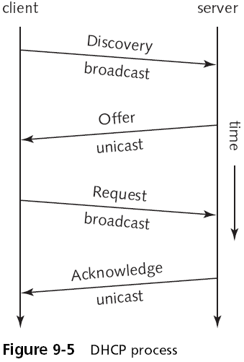
Dynamic Host Configuration Protocol (continued)
CCNA Guide to Cisco Networking Fundamentals, Fourth Edition

Slide 25
Dynamic Host Configuration Protocol (continued)
You can configure your Cisco router to be a DHCP server
DHCP relay
  The router can forward the request to other DHCP servers if it cannot satisfy a DHCP request
Configuring the router to be a DHCP server
  Enable the service using the service dhcp command at the global configuration mode prompt
  Configure DHCP bindings and decide where to store the DHCP bindings database
CCNA Guide to Cisco Networking Fundamentals, Fourth Edition

Slide 26
Dynamic Host Configuration Protocol (continued)
Configuring the router to be a DHCP server (continued)
  Define the pool of addresses
  Configure any optional IP configuration parameters
  Exclude any statically configured addresses
Monitoring DHCP
  The best way to check the bindings is to execute the show ip dhcp binding command on the router
  For information on the specific DHCP address pool, use the show ip dhcp pool command
CCNA Guide to Cisco Networking Fundamentals, Fourth Edition

Slide 27
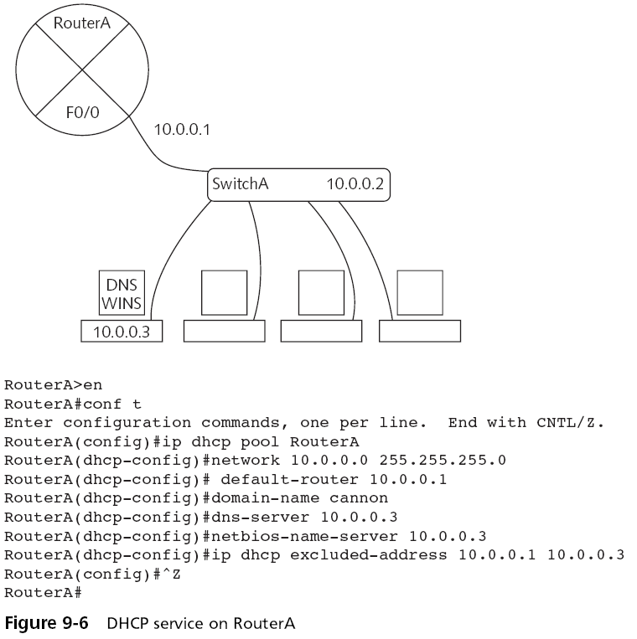
CCNA Guide to Cisco Networking Fundamentals, Fourth Edition

Slide 28
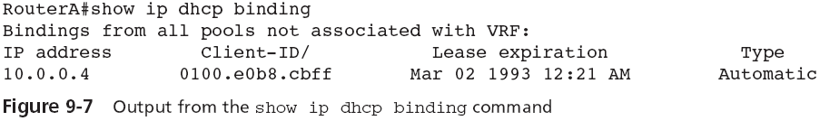
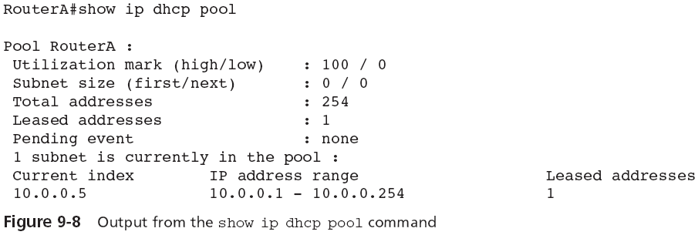
Dynamic Host Configuration Protocol (continued)
CCNA Guide to Cisco Networking Fundamentals, Fourth Edition

Slide 29
Security Device Manager
Cisco’s new Security Device Manager (SDM)
  Web-based tool for advanced configuration on Cisco routers
  SDM can be used to configure the NAT, DNS, and DHCP services
These services are relatively easy to configure using the command-line interface
CCNA Guide to Cisco Networking Fundamentals, Fourth Edition

Slide 30
Security Device Manager (continued)
Using SDM to Configure NAT
  Using SDM to configure static NAT
    See Figure 9-9
  Using SDM to configure dynamic NAT
    See Figures 9-10 and 9-11
  Using SDM to configure PAT
    See Figure 9-12
CCNA Guide to Cisco Networking Fundamentals, Fourth Edition

Slide 31
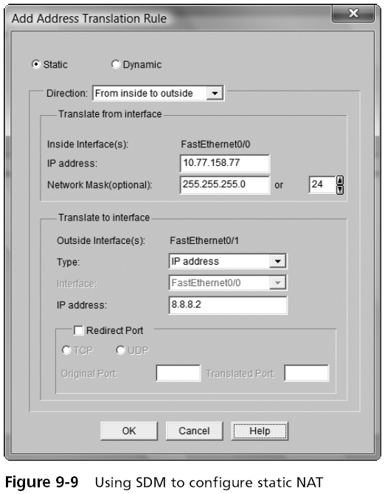
CCNA Guide to Cisco Networking Fundamentals, Fourth Edition

Slide 32
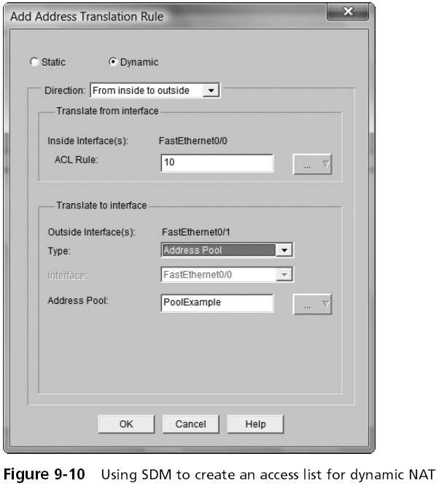
CCNA Guide to Cisco Networking Fundamentals, Fourth Edition

Slide 33
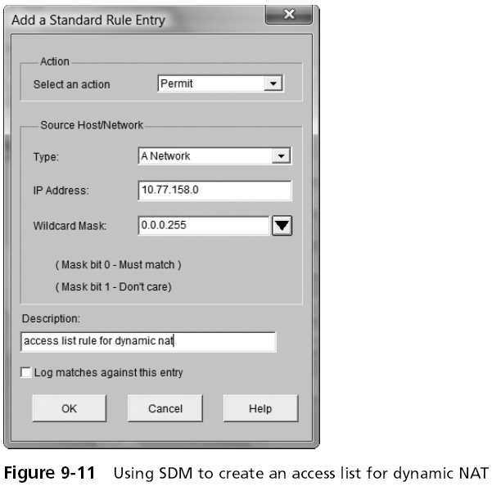
CCNA Guide to Cisco Networking Fundamentals, Fourth Edition

Slide 34
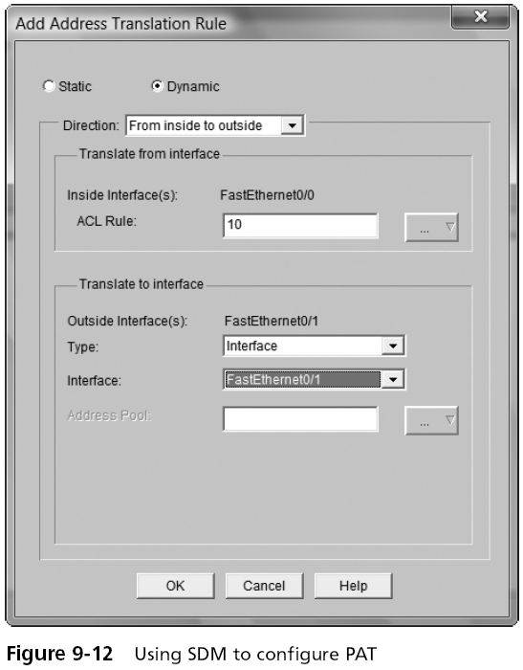
CCNA Guide to Cisco Networking Fundamentals, Fourth Edition

Slide 35
Security Device Manager (continued)
Using SDM to configure DNS
  See Figure 9-13
Using SDM to configure DHCP
  See Figure 9-14
CCNA Guide to Cisco Networking Fundamentals, Fourth Edition

Slide 36
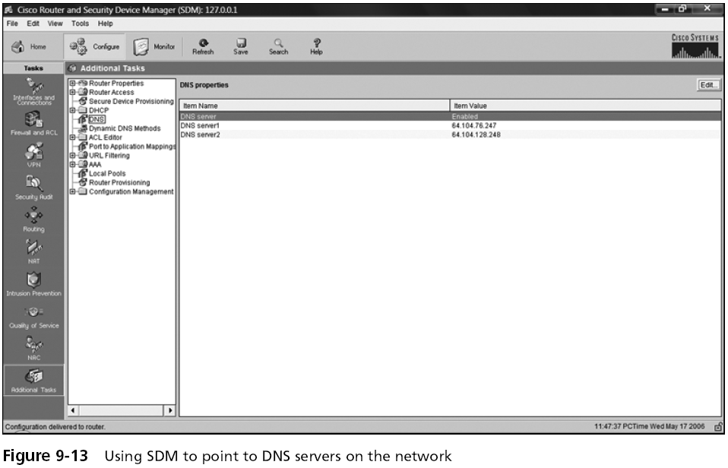
Security Device Manager (continued)
CCNA Guide to Cisco Networking Fundamentals, Fourth Edition

Slide 37
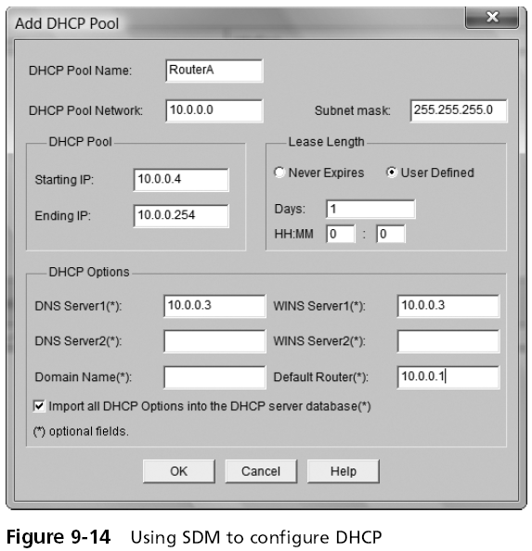
CCNA Guide to Cisco Networking Fundamentals, Fourth Edition

Slide 38
Summary
NAT is a technology that allows organizations to map valid external addresses to private or unregistered internal addresses
Organizations can use NAT to allow many more people to access the Internet by sharing one or more valid public addresses
Static NAT involves mapping each internal IP address to a separately defined outside IP address
Dynamic NAT involves the mapping of inside addresses to a smaller pool of outside addresses
CCNA Guide to Cisco Networking Fundamentals, Fourth Edition

Slide 39
Summary (continued)
PAT allows an organization to map more than one internal private IP address to a single outside IP address by using port numbers to identify the separate connections
The Domain Name Service (DNS) is used to provide an IP address-to-name mapping so that users can refer to hosts by name rather than address
CCNA Guide to Cisco Networking Fundamentals, Fourth Edition

Slide 40
Summary (continued)
The Dynamic Host Configuration Protocol provides IP configuration information such as address, subnet mask, default-gateway, DNS and WINS server location, and domain name to hosts on the network
SDM is a Web-enabled Cisco product that allows advanced router configuration without using the command-line interface
CCNA Guide to Cisco Networking Fundamentals, Fourth Edition

