Slide 1
Network Services
Networking for Home and Small Businesses – Chapter 6

Slide 2
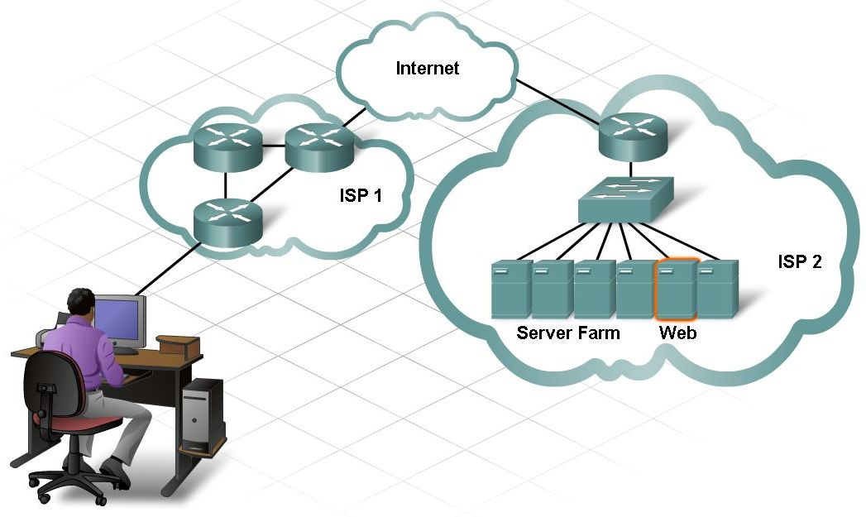
Compare and Contrast Clients and Servers
Server
  host running software application that provides information to other hosts on network
  all servers use same types of protocols and standards
  Example: Web Server
Client
  name given to an application that a host uses
  Example: Web browser
    host uses web client software to request a web page

Slide 3
Types of Servers
DNS (Domain Name Server/System)
  provides IP address of web site with the domain name
Telnet
  remote login
E-mail
  SMTP (Simple Mail Transfer Protocol)
  POP3 (Post Office Protocol)
  IMAP (Internet Message Across Protocol)
DHCP
Web
  uses HTTP protocol
FTP
  used to download and/or upload files between clients and servers

Slide 4
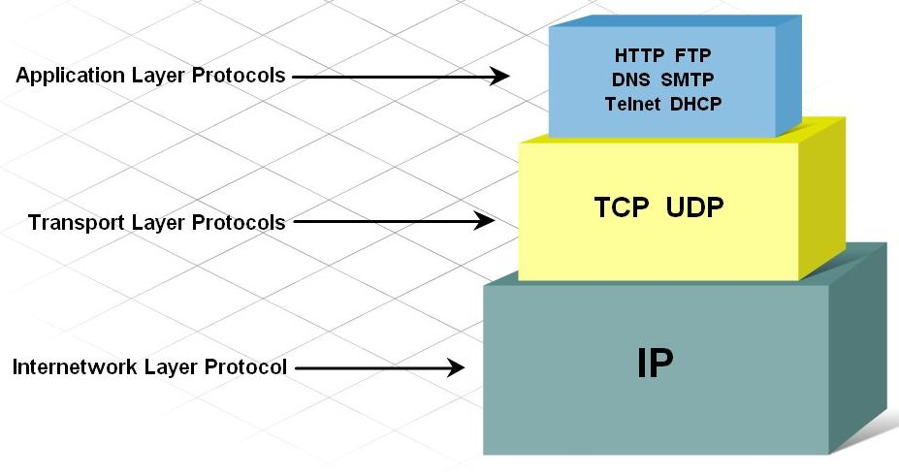
Client-Server Protocols
Application Layer Protocols
  determine the way in which a server and client interact
  HTTP – way to convey information on the web

Slide 5
Client-Server Protocols
Transport Layer Protocols
  manages individual conversations between client and servers
  formats messages into segments (PDU) to be sent to destination
  provides flow control
  provides acknowledgments between hosts

Slide 6
Client-Server Protocols
Internetwork Layer Protocols
  assigns logical addressing (IP)
  encapsulates segments into packets
  provides routing to the destination

Slide 7
Network Access Protocols
Example: Ethernet
Primary functions
  Data link management
    takes IP packets and encapsulates them into frames
    the frame reads the MAC address
  Physical network transmissions
    how bits are represented (1 and 0)
    how bits are sent (media)

Slide 8
TCP Protocols
Used by FTP and HTTP
Provides acknowledgment of delivery of the packet
  similar to registered mail
How it works . . .
  Message is broken into segments
  Segments are then numbered in sequence
  Keeps track of the number of segments
  If sender not receive the segments within a period of time . .
  The lost portion is retransmitted
Use of TCP will slow down delivery. Why??

Slide 9
UDP Protocols
U = UNRELIABLE
“Best effort delivery”
No acknowledgment, no guarantee
  similar to “snail mail”
No retransmission
Used by:
  streaming audio
  streaming video
  VoIP

Slide 10
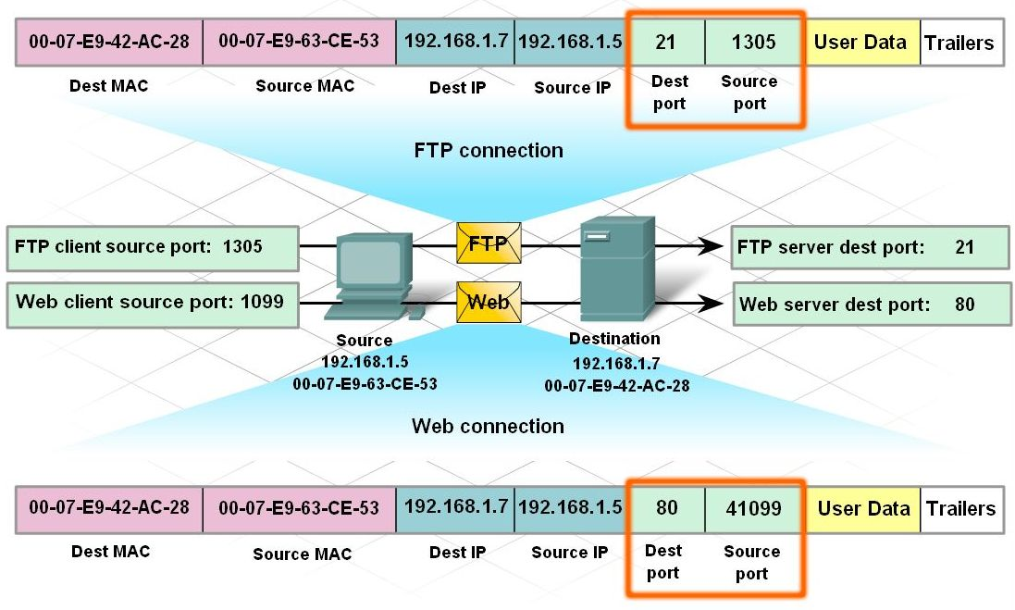
Port Numbers in Client-Server Conversations
Used by both TCP and UDP
Keeps track of different conversations across the network
Every message includes a source and destination port
Destination port
  sent by client in the segment to tell what service is requested
    Port 80 = HTTP
    Port 21 = FTP

Slide 11
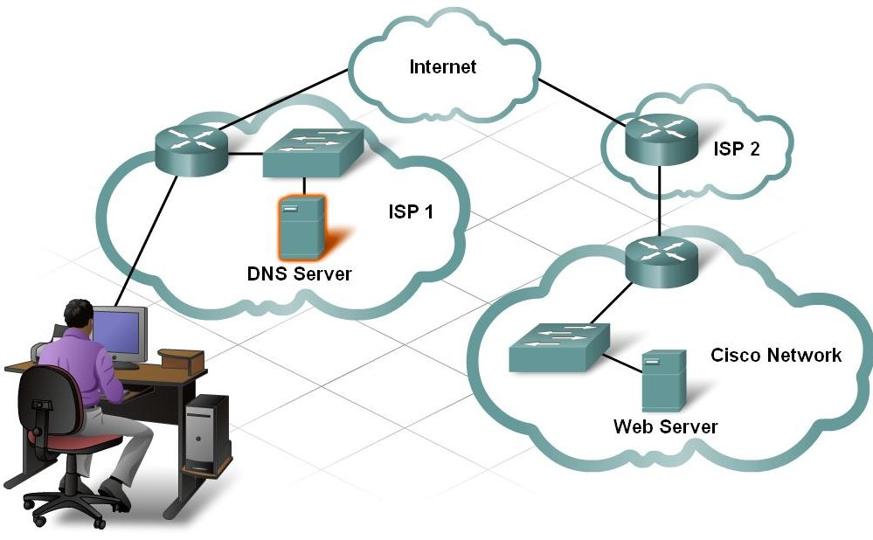
HTTP
Used for web pages
HTML
  helps display the contents of a web page
HTTP – unsecure protocol
  Port 80
HTTPS – provides extra security/encryption
  Port 443

Slide 12
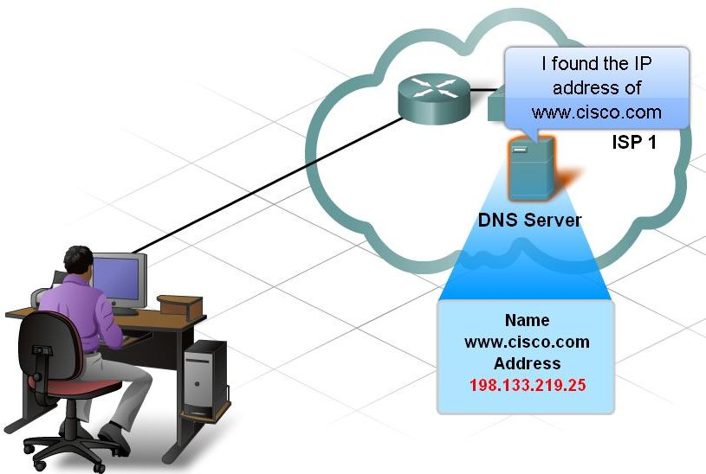
DNS Server (Domain Name System)
Associates a names with an IP address
Some groups
  .com
  .edu
Port 53 = DNS
  used if clients wants an IP address of a web site or host

Slide 13
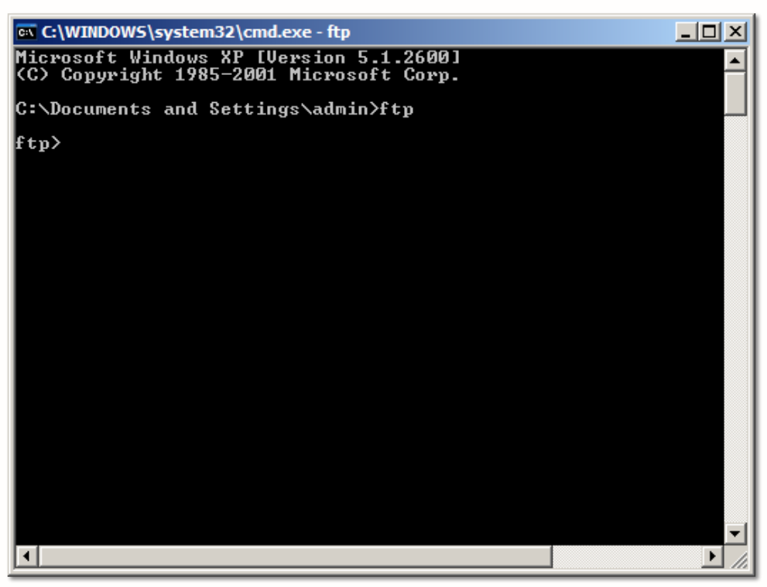
FTP (File Transfer Protocol)
Host must run FTP client access to access the FTP server
Two ports used to communicate
  FTP Request = Port 21
  To transfer files when open = Port 20

Slide 14
Email Protocols
SMTP (Simple Mail Transfer Protocol)
  used by email client to send messages to local email server
  local server decides whether or not to use a different server
  Port #25
POP3 (Post Office Protocol)
  receives/stores messages for the users
  when client connects to email server messages are downloaded to the client; messages are removed from server
  Port #110
IMAP (Internet Message Across Protocol)
  receives/stores messages but keeps messages on the server unless deleted by user
  Port #143

Slide 15
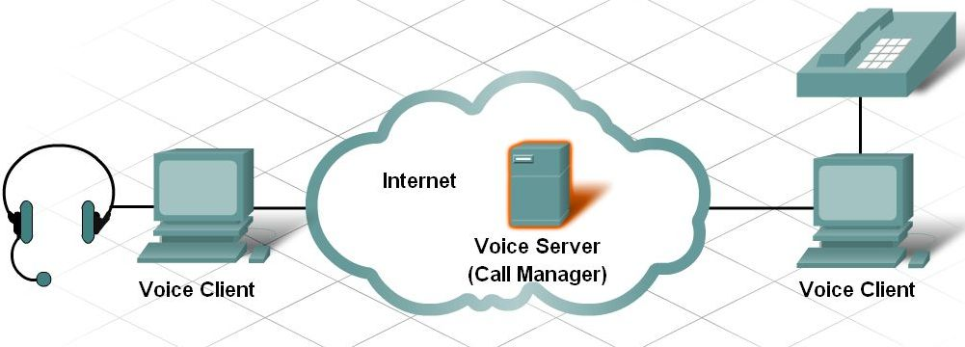
VoIP (Voice Over IP)
IP packets carry digitized voice as data
How it works
  Download client software from company service provider
  Once software is installed, user selects a unique name
  Calls made by selecting a username from list

Slide 16
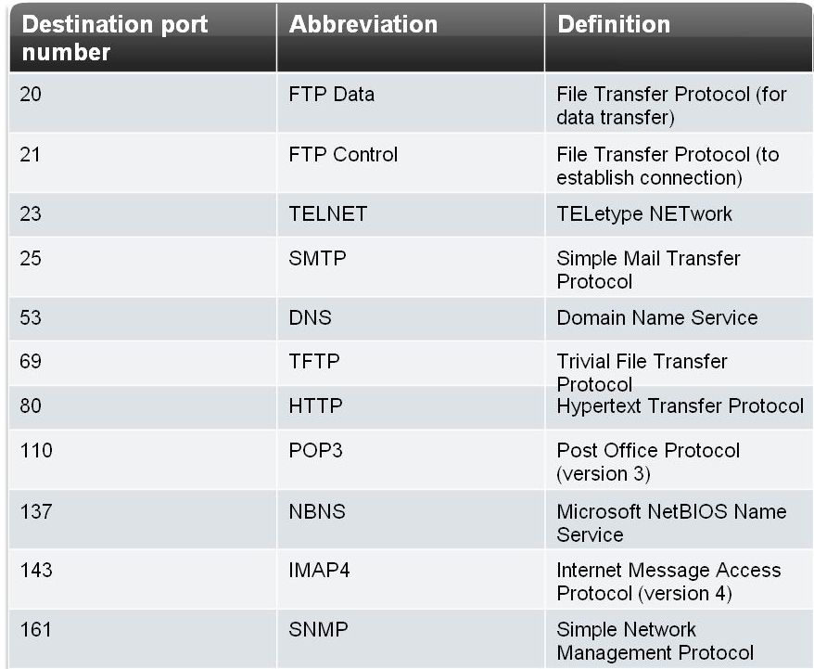
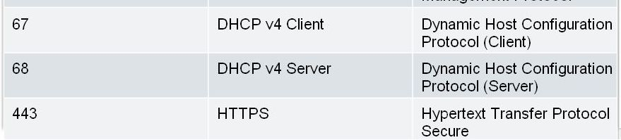
Port Numbers
ICANN (Internet Corp for Assigned Names and Numbers)
  assigns port numbers
Well-known ports
  1-1023 (destination ports)
Registered ports
  1024-49151
  source and destination ports
Private ports
  49152-65535 (source ports)

Slide 17
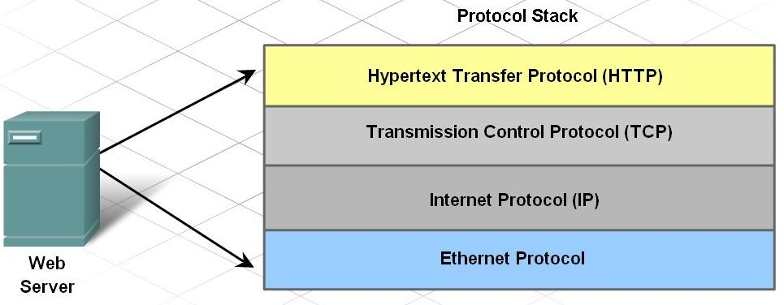
The Protocol Stack
Each upper layer relies on the layer below it
Upper Layers
  message content
Lower Layers
  help to move data

Slide 18
Encapsulation (sending data)
From top to bottom
Application data broken into segments
  segments contain source and destination ports
TCP segments sends it down to Internet layer
  source and destination IP added (packet)
Packet put into a frame
  header and trailer added
    header = source and destination MAC
    trailer = error checking
Broken into bits
  encoded onto the media (cabling)
6.3.1-1

Slide 19
De-encapsulation (receiving data)
From bottom to top
Bits are decoded from the media
Frame removes header and trailer
Packet removes the IP address
  source and destination IP
Segment is received and reassembled for the user
  viewing a web page
6.3.1-2

Slide 20
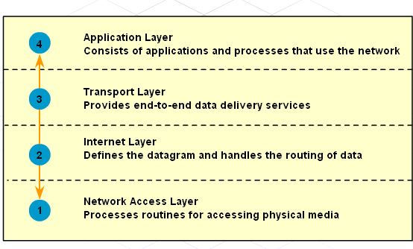
Why Use a Layered Model?
Assists in protocol design
Allows competition between vendors
  can all work together
One layer does not affect other layers
Allows for a common language

Slide 21
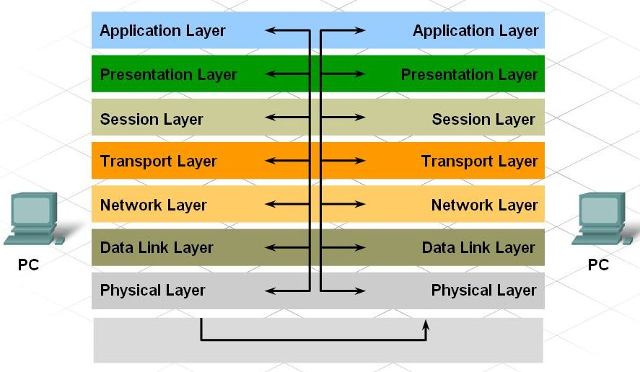
OSI MODEL
Developed in 1984
Reference model for how computers interact with each other
Organized into more specific groups than the TCP/IP Model

Slide 22
Summary
Clients and servers use protocols and standards for exchanging information.
Client-server services are identified through the use of port numbers.
A protocol stack organizes the protocols in layers, with each layer providing and receiving services from the layers below and above it.
When sending messages, protocols interact from the top layer to the bottom of the stack.
When receiving messages, protocols interact from the bottom layer to the top of the stack.

