Slide 1
Networking Fundamentals

Slide 2
Data networks
Businesses needed a solution that would successfully address the following three problems:
  How to avoid duplication of equipment and resources
  How to communicate efficiently
  How to set up and manage a network

Slide 3
Network history
In the 1980s users with stand-alone computers started to share files using modems to connect to other computers. This was referred to as point-to-point, or dial-up communication
Bulletin boards became the central point of communication in a dial-up connection. Drawbacks to this type of system were:
  That there was very little direct communication
  Availability was limited to only with those who knew about the location of the bulletin board
  Required one modem per connection. If five people connected simultaneously it would require five modems connected to five separate phone lines
From the 1960s-1990s, the DoD developed large, reliable, WANs for military and scientific reasons.
In 1990, the DoDs WAN eventually became the Internet

Slide 4
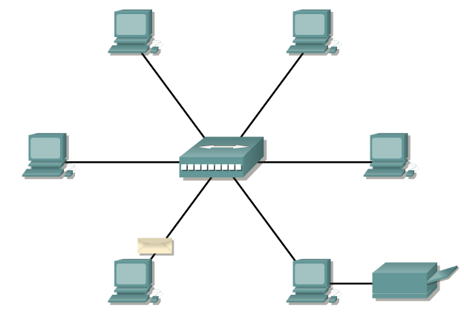
Data networks
One early solution was the creation of local-area network (LAN) standards. Because LAN standards provided an open set of guidelines for creating network hardware and software, the equipment from different companies could then become compatible.
This allowed for stability in LAN implementation.
In a LAN system, each department of the company is a kind of electronic island.
As the use of computers in businesses grew, it soon became obvious that even LANs were not sufficient.

Slide 5
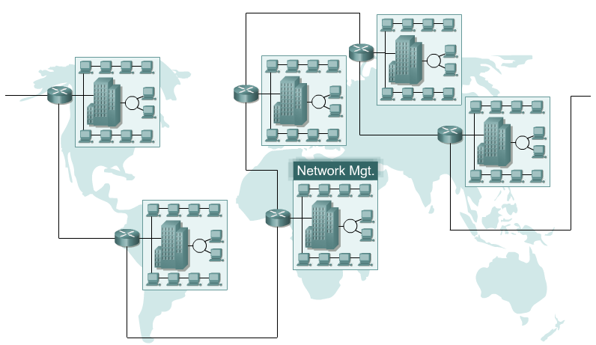
Data networks
What was needed was a way for information to move efficiently and quickly, not only within a company, but also from one business to another.
The solution was the creation of metropolitan-area networks (MANs) and wide-area networks (WANs).

Slide 6
Networking devices
A device is an equipment that connects directly to a network segment. There are 2 types:
  End-user devices include computers, printers, scanners that provide services directly to the user.
  Network devices include all the devices that connect the end-user devices together to allow them to communicate. They provide:
    extension of cable connections,
    concentration of connections,
    conversion of data formats,
    management of data transfers
A host is an end-user device that provide users with a connection to the network using a NIC

Slide 7
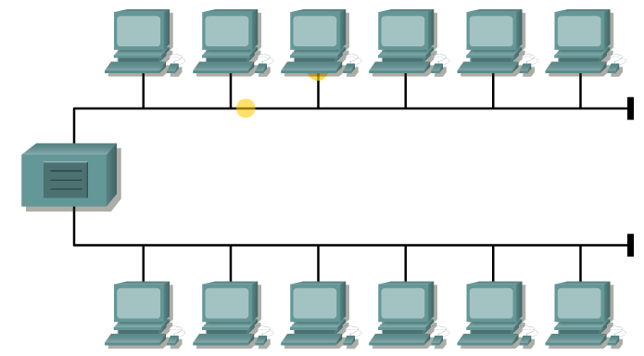
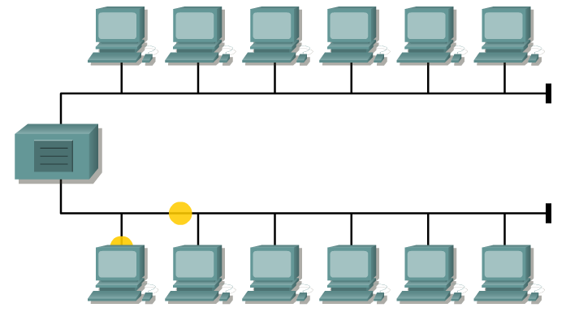

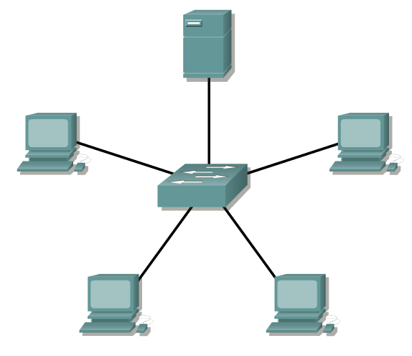
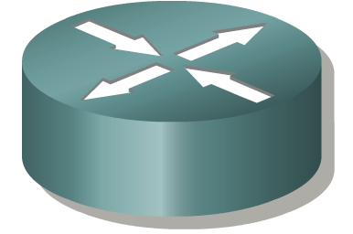
Networking devices

Slide 8
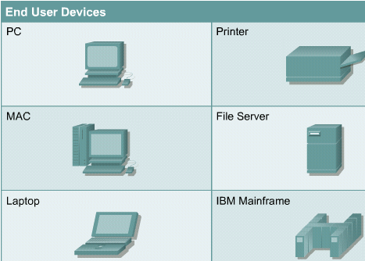
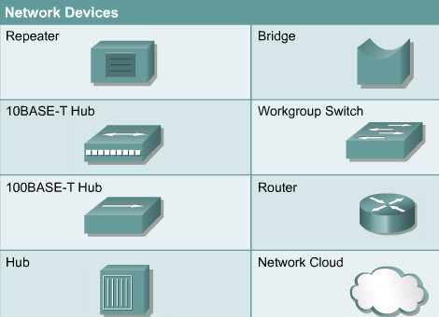

Slide 9
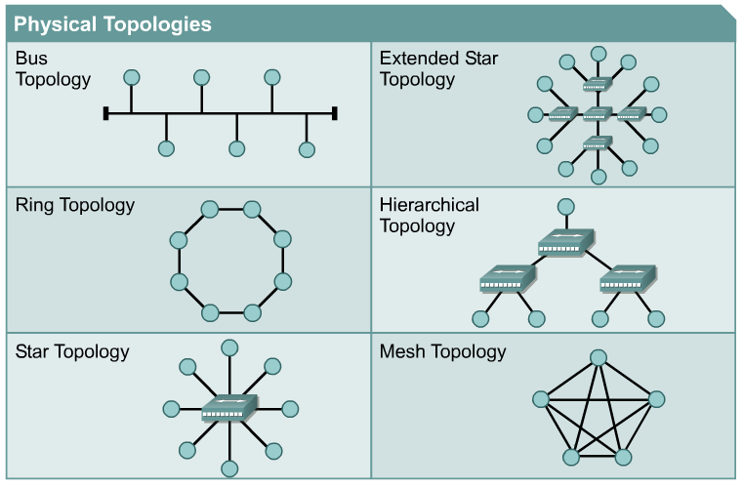
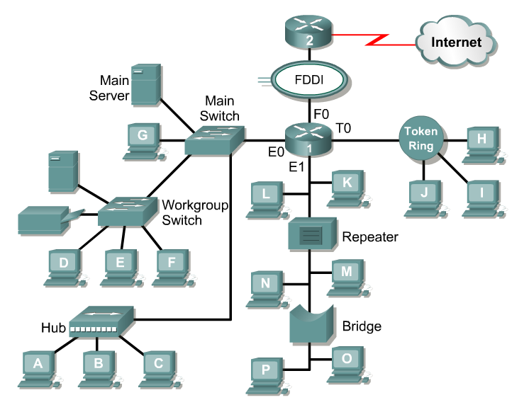
Network topology
Network topology defines the structure of the network.
Physical topology, which is the actual layout of the wire or media.
Logical topology, which defines how the media is accessed by the hosts for sending data.
The logical topology of a network is how the hosts communicate across the medium.
The two most common types of logical topologies are broadcast and token passing.

Slide 10
Network topology
The structure of the network:
  Physical topology
    Actual layout of the media
  Logical topology
    How the hosts access the media

Slide 11
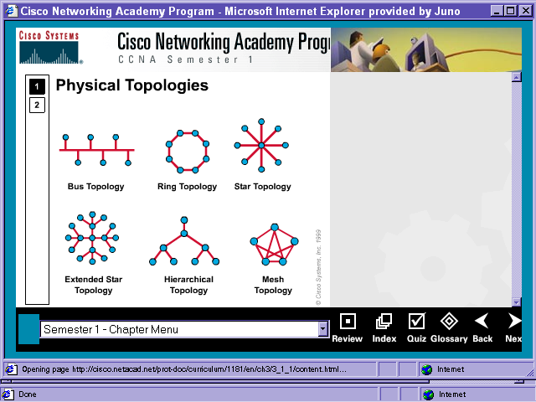
Physical Topology
Bus
  Uses a single backbone cable
  All hosts connect directly to backbone
Ring
  Connects each host to the next, and the last to the first
  Physical ring of cable

Slide 12
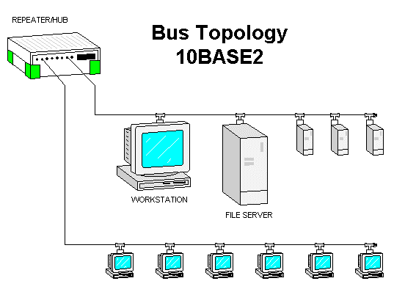
Bus Topology
“A bus topology uses a single backbone segment (length of cable) that all the hosts connect to directly.”

Slide 13
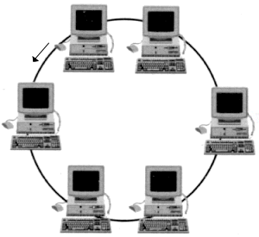
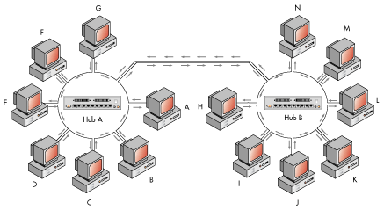
Ring Topology
“A ring topology connects one host to the next and the last host to the first. This creates a physical ring of cable.”

Slide 14
Physical Topology
Star
  Connects all cables to a central point of concentration
  Usually a hub or switch at center
Extended Star
  Links stars by linking hubs or switches

Slide 15
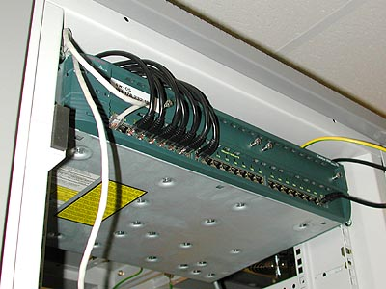
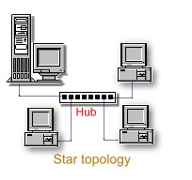
Star Topology
“A star topology connects all cables to a central point of concentration. This point is usually a hub or switch, which will be described later in the chapter.”

Slide 16
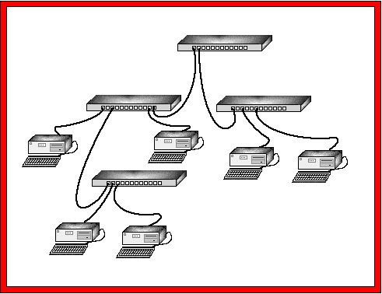
Extended Star Topology
“An extended star topology uses the star topology to be created. It links individual stars together by linking the hubs/switches. This, as you will learn later in the chapter, will extend the length and size of the network.”

Slide 17
Physical Topology
Hierarchical
  Similar to extended star
  Links star LANs to a computer that controls network traffic
Mesh
  Each host is connected to all other hosts
  No breaks, ever!

Slide 18
Logical Topologies
Defines how the hosts communicate across the medium
The two most common types of logical topologies are:
  Broadcast topology
    means that each host sends its data to all other hosts on the network medium. There is no order that the stations must follow to use the network.
    It is first come, first serve. Ethernet works this way as will be explained later in the course.
  Token passing
    controls network access by passing an electronic token sequentially to each host.
    When a host receives the token, that host can send data on the network. If the host has no data to send, it passes the token to the next host and the process repeats itself.
    Two examples of networks that use token passing are Token Ring and Fiber Distributed Data Interface (FDDI).
    A variation of Token Ring and FDDI is Arcnet. Arcnet is token passing on a bus topology.

Slide 19
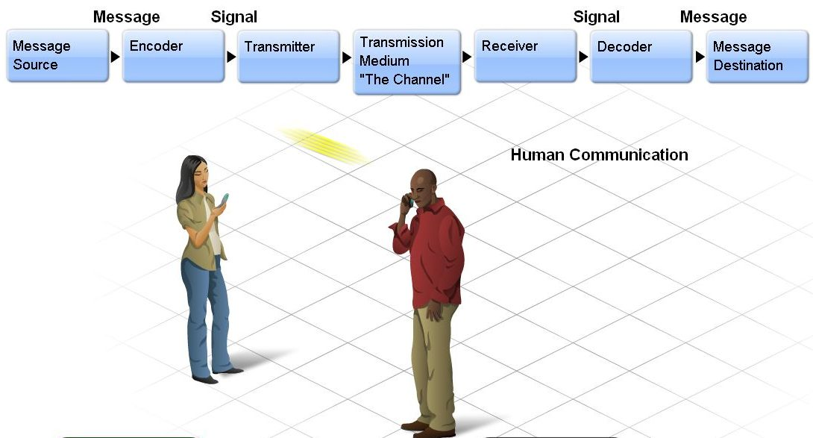
Communication Protocols
Primary purpose of a network – to communicate
Elements of communication
  Sender (source)
    has a need to communicate
  Receiver (destination)
    receives message and interprets it
  Channel
    pathway for information to travel

Slide 20
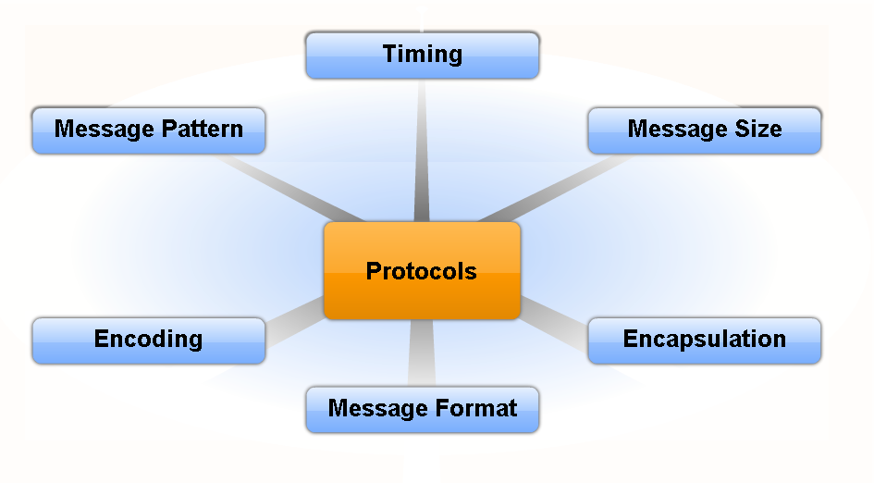
Successful delivery of the message
Rules (protocols) must be followed:
  Identification of the sender and/or receiver
  Channel in which to communicate (face-to-face)
  Mode of communication (written or spoken)
  Language
  Grammar
  Speed or timing

Slide 21
Rules of communication
Protocols define the details of how the message is transmitted, and delivered. This includes issues of:
Message format
Message size
Timing
Encapsulation
Encoding
Standard message pattern

Slide 22
Communication Protocols
Encoding vs. Decoding
One of the first steps to sending a message is encoding it.
Encoding
  Humans
    converting thoughts into language, symbols, or sounds
  Computers
    messages converted into bits by sending host
    each bit encoded into sound, light, or electrical impulses
    destination host then decodes the signal
Decoding
  reverse of encoding

Slide 23
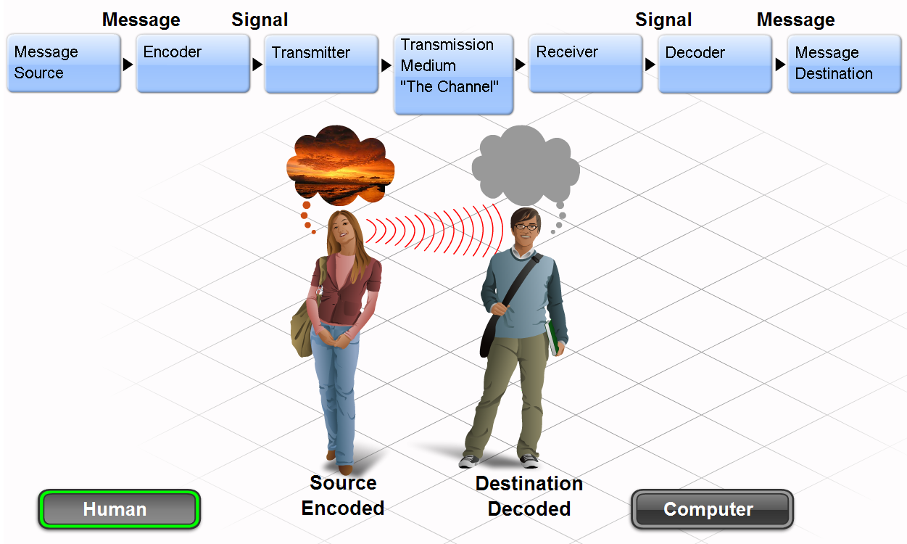

Slide 24
Communication Protocols
Message formatting and encapsulation
When a message is sent from source to destination, it must use a specific format or structure.
Compare to parts of a letter
  Identifier (recipient)
  Salutation
  Message
  Closing
  Identifier (sender)
Encapsulation
  placing the letter into the envelope
De encapsulation
  letter removed from the envelope

Slide 25
Message Formatting
Each computer message is encapsulated in a specific format, called a frame, before it is sent over the network.
A frame acts like an envelope; it provides the address of the intended destination and the address of the source host.
Messages that are not correctly formatted are not successfully delivered to or processed by the destination host.

Slide 26
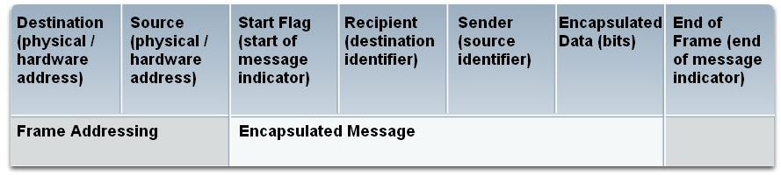

Slide 27
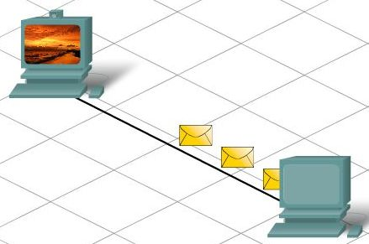
Communication Protocols
Messages have size restrictions depending on the channel used
If the message is broken into smaller pieces, it is easier to understand
If the message is too long or too short, will be considered undeliverable.

Slide 28
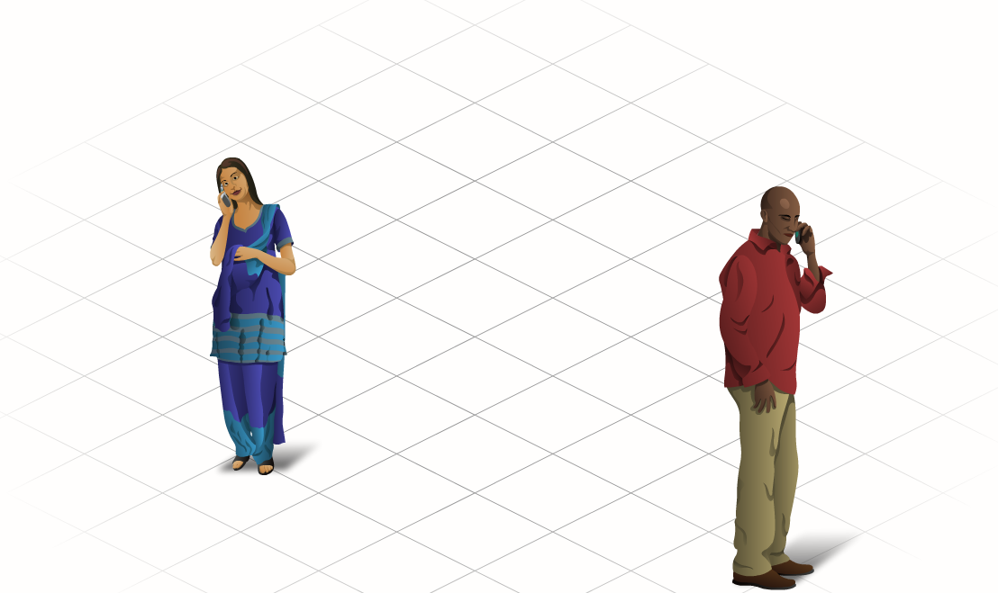
Communication Protocols
Timing
  when to speak; how fast or how slow
  how long to wait for a response
Access Method
  determines when someone is able to send a message
  can speak when no one else is talking, otherwise a COLLISON occurs
Flow Control
  timing for negotiations
  sender might transmit messages faster than the user can handle
Response Timeout
  how long should you wait for a response and what action to take
Acknowledgment
  may be required to ensure message was delivered

Slide 29
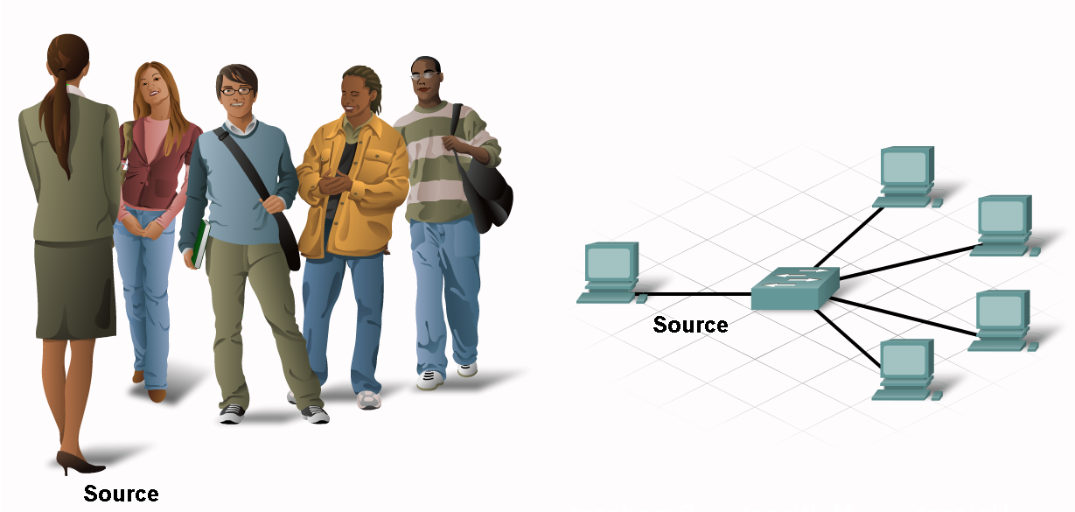
Communication Protocols
Message Patterns
Unicast – single destination
Multicast – same message to a group
Broadcast – all hosts need to receive the message

Slide 30
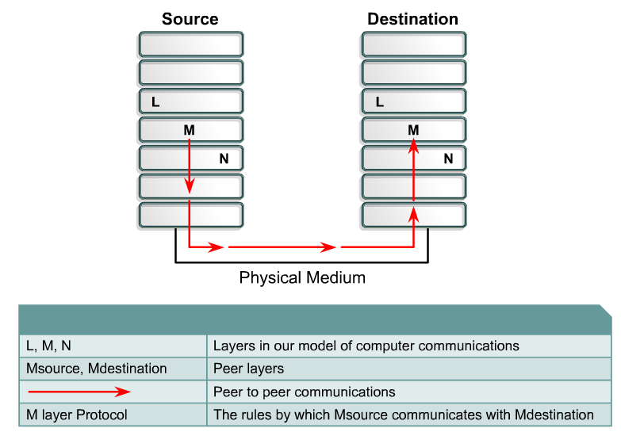
Network protocols
Protocol suites are collections of protocols that enable network communication from one host through the network to another host.
A protocol is a formal description of a set of rules and conventions that govern a particular aspect of how devices on a network communicate. Protocols determine the format, timing, sequencing, and error control in data communication.
Without protocols, the computer cannot make or rebuild the stream of incoming bits from another computer into the original format.

Slide 31
Network protocols
Protocols control all aspects of data communication, which include the following:
  How the physical network is built
  How computers connect to the network
  How the data is formatted for transmission
  How that data is sent
  How to deal with errors
Examples
Institute of Electrical and Electronic Engineers (IEEE),
American National Standards Institute (ANSI),
Telecommunications Industry Association (TIA),
Electronic Industries Alliance (EIA)
International Telecommunications Union (ITU), formerly known as the Comité Consultatif International Téléphonique et Télégraphique (CCITT).

Slide 32
Local-area networks (LANs)
LANs consist of the following components:
  Computers
  Network interface cards
  Peripheral devices
  Networking media
  Network devices
LANs make it possible to locally share files and printers efficiently
Examples of common LAN technologies are:
  Ethernet
  Token Ring
  FDDI

Slide 33
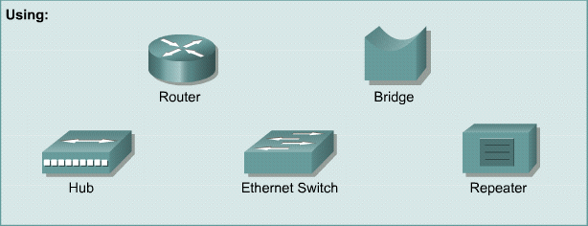
LAN Components
LANs are designed to:
  Operate in a limited geographical area
  Allow multiple access to high-bandwidth media
  Control the network privately under local administrative control
  Provide full time connectivity to local services
  Connect physically adjacent devices

Slide 34
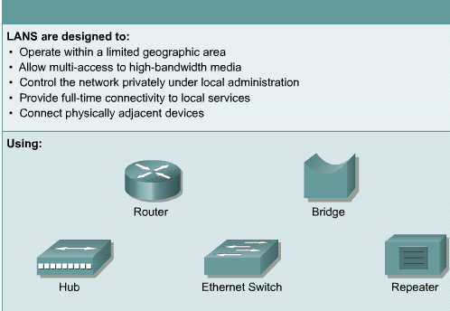
Local-area networks (LANs

Slide 35
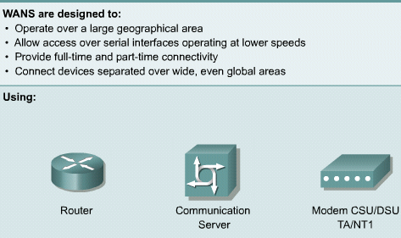
Wide-area networks (WANs)
WANs interconnect LANs
Some common WAN technologies are:
  Modems
  ISDN
  DSL
  Frame Relay
  T and E Carrier Series – T1, E1, T3, E3
  SONET

Slide 36
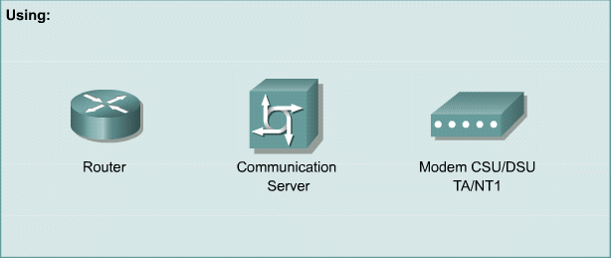
WAN Components
WANs are designed to:
  Operate over a large geographical area
  Allow access over serial interfaces at lower speeds
  Provide full and part time connectivity
  Connect devices separated over wide, even global areas

Slide 37
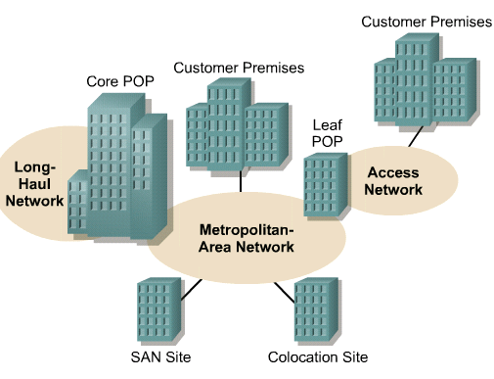
Metropolitan-area networks (MANs)
A MAN is a network that spans a metropolitan area such as a city or suburban area.
Usually consists of 2 or more LANs in a common geographic area.
Ex: a bank with multiple branches may utilize a MAN.
Typically, a service provider is used to connect two or more LAN sites using private communication lines or optical services.

Slide 38
Storage-area networks (SANs)
A SAN is a dedicated, high-performance network used to move data between servers and storage resources.
Separate, dedicated network, that avoids any traffic conflict between clients and servers
SANs offer the following features:
  Performance – allows concurrent access of disk or tape arrays by two or more servers at high speeds
  Availability – have disaster tolerance built in, because data can be mirrored using a SAN up to 10km or 6.2 miles away.
  Scalability – Like a LAN/WAN, it can use a variety of technologies. This allows easy relocation of backup data, operations, file migration, and data replication between systems.

Slide 39
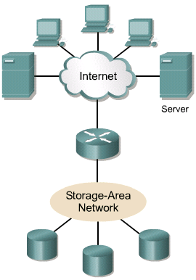
SAN

Slide 40
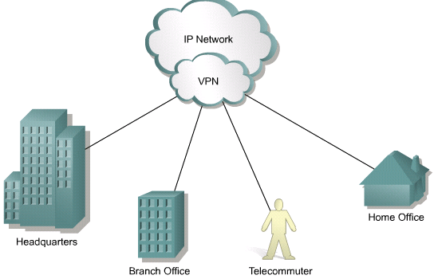
Virtual private network (VPN)
A VPN is a private network that is constructed within a public network such as the Internet.
It offers secure, reliable connectivity over a shared public network infrastructure such as the Internet.
A telecommuter can access the network of the company through the Internet by building a secure tunnel between the telecommuter’s PC and a VPN router in the company

Slide 41
Benefits of VPNs
Three main types of VPNs:
  Access VPNs – provide remote access to a mobile worker and a SOHO to the hq of the Intranet or Extranet over a shared infrastructure. Access VPNs use analog, dialup, ISDN, DSL, cable technologies
  Intranet VPNs – link regional and remote offices to the hq of the internal network over a shared infrastructure using dedicated connections. They allow access only to the employees of the enterprise.
  Extranet VPNs – link business partners to the hq of the network over a shared infrastructure using dedicated connections. They allow access to users outside the enterprise

Slide 42
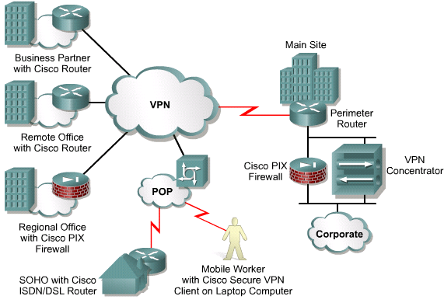
VPNs

Slide 43
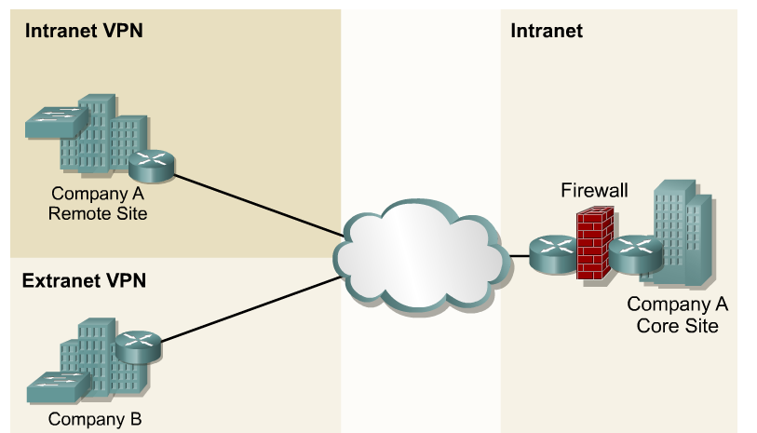
Intranets and extranets
Intranets are designed to permit access by users who have access privileges to the internal LAN of the organization.
Within an Intranet, Web servers are installed in the network.
Browser technology is used as the common front end to access information such as financial data or graphical, text-based data stored on those servers.
Extranets refer to applications and services that are Intranet based, and use extended, secure access to external users or enterprises.
This access is usually accomplished through passwords, user IDs, and other application-level security.

Slide 44
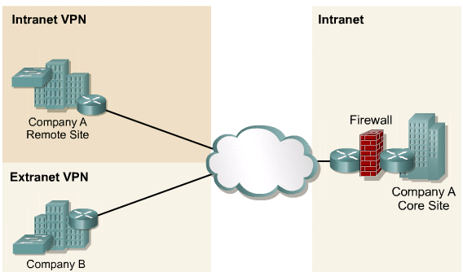
Intranets and extranets

Slide 45
Importance of bandwidth
Bandwidth is the amount of information that can flow through a network connection in a given period of time.
Bandwidth is finite
  the bandwidth of a modem is limited to about 56 kbps by both the physical properties of twisted-pair phone wires and by modem technology
Bandwidth is not free
  For WAN connections bandwidth is purchased from a service provider
A key factor in analyzing network performance and designing new networks
The demand for bandwidth is ever increasing

Slide 46

Analogies
Bandwidth is like the width of a pipe.
  The water is like the data, and the pipe width is like the bandwidth
Bandwidth is like the number of lanes on a highway.
  The data packets are the automobiles, and the bandwidth is comparable to the number of lanes on the highway. It is easy to see how low bandwidth connections can cause traffic to become congested all over the network

Slide 47
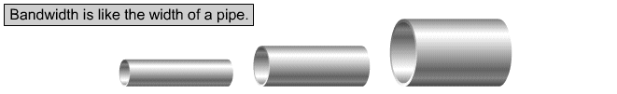
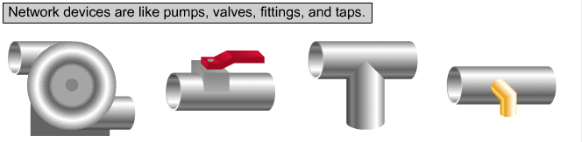
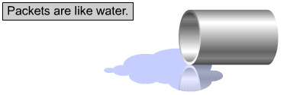
Bandwidth
Bandwidth Analogy 1

Slide 48
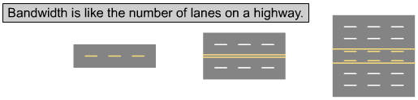
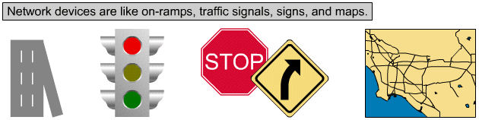
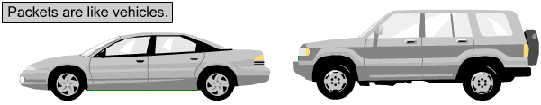
Bandwidth
Bandwidth Analogy 2

Slide 49
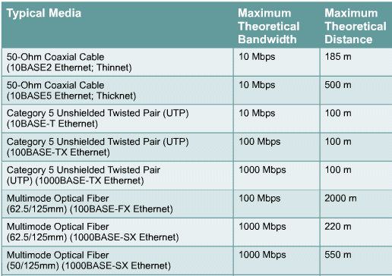
Measurement
In digital systems, the basic unit of bandwidth is bits per second (bps)
The actual bandwidth of a network is determined by a combination of the physical media and the technologies chosen for signaling and detecting network signals

Slide 50
Limitations
Bandwidth is limited by a number of factors
  Media
  Network devices
  Physics
Each have their own limiting factors
Actual bandwidth of a network is determined by a combination of the physical media and the technologies chosen for signaling and detecting network signals

Slide 51
Media bandwidth and limitations
Media | Max Length | Max Bandwidth
50 Ohm Coaxial Cable (10Base2) Thin Ethernet | 185m | 10Mbps
50 Ohm Coaxial Cable (10Base5) Thick Ethernet | 500m | 10Mbps
Category 5 Unshielded Twisted Pair (UTP) (10BaseT) Ethernet | 100m | 10Mbps
Category 5 Unshielded Twisted Pair (UTP) (100BaseTX) Ethernet | 100m | 100Mbps
Category 5 Unshielded Twisted Pair (UTP) (1000BaseTX) Ethernet | 100m | 1000Mbps
Multimode Optical Fibre 62.5/125mm 100BaseFX Ethernet | 2000m | 100Mbps
Multimode Optical Fibre 62.5/125mm 1000BaseSX Ethernet | 220m | 1000Mbps
Multimode Optical Fibre 50/125mm 1000BaseSX Ethernet | 550m | 1000Mbps
Singlemode Optical Fibre 9/125mm 1000BaseLX Ethernet | 5000m | 1000Mbps

Slide 52
Throughput
Throughput is the actual, measured, bandwidth, at a specific time of day, using specific internet routes, while downloading a specific file. The throughput is often far less than the maximum bandwidth
Factors that determine throughput:
  Internetworking devices
  Type of data being transferred
  Network topology
  Number of users on the network
  User computer
  Server computer

Slide 53
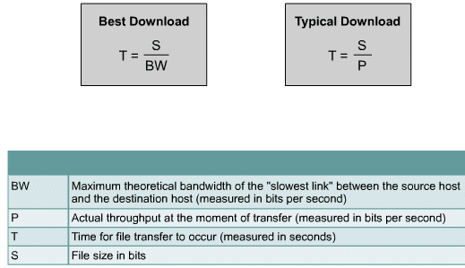
Data transfer calculation

Slide 54
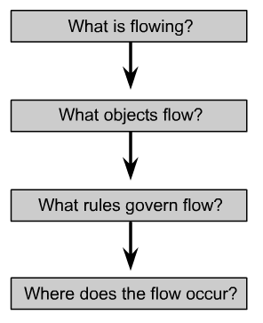
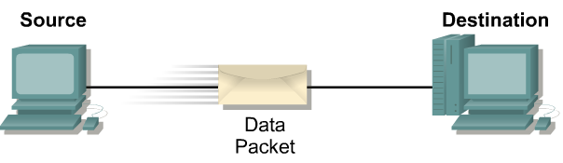
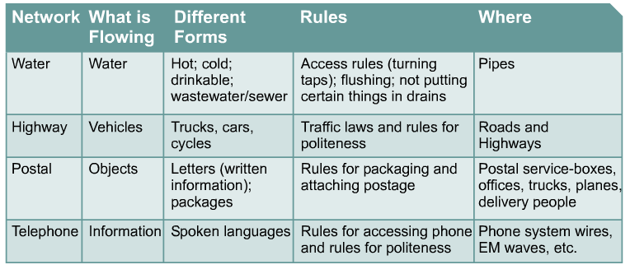
Using layers to analyze problems in a flow of materials
The concept of layers is used to describe communication from one computer to another.
The OSI and TCP/IP models have layers that explain how data is communicated from one computer to another.
The models differ in the number and function of the layers.
However, each model can be used to help describe and provide details about the flow of information from a source to a destination.

Slide 55
Layered models
Using a layered model
  Breaks network communication into smaller, more manageable parts.
  Standardizes network components to allow multiple vendor development and support.
  Allows different types of network hardware and software to communicate with each other.
  Prevents changes in one layer from affecting other layers.
  Divides network communication into smaller parts to make learning it easier to understand.

Slide 56
Using layers to analyze problems in a flow of materials
The concept of layers is used to describe communication from one computer to another
The information that travels on a network is generally referred to as data or a packet
A packet is a logically grouped unit of information that moves between computer systems.
As the data passes between layers, each layer adds additional information that enables effective communication with the corresponding layer on the other computer.

Slide 57
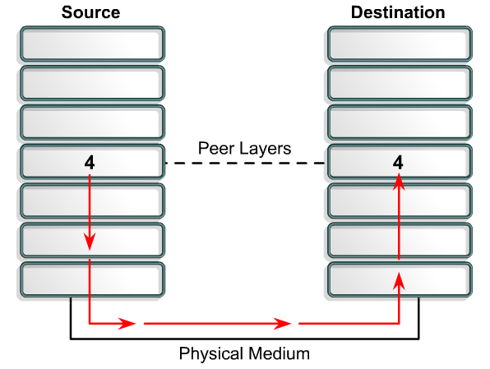
Using layers to describe data communication
In order for data packets to travel from a source to a destination on a network, it is important that all the devices on the network speak the same language or protocol.
A protocol is a set of rules that make communication on a network more efficient.

Slide 58
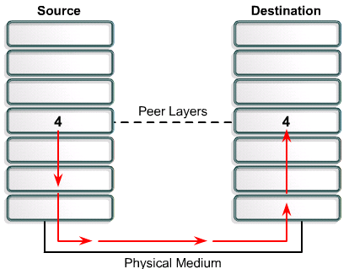
Describe data communication using layers
A data communications protocol is a set of rules or an agreement that determines the format and transmission of data
Layer 4 on the source computer communicates with Layer 4 on the destination computer. The rules and conventions used for this layer are known as Layer 4 protocols

Slide 59
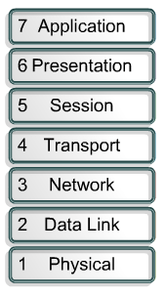
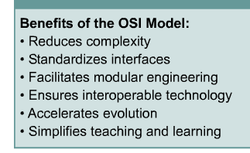
OSI model
To address the problem of network incompatibility, the International Organization for Standardization (ISO) researched networking models like Digital Equipment Corporation net (DECnet), Systems Network Architecture (SNA), and TCP/IP in order to find a generally applicable set of rules for all networks.
Using this research, the ISO created a network model that helps vendors create networks that are compatible with other networks.
The Open System Interconnection (OSI) reference model released in 1984 was the descriptive network model that the ISO created.
It provided vendors with a set of standards that ensured greater compatibility and interoperability among various network technologies produced by companies around the world.

Slide 60
OSI layers
The OSI model explains how packets travel through the various layers to another device on a network:
  It breaks network communication into smaller, more manageable parts.
  It standardizes network components to allow multiple vendor development and support.
  It allows different types of network hardware and software to communicate with each other.
  It prevents changes in one layer from affecting other layers.
  It divides network communication into smaller parts to make learning it easier to understand

Slide 61
2.2.2 The seven layers of the OSI reference model
7
Application
All
6
Presentation
People
Session
Seem
5
4
Transport
To
Network
Need
3
Data Link
Data
2
1
Physical
Processing

Slide 62
2.2.2 The seven layers of the OSI reference model
7
Application
Networks processes to applications
6
Presentation
Data representation
5
Session
Interhost communication
Transport
End-to-end connections
4
Network
Addresses and best path
3
2
Data Link
Access to media
1
Physical
Binary Transmission

Slide 63


OSI Model

Slide 64
2.2.3 The functions of each layer
7
Application
Layer 7: The Application Layer
The application layer is the OSI layer that is closest to the user; it provides network services to the user's applications. It differs from the other layers in that it does not provide services to any other OSI layer, but rather, only to applications outside the OSI model.
6
Presentation
5
Session
4
Transport
3
Network
2
Data Link
BROWSER
1
Physical

Slide 65
2.2.3 The functions of each layer
7
Application
Layer 6: The Presentation Layer
The presentation layer ensures that the information that the application layer of one system sends out is readable by the application layer of another system. Responsible for compression and encryption
6
Presentation
5
Session
4
Transport
3
Network
2
Data Link
DATA FORMAT
1
Physical

Slide 66
2.2.3 The functions of each layer
7
Application
Layer 5: The Session Layer
the session layer establishes, manages, and terminates sessions between two communicating hosts.
6
Presentation
5
Session
4
Transport
3
Network
DIALOGUES
2
Data Link
1
Physical

Slide 67
2.2.3 The functions of each layer
7
Application
Layer 4: The Transport Layer
The transport layer segments data from the sending host's system and reassembles the data into a data stream on the receiving host's system.
6
Presentation
5
Session
4
Transport
3
Network
QUALITY OF SERVICE
2
Data Link
RELIABILITY
1
Physical

Slide 68
2 2.2.3 The functions of each layer
7
Application
Layer 3: The Network Layer
The network layer is a complex layer that provides connectivity and path selection between two host systems that may be located on geographically separated networks.
6
Presentation
5
Session
4
Transport
3
Network
ADDRESSING
2
Data Link
PATH SELECTION
1
Physical

Slide 69
2.2.3 The functions of each layer
7
Application
Layer 2: The Data Link Layer
The data link layer provides reliable transit of data across a physical link. In so doing, the data link layer is concerned with physical (as opposed to logical) addressing, network topology, network access, error notification, ordered delivery of frames, and flow control.
6
Presentation
5
Session
4
Transport
3
Network
Data Link
FRAMES
2
1
Physical
MEDIA ACCESS CONTROL

Slide 70
2 2.2.3 The functions of each layer
7
Application
Layer 1: The Physical Layer
The physical layer defines the electrical, mechanical, procedural, and functional specifications for activating, maintaining, and deactivating the physical link between end systems.
6
Presentation
5
Session
4
Transport
3
Network
Data Link
SIGNALS
2
1
Physical
MEDIA

Slide 71


Peer-to-peer communications
In order for data to travel from the source to the destination, each layer of the OSI model at the source must communicate with its peer layer at the destination.
This form of communication is referred to as peer-to-peer.
During this process, the protocols of each layer exchange information, called protocol data units (PDUs).
Each layer of communication on the source computer communicates with a layer-specific PDU, and with its peer layer on the destination computer as illustrated in Figure

Slide 72
Peer-to-peer communications
For data to travel from the source to the destination, each layer of the OSI model at the source must communicate with its peer layer at the destination. This is called peer-to-peer communication
The protocols of each layer exchange information, called protocol data units (PDUs)
Each layer depends on the service function of the OSI layer below it. Ex:
  Transport layer deals with segments
  Network layer encapsulates segments into packets
  Data Link layer encapsulates packets into frames
  Physical layer converts frames to bit streams

Slide 73






2.2.4 Encapsulation
Encapsulation wraps data with the necessary protocol information before network transit.
Analogy
1
2
3
4
5

Slide 74

Peer-to-peer communications

Slide 75

TCP/IP model
The U.S. DoD created the TCP/IP reference model, because it wanted to design a network that could survive any conditions, including a nuclear war.
TCP/IP was developed as an open standard
Handles issues of representation, encoding, and dialog control
Handles quality of service issues of reliability, flow control, and error correction.
Divides TCP segments into packets and send them from any network. Best path determination and packet switching
a.k.a host-to-network layer, concerned with all of the components, both physical and logical, that are required to make a physical link.

Slide 76

2.3.2 The Layers of the TCP/IP reference model
The TCP/IP Model
Application Layer
The designers of TCP/IP felt that the higher level protocols should include the session and presentation layer details. They simply created an application layer that handles high-level protocols, issues of representation, encoding, and dialog control. The TCP/IP combines all application-related issues into one layer, and assures this data is properly packaged for the next layer. This is also referred to as the process layer.
Application
Transport
Internet
Network Access

Slide 77
2.3.2 The Layers of the TCP/IP reference model
The TCP/IP Model
Application
Transport Layer
The transport layer deals with the quality-of-service issues of reliability, flow control, and error correction.
Transport
Internet
TCP
Network Access

Slide 78
2.3.2 The Layers of the TCP/IP reference model
The TCP/IP Model
Application
Internet Layer
The purpose of the Internet layer is to send source packets from any network on the internetwork and have them arrive at the destination independent of the path and networks they took to get there.
Transport
Internet
Network Access
IP

Slide 79
2.3.2 The Layers of the TCP/IP reference model
The TCP/IP Model
Application
Network Access Layer
It is also called the host-to-network layer. It is the layer that is concerned with all of the issues that an IP packet requires to actually make a physical link, and then to make another physical link. It includes the LAN and WAN technology details, and all the details in the OSI physical and data link layers.
Transport
Internet
Network Access

Slide 80

TCP/IP model
Some of the common protocols specified by the TCP/IP reference model layers. Some of the most commonly used application layer protocols include the following:
File Transfer Protocol (FTP)
Hypertext Transfer Protocol (HTTP)
Simple Mail Transfer Protocol (SMTP)
Domain Name System (DNS)
Trivial File Transfer Protocol (TFTP)
The common transport layer
protocols include:
Transport Control Protocol (TCP)
User Datagram Protocol (UDP)
The primary protocol of the
Internet layer is:
Internet Protocol (IP)

Slide 81

TCP/IP model
Networking professionals differ in their opinions on which model to use. Due to the nature of the industry it is necessary to become familiar with both. Both the OSI and TCP/IP models will be referred to throughout the curriculum. The focus will be on the following:
TCP as an OSI Layer 4 protocol
IP as an OSI Layer 3 protocol
Ethernet as a Layer 2 and Layer 1 technology
Remember that there is a difference between a model and an actual protocol that is used in networking. The OSI model will be used to describe TCP/IP protocols.

Slide 82

2.3.3 TCP/IP Protocol Graph

Slide 83
TCP/IP model
Networking professionals differ in their opinions on which model to use. Due to the nature of the industry it is necessary to become familiar with both. Both the OSI and TCP/IP models will be referred to throughout the curriculum. The focus will be on the following:
TCP as an OSI Layer 4 protocol
IP as an OSI Layer 3 protocol
Ethernet as a Layer 2 and Layer 1 technology
Remember that there is a difference between a model and an actual protocol that is used in networking. The OSI model will be used to describe TCP/IP protocols.

Slide 84

2.3.4 Comparison of the OSI model and the TCP/IP model

Slide 85
2.3.4 Comparison of the OSI model and the TCP/IP model
SIMILIRATIES
both have layers
both have application layers, though they include very different services
both have comparable transport and network layers
packet-switched (not circuit-switched) technology is assumed
networking professionals need to know both
DIFFERENCES
TCP/IP combines the presentation and session layer issues into its application layer
TCP/IP combines the OSI data link and physical layers into one layer
TCP/IP appears simpler because it has fewer layers
TCP/IP protocols are the standards around which the Internet developed

Slide 86

Detailed encapsulation process
If one computer (host A) wants to send data to another computer (host B), the data is packaged through a process called encapsulation
As the data packet moves down through the layers of the OSI model, it receives headers, trailers, and other information.

Slide 87

Detailed encapsulation process
Networks must perform the following five conversion steps in order to encapsulate data:
Build the data.
Package the data for end-to-end transport.
Add the network IP address to the header.
Add the data link layer header and trailer.
Convert to bits for transmission.

Slide 88

Data Encapsulation Example
Application Header + data
Application Layer
Layer 4: Transport Layer
Layer 3: Network Layer
Layer 2: Network Layer
010010100100100100111010010001101000…
Layer 1: Physical Layer
Let us focus on the Layer 2, Data Link, Ethernet Frame for now.

Slide 89

Encapsulation

