Slide 1
Internet Applications
INTERNET
APPLICATIONS

Slide 2
Internet Applications
Internet Applications
Domain Name Service
Proxy Service
Mail Service
Web Service

Slide 3
DNS
DNS

Slide 4
Internet Naming Hierarchy
DNS
The silent dot at the
end of all addresses
.com
.net
.org
.in
.tcd
.ac
.co
.iitk
www
www

Slide 5
DNS Operation
DNS Setup
A DNS server maintains the name to IP address mapping of the domain for which it is the name server.
The DNS server for a domain is registered with the domain registrar and the entry is maintained by the Internet Root-Servers (13) or Country Level Root-Servers.
Whenever a server is queried, if doesn’t have the answer, the root servers are contacted.
The root servers refer to the DNS server for that domain (in case the domain is a top level domain) or the Country Root Server (in case the domain is country level domain).

Slide 6
Proxy Server
PROXY SERVER

Slide 7
Internet Connections
Proxy Server
ISP network
ISP network
Backbone
networks
Bandwidth-limited
links
ISP
network
Customers connect to an ISP
ISPs connect to backbone
Customer Networks

Slide 8
Internet Connections
Proxy Server
Cost of connections is based on bandwidth
Cost of connection is a major part of network cost
Organisations only obtain as much bandwidth as they
can afford
Many organisations in Asia-Pacific only have 64kb/s –
2Mb/s connections (as compared to their counterpart
in US and Europe who have bandwidths of 2.4 Gbps –
10 Gbps)

Slide 9
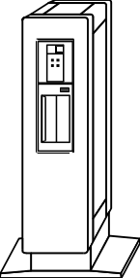
What is a Web Proxy?
Proxy Server
A proxy is a host which relays web access requests
from clients
  Used when clients do not access the web directly
  Used for security, logging, accounting and
  performance
browser
proxy
web

Slide 10
What is Web Caching?
Proxy Server
Storing copies of recently accessed web pages
Pages are delivered from the cache when requested again
Browser caches
Proxy caches

Slide 11
Why Cache?
Proxy Server
Shorter response time
Reduced bandwidth requirement
Reduced load on servers
Access control and logging

Slide 12
Popular Proxy Caches
Proxy Server
Apache proxy
MS proxy server
WinProxy
Squid
  Squid is popular because it is powerful, configurable and free
Many others

Slide 13
Web Server
WEB SERVER

Slide 14
Web Server
Web Server
HTTP (Hyper Text Transfer Protocol) is used to transfer web pages from a Web Server to Web Client (Browser)
Web Pages are arranged in a directory structure in the Web Server
HTTP supports CGI (Common Gateway interface)
HTTP supports Virtual Hosting (Hosting multiple sites on the same server)
Popular Web Servers
  Apache
  Windows IIS
  IBM Websphere

Slide 15
Email
EMAIL

Slide 16

Mail Architecture
Email
Internet
Mail
Server
Mail
Server
Mail Client
Mail Client

Slide 17
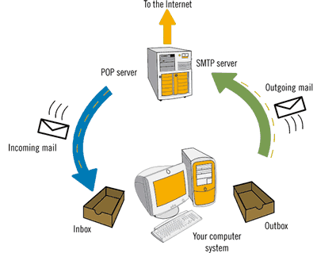
Mail Architecture
Email

Slide 18
Mail Architecture
Email
Simple Mail Transfer Protocol (SMTP) is used to
transfer mail between Mail Servers over Internet
Post Office Protocol (PoP) and Interactive Mail
Access Protocol (IMAP) is used between Client and
Mail Server to retrieve mails
The mail server of a domain is identified by the MX
record of that domain
Popular Mail Servers
        Sendmail/Postfix
        Microsoft Exchange Server
        IBM Lotus

