Slide 1
GROUP 3
DHCP (Dynamic Host Configuration Protocol)

Slide 2
Name | Emp ID
Aaqib Ur Rehman | 094049_IN
Ajaykumar Yadav* | 093943_IN
Bhavana C | 093938_IN
Dileep Bandi | 093940_IN
Laveena R | 093951_IN
Pavithra V | 094000_IN

Slide 3
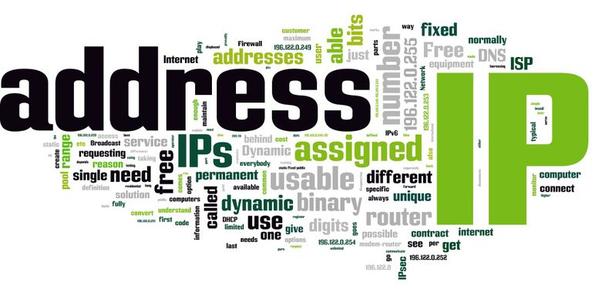

Slide 4
NEED FOR DYNAMIC ALLOCATION
IP address allocation is part of proper network design, which is crucial to the performance and expandability of a network.
When you define which IP addresses will be on which network, you are not only setting a precedent that will be difficult to change, you are limiting the size of your network. This is because IP networks/subnets have limited sizes.
Security- Static IP Address could be a security risk as the IP address is constant. There is a greater chance of hacking the website.
Configuration- The process to set a static IP is manual and relatively complex.
Keeping place with technology- It is relatively complex to transfer the server settings from a static IP computer to a new computer.

Slide 5
ARP Vs RARP
ARP | RARP
1.Mapping an IP address(IPv4) to a physical machine address(MAC). | 1.Mapping a physical machine address (MAC) to an IP address(IPv4).
2.ARP maps 32-bit logical (IP) address to 48-bit physical address. | 2.RARP maps 48-bit physical address to 32-bit logical (IP) address.
3. ARP when provided with the logical address of the receiver it obtains the physical address of the receiver. | 3.RARP when provided with the physical address of the host, it obtains the logical address of the host from the server.

Slide 6
BOOTSTRAP PROTOCOL (BOOTP)
BOOTP (Bootstrap Protocol) is a protocol that lets a network user be automatically configured (receive an IP address) and have an operating system booted (initiated) without user involvement.
The BOOTP server, managed by a network administrator, automatically assigns the IP address from a pool of addresses for a certain duration of time.
PORTS:
1. 67(UDP)server.
2. 68 (UDP) host.

Slide 7
DHCP
Dynamic Host Configuration Protocol (DHCP) is a client/server protocol that automatically provides an Internet Protocol (IP) host with its IP address and other related configuration information such as the subnet mask and default gateway.
Benefits of DHCP:
DHCP Server service provides the following benefits:
Reliable IP address configuration: DHCP minimizes configuration errors caused by manual IP address configuration, such as typographical errors, or address conflicts caused by the assignment of an IP address to more than one computer at the same time.
Reduced network administration: DHCP includes the following features to reduce network administration:
Centralized and automated TCP/IP configuration.
The ability to define TCP/IP configurations from a central location.
The ability to assign a full range of additional TCP/IP configuration values by means of DHCP options.

Slide 8
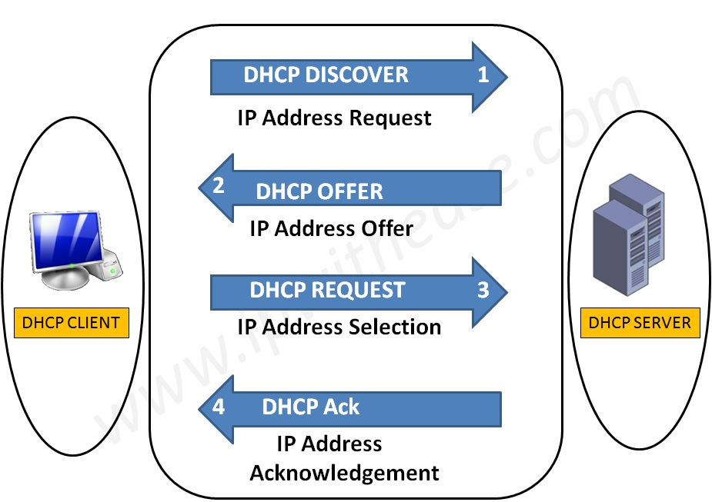
DHCP Architecture
DHCP contains:
DHCP clients
DHCP servers
DHCP relay agents on a network
Clients interact with servers using DHCP messages
To obtain and renew IP address leases.

Slide 9
DHCP Allocation Methods
Dynamic allocation
given IP address is revocable
IP address is given from a Pool (range of IP addresses) at the server
Automatic allocation
Same method is used in getting the address
Given IP address is never revoked
Manual allocation:
The address is allocated based on the user’s request
The address could be out of the DHCP allocated pool
Based on the identity of the node and the possibility of revoking the above methods differ.

Slide 10
BOOTP | DHCP
Intended to configure diskless workstations with limited boot capabilities. | Intended to configure frequently relocated networked computers (such as portables) that have local hard drives and full boot capabilities
Dynamic BOOTP has a default 30-day expiration on IP address leases. | DHCP has a default eight-day expiration on IP address leases.
Supports a limited number of client configuration parameters called vendor extensions | Supports a larger and extensible set of client configuration parameters called options.
BOOTP clients do not rebind or renew configuration with the BOOTP server except when the system restarts | DHCP clients do not require a system restart to rebind or renew configuration with the DHCP server. Instead, clients automatically enter a rebinding state at set timed intervals to renew their leased address allocation with the DHCP server. This process occurs in the background and is transparent to the user.

Slide 11
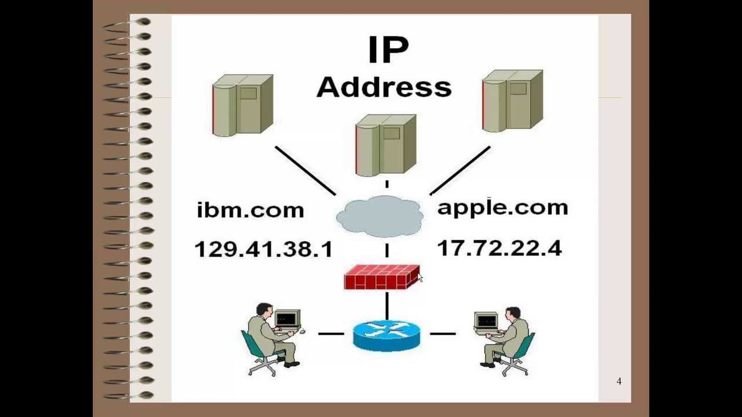
Internet Protocol (IP) Address
IP address is a numerical unique address assigned to each device connected to a computer network that uses the Internet Protocol for communication.
IP address makes it easier for the computers to locate the server from anywhere in the world .
Static IP Address : Computer keeps a single IP address.
Dynamic IP Address : Network assigns the computer a new address each time it connects to the network.

Slide 12
IP Version
IP
IPv4
IPv6
IPv4 addresses are 32 bit length.
IPv4 addresses are represented in decimals.
DHCP is required to configure IPv4 addresses.
IPv4 addresses are 128 bit length.
IPv4 addresses are represented in hexadecimals.
Auto-configuration of addresses is available.

Slide 13

IPv4 is a connectionless protocol for use on packet-switched networks.
It provides the logical connection between network devices by providing identification for each device.
This protocol works at the network layer of the OSI model and at the Internet layer of the TCP/IP model.
IPv4 uses 32-bit addresses which limits the address space to 4294967296 (2³²) addresses.
Example : 10.0.0.1

Slide 14
Classes and Subnet mask in IPv4
Class A : 0-127
Class B : 128-191
Class C : 192-223
Class D : 224-239
Class E : 240-255
255.0.0.0
255.255.0.0
255.255.255.0
N/A
N/A

Slide 15
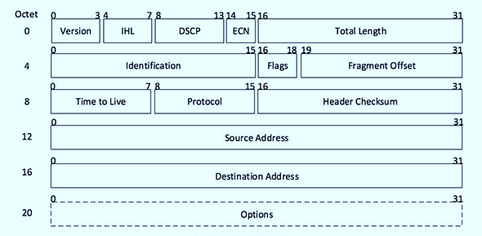
IPv4 Header Format

Slide 16
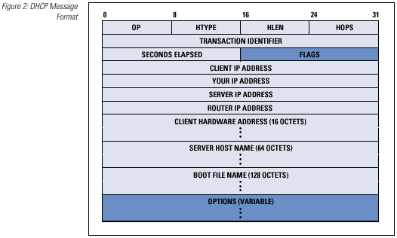
DHCP header
Operation code: This is 8-bit field defines the type of DHCP packet.
Hardware type: Defines the type of Physical network.
Hardware length: defines the length of the physical address in bytes.
Hop count: Defines the maximum number of hops the packet can travel.
Transition ID: The transaction Identification is set by the client and is used to match a reply with the request.
Number of seconds: The number of seconds elapsed since the time the client started to boot.
Flag: Flag is in which only the left most bit is used and the rest of its bits should be 0s. It specifies a forced broadcast reply from the server.
Client IP address: If the client does not have this information, this field will be 0.
Your IP address: it is filled by the server at request of the client.
Server IP address : It is filled by the server in a reply message.
Gateway IP address: It is IP address of the router. It is filled by the server in a reply message.
Client hardware address: this is a physical address of the client. It should be unique.
Server name: It is filled by server in a reply packet.
Boot file system: It should be a null terminated string.
Options (variable): For optional parameter.

Slide 17
DHCP Address Allocation Mechanism
The two main functions of the Dynamic Host Configuration Protocol are to provide a mechanism for assigning addresses to hosts, and a method by which clients can request addresses and other configuration data from servers.
DHCP standard includes three different address allocation mechanisms.
1) Manual Allocation
2) Automatic Allocation
3) Dynamic Allocation

Slide 18
Manual Allocation
Manual allocation is the simplest method, and is equivalent to the method BOOTP uses for address assignment.
Each device has an address that an administrator gives it ahead of time, and all DHCP does is look up the address in a table and send it to the client for which it is intended.
This technique makes the most sense for devices that are “mainstays” of the network, such as servers and routers.

Slide 19
Dynamic Allocation
An administrator sets up a pool (usually a range or set of ranges) of IP addresses that are available for use.
Each client that is configured to use DHCP contacts the server when it needs an IP address.
The server keeps track of which IP addresses are already assigned, and leases one of the free addresses from the pool to the client.
The server decides the amount of time that the lease will last. When the time expires, the client must either request permission to keep using the address (renewing the lease) or must get a new one.

Slide 20
Benefits Of Dynamic Allocation
Automation
Centralized Management
Address Reuse and Sharing
Portability and Universality
Conflict Avoidance

Slide 21
Automatic Allocation
It can be used in cases where there are enough IP addresses for each device that may connect to the network, but where devices don't really care what IP address they use.
Once an address is assigned to a client, that device will keep using it.
Automatic allocation can be considered a “special case” of dynamic allocation.
It is essentially dynamic allocation where the time limit on the use of the IP address by a client (the lease length) is forever.

Slide 22
Use Of MAC In DHCP
Enable and define an explicit allow list. The DHCP server provides DHCP services only to clients whose MAC addresses are in the allow list.
Enable and define an explicit deny list. The DHCP server denies DHCP services only to clients whose MAC addresses are in the deny list.
Enable and define an allow list and a block list. The block list has precedence over the allow list.
This means that the DHCP server provides DHCP services only to clients whose MAC addresses are in the allow list, provided that no corresponding matches are in the deny list.

Slide 23


Slide 24

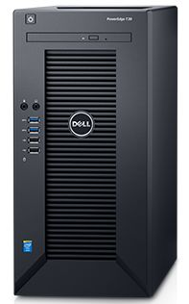
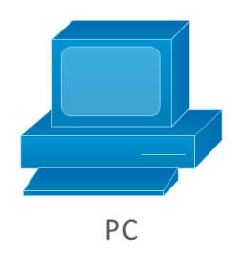
Step 4. DHCP server assign IP address and make sure that allotted IP is not used by any other client in network ,after confirmation it send DHCP ACK or else it will send DHCP NAK
Step 3. Client can receive multiple offer , it will choose one DHCP server and this is notified by DHCP Request message.
Step 1.Client will broadcast DHCP Discover packets in network
Steps 2. DHCP Server will send DHCP Offer which contains IP address offered by DHCP server.
Where is DHCP?
New DHCP CLIENT
DHCP Request
MAC Address
IP Addresses
DHCP ACK
DHCP CLIENT
DHCP RELAY AGENT
DHCP SERVER
DHCP CLIENT

Slide 25
DORA Process
Discovery
Offer
Request
DHCP CLIENT
ACK
DHCP SERVER

Slide 26
STEP BY STEP PROCESS OF DHCP
A device (the client) requests an IP address from a router (the host), after which the host assigns an available IP address to allow the client to communicate on the network.
Once a device is turned on and connected to a network that has a DHCP server, it will send a request to the server, called a DHCPDISCOVER request.
After the DISCOVER packet reaches the DHCP server, the server attempts to hold on to an IP address that the device can use, and then offers the client the address with a DHCPOFFER packet.

Slide 27
Once the offer has been made for the chosen IP address, the device responds to the DHCP server with a DHCPREQUEST packet to accept it.
After which the server sends an ACK that's used to confirm that the device has that specific IP address and to define the amount of time that the device can use the address before getting a new one.
If the server decides that the device cannot have the IP address, it will send a NACK.

Slide 28
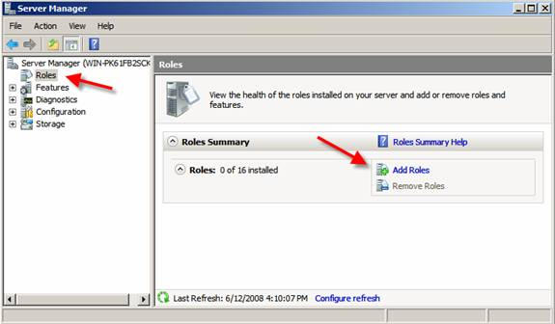
How to configure DHCP server
1. Adding a new Role in Windows Server

Slide 29
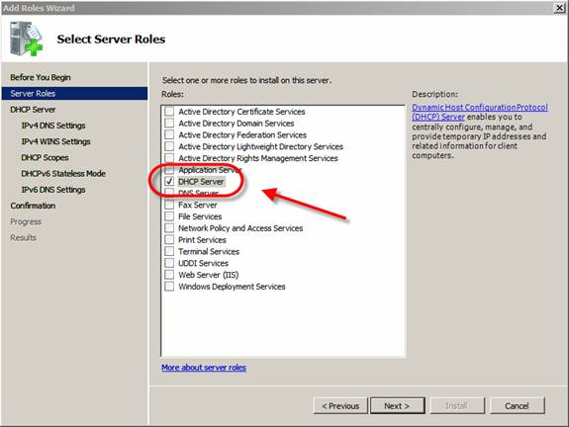
2. Selecting the DHCP Server Role

Slide 30
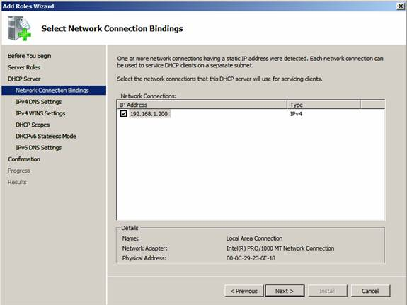
3. Network connection binding

Slide 31
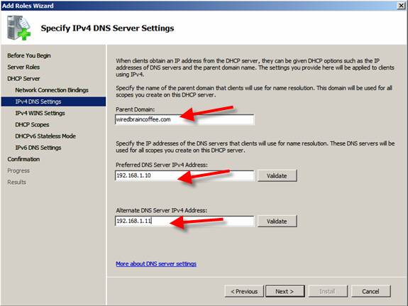
4. Entering domain and DNS information

Slide 32
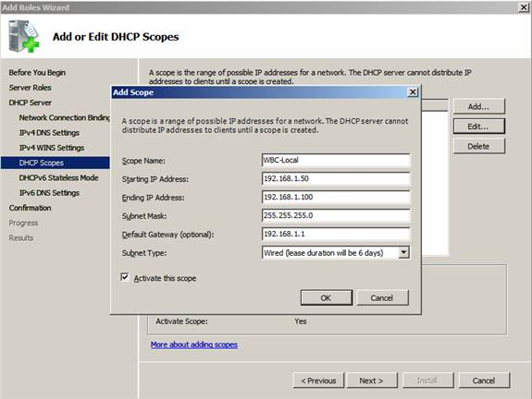
5. Adding a new DHCP Scope

Slide 33
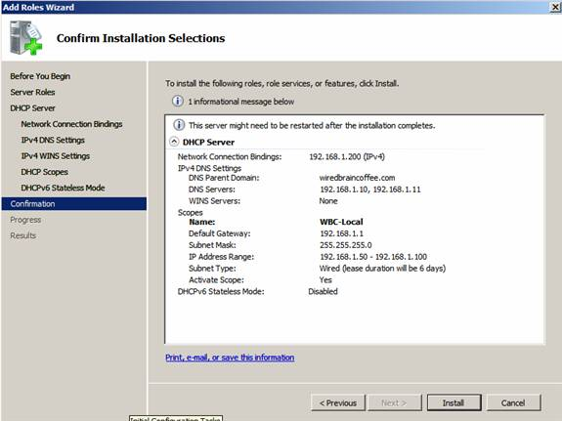
6. Confirm Installation Selections

Slide 34
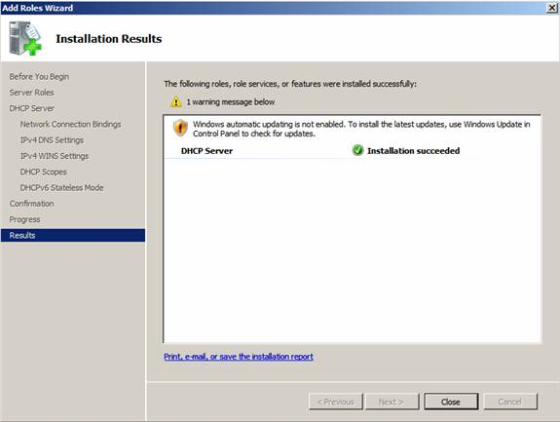
7. Windows Server 2008 DHCP Server Installation succeeded

Slide 35
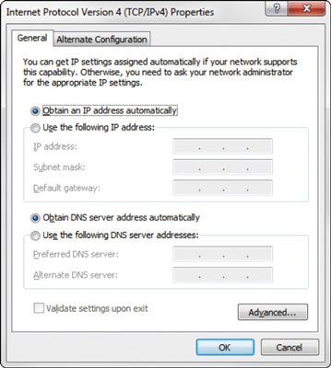
How to configure DHCP client

Slide 36
Any Questions?

