Slide 1
REGISTRY

Slide 2
What is Registry?
The Registry is a database that stores Your computer hardware,
software,security,user settings or profiles,
and property settings for folders and programs.
The registry is where all the settings for windows
and other apps are stored.
Use
The Microsoft Registry Editor (regedit.exe) enables you to view, search for, and change settings in your system registry, which contains information about how your computer runs.

Slide 3
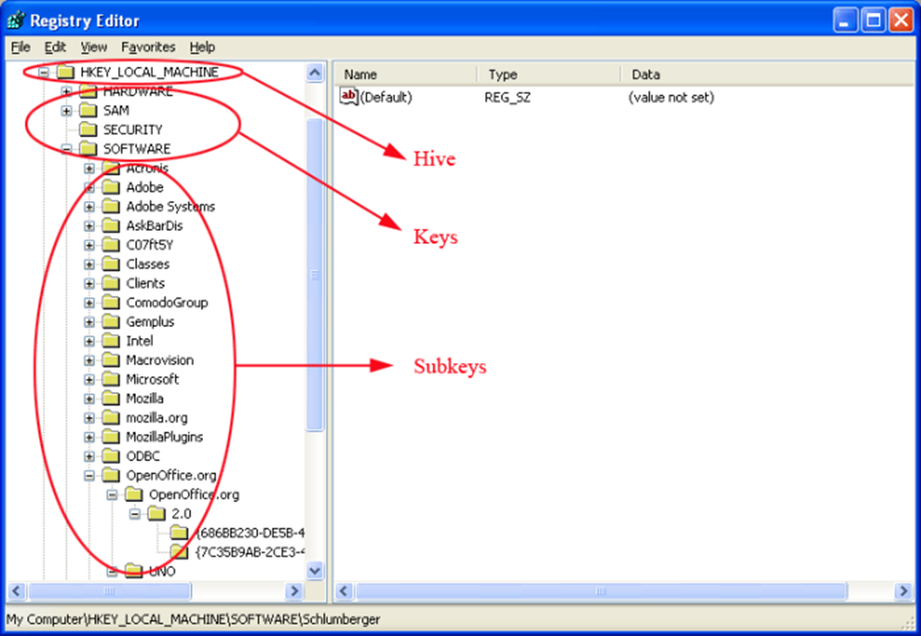
Structure(Key & values, Hives)

Slide 4
What is Hive?
In Registry Editor, the hives are the set of registry keys that appear as folders on the left hand side of the screen when all other keys have been minimized
Registry hive | Supporting files
HKEY_CURRENT_CONFIG | System, System.alt, System.log, System.sav
HKEY_CURRENT_USER | Ntuser.dat, Ntuser.dat.log
HKEY_LOCAL_MACHINE\SAM | Sam, Sam.log, Sam.sav
HKEY_LOCAL_MACHINE\Security | Security, Security.log, Security.sav
HKEY_LOCAL_MACHINE\Software | Software, Software.log, Software.sav
HKEY_LOCAL_MACHINE\System | System, System.alt, System.log, System.sav
HKEY_USERS\.DEFAULT | Default, Default.log, Default.sav

Slide 5
What is registry key?
Registry keys contain registry values, just like folders contain files.
What is a value?
Values are a bit like the files in the folders, and they contain the actual settings.
Location:
Registry hives are located in Windows\System32\Config folder. That is, for instance, if Windows is installed on drive “C”, you can find Registry hives by navigating to C:\Windows\System32\Config folder.

Slide 6
Editing Windows Registry
Add a new key.
Add a new value.
Rename a key or value.
Change an existing value.
Delete a key or value.

Slide 7
Backup and Recovery
Back up the Registry.
Choose File→ Export.
The Export Registry File window appears.
Choose a location for the backup.

Slide 8
Restore
You can restore the backup registry files using the IMPORT option
Go to the file option in the registry and select the import option and select the file where it is located.
Then you will be able to restore the backup files.
Before making any changes in the registry, you should backup all the registry files.

Slide 9
What is Services.msc?
A service is a small program that usually starts when the Windows operating system loads
You won't normally interact with services like you do with regular programs because they run in the background and don't provide a normal user interface.
USES:
Services can be used by Windows to control many things like printing, sharing files, communicating with Bluetooth devices, checking for software updates, hosting a website, etc.

Slide 10
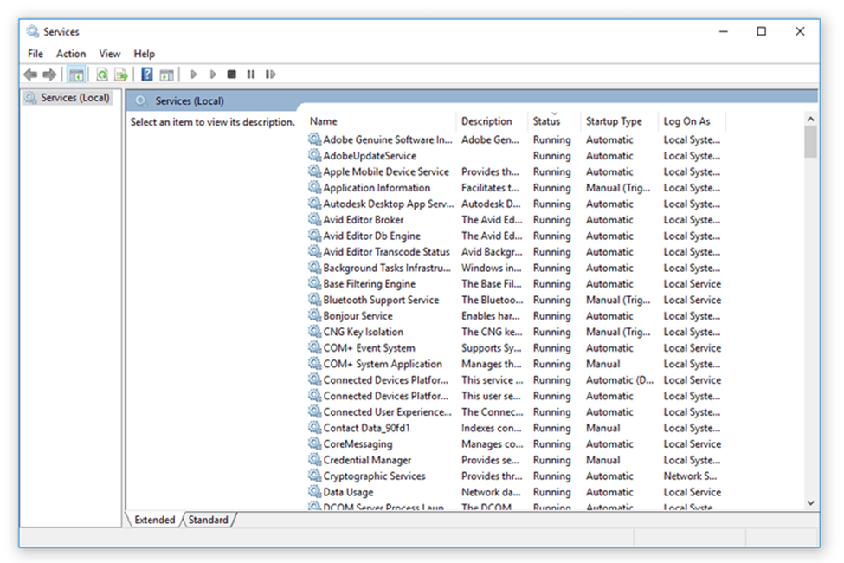

Slide 11
Function of Services
services.msc is an extension locate the services running on a computer : the one which runs at the background and is responsible for each and every program or application which we use on a computer.
for any program or application to work perfectly it's service should be enabled. for example: print spooler service should be enabled only then we will be able to print.

Slide 12
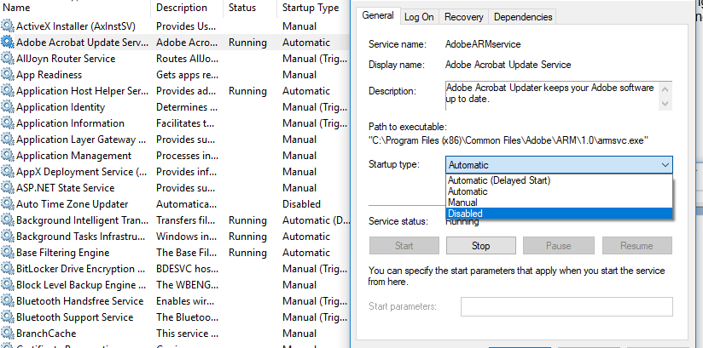

Slide 13
List of services
You can see the full list of services by going to services.msc >action>export and save the file.
You will be able to see all the list of services in the saved document.
Based on the operating system the services may be increased.

Slide 14
Service application
Windows services are a special class of programs that are configured to launch and run in the background, usually without any sort of user interface and without needing a user to log in to the PC.
The primary advantage of running an app as a service is that you can have a program start before a user to log in.

Slide 15
Key Features & Benefits of Running an Application as a Windows Service
Secure — no need to auto-logon to Windows
Constantly monitors your application and restarts it whenever it fails
Able to restart your application (or reboot the computer) at a scheduled time
Able to automatically start your application when your computer boots, to run when no user is logged in and to run despite logon/logoffs — all to guarantee uptime without manual user intervention

Slide 16
Service Control Manager
Service Control Manager (SCM) is a special process under the Windows NT family of operating systems that starts and stops Windows processes, including device drivers and startup programs.
Its main function is to start all the required services at system startup
At boot time, SCM is launched by Wininit.

Slide 17
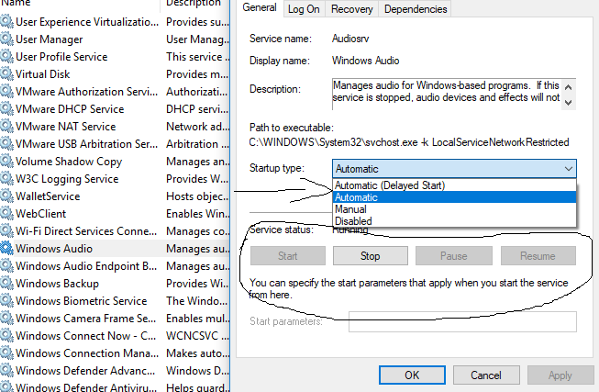

Slide 18
What is Device Driver?
A driver is software that Windows uses to communicate with hardware devices. Without drivers, hardware that is connected to the computer does not work correctly.
For example, if a video card or a printer does not have the correct driver installed, that device may not work correctly.

Slide 19
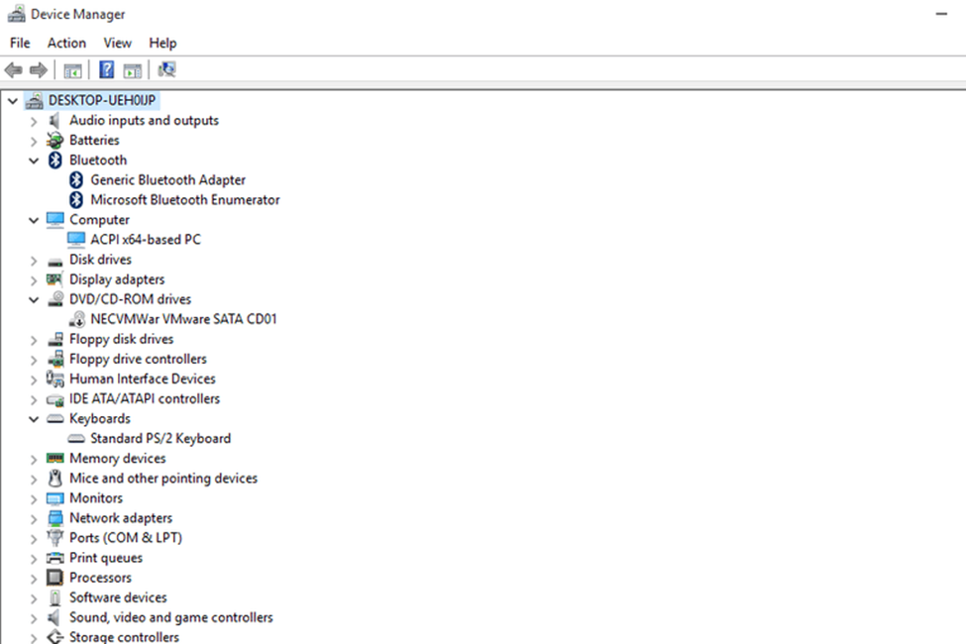

Slide 20
What is Device Controller?
A device controller is a part of a computer system that makes sense of the signals going to, and coming from the CPU.
Any device connected to the computer is connected by a plug and socket, and the socket is connected to a device controller.
It functions as a bridge between the device and the operating system.The electrical part of an I/O device is known as a device controller and can take the form of a chip on personal computers.

Slide 21
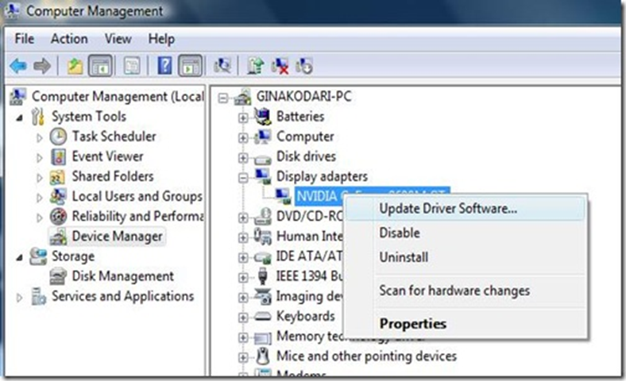
How to install, update and uninstall driver

