Slide 1
GROUP 4
HRISHIKESH 093956_IN
RUSHABH 093976_IN
AMOL 093942_IN
SAIPRIYA 093945_IN *
PRATHYUSHA 093984_IN
BHAVYASHREE 093936_IN
GAURAV 093955_IN

Slide 2
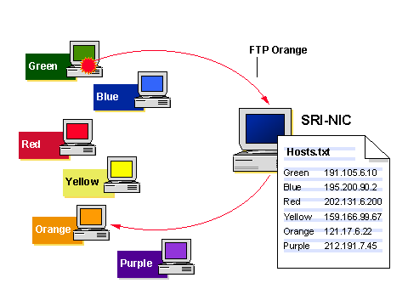
DNS History
ARPANET utilized a central file HOST.txt.
Contains name’s to address mapping.
Maintained by SRI’s NIC
(Stanford-Research-Institute, Network –Information -Center)
Administrators email updates the NIC.
NIC updates HOSTS.txt periodically.
Administrators FTP (Download) HOSTS.txt.

Slide 3
DNS HISTORY Cont….
As the system grew, HOSTS.txt had problems with
Scalability ( Traffic and load).
Traffic: As the network grew the users of the network grew, so there was traffic.
Load: As the user’s grew the data from the user was more and the HOSTS.txt file has a limitation’s
Name Collisions.
Different IP address were having the same naming conventions.
Consistency.
There was no consistency because the network had huge traffic and load.
In 1984, Paul Mockapetris released the first version (RFCs882 and 883,
superseded by 1034 and 1035….)

Slide 4
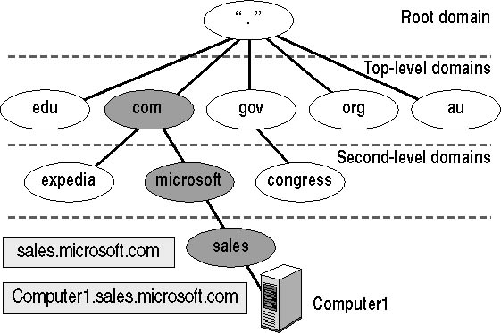
DNS Hierarchy
DNS uses a hierarchy to manage its distributed database system. The DNS hierarchy, also called the domain name space, is an inverted tree structure, much like eDirectory.

Slide 5
Top-Level Name Component of the DNS Hierarchy
Top-Level Name Component | Description | Example DNS Domain Name
.com | An Internet name authority delegates portions of the domain namespace under this level to commercial organizations, such as the Microsoft Corporation. | microsoft.com
.edu | An Internet name authority delegates portions of this domain namespace to educational organizations, such as the Massachusetts Institute of Technology (MIT). | mit.edu
.gov | An Internet name authority delegates portions of this domain namespace to governmental organizations, such as the White House in Washington, D.C. | whitehouse.gov
.org | An Internet name authority delegates portions of this domain namespace to noncommercial organizations, such as the Center for Networked Information Discovery and Retrieval (CNIDR). | cnidr.org
.net | An Internet name authority delegates portions of this domain namespace to networking organizations, such as the National Science Foundation (NSF). | nsf.net

Slide 6
Root Hints
Root hints are DNS data stored in a DNS server.
Root hints are used to prepare servers authoritative for non-root zones so that they can learn and discover authoritative servers that manage domains located at a higher level or in other subtrees of the DNS domain namespace.
These hints are essential for servers authoritative at lower levels of the namespace when locating and finding servers under these conditions.
By default, the DNS Server service implements root hints using a file, named Cache.dns, stored in the %systemroot%\System32\Dns folder on the server computer.

Slide 7
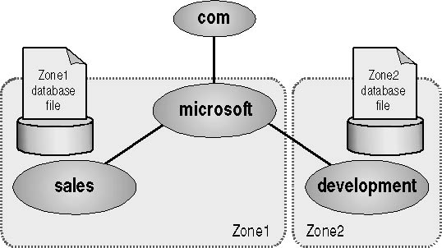
Zone Resolution
A zone represents a discrete portion of the domain namespace. Zones provide a way to partition the domain namespace into manageable sections and they provide the following functions:
Multiple zones in a domain namespace are used to distribute administrative tasks to different groups.

Slide 8
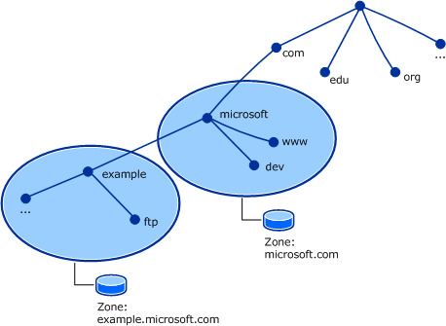
What is a DNS Zone ?
Every domain name, which is a
part of the DNS system, has
several DNS settings, also known
as DNS records ,to keep this DNS
records in order, the DNS zone
was created.
Each DNS zone represents a
boundary of authority subject to
management by certain entities.

Slide 9
Types of DNS Zones
There are 3 types of DNS Zone.
Primary DNS Zone
Secondary DNS Zone
Stub DNS Zone

Slide 10
Primary DNS Zone
Primary DNS Zone contain a read/write copy of the zone data.
All the DNS records added manually or automatically, are written in
this Primary zone of the DNS server
The data is stored in a standard text file – .txt.
Something essential is that to be able to make changes to the DNS
zone, the Primary zone must be available.

Slide 11
Secondary DNS Zone
The Slave zone is a read-only copy of the zone data.
The secondary DNS zone can receive the updated records only from
the primary DNS zone of the DNS server.
Secondary DNS zone can be used as a back up.

Slide 12
Stub DNS Zone
A stub zone is also read-only like a secondary zone, so
administrators can't manually add, remove, or modify resource records on it.
But the differences end here, as stub zones are quite different from secondary
zones in a couple of significant ways.
First, while secondary zones contain copies of all the resource records in the corresponding zone on the master name server, stub zones contain only three kinds of resource records:
A copy of the SOA record for the zone.
Copies of NS records for all name servers authoritative for the zone.
Copies of A records for all name servers authoritative for the zone.

Slide 13
DNS RECORDS
It is database record that maps a URL to an IP address
It contains the basic information of all elements of a domain system.
Each record has a type, an expiration time, class.
There are different types of records used in DNS. Most commonly used records are:
1. A/AAAA
2.CNAME
3.PTR
4.MX

Slide 14
1.A/AAAA:
A/AAAA is used to translate domain names into IP address.
A is used to specify the IPV4 address and AAAA is used to specify the IPV6 address
EX:
Example.com A 12.30.56.96
Example.com AAAA
0123:4567:89ab:cdef:0123:4567:89ab:cdef

Slide 15
2.CNAME: (Canonical NAME)
It is used for creating alias names for the domains.
CNAME record should not be used for a domain that gets a mail, as the mail server deals it with in an odd manner.
MX records cannot refer to CNAME_ defined hostnames.
Ex:
bar.example.com. CNAME foo.example.com.

Slide 16
3.PTR(Pointer Record)
It is used to translate IP address to domain name, by reverse
DNS lookup.
As a prerequisite to create a PTR record , we need to create
a valid A/ AAAA record that points to desired domain of that IP .
Ex:
If our network is 192.168.0.0/24, the available IPs in this network are from 192.168.0.1 to 192.168.0.255 and our reverse zone has following format: 0.168.192.in-addr.arpa

Slide 17
4.MX(Mail Exchange)
It is a record that redirects an email to a specified mail server that accepts the mail on behalf of the domain.
Ex:
example.com MX 10 mail.example.com.
mail.example.com. A 12.34.56.78
The preference value mentioned in the above example is used to prioritize mail delivery if multiple mail servers are available.

Slide 18

The Resolution Process
Let’s look at the resolution process step-by- step:
Group4.Capgemini.com
ping www.abc.com

Slide 19


The Resolution Process
The workstation group4 asks its configured name server, capgemini, for www.abc.com’s address
capgemini.server.com
What’s the IP address of
www.abc.com ?
group4.capgemini.com
ping www.abc.com

Slide 20


The Resolution Process
•
The name server capgemini asks a root name server, mr, for
www.abc.com’s address
What’s the IP address of www.abc.com?
mr.root-servers.net
capgemini.server.com
group4.capgemini.com
ping www.abc.com

Slide 21
The Resolution Process
The root server mr refers capgemini to the com name servers This type of response is called a “referral”
•
capgemini.server.com
mr.root-servers.net
Here’s a list of the com name servers. Ask one of them.
group4.capgemini.com
ping www.abc.com

Slide 22


The Resolution Process
The name server capgemini asks a com name server, com , for www.abc.com ‘s address
What’s the IP address of www.abc.com ?
m.roo
mr.root-servers.net
capgemini.server.com
com.name-servers.net
group4.capgemini.com
ping www.abc.com

Slide 23
The Resolution Process
The com name server com.name refers capgemini to the
abc.com name servers
Here’s a list of the nominum.com name servers.
Ask one of them.
mr.root-servers.net
capgemini.server.com
group4.capgemini.com
ping www.abc.com
com.name-servers.net

Slide 24



The Resolution Process
•
The name server capgemini asks a abc.com name server,
ns1.abc, for www.abc.com address
What’s the IP address of www.abc.com
mr.root-servers.net
capgemini.server.com
ns1.abc.net
com.name-servers.net
group4.capgemini.com
ping www.abc.com

Slide 25
The Resolution Process
The abc.com name server ns1.abc
responds with www.abc.com’s address
mr.root-servers.net
capgemini.server.com
Here’s the IP address for www.abc.com
ns1.abc.net
com.name-servers.net
group4.capgemini.com
ping www.abc.com

Slide 26
The Resolution Process
The name server capgemini responds to group4 with
www.abc.com address
Here’s the IP address for www.abc.com
mr.root-servers.net
capgemini.server.com
ns1.abc.net
com.name-servers.net
group4.capgemini.com
ping www.abc.com

Slide 27
What Is a DNS Cache?
DNS Cache sometimes it called DNS resolver cache.
It is a temporary database which has been maintained by the computer’s operating system.
That contains records of all the recent and attempted visits of the website and other Internet domains.

Slide 28
The Purpose of a DNS Cache
The internet relies on the Domain Name System (DNS) to maintain an index of all public websites and their corresponding IP addresses.
The DNS cache attempts to speed up the process even more by handling the name resolution of recently visited addresses before the request is sent out to the internet.

Slide 29
How a DNS Cache Works
Before a browser issues its requests to the outside network, the computer intercepts each one and looks up the domain name in the DNS cache database.
docs.google.com
-------------------------------------
Record Name . . . . . : docs.google.com
Record Type . . . . . : 1
Time To Live . . . . : 21
Data Length . . . . . : 4
Section . . . . . . . : Answer
A (Host) Record . . . : 172.217.6.174

Slide 30
What Is DNS Cache Poisoning?
A DNS cache becomes poisoned or polluted when unauthorized domain names or IP addresses are inserted into it.
DNS Flushing: What It Does and How to Do It
When troubleshooting cache poisoning or other internet connectivity issues, a computer administrator may wish to flush (i.e. clear, reset, or erase) a DNS cache.

Slide 31
Recursive resolution
A recursive query is a kind of query, in which the DNS server, who received your query will
do all the job of fetching the answer, and giving it back to you. During this process, the DNS
server might also query other DNS server's in the internet on your behalf, for the answer.

Slide 32
Iterative resolution
client sends query to 1st server if server is authorized to
domain name it sends answer otherwise send IP address of next
server who can resolve query. Now here client sends query to 2nd
server .Client continues this process of sending query to server until
query is resolved.
In recursive client only send query to 1st server then server will send request to next server until query is resolved.
In iterative client is responsible for sending query to different servers until query is resolved.

Slide 33
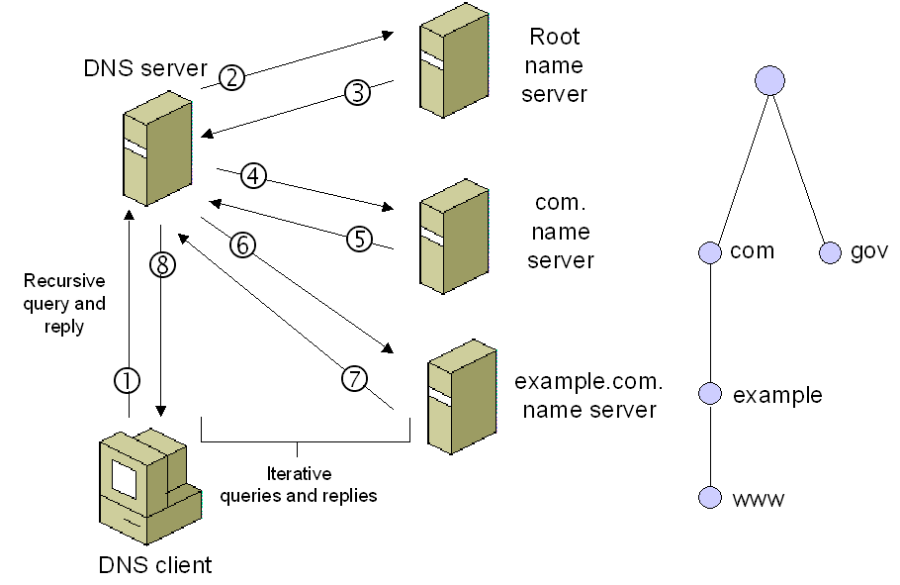
DNS server which keeps all root zone is called TLD name server.

Slide 34


A root server
Located at Amsterdam, , the Netherlands
198.41.0.4 – IPV4
2001:503:ba3e::2:30 – IPV6
B root server
Located at Budapest, Hungary
199.9.14.201 – IPV4
2001:500:200::b – IPV6

Slide 35


C root server
Located at Paris, France
192.33.4.12 – IPV4
2001:500:2::c – IPV6
D root server
Located at London, United Kingdom
199.7.91.13 – IPV4
2001:500:2d::d – IPV6

Slide 36


E root server
Located at Boston, US
192.203.230.10 – IPV4
2001:500:a8::e – IPV6
F root server
Located at Melbourne, Victoria, Australia
192.5.5.241 – IPV4
2001:500:2f::f – IPV6

Slide 37


G root server
Located at Chicago, Illinois, USA
192.112.36.4 – IPV4
2001:500:12::d0d – IPV6
H root server
Located at Des Moines, Iowa, USA
198.97.190.53 – IPV4
2001:500:1::53 – IPV6

Slide 38


I root server
Located at Chennai, Tamilnadu, India
192.36.148.17 – IPV4
2001:7fe::53 – IPV6
J root server
Located at Singapore
192.58.128.30 – IPV4
2001:503:c27::2:30 – IPV6

Slide 39


K root server
Located at Moscow, Russia
193.0.14.129 – IPV4
2001:7fd::1 – IPV6
L root server
Located at Tehran, Iran
199.7.83.42 – IPV4
2001:500:9f::42 – IPV6

Slide 40

M root server
Located at Chimbote, Peru
202.12.27.33 – IPV4
2001:dc3::35 – IPV6

Slide 41
Working of DNS
Website Request
Ask resolver
Ask root server
Ask TLD server
Ask authoritative name servers
Cache the IP and return it to the browser

Slide 42
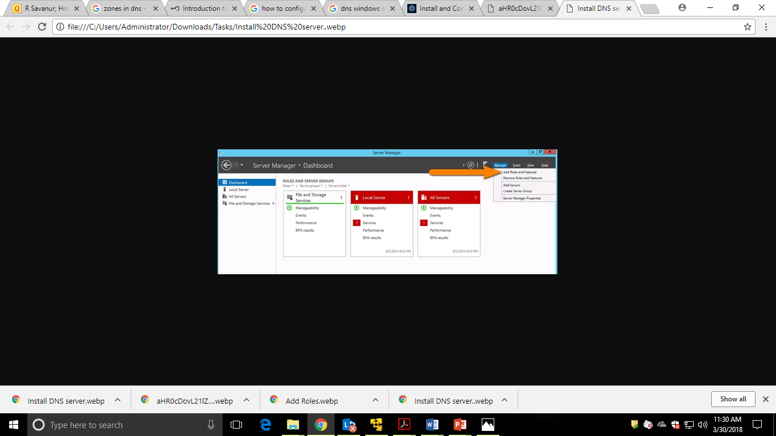
DNS Configuration

Slide 43
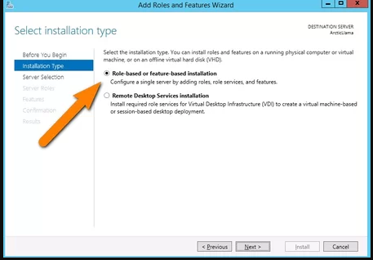
DNS Configuration Contd……..

Slide 44
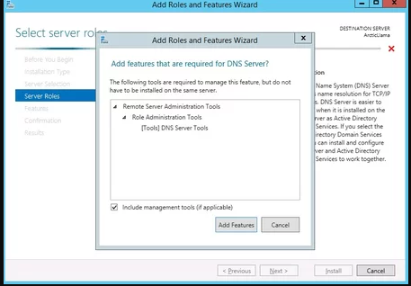
DNS Configuration Contd……..

Slide 45
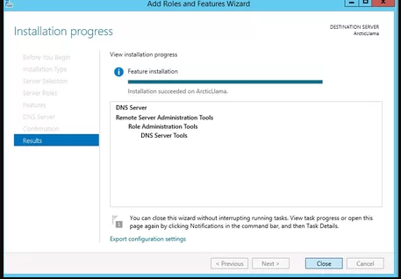
DNS Configuration Contd……..

Slide 46
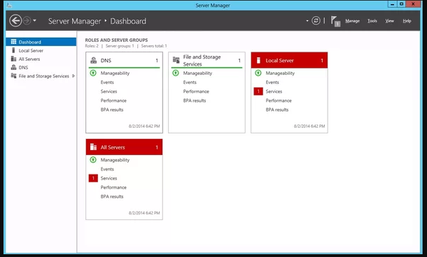
DNS Configuration Contd……..

Slide 47
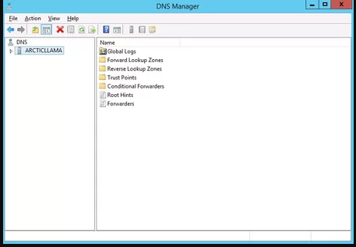
DNS Configuration Contd……..

Slide 48
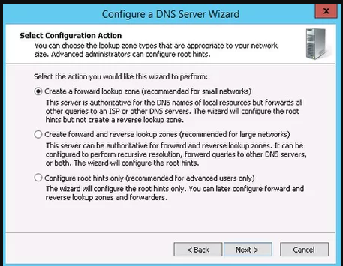
DNS Configuration Contd……..

Slide 49
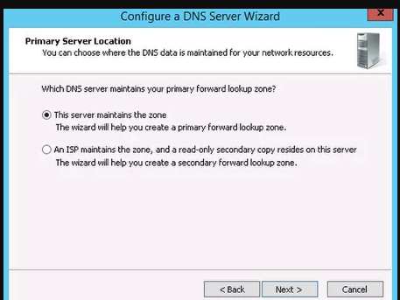
DNS Configuration Contd……..

Slide 50
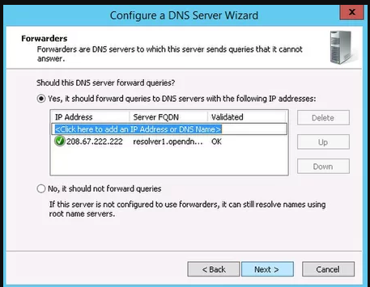
DNS Configuration Contd……..

Slide 51
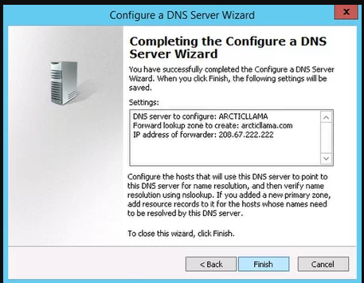
DNS Configuration Contd……..

Slide 52
THANK YOU

