Slide 1

MAIL SERVER
LOGO

Slide 2
LOGO
Presented To : Mam Sara Zainab
Presented by : Jazib Amjad

Slide 3

MAIL SERVER
LOGO
ν
A message transfer agent or Mail transfer agent (MTA) or mail relay is software that transfers electronic mail messages from one computer to another using a client-server application architecture.
ν
An MTA implements both the client (sending) and server (receiving) portions of the SIMPLE MAIL TRANSFER PROTOCOL.
ν
A mail server is a computer that serves as an electronic post office for email. Mail exchanged across networks is passed between mail servers that run specially designed software. .
ν
This software is built around agreed-upon, standardized protocols for handling mail messages and the graphics they might contain
Page ▪ 3

Slide 4

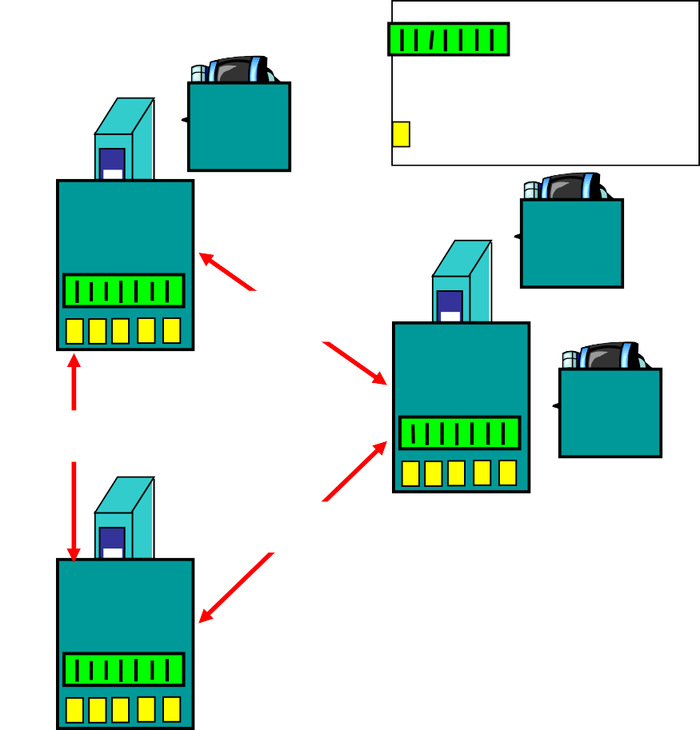



Electronic Mail: Overview
LOGO
Three major components:
user agents, mail servers, SMTP
outgoing message queue
user mailbox
user agent
mail
user agent
User Agent
“mail reader”
composing, editing, reading mail messages
mail server
SMTP
ν
e.g., Eudora, Outlook, elm, Netscape Messenger
server
user agent
SMTP
Mail Servers
ν mailbox contains incoming messages for user
SMTP
mail server
user agent
ν
message queue of outgoing (to
be sent) mail messages
use SMTP protocol between mail servers to send email messages
client: sending mail server
“server”: receiving mail server Gmail?
user agent
user agent

Slide 5
SMTP
LOGO
uses TCP (Transmission Control Protocol )to reliably transfer email message from client to server, port 25
direct transfer: sending server to receiving server
three phases of transfer
handshaking (greeting)
transfer of messages
Closure
command/response interaction
commands: ASCII text
response: status code and phrase
messages must be in 7-bit ASCII

Slide 6
Mail Services
LOGO
Three major mail services:
νSimple Mail Transfer Protocol
SMTP
νPost Office Protocol
POP3
νInternet Mail Access Protocol
IMAP or IMAP4

Slide 7
What is SMTP?
LOGO
Simple Mail Transfer Protocol (SMTP) is the standard protocol for sending emails across the Internet.
SMTP uses TCP port 25 or 2525
Sometimes you may have problems sending messages
ISP(Internet service provider) may have closed port 25
To determine the SMTP server for a given domain name
MX (Mail eXchange) DNS record is use
Simple Mail Transfer Protocol
e-mail transmissions across the Internet
The protocol used today is also known as ESMTP
Relatively simple text-based protocol

Slide 8
What is SMTP?
LOGO
Client-Server protocol
The client transmits an email message to the server
Either
. MUA (Mail User Agent),
- or -
a relaying server's MTA (Mail Transfer Agents)
can act as an SMTP client.
Command/response interaction
commands: ASCII text
Messages must be in 7-bit ASCII

Slide 9
What is SMTP?
LOGO
ν
SMTP requires message (header & body) to be in 7-bit ASCII
ν
SMTP server uses CRLF.CRLF to determine end of message
ν
SMTP is a "push" protocol that does not allow one to "pull" messages from a remote server on demand
ν
To do a pull (i.e. receive) a mail client must use POP3 or IMAP

Slide 10
What is SMTP?
LOGO
After establishing a connection between the sender (the client) and the receiver (the server), the following page shows a legal SMTP session.
In the following conversation, everything sent by the client is prefaced with
C: and everything sent by the server
S:On most computer systems, a connection can be established using the telnet command on the client machine, for example:
ν telnet www.example.com 25

Slide 11
Sample communications
LOGO
S: 220 www.example.com ESMTP Postfix C: HELO mydomain.com
S: 250 Hello mydomain.com
C: MAIL FROM:<sender@mydomain.com> S: 250 Ok
C: RCPT TO:<friend@example.com> S: 250 Ok
C: DATA
S: 354 End data with <CR><LF>.<CR><LF> C: Subject: test message
C: From: sender@mydomain.com C: To: friend@example.com
C:
C: Hello,
C: This is a test. C: Goodbye.
C: .
S: 250 Ok: queued as 12345 C: QUIT
S: 221 Bye

Slide 12

Which one to use?
LOGO
Outbound Mail
νSMTP for outbound email
Port 25 or 2525
Inbound Mail
νPOP3 for inbound email
Port 110
νIMAP for inbound email
Port 143

Slide 13

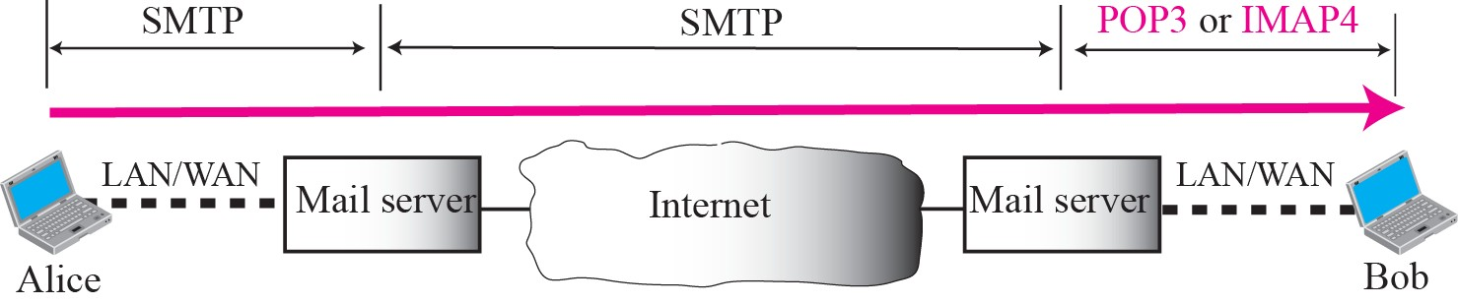
Pop3 and IMAP4
LOGO
1

Slide 14

POP Overview
LOGO
Local e-mail clients use the Post Office Protocol version 3 POP3
Retrieves e-mail from a remote server over a TCP/IP connection
Many subscribers to individual Internet service provider e-mail accounts access their e-mail with client software that uses POP3.
POP3 has made earlier versions of the protocol obsolete
POP (informally called POP1 and POP2)
POP almost always means POP3 in the context of e-mail protocols

Slide 15

POP Overview
LOGO
The design of POP3 and its procedures supports end-users with intermittent connections (such as dial-up connections)
Allows users to retrieve e-mail when connected
View and manipulate the retrieved messages without needing to stay connected
Although most clients have an option to leave mail on server, e-mail clients using POP3 generally:
Connect
Retrieve all messages
Store them on the user's PC as new messages
Delete them from the server
Disconnect.

Slide 16
POP Overview
LOGO
The fundamental difference between POP3 and IMAP4:
POP3 offers access to a mail drop
Mail exists on the server until it is collected by the client
If the client leaves some or all messages on the server
In contrast, IMAP4 offers access to the mail store
The client may store local copies of the messages
These are considered to be a temporary cache
Whether using POP3 or IMAP to retrieve messages:
E-mail clients are commonly categorized as either POP or IMAP clients, but in both cases the clients also use SMTP
POP3 that allow some clients to transmit outbound mail via POP3

Slide 17
POP Overview
LOGO
In contrast, the newer, more capable Internet Message Access Protocol (IMAP) supports both connected and disconnected modes of operation.
ν E-mail clients using IMAP generally leave messages on the server until the user explicitly deletes them.
This and other fact of IMAP operation allow multiple clients to access the same mailbox
ν
Most e-mail clients support either POP3 or IMAP to retrieve messages
ν Few Internet Service Providers (ISPs) support IMAP

Slide 18
IMAP
LOGO
Internet Message Access Protocol
Commonly known as IMAP or IMAP4
An application layer Internet protocol
Operates on port 143
Allows a local client to access e-mail on a remote server
Previously called Internet Mail Access Protocol, Interactive Mail Access Protocol (RFC 1064), and Interim Mail Access Protocol)
ν
Current version is IMAP version 4 revision 1
ν
IMAP4 and POP3 are the two most prevalent Internet standard protocols for e-mail retrieval
ν Allows interoperability with other servers and clients

Slide 19
IMAP
LOGO
ν
Support for the Internet standard protocols
Allows other e-mail clients to access these servers
Allows the clients to be used with other servers
E.g. Qualcomm's Eudora or Mozilla Thunderbird
ν
IMAP is often used in large networks
ν For example, a college campus mail system.
ν
IMAP allows users to access new messages
ν The mail is stored on the network
ν
With POP3, users either
download the e-mail to their computer
access it via the web.
take longer than IMAP
must either download any new mail or "refresh" the page to see the new messages.

Slide 20

Difference
between
POP3 and IMAP
 | L | OGO
POP3 - Post Office Protocol | IMAP - Internet Messaging Access Protocol
You can use only one computer to check your email | You can use multiple computers to check your email
Your mails are | Your mails are
stored on the | stored on the server
computer that you
use
Outgoing email is stored locally on your PC | Outgoing email is filtered to a mailbox on the serve
•
POP3 works by reviewing the inbox on the mail server, and downloading the new messages to your computer. IMAP downloads the headers of the new messages on the server, then retrieves the message you want to read when you click on it.
•
When using POP3, your mail is stored on your PC. When using IMAP, the mail is stored on the mail server. Unless you copy a message to a "Local Folder" the messages are never copied to your PC.

Slide 21
Advantages And Disadvantages Of
LOGO
E-mail?
Advantages:
Quick delivery and reply of messages
Convenient
Can contact a group of people at once
No limit on how short or how long the message should be (it would seem ridiculous to send a one line letter to someone in the post, but on email this is acceptable)
Can attach large documents and other files with a click of a button (and without using up resources like paper)
Doesn't use any paper (good for the environment)
ν
Disadvantages:
Less social contact with people (social skills won't be as well developed)
Less hand-writing practice
Can be bad for your eyes if you spend too long sending e-mails on your computer
Messages may be misinterpreted easily
Abbreviated language may become common practice for some people
Can provide an easy way to spread viruses to computers
Can be easy to make a "typo" and say the wrong thing, or send the email to the wrong person
- Access to a computer and the internet is necessary, and this may not be convenient for all people

Slide 22
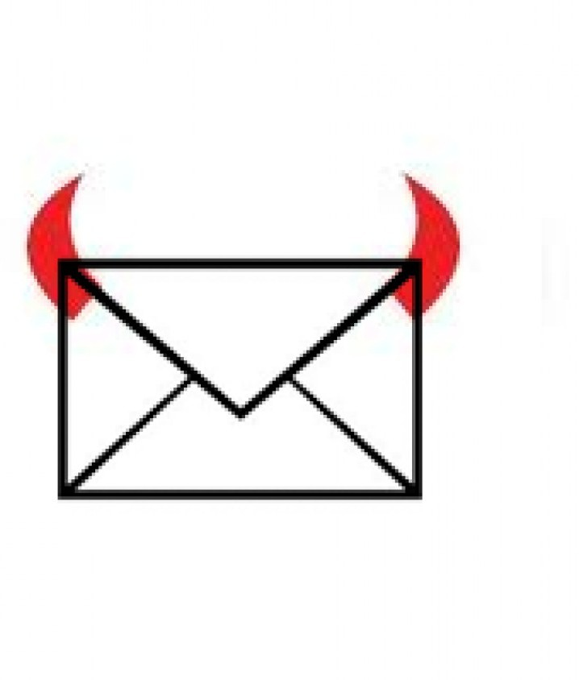
Thank You

