Slide 1
Windows
Fundamentals

Slide 3
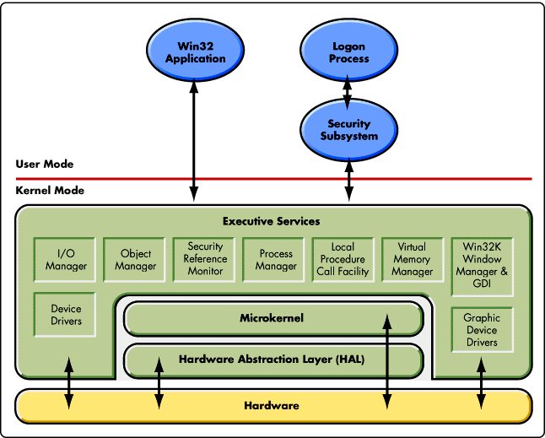
Kernel Architecture

Slide 4
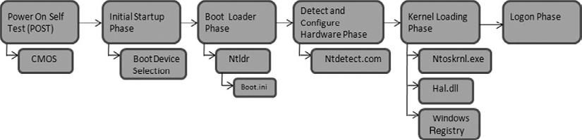
Booting Process

Slide 5
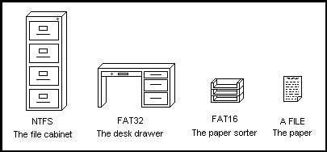
File System

Slide 6
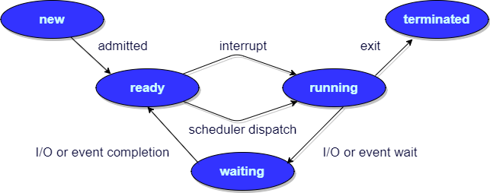
Process Management

