Slide 1
Windows
Fundamentals

Slide 2
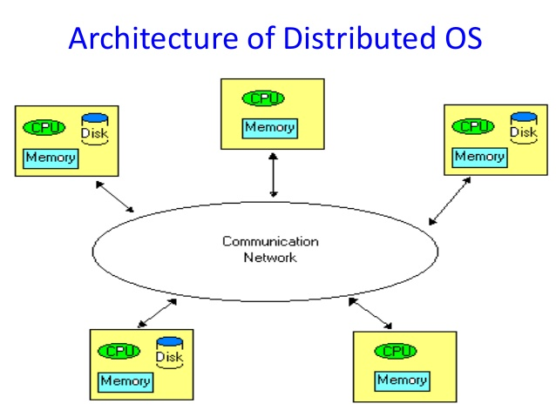
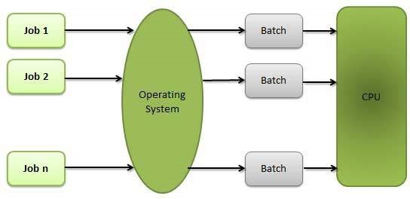
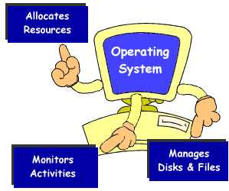
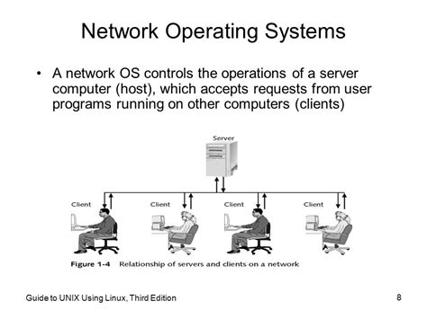
Types Of Operating System
Distributed Operating System
Batch Operating System
Multi Tasking Operating System
Network Operating System

Slide 3
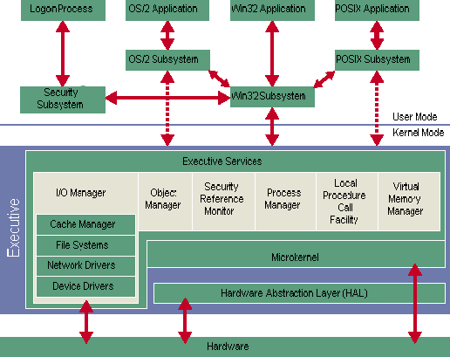
Kernel Architecture

Slide 4

Booting Process

Slide 5
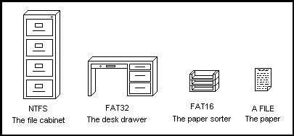
File System

Slide 6
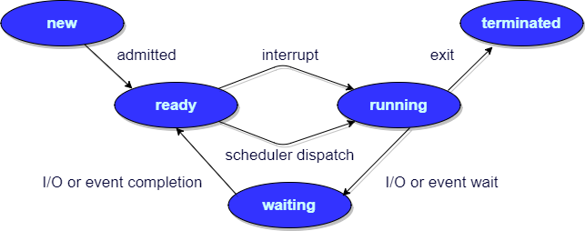
Process Management

Slide 7
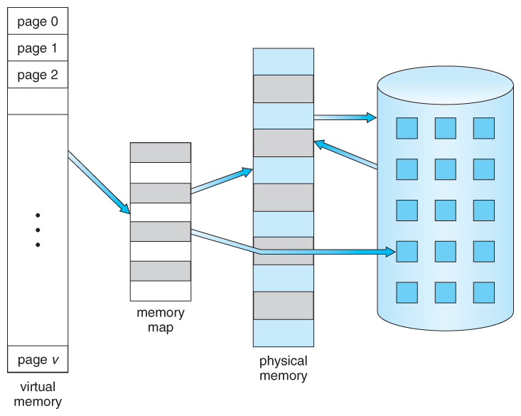
Memory management

