Slide 1
Application Fundamentals

Slide 2
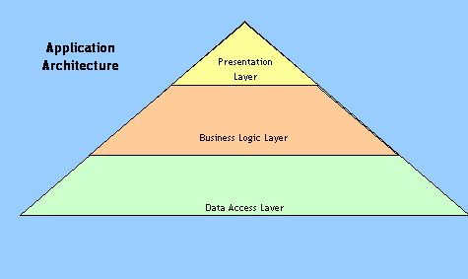
Introduction
Application is a program designed to perform a group of coordinated functions, tasks, or activities for the benefit of the user.
Web applications ,android application and desktop application etc
Killer app-only runs on one platform increasing the desirability of that platform.
Components of Application
Presentation logic
Business logic
Data persistence logic

Slide 3
Life cycle of application
ALM is a set of pre-defined processes that start somewhere in the business as an idea, a need, a challenge or a risk and then pass through different development phases such as definition, design, development, coding, testing, deployment, release and maintenance spanning across an entire lifecycle of a product. The entire ALM process is closely monitored and controlled proper tracking and documentation of any changes to the application.
Performance Tuning & Optimization
Maintenance
Crash Recovery
Migration
Deployment

Slide 4

Application Types
Types of application:
Compiled : Microsoft visual studio
Interpreted :different coding Language ruby ,python, php…
Application Programming Interface:
An application program interface (API) is code that allows two software programs to communicate with each other.
API is a set of routines, protocols and tools for developing software and applications.
APIs make it very easy to share data.

Slide 5
Benefits &Types of API
Efficiency
Wider reach
Automation
Partnership
Simple
Web service API: REST, SOAP
Source code API
Library based: TWAIN,OCI(oracle call interface)
Class based: JAVA ,Android, google API
Object remoting API : CORBA
Hardware API :SDk..

Slide 6
Application architecture types:
Thick client:Major processing is done at the client side and involves only a periodic connection to the server. fat client which has most resources installed locally.
Thin client :A thin client is a networked computer with few locally stored programs and a heavy dependence on network resources
Rich internet : A rich client has some resources installed locally but also depends on other resources distributed over the network .It relies largely upon network-distributed resources

Slide 7
Application attacks and counter measures
Application security is the use of software, hardware, and procedural methods to protect applications from external threats,
ATTACKS:
SQL injection
Cross-Site Scripting Attacks
Denial of Service
Session Hijacking/CrossSite Request Forgery(CSRF)

Slide 8
Counter measures
Counter measures:
Using stored procedures with parameters that are automatically parameterized.
Implementing CAPTCHA or prompting users to answer questions. This ensures that a form or request is being submitted by a human and not a bot.
Use a Web Application Firewall (WAF) to monitor your network and block potential attacks.

Slide 9
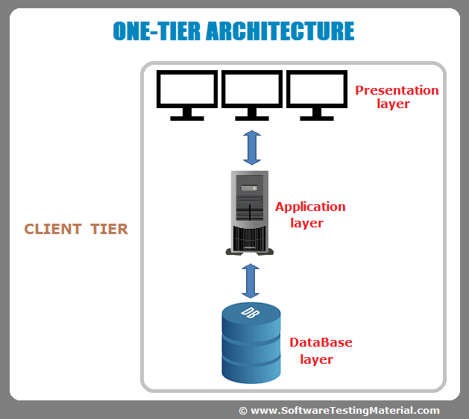
Tier:
1 tier application
2 tier application
3 tier application

Slide 10
