Slide 1
LINUX FUNDAMENTALS
Group 6

Slide 2

File System
Linux File System Contains

Slide 3


Process Scheduling :
Functions of Scheduler:
CPU Utilization
Throughput
Turnaround
Wait time
Response time
Types of scheduling
FIFO
Round Robin
SJF
Priority Based

Slide 4
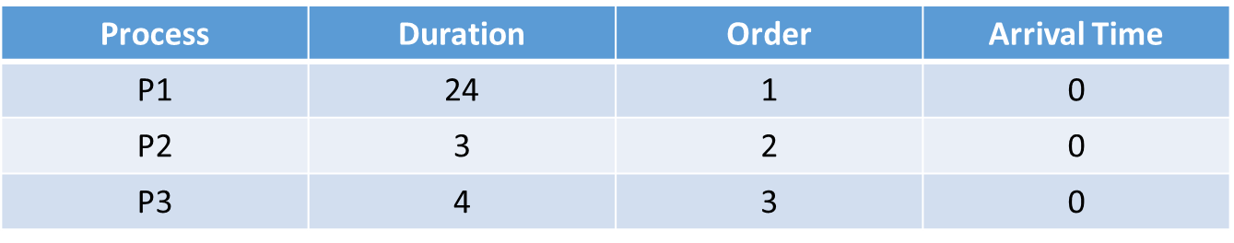
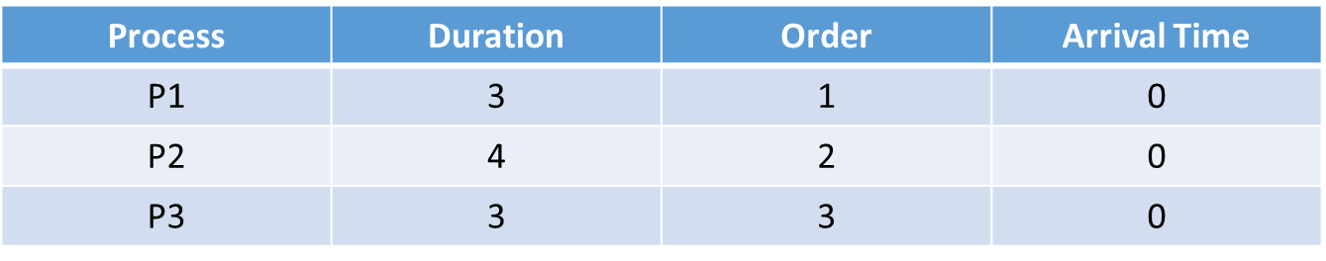
FIFO(First in First Out):
FIFO simply queues processes in the order that they arrive in the ready queue.
Eg:
Round Robin Scheduling:
Round Robin is a CPU scheduling algorithm where each process is assigned a fixed time slot in a cyclic way.
Eg:

Slide 5
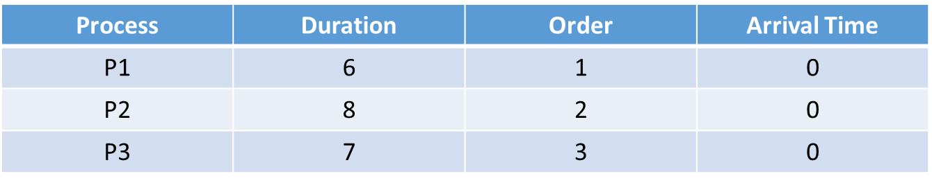
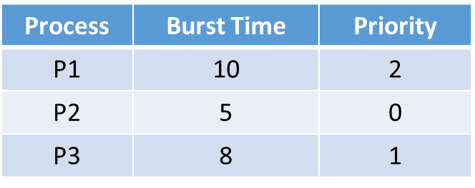


SJF(Shortest Job First serve) or shortest job next
It is a scheduling policy that selects the waiting process with the smallest execution time to execute next.
Eg:
0 6 13 21
Round Robin Scheduling:
Process with the highest priority is to be executed first and so on.
Eg:

Slide 6
DEVICE MANAGEMENT
Device File:
Device files allow user programs to access hardware devices on the system through the kernel.
Types of Device File:
Character Devices
Block Devices
IRQ (Interrupt request ):
Divided in 2 parts
Top Half
Bottom Half

