Slide 1
LINUX FUNDAMENTALS
GROUP 6
GAURAV
10/4/2018

Slide 2
KERNEL AND ITS SUBSYSTEM
User Space
Tools & Application
Process Scheduler
Memory Manager
Virtual FileSystem
Kernel Space
Network Interface
IPC
Hardware

Slide 3
BOOTING PROCESS
BIOS
GRUB
init
MBR
KERNEL
RUN
LEVELS

Slide 4
SHELL
Shell(Command Interpreter):
The shell is the layer of programming that understands and executes the commands a user enters.
ENVIRONMENTAL VARIABLES:
Dynamic values
Case Sensitive
Permanent & Temporary
Types Of Shell
ASH
BOURNE
BASH
COM
T-SHELL
C-SHELL
Z-SHELL

Slide 5
File System
Linux File System Contains
Boot Block | Super Block | I-Node | Data Block
Types
Ext2
Ext3
Ext4
ISOFS
SYSFS
PROCFS

Slide 6
PROCESS MANAGEMENT
PROCESS SCHEDULING:
Functions of scheduler
Scheduling refers to the way processes are assigned to run on the available cpu’s.
Cpu Utilization
Throughput
Turn Around
Wait Time
Response Time
Fairness
TYPES OF SCHEDULING
INTER PROCESS MANAGEMENT
Assigning Priority
Kill Process
FIFO | Round Robin | SJF | Priority Based
Redirection
Zombie
Interactive and Batch Process

Slide 7
DEVICE MANAGEMENT
Device File:
Device files allow user programs to access hardware devices on the system through the kernel.
Types of Device File:
Character Devices
Block Devices
IRQ (Interrupt request ):
Divided in 2 parts
Top Half
Bottom Half

Slide 8
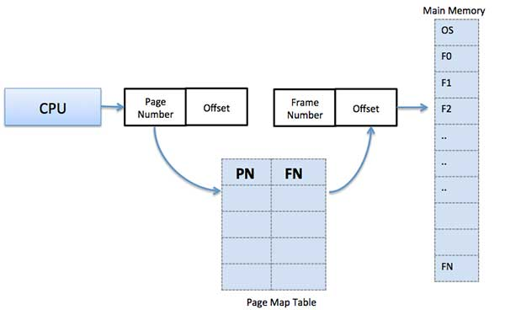
MEMORY MANAGEMENT
Virtual Memory: In the Virtual Memory the Physical Memory (Hard Disk) will be treated as the Logical Memory (random access memory (RAM)).
Algorithm used : LRU , Buddy
Page allocation and deallocation

