Slide 1
WINDOWS FUNDAMENTALS
GROUP 6
RAJ SUBASH
10/4/2018

Slide 2

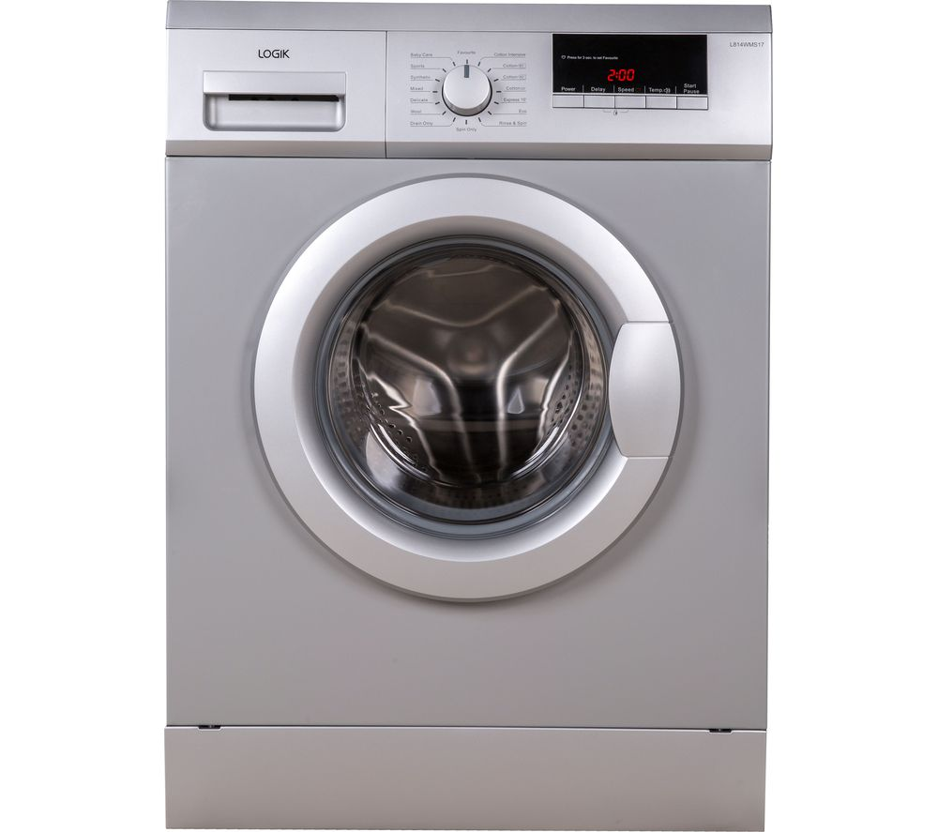
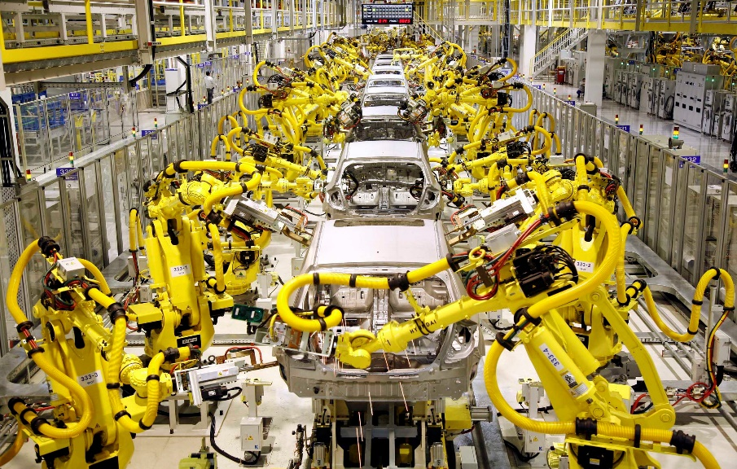
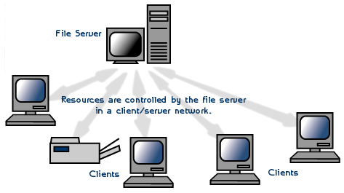
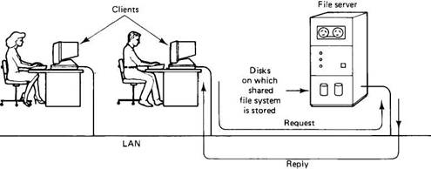
TYPES OF OPERATING SYSTEM

Slide 3
KERNEL ARCHITECTURE
Win 32 application
Logon process
Winlogon.exe
Win 32 subsystems
Win32k.sys
Local Security Authority
(LSA)
Security Accounts Manager (SAM)
USER MODE
EXECUTIVE SERVICES
KERNEL MODE
I/O Manager
Power manager
Object
manager
Process & Thread manager
Memory
Manager
Security
Reference
manager
Configuration
Manager
(Registry)
Local procedure call
PNP manager
Kernel Transaction
manager
Cache manager
Kernel
Window manager
File system
GDI
Network Drivers
Hardware Abstraction Layer
Device Drivers
Graphic Drivers
Hardware

Slide 4
BOOTING PROCESS
Power On Self Test
(POST)
MBR
OS Loader Phase
Kernel Initialization
Session Initialization
Win logon
Initialization
CMOS
Partition
Table
Boot sector
Phase 0
Boot Mgr
Phase 1
Explorer
Initialization

Slide 5
FILE SYSTEM
FAT
Boot Sector
FAT 1
FAT 2
(Duplicate)
Root Folder
Other Folder and Files
NTFS
Boot Sector
Master File Table
File System Data
File Area

Slide 6
PROCESS STATE
schedule
New
Ready
Running
completed
Termination
create
priority
Resume
Suspend
I/O Completed
I/O Request
Suspend
Ready
Wait
Resume
Suspend
Suspend Wait
Process completed I/O
But still in Suspend

Slide 7
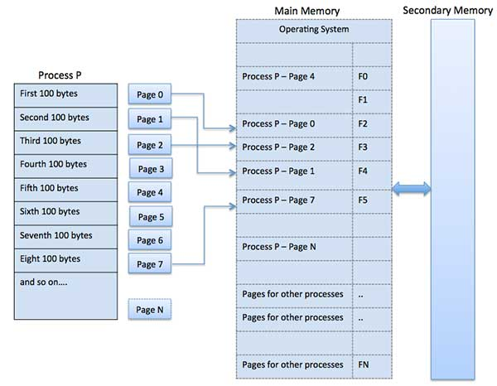
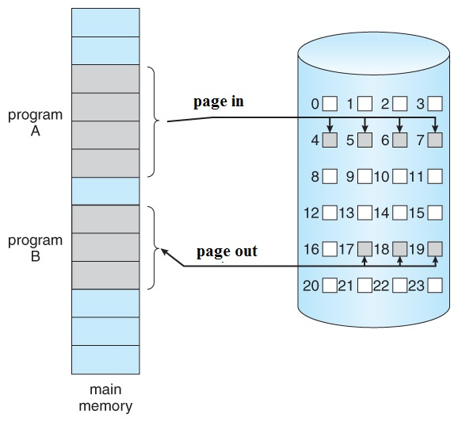
MEMORY MANAGEMENT

