Slide 1
DATABASE FUNDAMENTALS
GROUP 6
NANDINI
10/4/2018

Slide 2
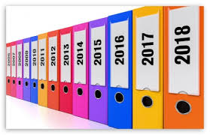
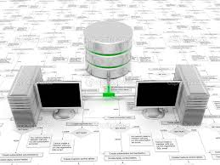
DATABASE
A database is a collection of information that is organized so that it can be easily accessed, managed and updated.
History :
Hierarchical database
Network database
The network model builds on the hierarchical model by allowing many-to-many relationships
The hierarchical model organizes data into a tree-like structure, where each record has a single parent or root.
Relational database
The relational model sorts data into tables, also known as relations, each of which consists of columns and rows.
Object relational database
It combines the simplicity of the relational model with some of the advanced functionality of the object-oriented database model.
In which information is represented in the form of objects as used in object-oriented programming.
Object database

Slide 3
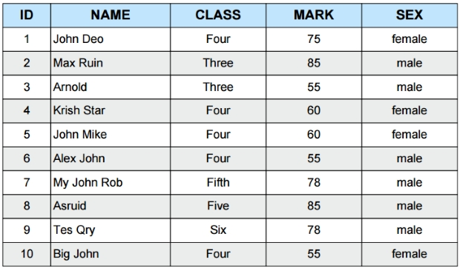
DATABASE MANAGEMENT SYSTEM:
DBMS is the software system that allows users to define, create and maintain a database and provides controlled access to the data.
ACID Properties:
TERMINOLOGIES:
1.A-Atomicity 3.I- Isolation
2.C-Consistency 4.D- Durability
Attribute
Field
Tuple
Cardinality=10
Domain
Degree=5

Slide 4
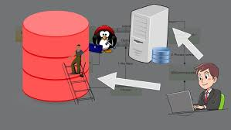
RDBMS
A relational database refers to a database that stores data in a structured format, using rows and columns.
Entity Relationship Modeling :
The entity-relationship model (or ER model) is a way of graphically representing the logical relationships of entities (or objects) in order to create a database.
EF codd rules:
Rule 1: Information Rule
Rule 2: Guaranteed Access Rule
Rule 3: Systematic Treatment of NULL Values
Rule 4: Active Online Catalog
Rule 5: Comprehensive Data Sub-Language Rule
Rule 6: View Updating Rule
Rule 7: High-Level Insert, Update, and Delete Rule
Rule 8: Physical Data Independence
Rule 9: Logical Data Independence
Rule 10: Integrity Independence
Rule 11: Distribution Independence
Rule 12: Non-Subversion Rule

Slide 5
NORMALIZATION:
Normalization is a database design technique which organizes tables in a manner that reduces redundancy and dependency of data.
Types of normalization:
1.UNF 4.3NF
2.1NF 5.BCNF
3.2NF
SQL:
SQL is a standard language for storing, manipulating
and retrieving data in databases.
Joins
Index
views
SQL types
DDL
DML
DCL
TCL
Create
Alter
Truncate
Drop
Desc
Rename
Insert
Update
Delete
Select
Grant
Revoke
Savepoint
Rollback
Commit

Slide 6





Database Layered Architecture: DBMS Products:
Logical Modules of RDBMS:
Application Layer
Logical Layer
Physical Layer
Query Processing
Physical Layer
Physical Layer
Storage Management

Slide 7
APPLICATION FUNDAMENTALS
GROUP 6
NANDINI
10/4/2018

Slide 8
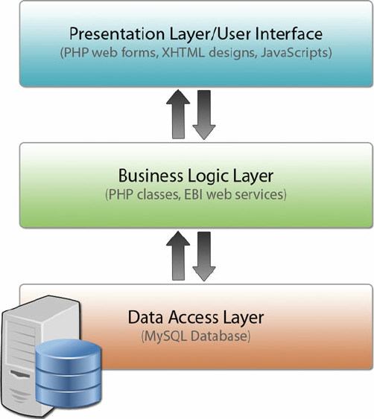
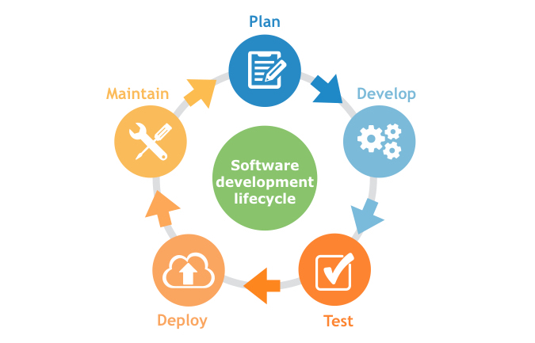
APPLICATION
Application is a program designed to perform a group of coordinated functions, tasks, or activities for the benefit of the user.
Components of Application:
Life cycle of application:

Slide 9

APPLICATION
Types of Application:
Compiled
Interpreted
Application Programming Interface:
An application program interface (API) is code that allows two software programs to communicate with each other.
Application security:
Application security is the use of software, hardware, and procedural methods to protect applications from external threats.
Attacks:
SQL injection
Cross-Site Scripting Attacks
Denial of Service
Session Hijacking/Cross Site Request Forgery(CSRF)
Counter measures:
Using stored procedures with parameters that are automatically parameterized.

Slide 10
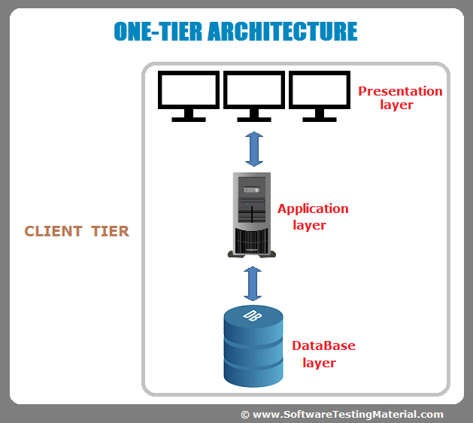
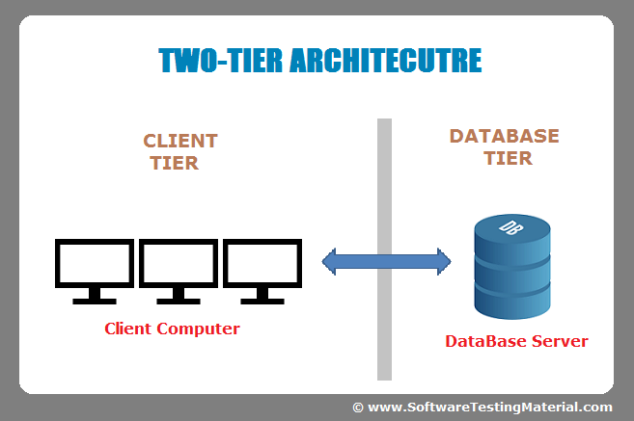
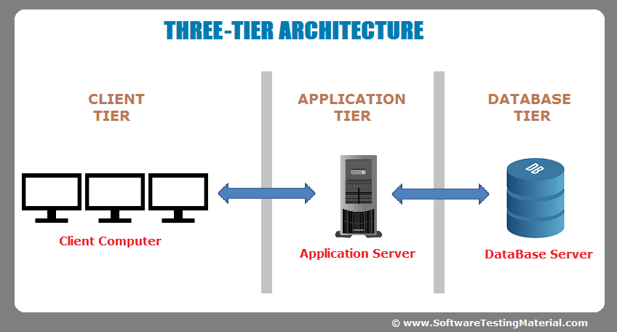
APPLICATION ARCHITECTURE
Thick client architecture
Thin client architecture
Rich internet application
TIER:
Enterprise Applications

Slide 11
STORAGE FUNDAMENTALS
GROUP 6
NANDINI
10/4/2018

Slide 12
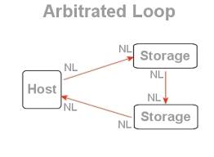
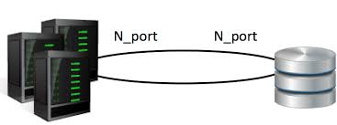
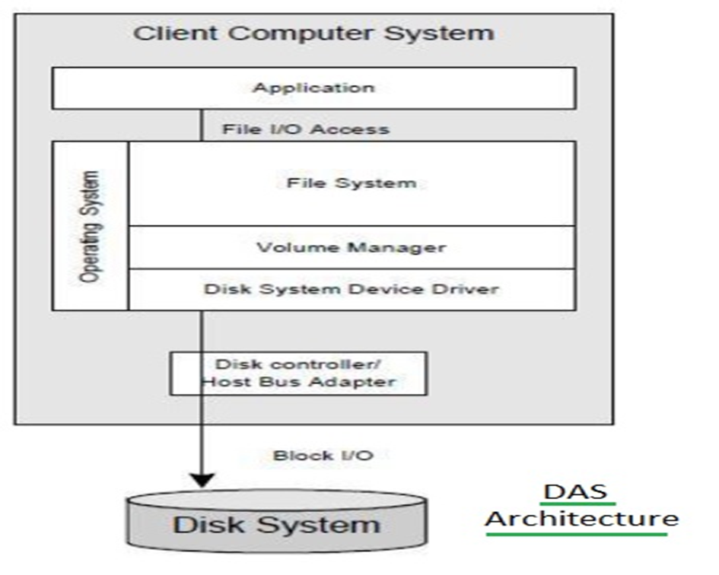
STORAGE
Storage is a process through which digital data is saved within a data storage device by means of computing technology.
Fiber channel:
FC Point to Point
FC Arbitrated Loop
Storage Model:
Direct Attached Storage (DAS)

Slide 13
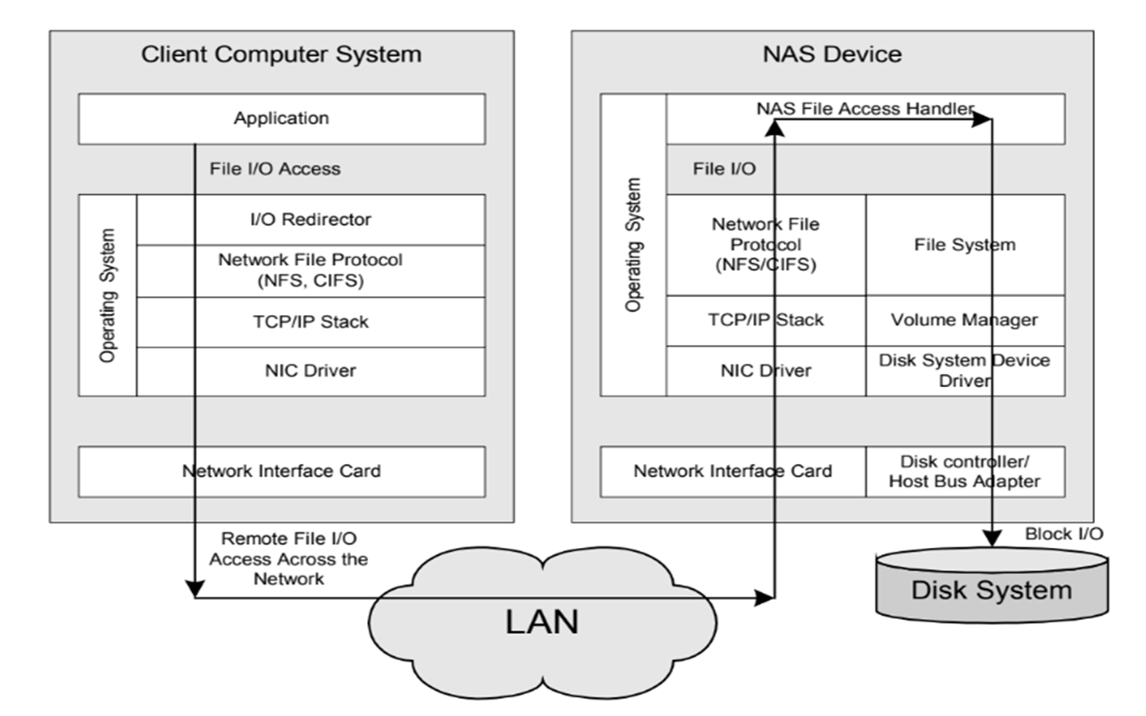
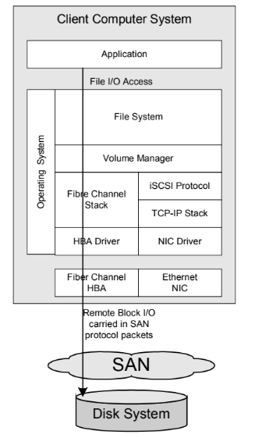
TYPES OF STORAGE
Network Attached Storage (NAS) Storage Area Network(SAN)

Slide 14
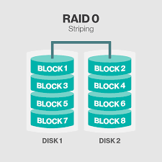
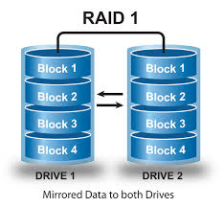
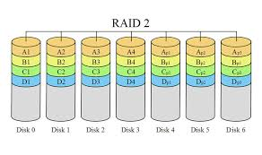
RAID(REDUNDANT ARRAY OF INEXPENSIVE DISKS) LEVELS
Basic idea is to connect multiple disks together to provide large storage capacity, faster access to reading data and redundant data
RAID Level-0
RAID Level-1
RAID Level-2

Slide 15
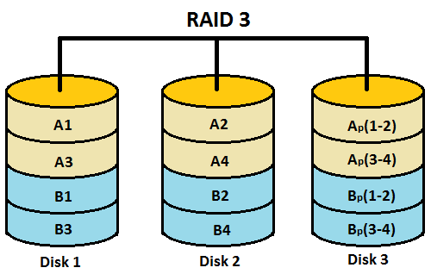
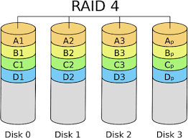
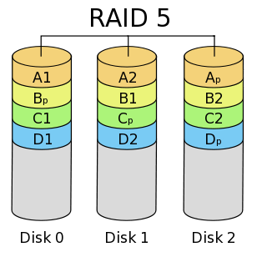
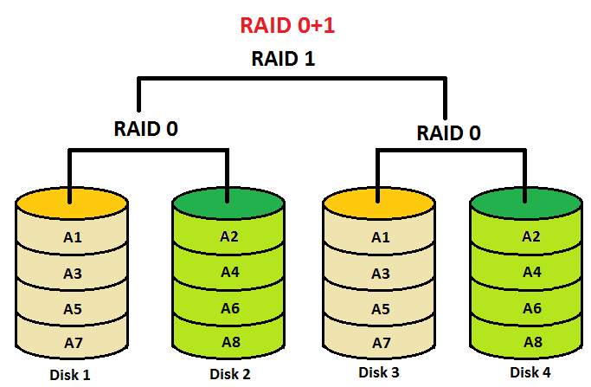
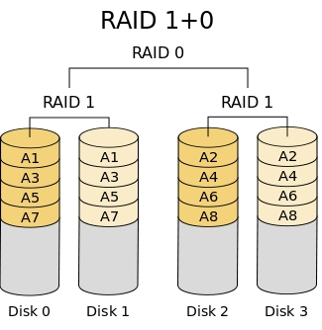
RAID Level-3
RAID(REDUNDANT ARRAY OF INEXPENSIVE DISKS) LEVELS
RAID Level-4
RAID Level-5
RAID Level- 1+0 & 0+1

Slide 16
THANK YOU

