Slide 1
FILE SYSTEM
Disk , Partition and Volume
Files and Directories
File Attribute and Operations

Slide 2
What is File System ?

Slide 3
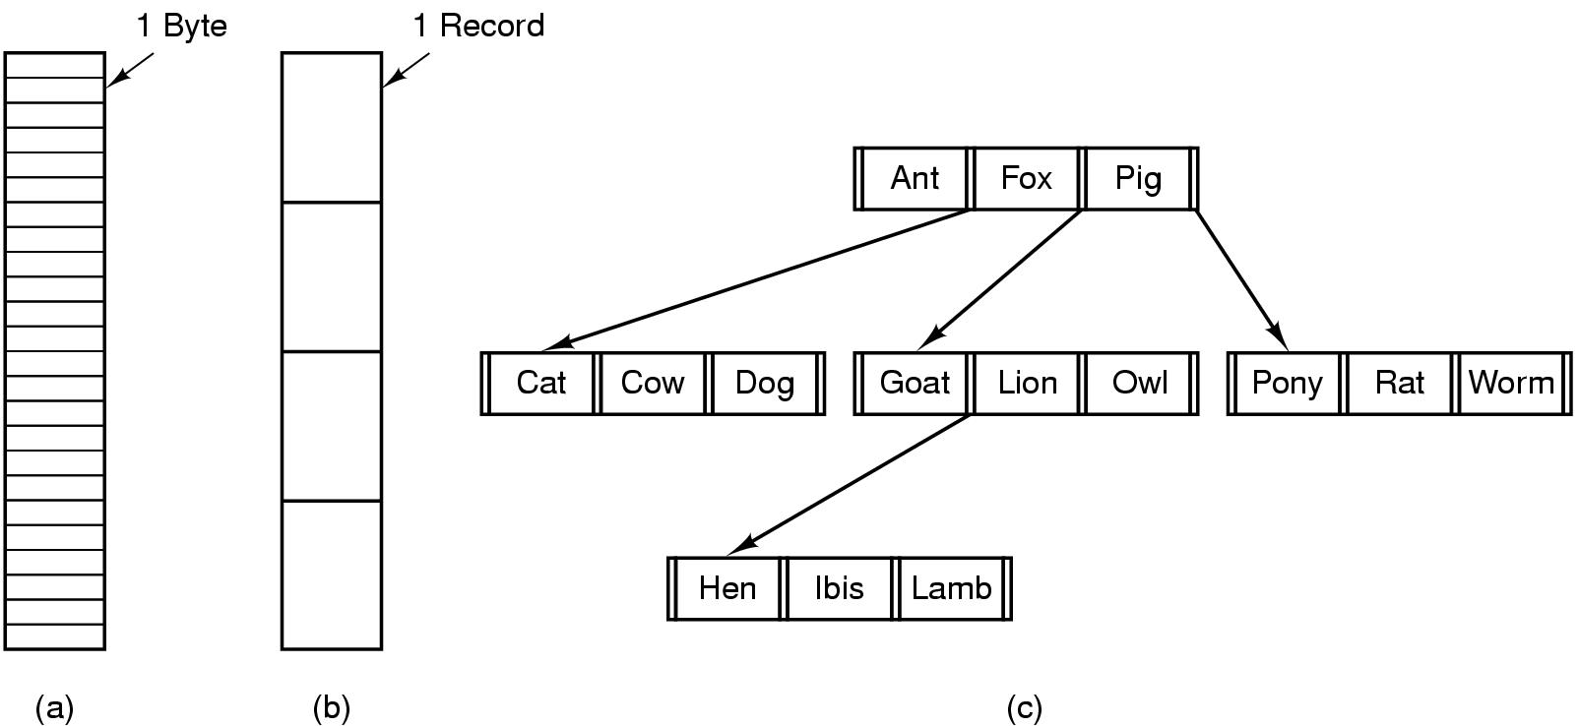
File Structure
Three kinds of files
byte sequence
record sequence
tree

Slide 4
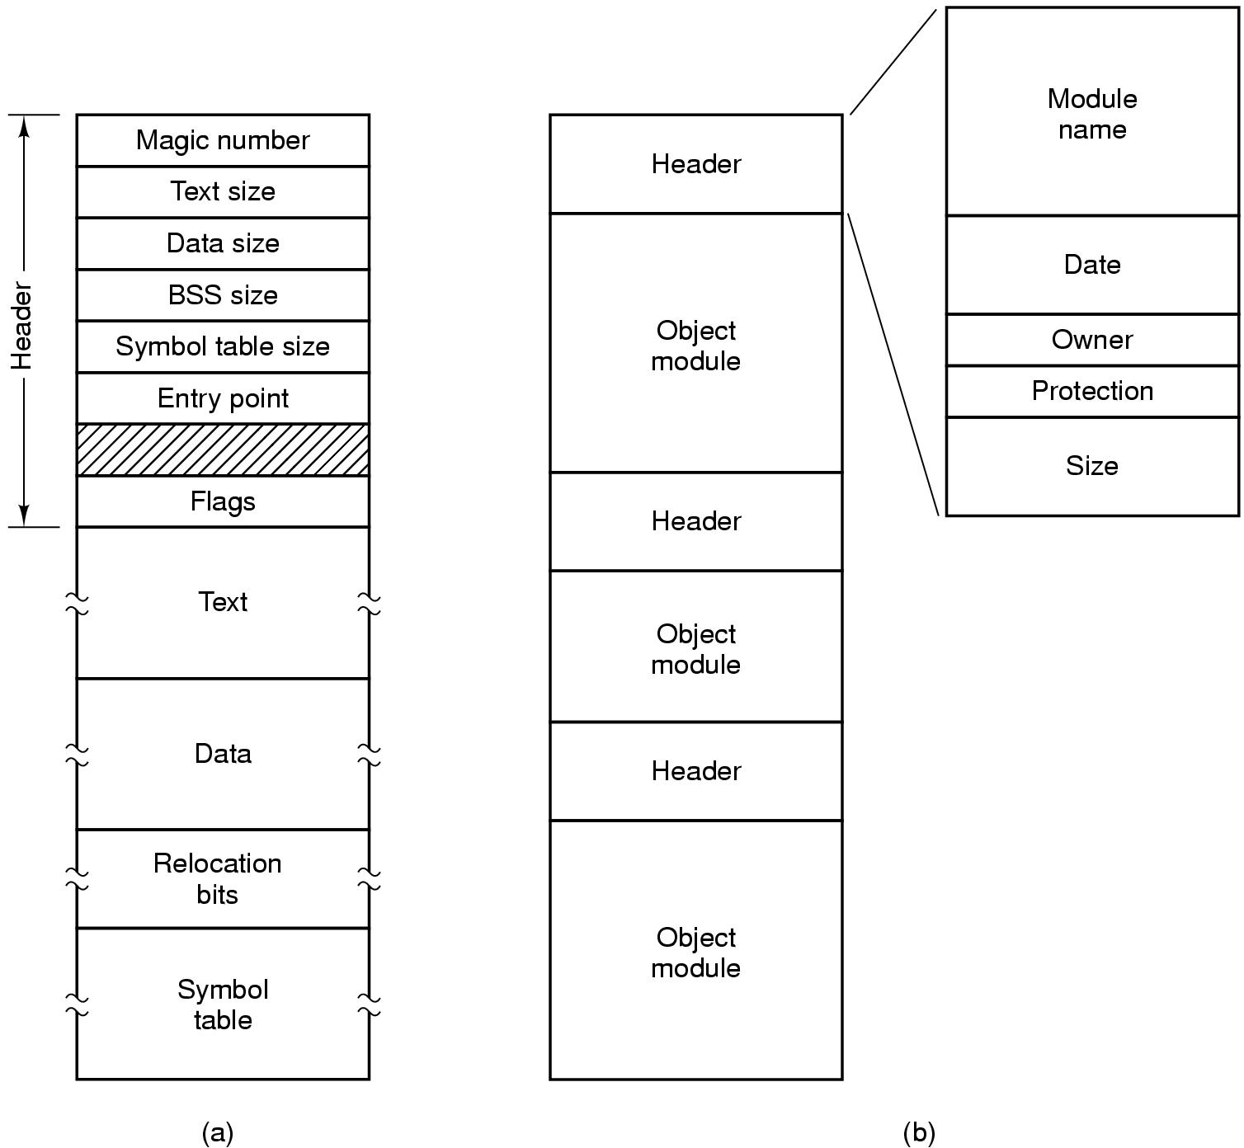
File Types
(a) An executable file (b) An archive

Slide 5
File Access
Sequential access
read all bytes/records from the beginning
cannot jump around, could rewind or back up
convenient when medium was mag tape
Random access
bytes/records read in any order
essential for data base systems
read can be …
move file marker (seek), then read or …
read and then move file marker

Slide 6
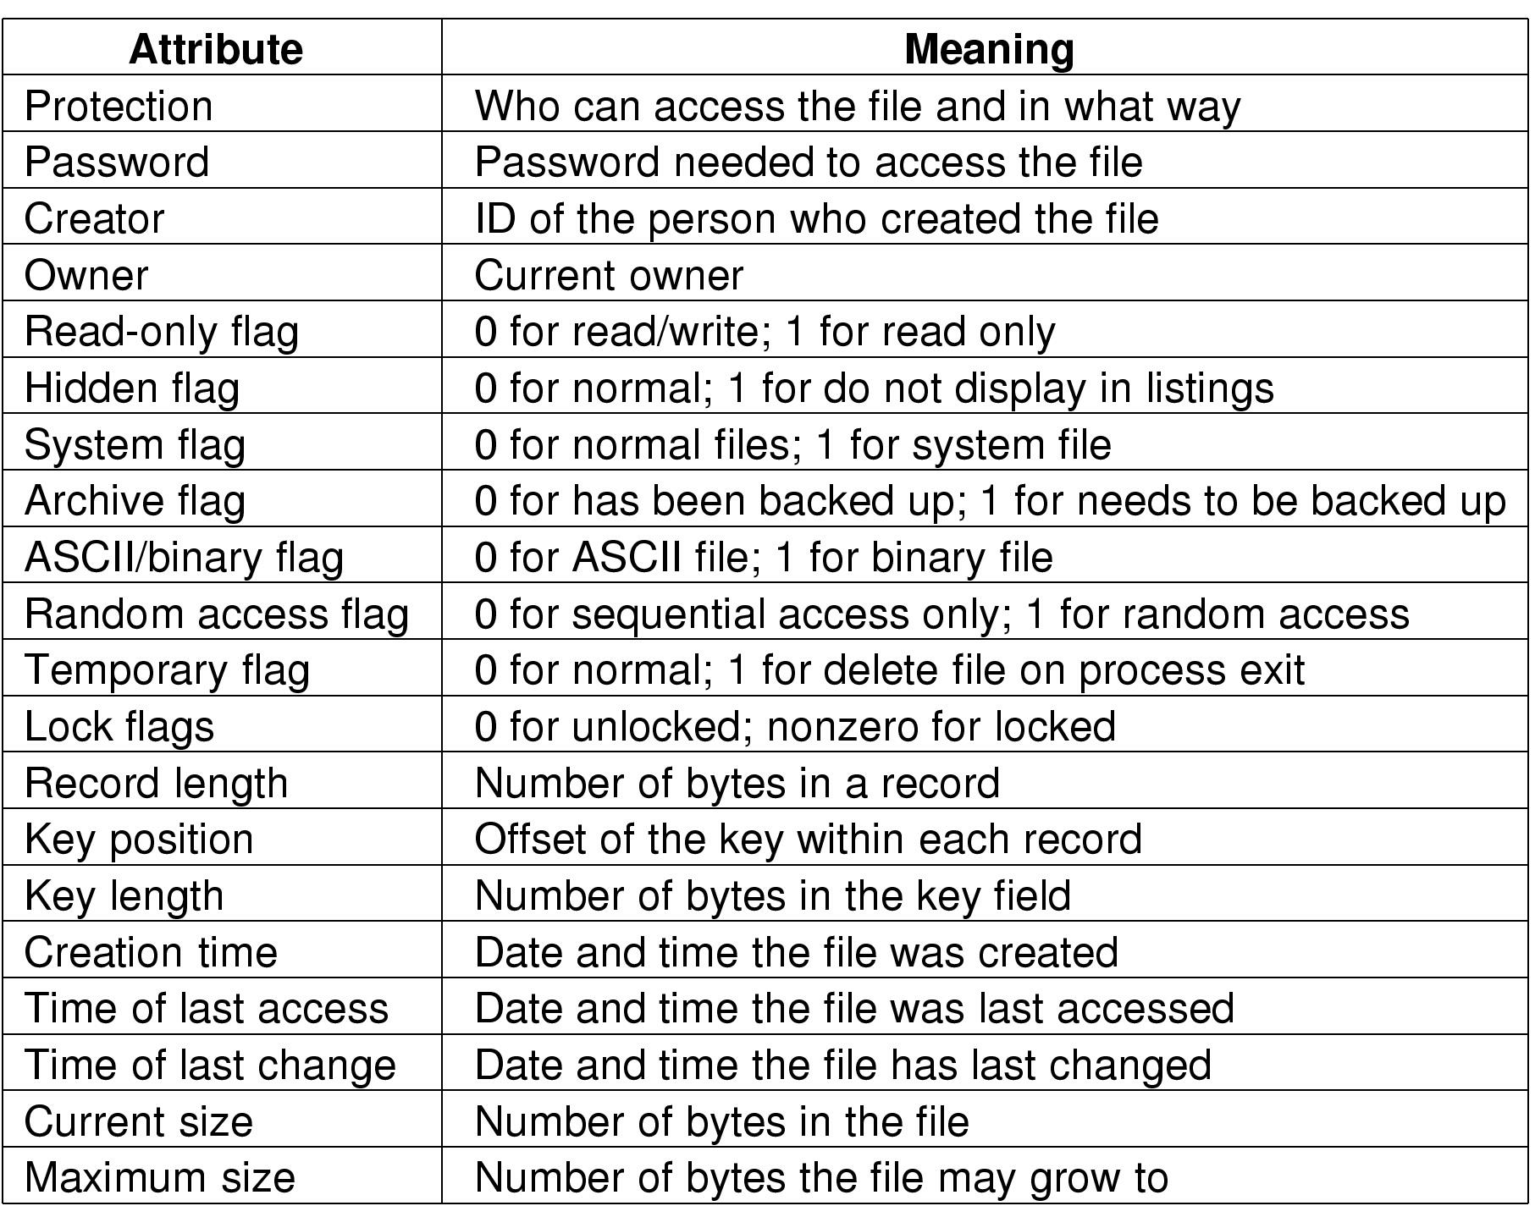
File Attributes
Possible file attributes

Slide 7
File Operations
Create
Delete
Open
Close
Read
Write
Append
Seek
Get attributes
Set Attributes
Rename

Slide 8
Windows file system
FAT
NTFS
GPT
ReFS

