Slide 1
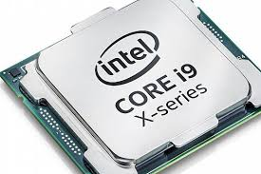
PROCESSOR
A processor is an integrated electronic circuit that performs the calculations that run a computer. A processor performs arithmetical, logical, input/output (I/O) and other basic instructions that are passed from an operating system (OS). Most other processes are dependent on the operations of a processor.

Slide 2
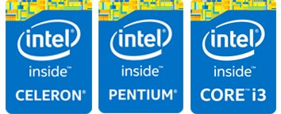

DIFFERENT PROCESSOR FAMILY
Intel
Celeron
Pentium
Core
Advanced Micro Devices (AMD)
Sempron
Athlon
Phenom

Slide 3
TYPES OF CORES
Dual Core Processors
Quad Core Processors
Hexa Core Processors
Octa Core Processors
Deca Core Processors

Slide 4
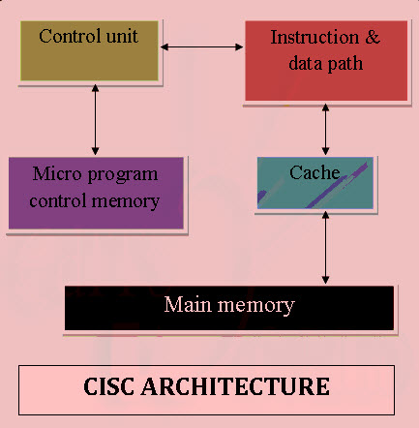
ARCHITECTURE TYPES
CISC Architecture:
The CISC approach attempts to minimize the number of instructions per program, sacrificing the number of cycles per instruction.

Slide 5
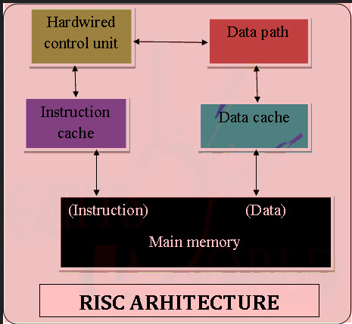
RISC Architecture:
RISC is a type of microprocessor architecture that uses highly-optimized set of instructions. RISC does the opposite, reducing the cycles per instruction at the cost of the number of instructions per program.

Slide 6
OPERATION
Fetch:
The next instruction is fetched from the memory address that is currently stored in the program counter and stored into the instruction register. At the end of the fetch operation, the PC points to the next instruction that will be read at the next cycle.
The fetch step is the same for each instruction:
The CPU sends the PC to the MAR and sends a read command on the address bus
In response to the read command (with address equal to PC), the memory returns the data stored at the memory location indicated by PC on the data bus

Slide 7
The CPU copies the data from the data bus into its MDR (also known as MBR, see section Components above)
A fraction of a second later, the CPU copies the data from the MDR to the instruction register
The PC is incremented so that it points to the following instruction in memory. This step prepares the CPU for the next cycle.
The control unit fetches the instruction's address from the memory unit.
Decode:
During this cycle the encoded instruction present in the instruction register is interpreted by the decoder.

Slide 8
Execute:
The function of the instruction is performed. If the instruction involves arithmetic or logic, the ALU is utilized. This is the only stage of the instruction cycle that is useful from the perspective of the end user. Everything else is overhead required to make the execute step happen.

