Slide 1

Property Predictions Data Research Assignment
Anthony Moliterno

Slide 2
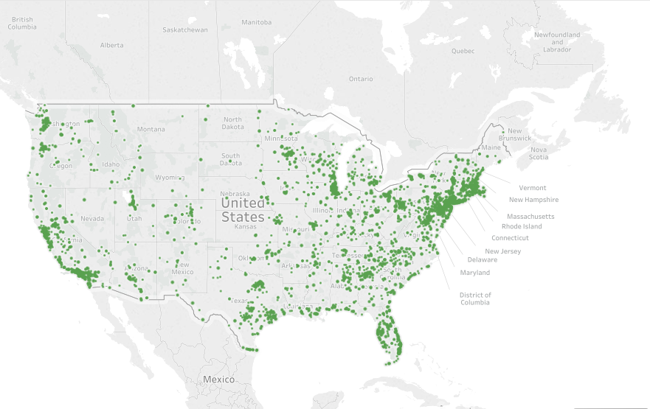
Contents
Overview
EDA
Data Cleaning & Feature Engineering
Model testing & Results
Further work

Slide 3
Overview
Good news – results suggest property volume can be aided by prediction models
Several models performed positively and were value-add
There is still room to devise some truly creative and differentiated solutions
There remains several unexplored methods which could further add value
There is still room to include other high-quality datasets
Feature engineering can still be explored in creative ways

Slide 4
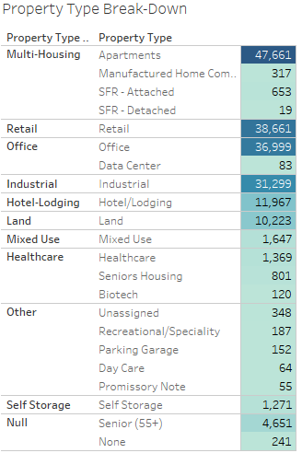
EDA –Property Type
General notes
The company’s property information shows it to be generally well diversified by sector
Deal volume has been increasing at rapid rates over time as well

Slide 5
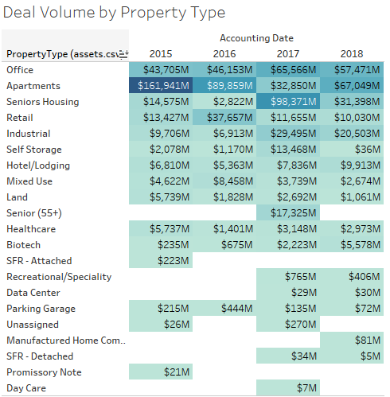
EDA –Property Type
General notes
Notably, Senior Housing volume was disproportionately high in deal volume compared to the property count
However it’s activity was more volatile vs. other types

Slide 6
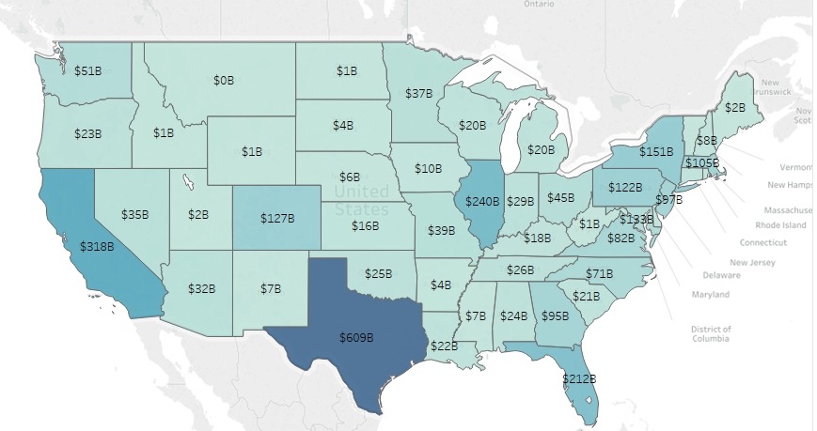
EDA –Property Type
High volume exhibited in the major market areas
High concentration in Texas, but solid volume in all major-and-upcoming markets

Slide 7
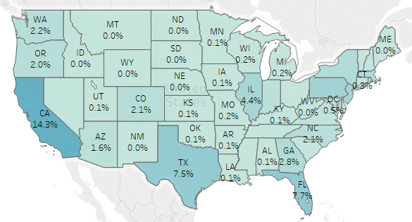
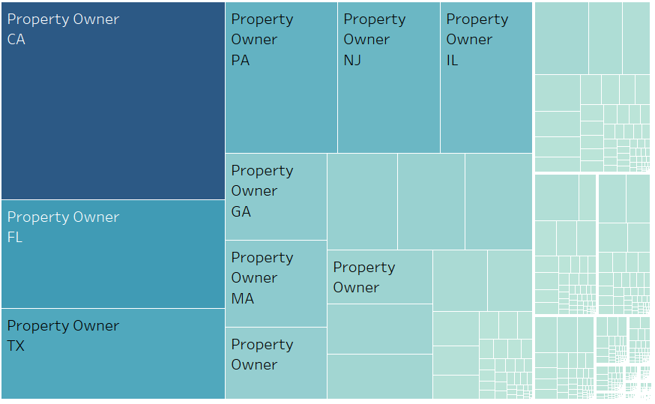
EDA –Client Type by State
Clients were more concentrated to major markets than Property locations
Most common clients in every state were almost always Property Owners

Slide 8
EDA – Data Limitations & Analytical Challenges
Data Challenges
Modeling Challenges
Some variables had significant proportion of NA’s that required imputation
95% of properties had no transaction history, rendering much of the data underutilized
Transaction values often included multiple properties
Outliers suggest there exists some input error, although it seems insignificant
Ex:
Unreasonable Year values
YearBuilt>YearRenovated
Negative Acreage
Data was mostly categorical information containing many levels – this requires greater attention
Much of the data is concentrated around geographic information
Modeling market dynamics over time requires additional assumptions and data

Slide 9
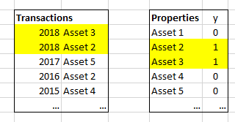
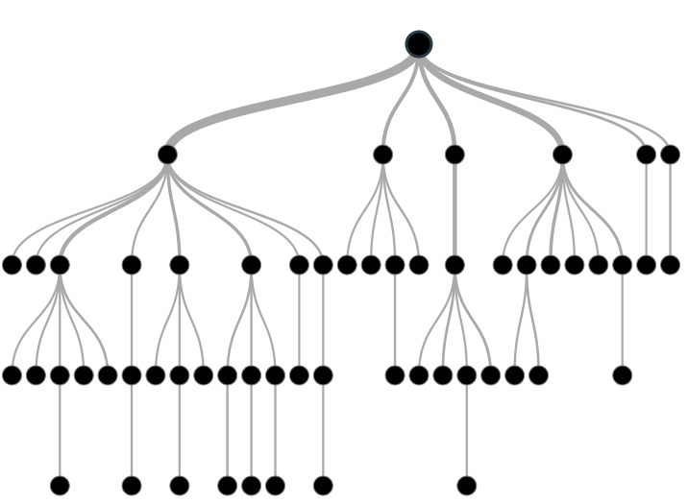
Solution Idea #1: Identify Key Characteristics to Predict
Recently sold were “flagged” as y=1 in Properties database, unsold as y=0
Fit models to predict these flags based on property characteristics (ex: location, size)
Refitted the model every year and assessed stability over time
Ex: a model fit on 2018-sold properties, which can be used to predict likelihood of being sold in 2019

Slide 10



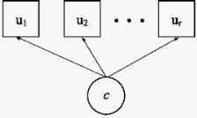

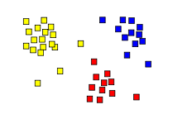

Solution Idea #2: Clustering Prediction
Latent Class Analysis to cluster property types
(Basically K-means but for categorical data)
Look for consistencies in which cluster types are selling most
Can be effective in understanding categorical relationships from a high level
Classes can be used as target variables under supervised modeling methods for prediction
Big & New
Small & Old
Southern &
Suburban

Slide 11
Modeling – High Level Overview
Attempted Solution #1 since it was the most feasible with the resources at hand
Started simple with linear models and advanced to complex nonlinear models
Logistic Regression, Linear SVM, Decision Trees, Random Forests, Bagging + Trees, Adaptive Boosting + Trees
Wish list (i.e. excluded due to resources): K-Nearest Neighbors, Multi-Layer Perceptron
Performed Grid Search for optimal parameters, and Cross Validation for pressure testing

Slide 12
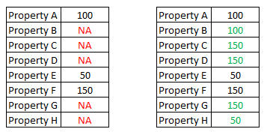
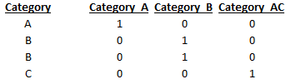
Modeling – Data Cleaning
Screened for selected variables
Dropped categorical variables with too many labels (ex: City name), or which were redundant.
For this analysis we focused only on US properties
Imputed missing information (ex: “NA”) and unreasonable values (“Year: -200”)
Used random selection of existing information for imputation (this helps preserve distribution)
Variables were excluded due to high NA’s (>25%) were dropped
Encoded categorical variables (models work better with numbers)
Ex:
Created a ‘y’ target variable
Sold: y=1
Unsold: y=0

Slide 13
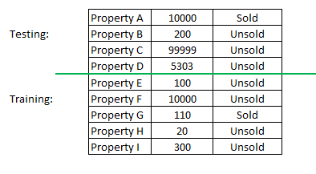
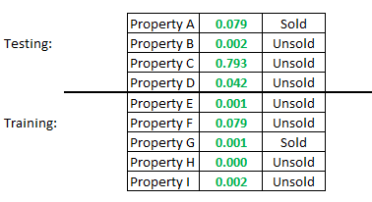
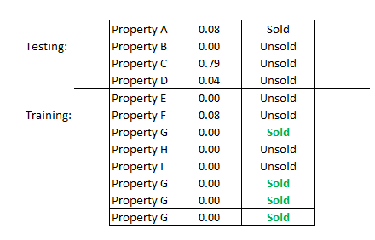
Modeling – Data Cleaning
Split + Scaled
Split into train and validation
Helps measure model performance against unseen data
Normalized all variable values: ranging 0-1
Putting all variables on the same scale helps reduce bias
Upsampled data to balance dataset for better modelling
An even balance of data helps fit better models

Slide 14
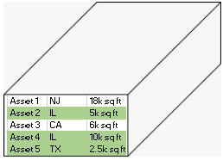
Modeling – Approach to Training & Testing
Training was accomplished by conducting many train + validation sets on the Asset dataset, with y=0 or y=1 indicating what was sold that year
Hypothesis: LTM is indicative of NTM
In practice, model can be recalibrated in real time
Preliminary validation scores indicated there exists a solution space to be solved
Testing was then conducted by analyzing each model’s performance over time for consistency and stability
Testing
2018
2017
Train & Validate
…
2015

Slide 15
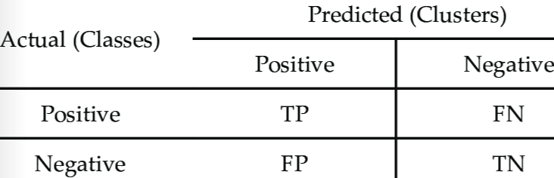
Modeling - Metrics
Chosen metric for model success was maximizing the Precision Rate for every property identified as positive
This ensures brokers are making the most productive use of their time

Slide 16
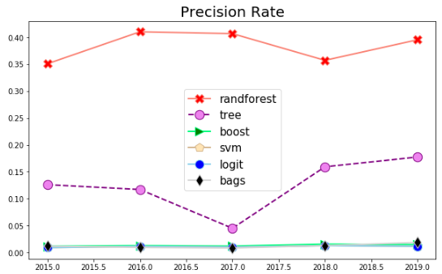
Results - Testing

Slide 17
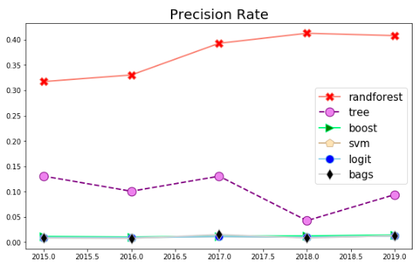
Results – Model Robustness Over Time
Model Age: Brand New
Model Age: 1 year old

Slide 18
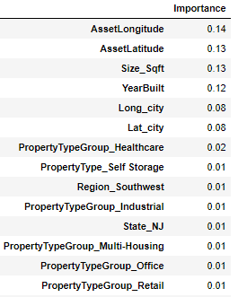
Results - Summary
Factor Importance, as predicted by Random Forests
Non-linear tree-based models significantly outperformed linear models
Random Forests performed best
Factor importance is indicative of very intricate relationships between variables

Slide 19
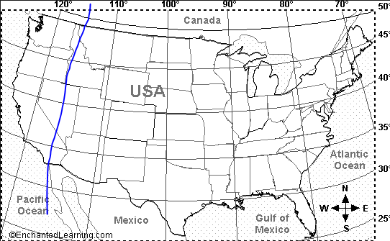
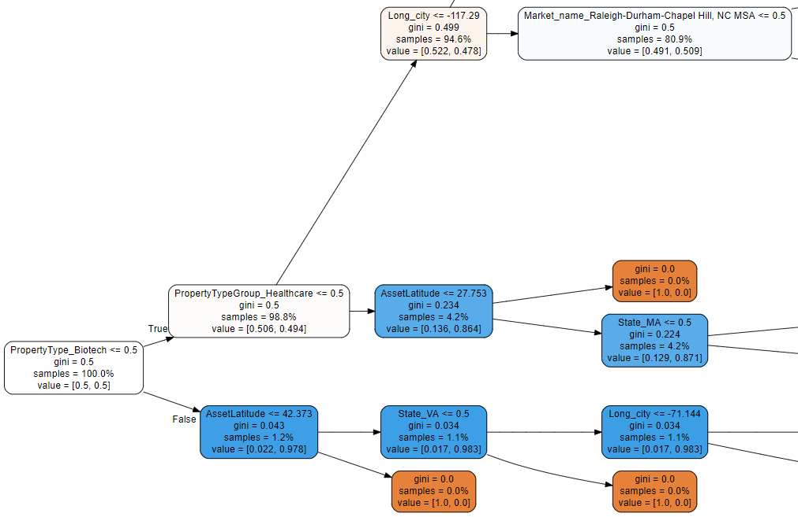
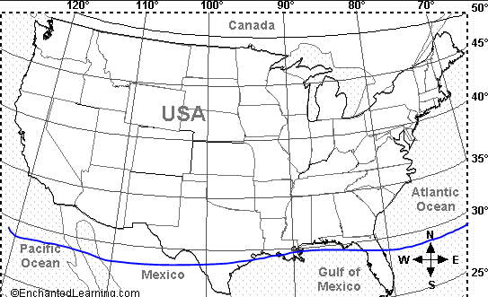
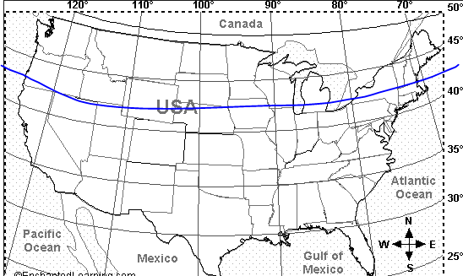
Model Theory – How Trees Work
Not HC: Are you West?
Root node begins with all samples
All samples trickle down!
Splits based on one feature at a time
Determined by achieving best purity
Features can be reused many times!
Terminates when:
Node is fully pure
-or-
Sample size becomes too low
Tree becomes too deep
East: in NC-region?
Terminated: No Far-South HC likely to be sold
Begins with 100% samples
Best split is based on Biotech
Not Biotech: Are you HC?
HC: Are you far South?
Biotech: Where in Latitude?
Terminated: No Far-North Biotech likely to be sold
Terminated: No Southern Biotech in VA likely to be sold
http://www.webgraphviz.com/

Slide 20
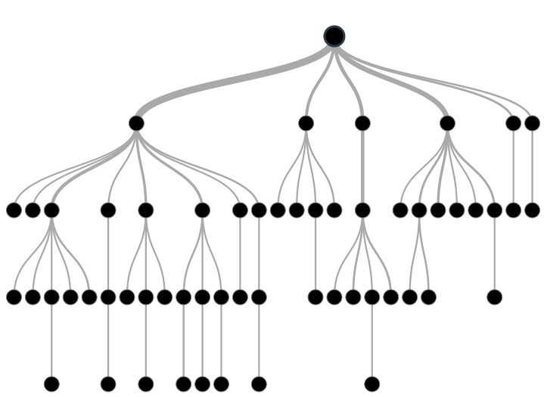
Random forests vs. Decision Trees
Decision trees work in a very hierarchical fashion, using the immediate “best split” until finished
This can be short-sighted and not be optimal
Sometimes it’s better to go through lesser splits now, to achieve best end results
Answer: Random forests averages multiple trees, based on fewer, randomly selected features
Leaving out certain variables can prevent them from over-influencing results
Y=1
Y=0
Y=1

Slide 21
Results - Summary
The model is able to increase probability of success from a pure random probability of 4% to targeted probability of >40%
As a result, it is clear this analysis has been value-add and can be productive in providing guidance for properties likely to be sold
It can also be helpful in ruling-out properties unlikely to be sold.
However there is plenty of opportunity to enhance the model…

Slide 22

Future Work
Greater variety of predictors can improve forecasting and yield richer insights into the market:
Population, growth
Median income, growth
Local industry sectors
Local industry/company financial performance
Local traffic levels
Local business compositions
Interest rates & lending
Home building & sales data
Better imputation methods (ex: SMOTE)
Alternative prediction models (ex: Solution #2, Neural Nets)

