Slide 1

Android Hackathon Solution By Name: Amol Khot email: amol.amar.khot@gmail.com
Date: 12/12/2017

Slide 2

Executive Summary
Application Details
Requested Objectives of the Project
Application Title : Know Your Nation Package Name : amolkhot.hackathon.knowyournation Latest Version : 1.2
Technical Features
Loading Country data from JSON file
Load minimum data in the memory
Provide Search feature
Used Regular Expression for search
Advanced Search – Search of Capital, Country Name, Country Code, Region, Sub-Region, Native Name, Currency
Loading Country Flag (If Internet is available)
Show all Countries in a Region/Sub Region
Jump to Google Map of selected Country (zoom level is depending upon area of the Country)
External Library Used
androidsvg_1.2.1

Slide 3
High level solution Architecture
Know You Nation Application
User Interface
getCountryListByRegion(region)
getCountryListBySubRegion(sub_region)
getCountryList(filter_text)
filteredCountryList()
getCountryDetails(country_name)
countryDetails()
CountryList()
CountryList()
API
ViewController
Generate CountryListAdapter
Generate Country Data
Load Flag Image from URL
DataController
Process JSON
Generate TEMP Database
Generate Search String
JSON
File System
Temporary Database

Slide 4
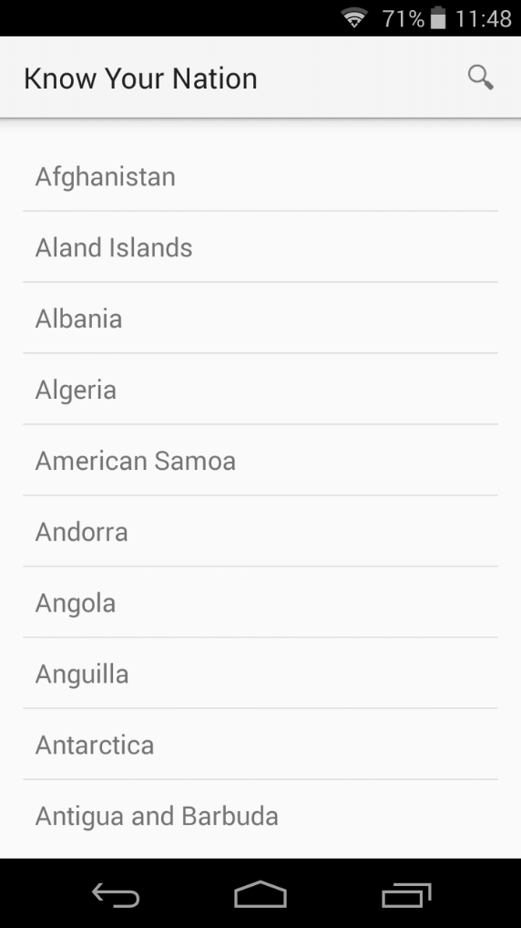
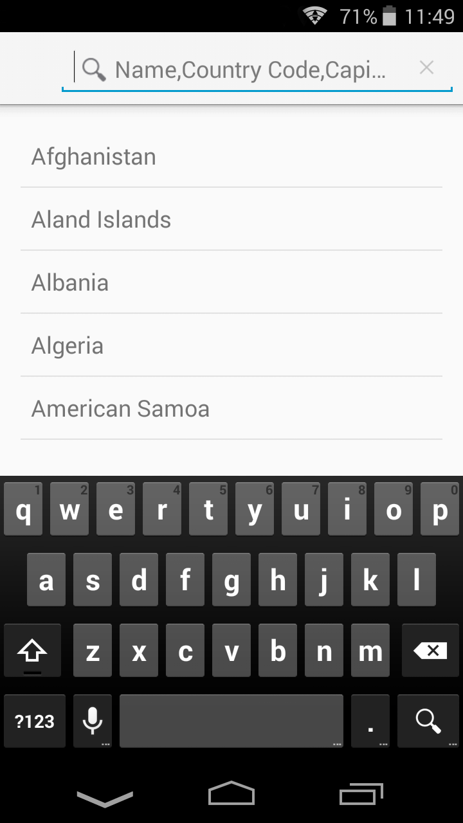
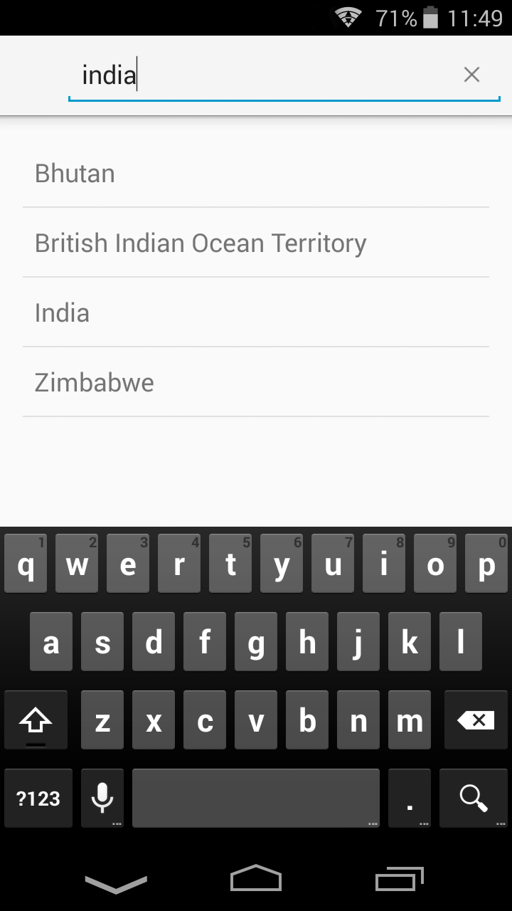
Screen Flow (Country Listing)
1
2
Country Listing
1. Country Search Result Screen

Slide 5
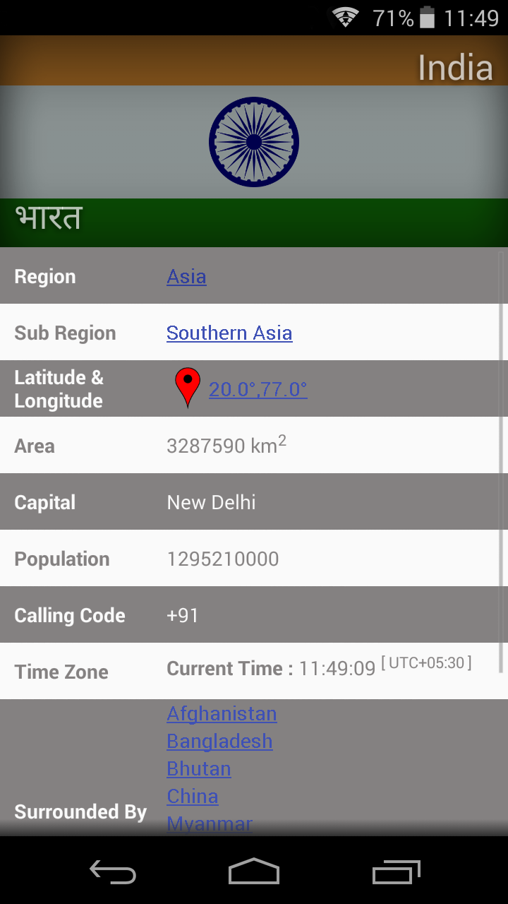
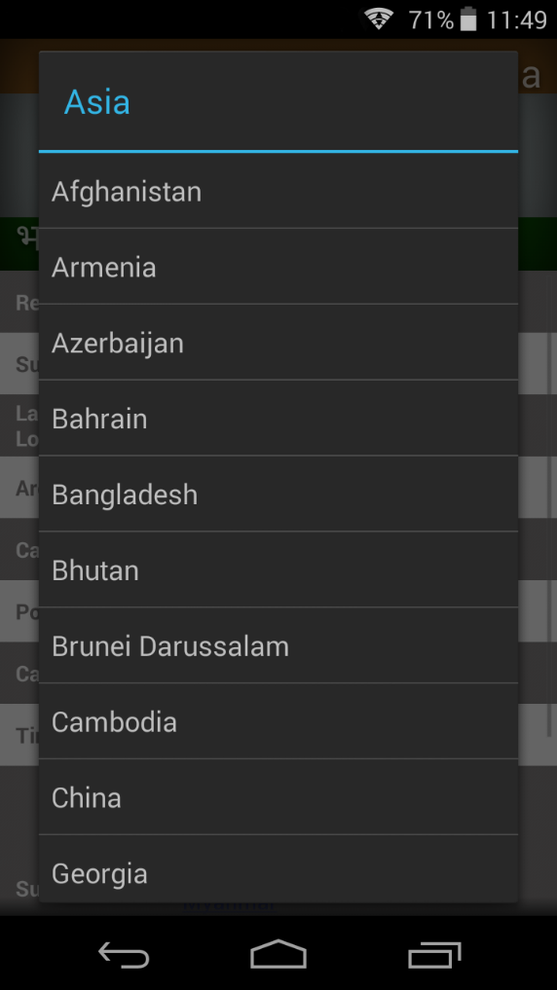
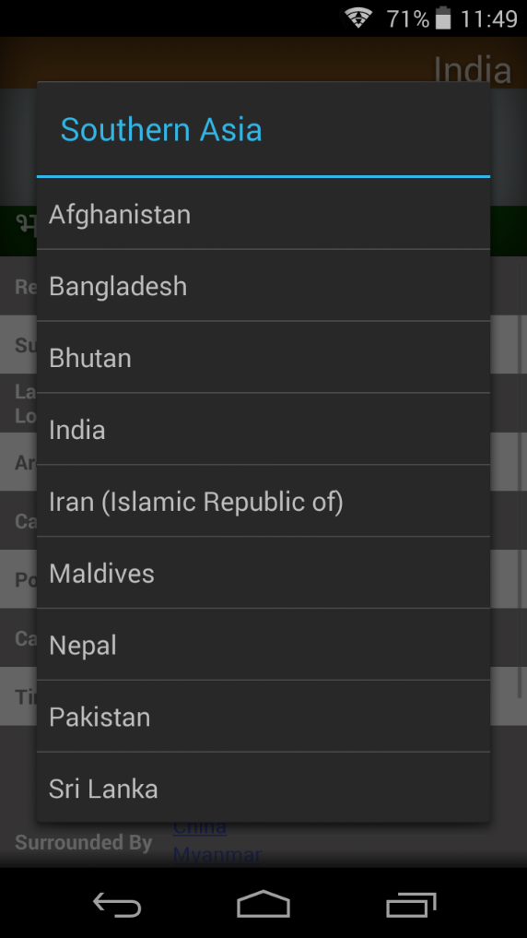
Screen Flow (Country Details)
3
4
5
6
2. Country Details
3. Region Countries
4. Sub-Region Countries

Slide 6
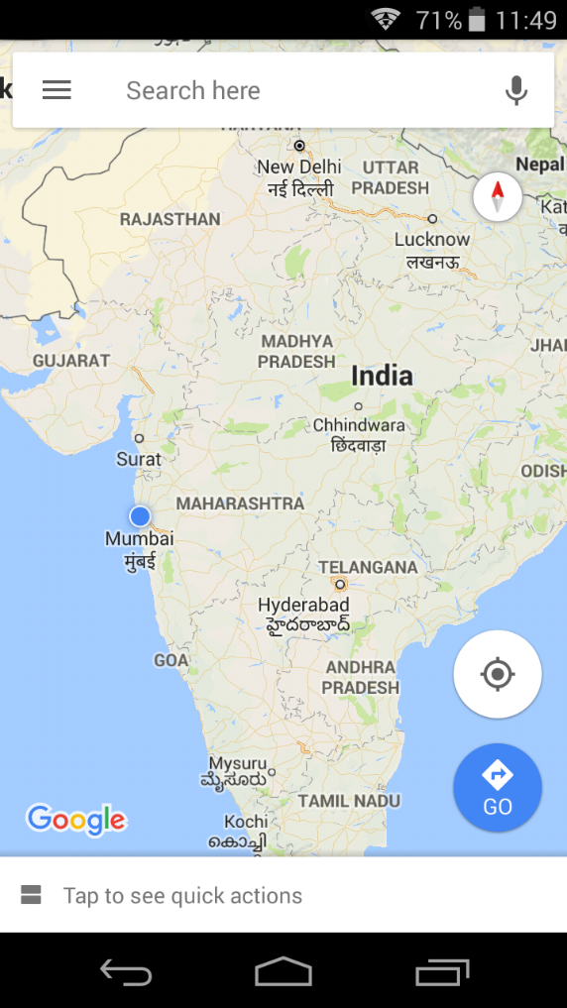
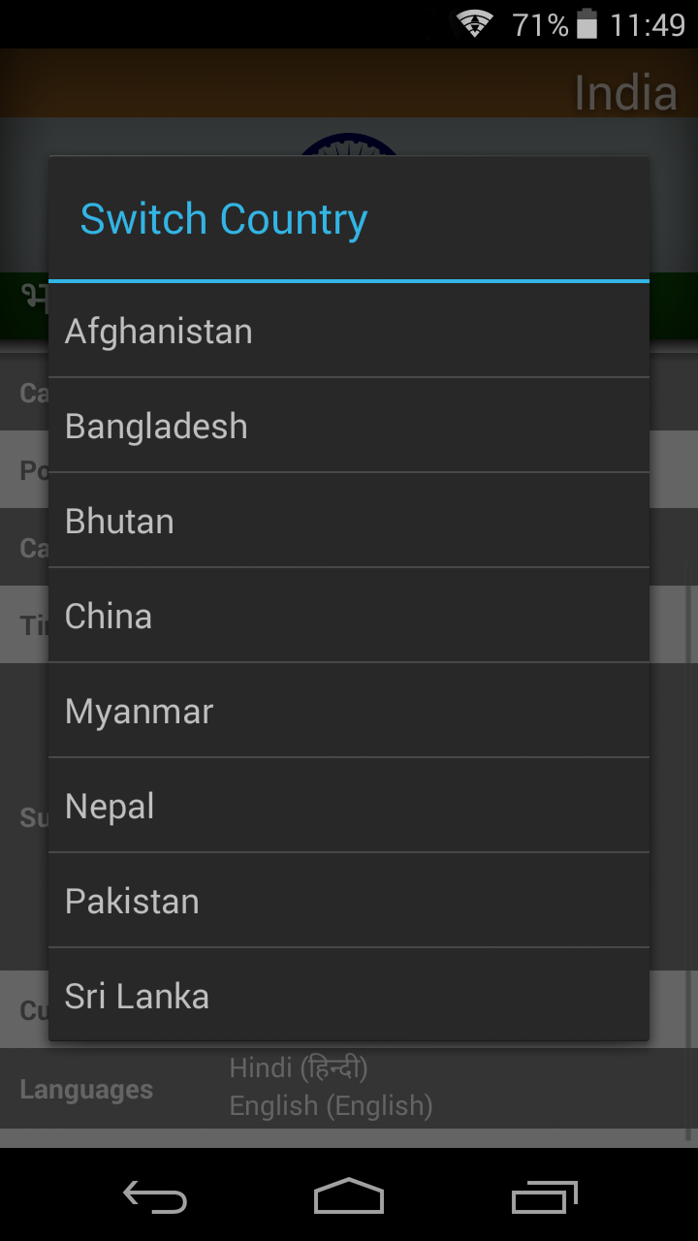
Screen Flow (Country Details)
5. Google Map
6. Surrounded By

Slide 7

About TechGig
Techgig.com is a culmination of everything related to technology, a platform exclusively for IT professionals to synergize, share, exchange ideas, facts and information as well as showcase their work and express their views on the vast repertoire that the IT industry encompasses. Garnering cutting edge views, reviews and news, jobs as well as providing a podium for connecting with your colleagues, peers are the mainstay of Techgig.com.
Techgig.com was launched by Times Business Solutions(A Division of Times Internet Limited) which is the "life interactive" arm of The Times Group. TBS believes in the power of internet and seeks to harness the impact that internet can create through providing global internet users innovative platforms for support and assistance in every aspect of their lives. Techgig.com is another such innovation from TBS that believes in empowering the IT community.

