Slide 1
MARKETING PLAN
Premium Mid-Century Shaving
Amol Kolhe | Ekaterina Marchenko | Indraraj Naidu | Sneha Thanasekaran

Slide 2
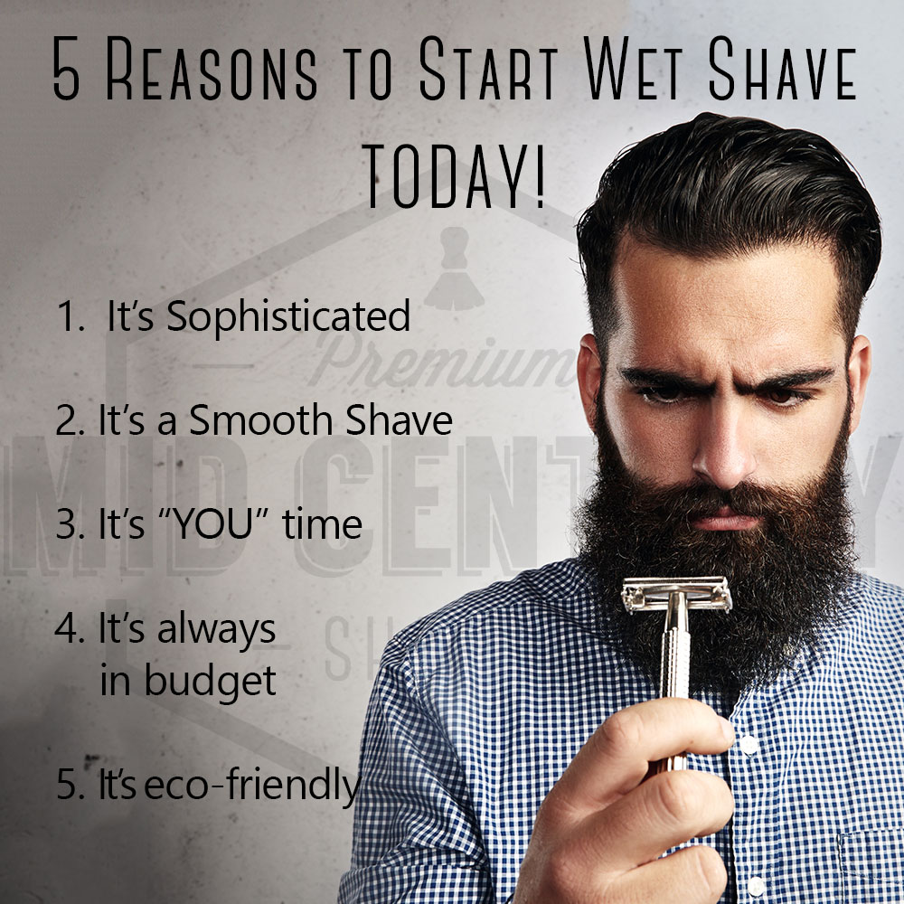
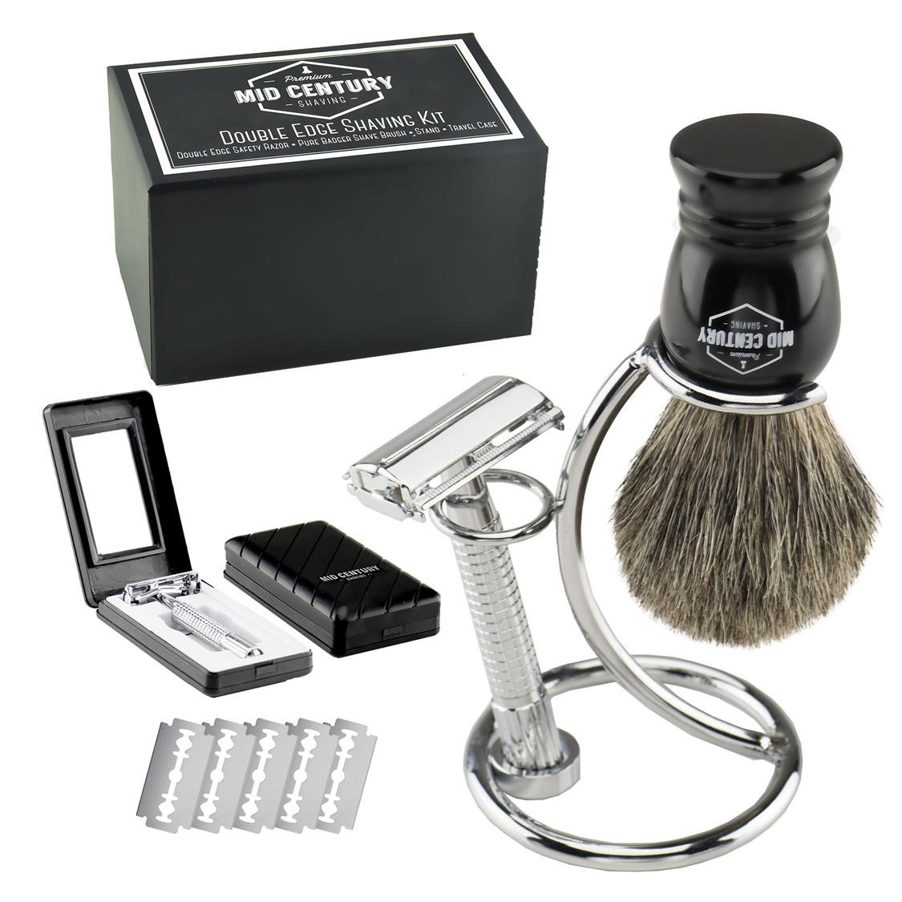

Slide 3
THE COMPANY
Marketing Objectives
  Raise awareness of wet shaving
  Premium shaving Experience
Goals
  Increase the number of visitors through organic search
  Penetrate the market to gain a significant market share
Company Orientation
  Product Concept
    High Value Product

Slide 4
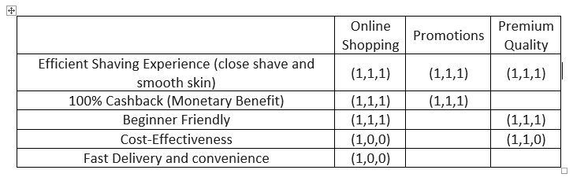
Differential Advantage
closest possible shave
Single blade system – No ingrown hair
“How To” Guide
Long Lasting Razors
Stable Product since 1908
DA for Main Rivals
Strong, perfectly aligned razor
$20 – Total expense for 18 weeks
Not overcompensated with technology and too many blades

Slide 5
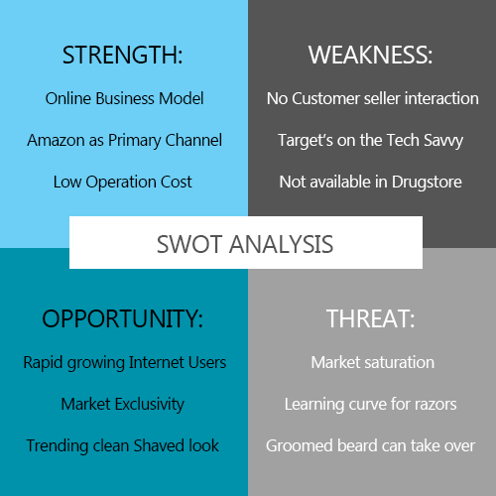
THE 5 Cs
Company
Customers
Context
Competition
Collaborators

Slide 6
Market Research
Online Survey
More than 52.40% relate to the Wet shaving
35.03% would consider buying vintage products
38.12% prefer buying shaving supplies online
Web Analytics & keyword Research
The total number of visits this year is about 10.8K
Bounce rate is 31.89%
5.2k are either through search or paid ads
Saturated Keywords:
  Wet shaving
  Safety razors

Slide 7
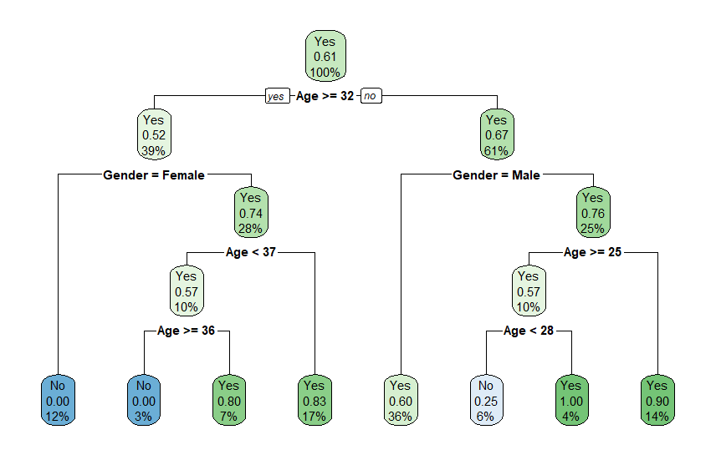
Classification Analysis
There is a 54% change that a target consumer would change to safety razor

Slide 8
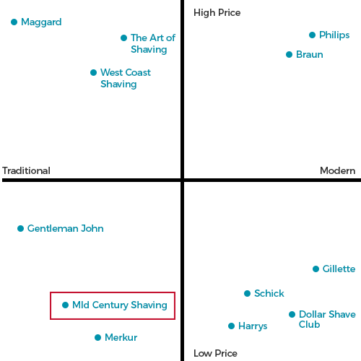
Market Positioning & Target
Young Professionals between the age group18 to 25 looking at efficient clean shaving options
Married men from 25 to 45 with a steady income between $60K to $150K per annum

Slide 9
Market MIX DECISION
Promotion
Beginner’s guide to wet shave
100% cashback
Influencer marketing along with paid ads
PLACEMENT
Focus on Amazon
Retail stores After 5 years
Web Analytics for ad channels
Products
Eventual Increase in the product line
Product diversification
Psychological advantage
PRICE
Competitive pricing strategy
High value category
Break Even Point 492 Units

Slide 10
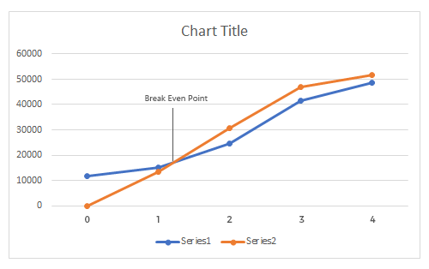
Breakeven Point
Break Even Point | 492 unit
Break Even Value | 1.53 yr
Customer Lifetime Value | $160

Slide 11
Conclusion
Key performance indicators to set the goal and assess the success of the marketing plan in the next 5 years.
Market Share
  40% increase in the market share
Overall Sales
  to increase the conversion rate by at least 50% and decrease the bounce rate to less than 10%
Brand Rating
  100% increase in the number of review and rating
Product Innovation
  Rolling out 3 products every year
FORECAST
# of Customer = 5000
Total Revenue = $149,950

Slide 12
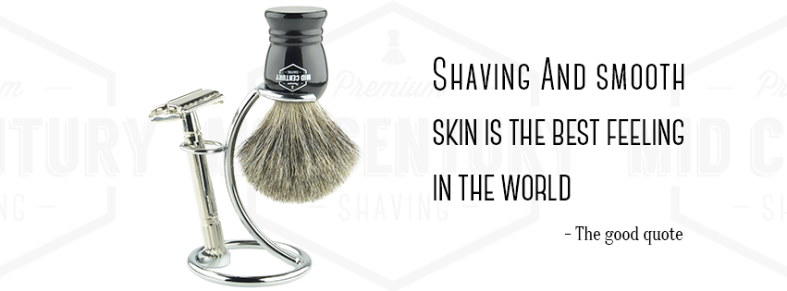
Thank you

