Slide 1
Sleep Analysis
An Overview of Sleep Metrics and Insights

Slide 2

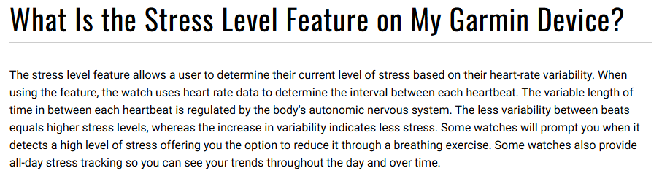

Slide 3
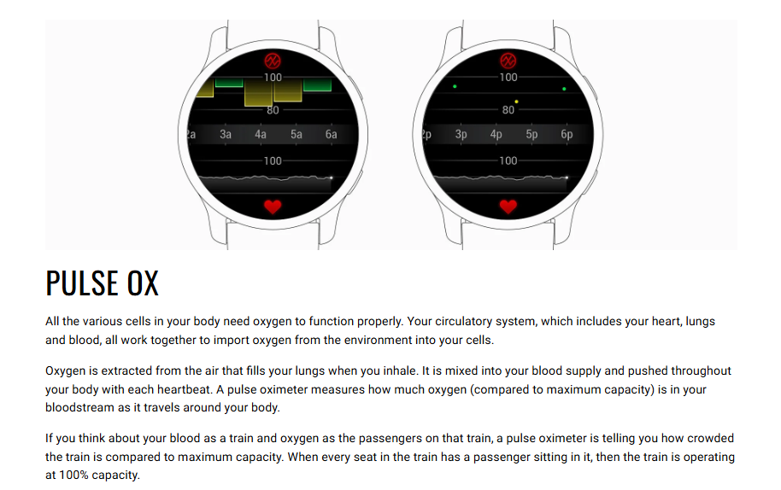
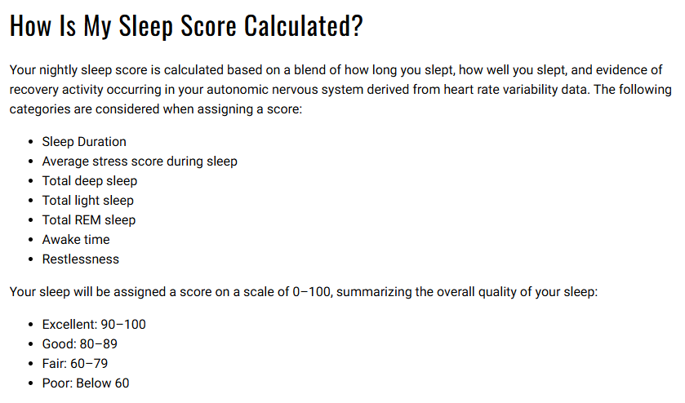

Slide 4
Key Sleep Metrics
Sleep Duration (hrs)
Sleep Score
Deep Sleep Duration (hrs)
Light Sleep Duration (hrs)
REM Duration (hrs)
Awake Time (hrs)
Stress Avg
Steps
Resting Heart Rate (bpm)
High Heart Rate (bpm)
Avg SpO₂
Lowest SpO2
Avg Respiration (bprm)
Lowest Respiration (bprm)

Slide 5
Pseudo Code for Sleep Analysis Script
1. Import Required Libraries
2. Load and Prepare Data
3. Calculate Correlations
4. Analyze Strong Correlations
5. Compute Summary Statistics
6. Model Sleep Duration and Sleep Score
7. Calculate Sleep Efficiency
8. Detect Anomalies and Outliers
9. Visualize Low Sleep Score and Stress
10. Visualize Sleep Types and Trends
11. Additional Visualizations
12. Weekday vs Weekend Comparison

Slide 6
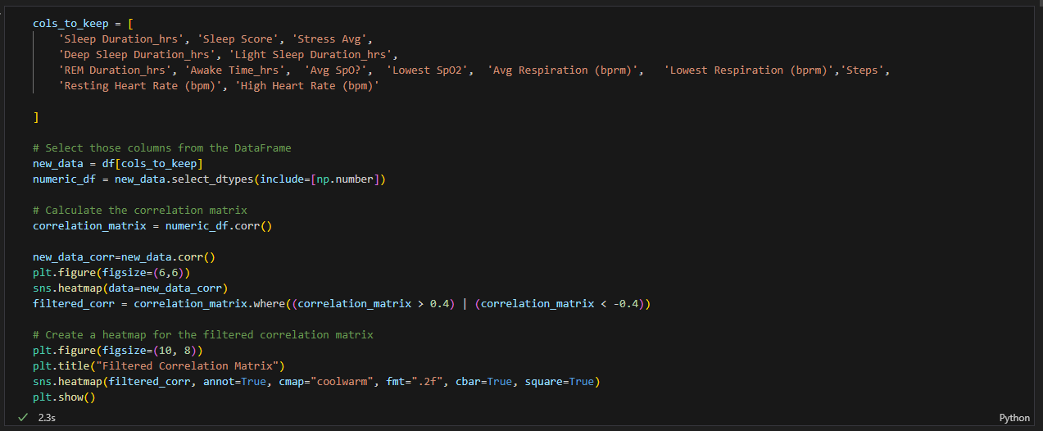

Slide 7
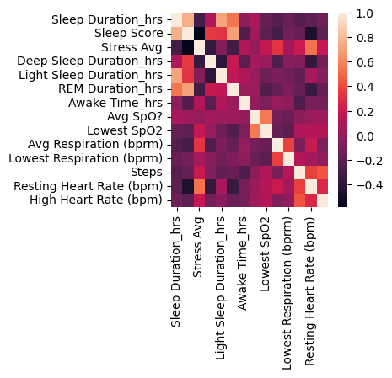
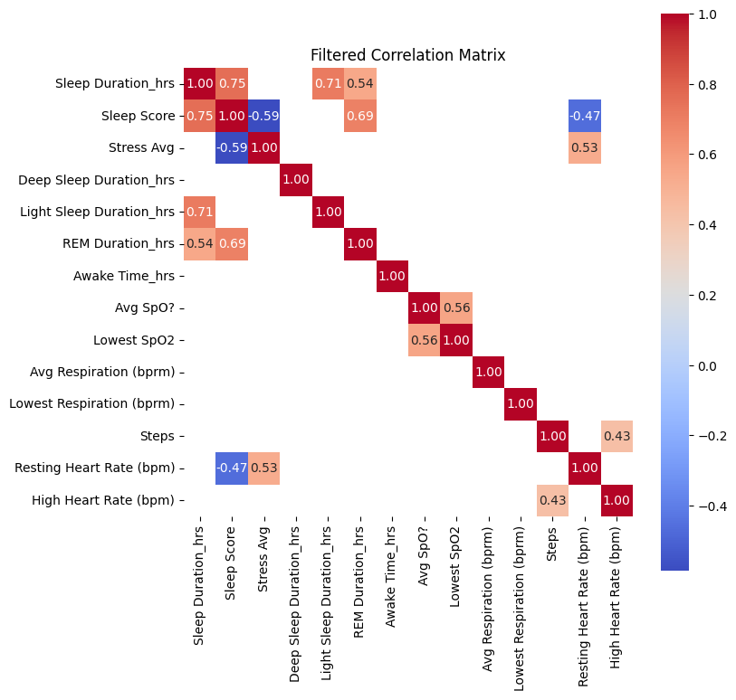

Slide 8
Parameter | Correlation with Sleep Score | Interpretation
Sleep Duration (hrs) | 0.75 | Longer sleep duration is associated with a better sleep score.
Stress Average | -0.59 | Higher stress levels are associated with lower sleep scores.
Deep Sleep Duration (hrs) | Not shown | Generally contributes to sleep quality but not explicitly shown in this matrix.
Light Sleep Duration (hrs) | 0.71 | Adequate light sleep contributes to higher sleep scores.
REM Duration (hrs) | 0.69 | Longer REM sleep durations improve sleep scores.
Resting Heart Rate (bpm) | 0.53 | Slight tendency for lower resting heart rates to improve sleep quality.

Slide 9
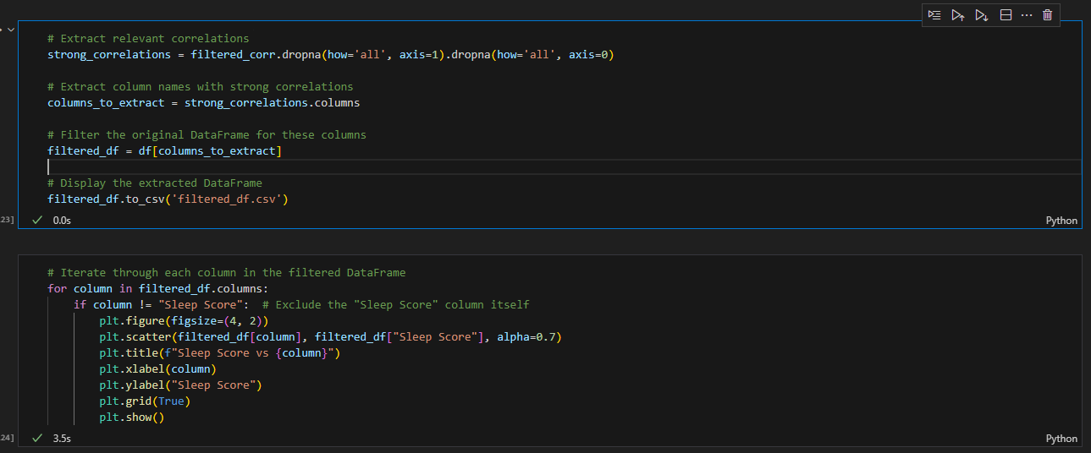

Slide 10
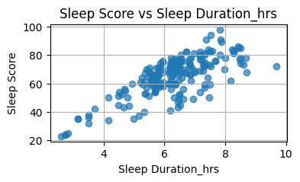
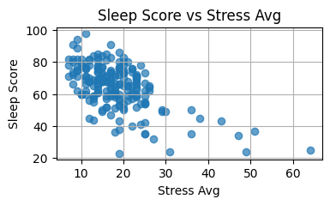
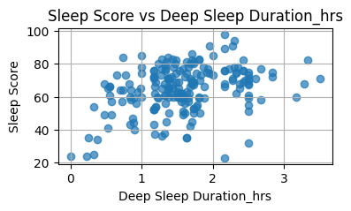
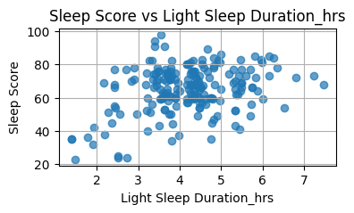

Slide 11
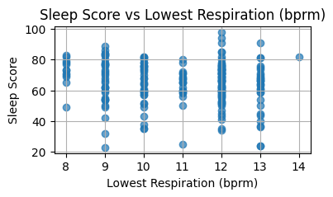
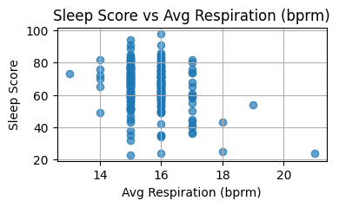
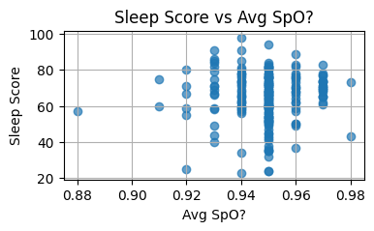
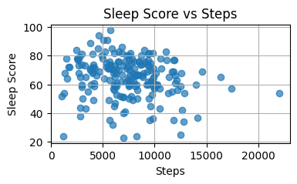

Slide 12
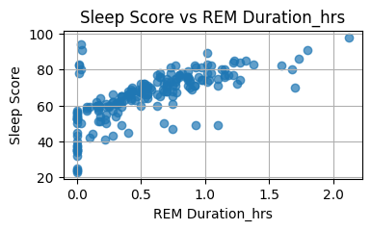
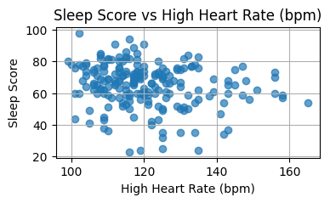
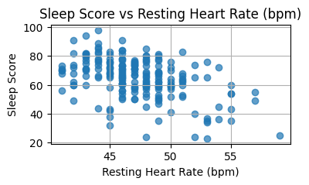
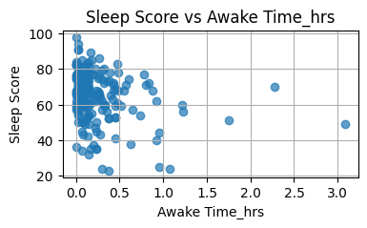

Slide 13
Parameter | MeanValue | Global Average | Comparison
Sleep Duration (hrs) | 6.2922 | 7-8 hrs | Below the global average; insufficient sleep may affect overall health.
Sleep Score | 64.925 | ~75-85 | Below the average, indicating moderate to poor sleep quality.
Stress Avg | 18.23 | ~10-15 | Higher than average stress levels, which could negatively impact sleep and overall well-being.
Deep Sleep Duration (hrs) | 1.5787 | ~1.5-2 hrs | Near the lower end of the average range.
Light Sleep Duration (hrs) | 4.1865 | ~4-5 hrs | Within the global average range.
REM Duration (hrs) | 0.53805 | ~1.5-2 hrs | Below average REM sleep, potentially impacting memory and emotional regulation.
Awake Time (hrs) | 0.23845 | ~0.5 hrs | Lower than average, indicating minimal wake time during sleep cycles, which is good.

Slide 14
Avg SpO₂ | 0.94865 (~94.8%) | ~95-98% | Slightly below average, indicating mildly reduced oxygen saturation during sleep.
Lowest SpO₂ | 0.93545 (~93.5%) | ~90-95% | Within the expected range, though closer to the lower end.
Avg Respiration (bprm) | 15.65 | ~12-20 bprm | Within the normal range of respiratory rates.
Lowest Respiration (bprm) | 10.99 | ~10-12 bprm | Within the lower end of the range, indicating efficient breathing during sleep.
Steps | 7388.71 | ~7000-10,000 steps/day | Within the recommended range but slightly below the upper average for active individuals.
Resting Heart Rate (bpm) | 47.235 | ~60-100 bpm | Significantly below average, which is common for highly fit individuals or athletes.
High Heart Rate (bpm) | 120.675 | ~120-140 bpm | Within the average range for peak heart rate.

Slide 15
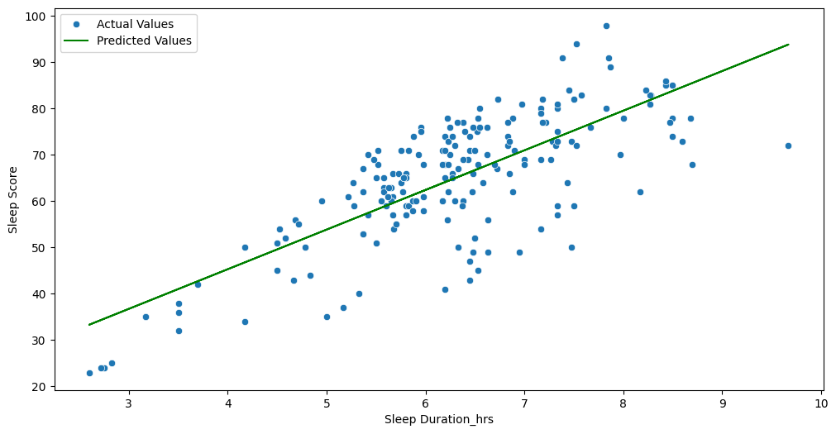
Linear Regression Model to predict Sleep Duration

Slide 16
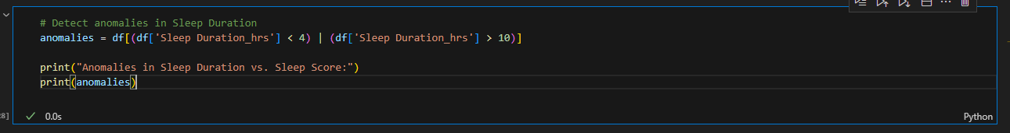
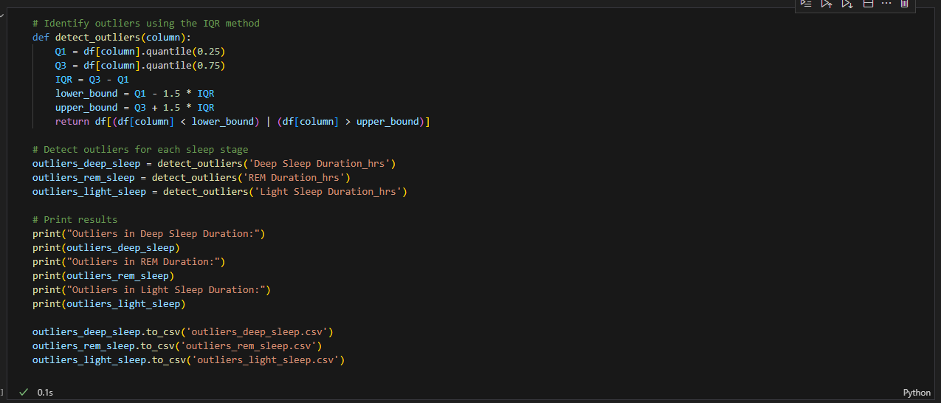

Slide 17
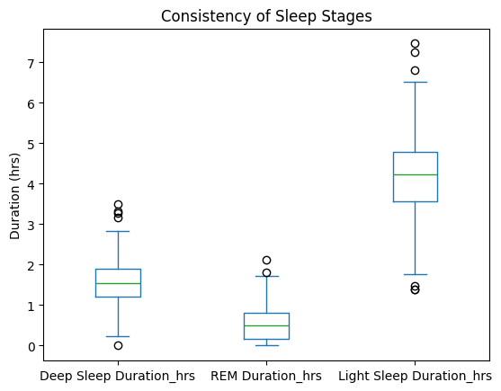
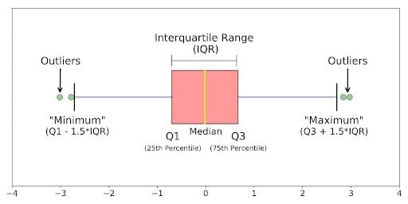

Slide 18
Deep Sleep Duration
The median for deep sleep duration is around 1.5–2 hours.
IQR (Interquartile Range): The IQR is relatively small, indicating that most data points for deep sleep duration are consistent across individuals.
Outliers: Several outliers are visible above the upper whisker (more than 3 hours). These may represent individuals with abnormally long periods of deep sleep or recording errors.
Actionable Insight:
If deep sleep duration is below 1.5 hours for most individuals, focus on improving deep sleep through:
A cooler, darker sleep environment.
Avoiding caffeine or alcohol close to bedtime.
Maintaining a consistent sleep schedule.
REM Sleep Duration
Median: Approximately 0.5 hours, suggesting that most individuals spend relatively little time in this sleep stage.
IQR: REM durations mostly range between 0.3 and 0.7 hours, showing less variability compared to other stages.
Outliers: Some outliers exist below 0.3 hours and above 0.8 hours, indicating abnormal durations of REM sleep for a few individuals.
Actionable Insight:
REM sleep is crucial for cognitive functions like memory and mood regulation. The goal should be 1.5–2 hours of REM sleep per night.
To improve REM sleep, focus on stress management, maintaining a dark, quiet sleep environment, and avoiding late-night alcohol consumption.

Slide 19
Light Sleep Duration
Median: Approximately 4 hours, suggesting light sleep constitutes the largest portion of sleep for most individuals.
IQR: Light sleep durations span 3 to 5 hours, showing greater variability compared to deep and REM sleep.
Outliers: A few individuals exceed 7 hours, indicating a disproportionate amount of time in light sleep, which may indicate fragmented or poor-quality sleep.
Actionable Insight:
While light sleep is normal and makes up the majority of total sleep, excessive light sleep may suggest inefficient sleep cycles.
Focus on improving sleep quality through consistent sleep schedules and reducing nighttime disturbances.
Overall Observations
The consistency in Deep Sleep Duration and REM Duration is a positive sign, with fewer variations across days.
Variability in light sleep duration could be due to lifestyle habits, sleep disruptions, or other factors (e.g., late-night activity, stress, or underlying health issues).

Slide 20
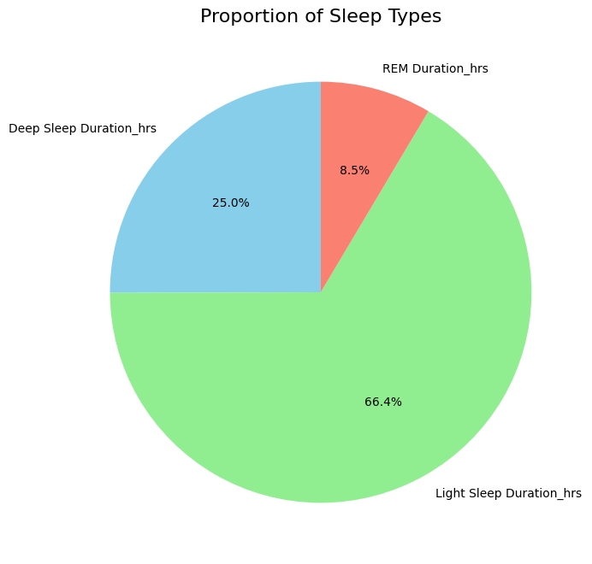
Sleep Stage | Proportion in Chart | Global Average | Comparison
Deep Sleep Duration | 25.00% | 15–20% | Above average; positive as deep sleep aids in physical restoration and immunity.
REM Sleep Duration | 8.50% | 20–25% | Significantly below average; may impact cognitive function and memory.
Light Sleep Duration | 66.40% | 50–60% | Above average; could indicate fragmented or less restorative sleep cycles.

Slide 21
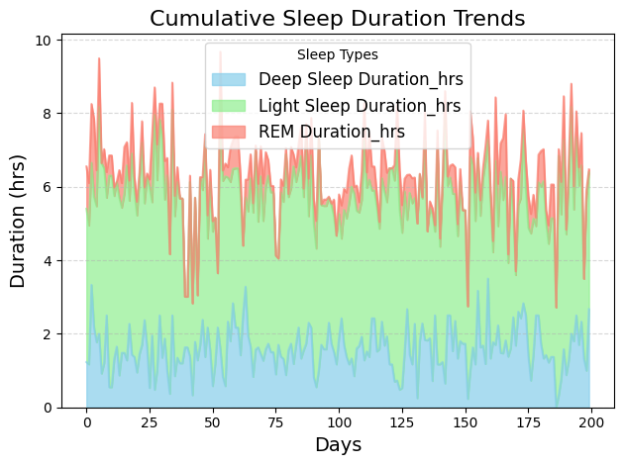
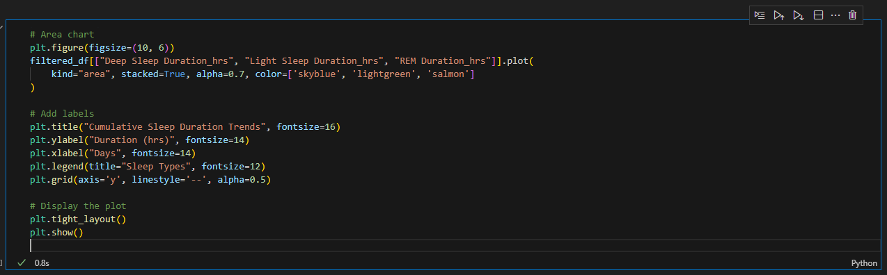

Slide 22
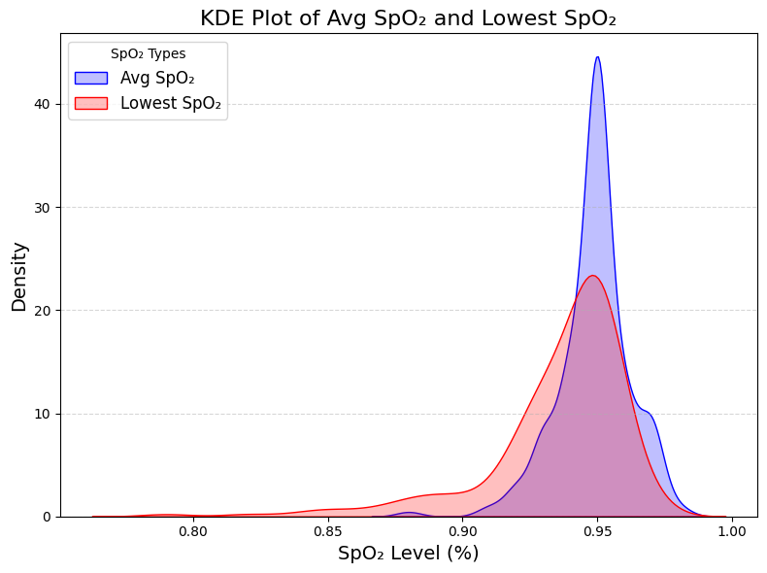
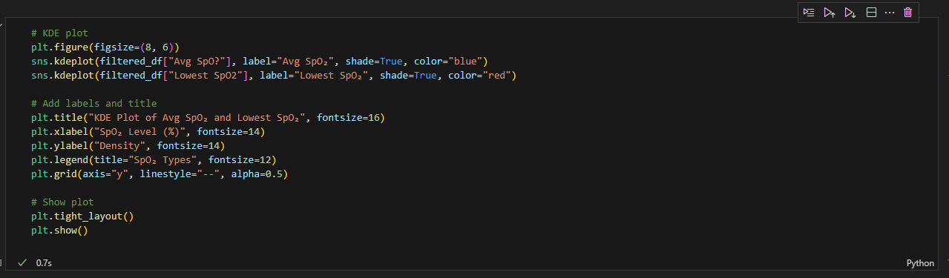
KDE Plot

Slide 23
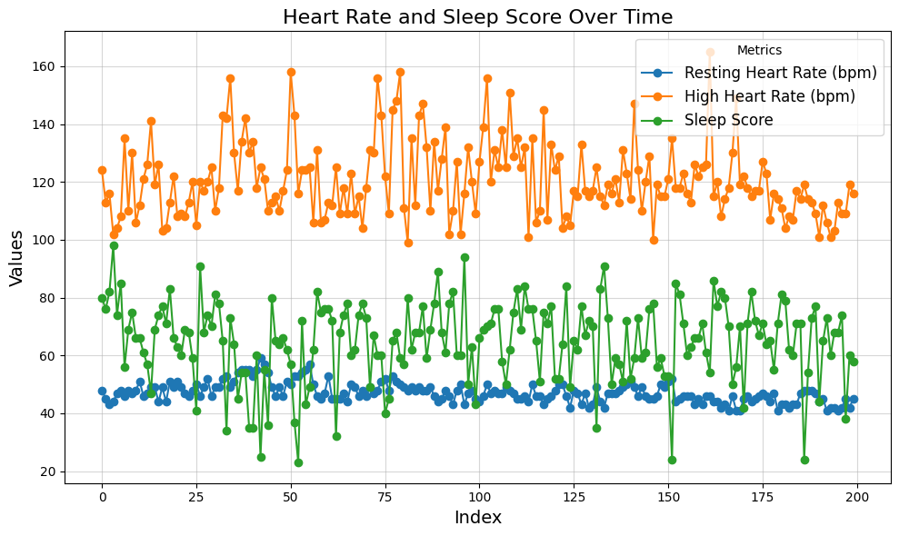

Slide 24
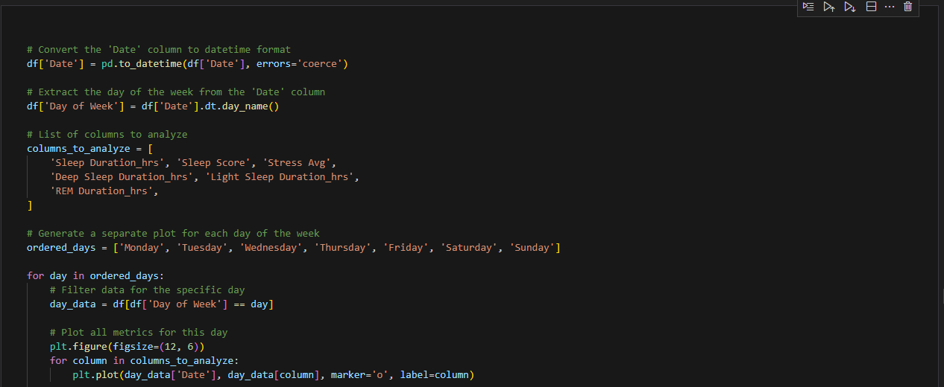
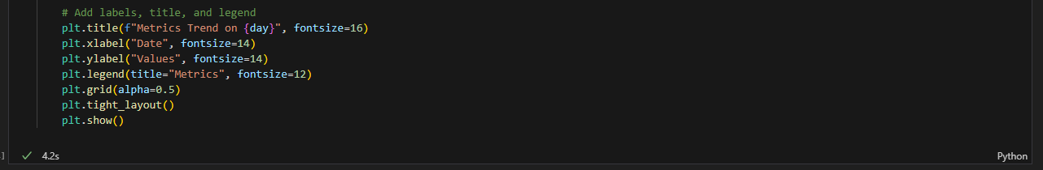

Slide 25
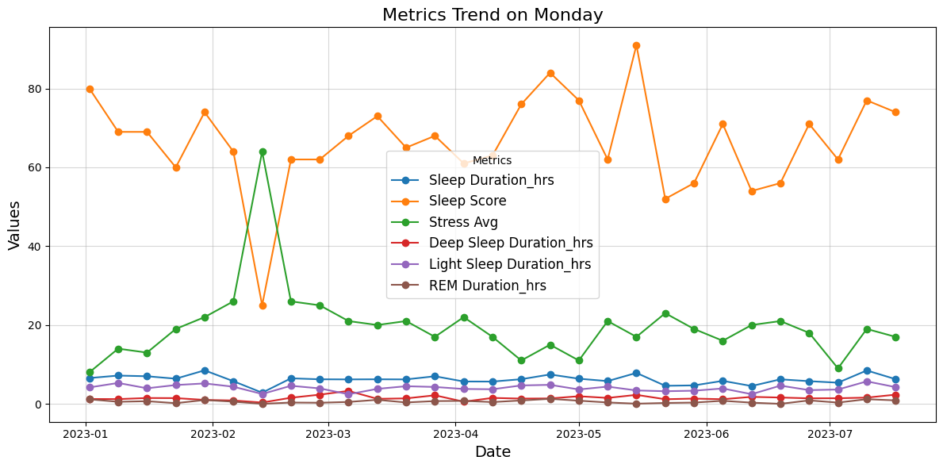
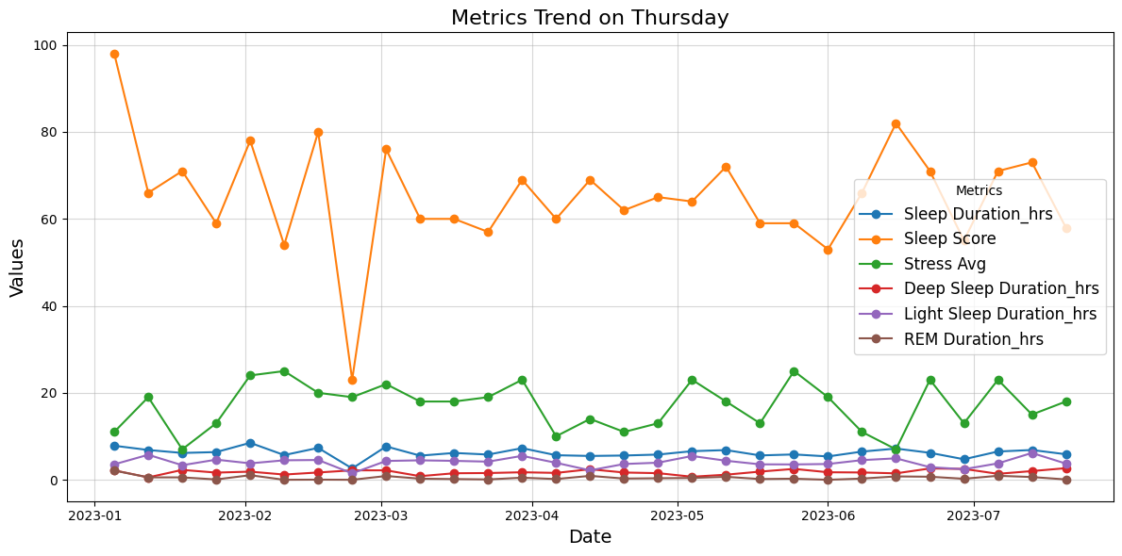
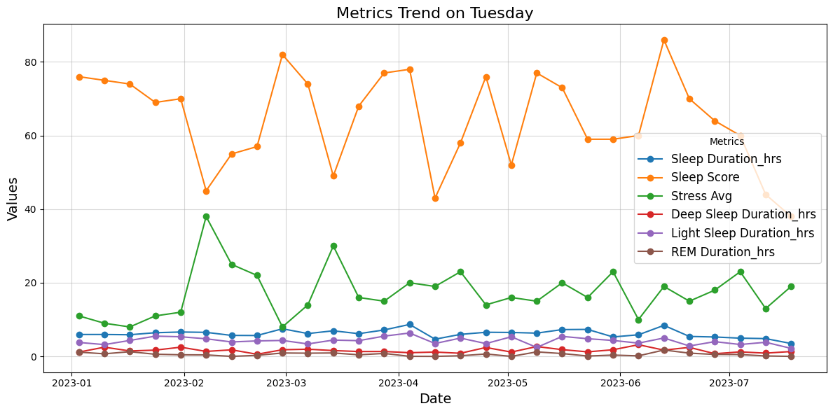
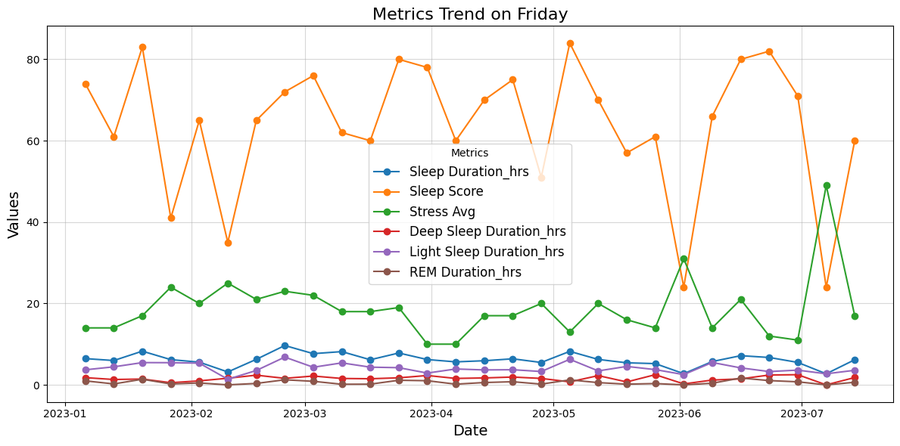
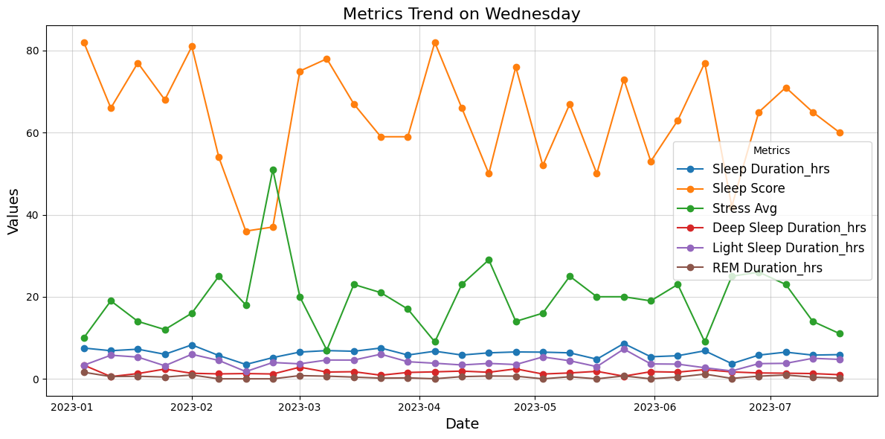

Slide 26
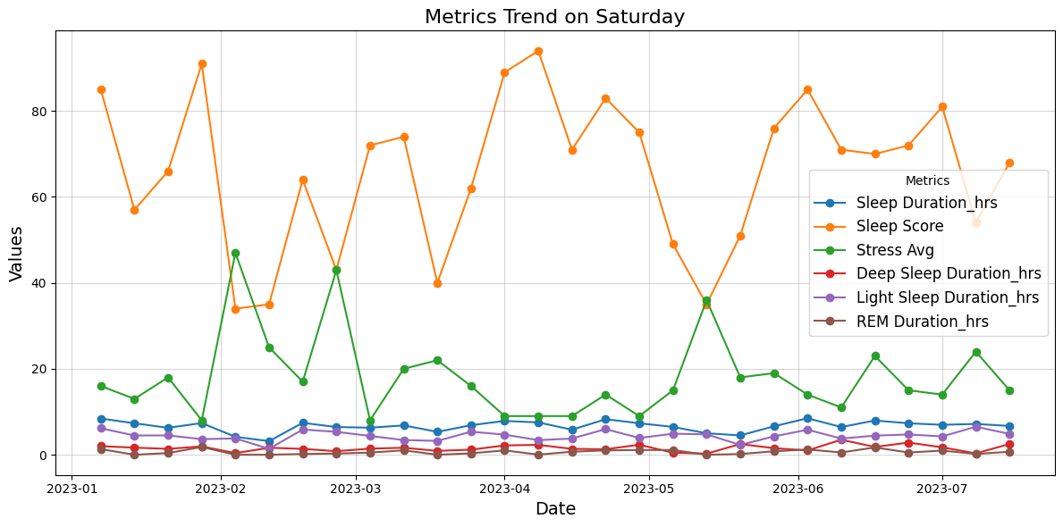
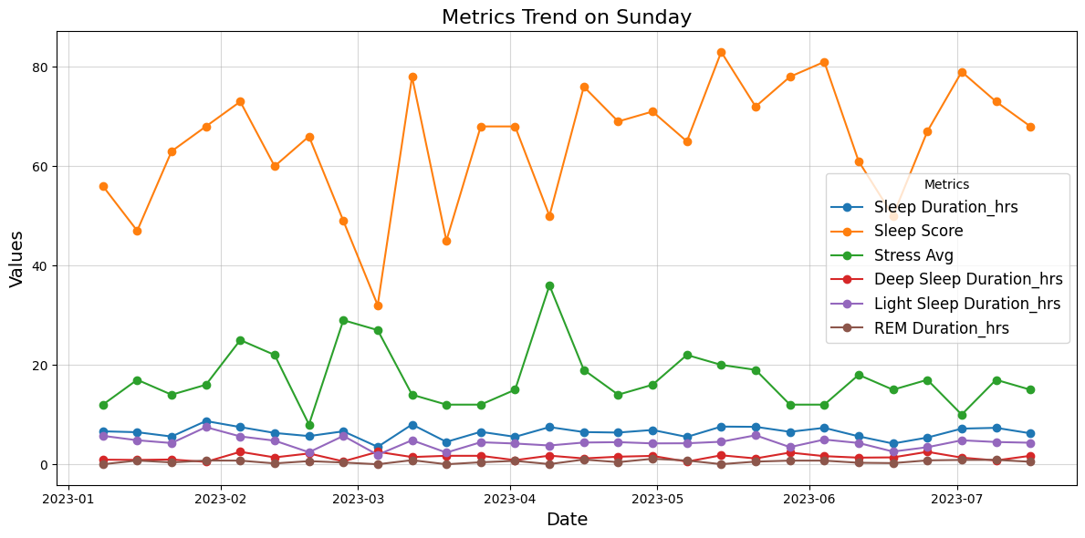

Slide 27
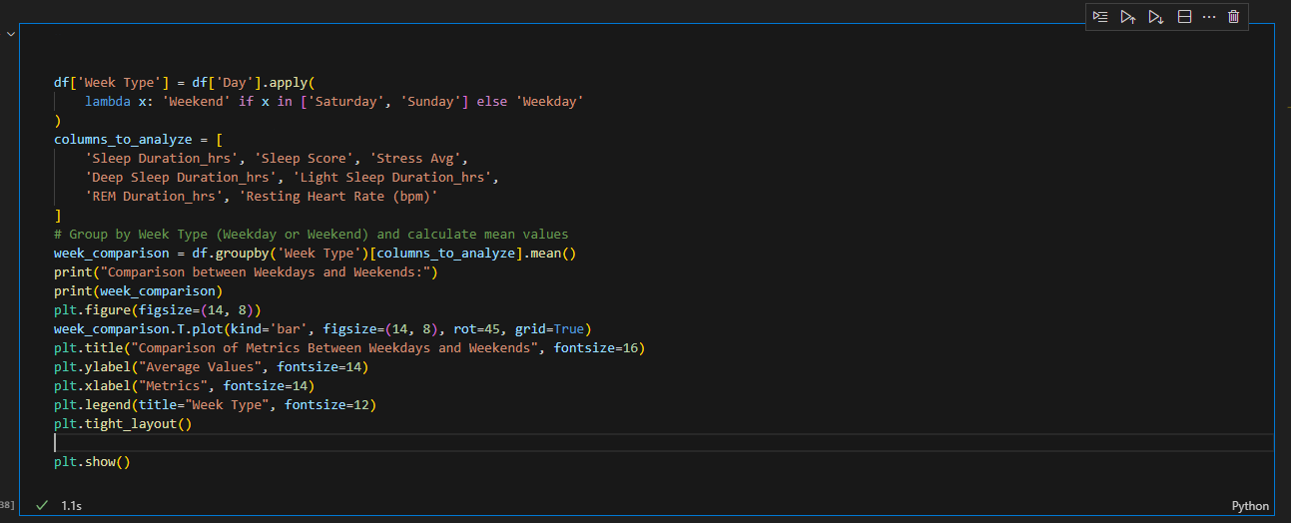
Weekend VS Weekday

Slide 28
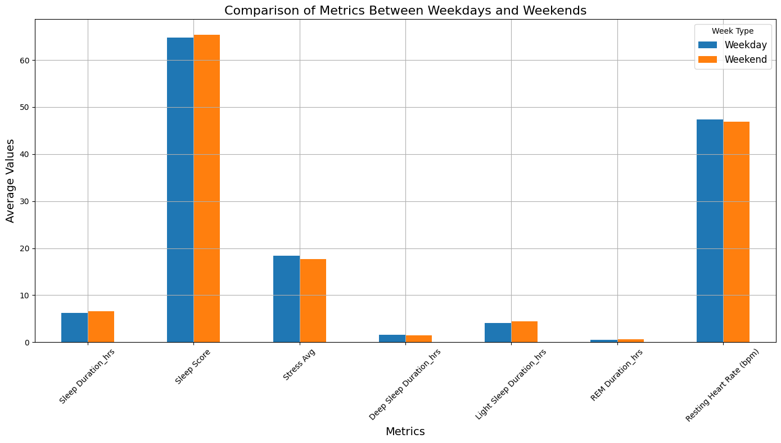

Slide 29
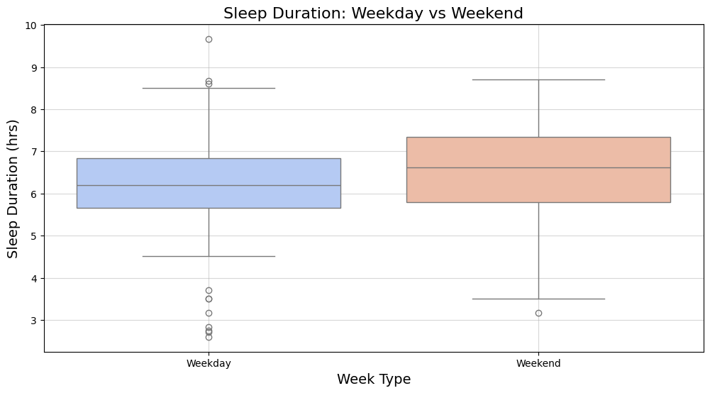

Slide 30
Aspect | Weekday | Weekend | Insights
Median Sleep Duration | ~6 hours | ~7 hours | Sleep duration is higher on weekends, indicating compensatory sleeping.
Interquartile Range (IQR) | 5–7 hours | 6–8 hours | Weekends show less variability, suggesting more consistent sleep patterns.
Outliers (Low) | Below 4 hours | Below 5 hours | More individuals experience insufficient sleep on weekdays compared to weekends.
Outliers (High) | Above 9 hours | Above 9 hours | Some individuals oversleep on both weekdays and weekends, likely compensating for deficits.
Variability | Higher variability | Lower variability | Weekday sleep patterns are more inconsistent compared to weekends.
Key Comparison | Shorter sleep duration, more outliers | Longer sleep duration, fewer outliers | Weekends generally show healthier sleep patterns compared to weekdays.

Slide 31
Average Sleep Efficiency: 96.37%
Global Average – 80 to 90%
Low Averages for Other Parameters
1. Short Total Sleep Duration | Inadequate total sleep reduces time available for REM and light sleep stages.
2. Disrupted Sleep Architecture | High efficiency doesn’t reflect the quality or balance across sleep stages.
3. Weekday vs. Weekend Sleep | Short weekday sleep durations reduce averages across all stages, especially REM sleep.
Aspect | Reason
High Sleep Efficiency (96.37%)
1. Time in Bed Utilized Well | Minimal time spent awake in bed leads to high efficiency despite low total sleep duration.
2. Shorter Sleep Duration | Reduced time in bed inflates efficiency as a mathematical outcome.
3. Minimal Wake Interruptions | Few or no mid-sleep awakenings ensure a high percentage of time asleep.
4. Compensatory Sleep Cycles | The body prioritizes essential stages (e.g., deep sleep), leading to efficient sleep.
5. Good Sleep Hygiene | Quick sleep onset and uninterrupted cycles contribute to high efficiency.

Slide 32
Recommendations for Better Sleep
Maintain a consistent sleep schedule.
Create a comfortable sleep environment.
Engage in regular physical activity.
Monitor and reduce stress levels.

