Slide 1


Slide 2
IPL - 2017
Name - AMOL GORAKSHANATH PURKAR
Batch No - PGA WD 32

Slide 3
Indian Premier League (IPL)
(2017)
Content
The brainchild of the Board of Control for Cricket in India (BCCI)
There are 8 teams
Mumbai Indians, the Chennai Super Kings, the Royal Challengers Bangalore, the Deccan Chargers (based in Hyderabad), the Delhi Daredevils, the Punjab XI Kings (Mohali), the Kolkata Knight Riders, and the Rajasthan Royals (Jaipur)

Slide 4
Problem Statement
IPL is the top level of the cricket league system. It is contested by 8 to 10 teams, it operates on a system of promotion and relegation with the cricket League. They have accumulated the data of all the matches that has happened betweeen 2008-2017 inclusively. The company is trying to find the pattern of evolution of different teams over the years. But their traditional systems are not up to the mark to find out deeper patterns. To tackle this problem they hired me.

Slide 5
Exploratory Data Analysis (EDA)
and
Feature Engineering

Slide 6
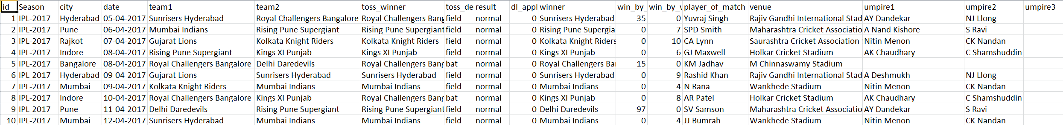
Data Set Details
only six continuous features –
id , season, dl_applied, win_by_runs, win_by_wickets, and umpire3.
There are 18 features with 756 observations in the dataset.

Slide 7
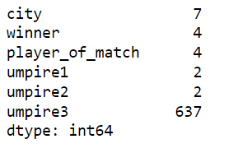
Missing Values
'city' feature has 19 missing values.
‘umpire1’ and ‘umpire2’has each two missing values.
'umpire3' feature has 84% of missing data.
Dataset has No duplicate rows.

Slide 8
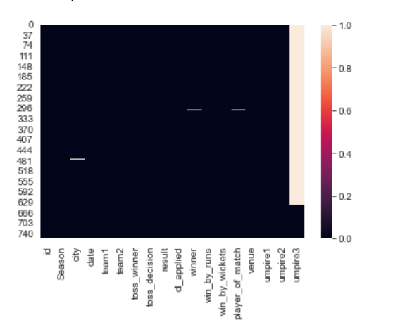
Nulls

Slide 9
Missing Values
Handled Missing values in city features by updating it with ‘Mumbai‘.
Reason updating it to Mumbai is that most those matches played on Mumbai cricket ground.
Handled missing values in Umpire3 by dropping the column itself.
Converted date column type from object to date time type.

Slide 10
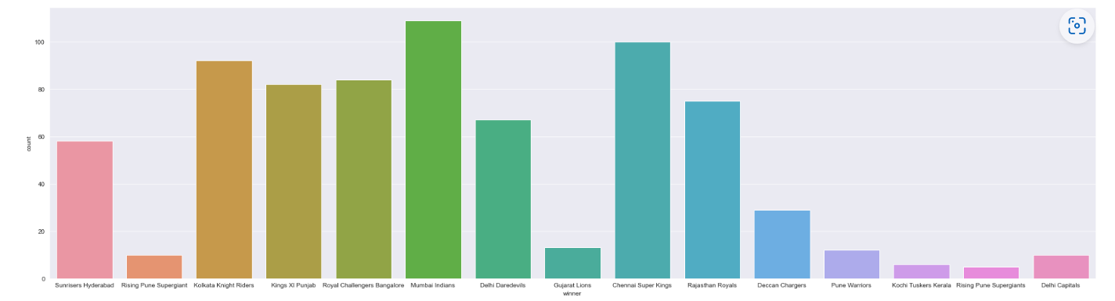
Winners

Slide 11
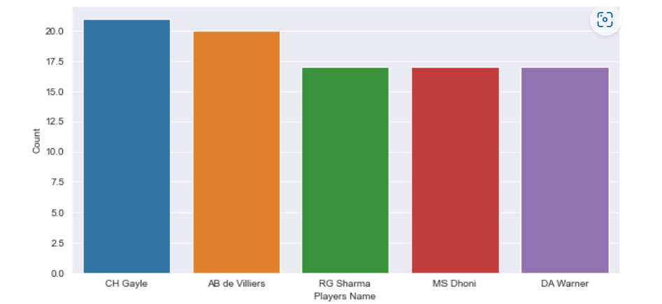
5 most player_of_match

Slide 12
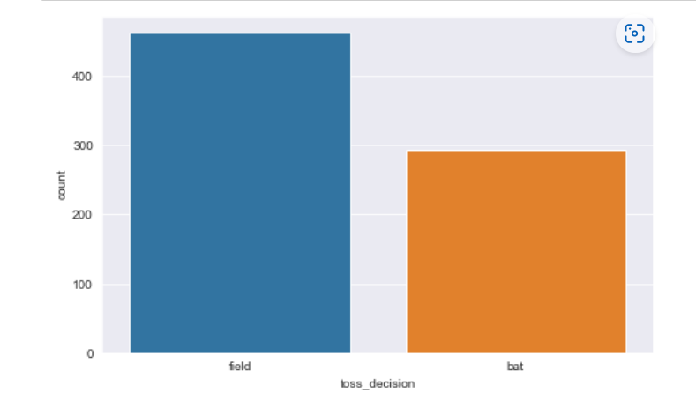
Toss Decision

Slide 13
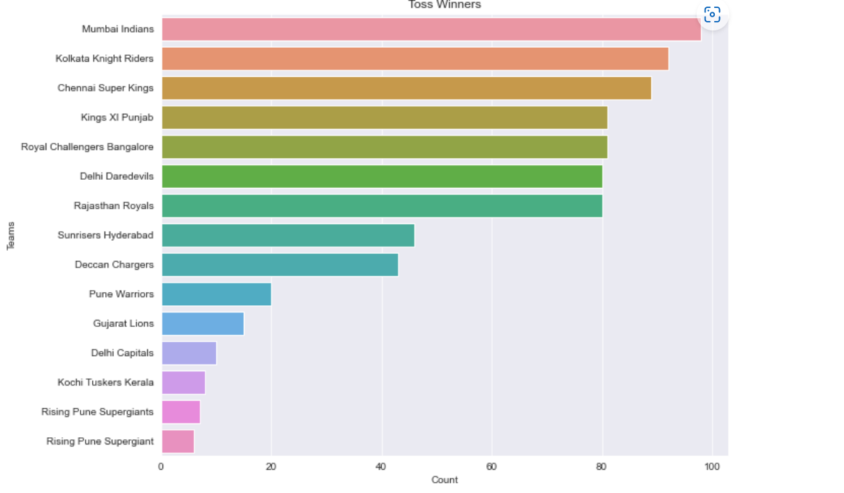
Toss Winner

Slide 14
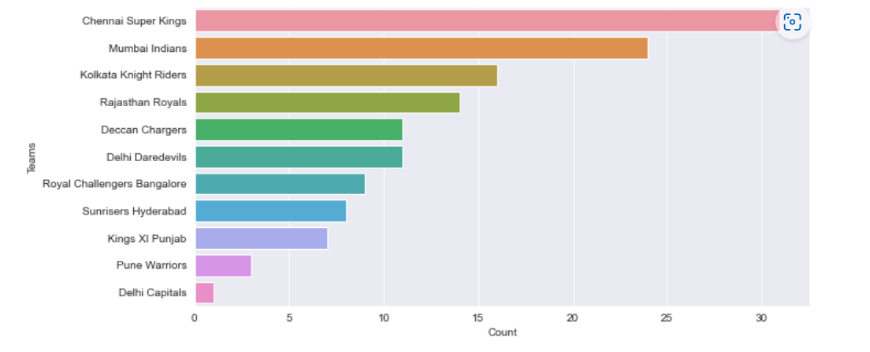
Batting First and Won

Slide 15
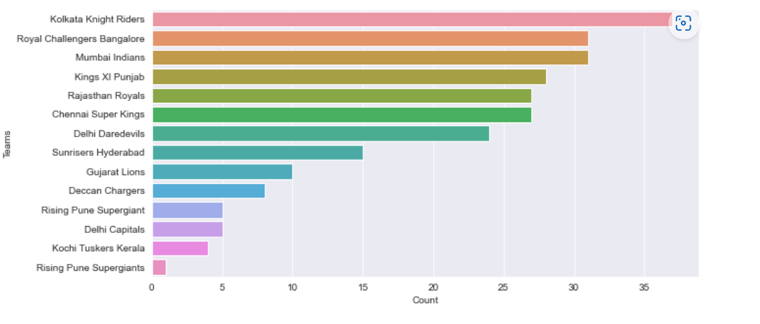
Bowling First and Won

Slide 16
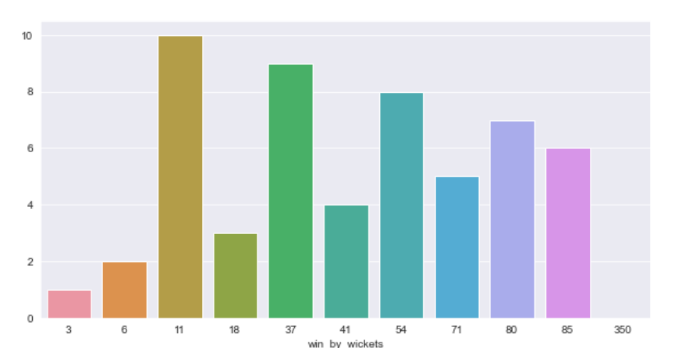
Won by Wicket

Slide 17
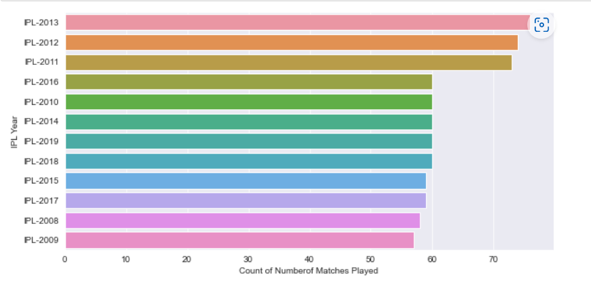
Number of matches played each year

Slide 18
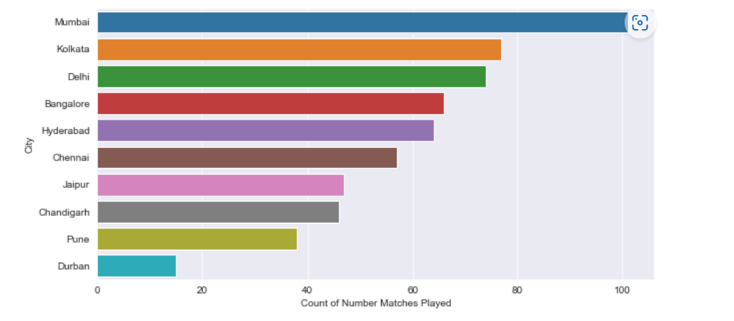
Number of Matches played in
Most cities

Slide 19
THANK YOU !

