Slide 1
Capstone Project-4 Zomato Restaurant Clustering and Sentiments Analysis
Team members KAMALUDDIN SHAIKH AMOL RASAM SHUBHAM JHA PRETESH

Slide 2
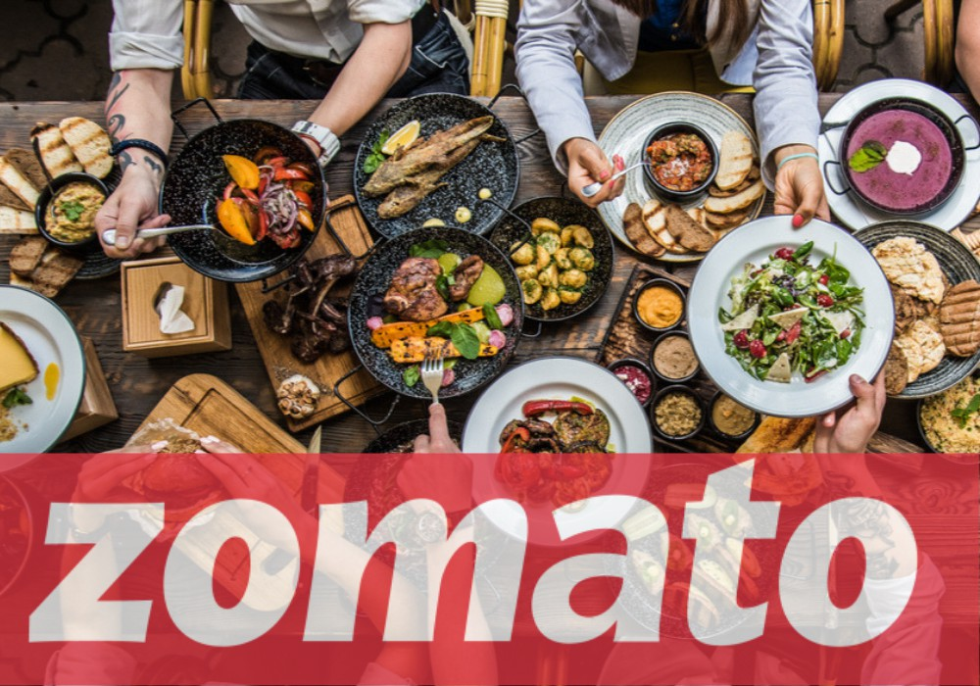
Content
Problem Statement
Data Summary
Clustering
EDA
Optimal No of Clusters
Restaurants in Different Clusters
Cuisines in Different Clusters
Sentiment Analysis
EDA
Data Preprocessing
Top Words before and after Stemming
ML Model & Metrics
Challenges
Conclusion

Slide 3
Problem Statement
The Project focuses on Customers and Company, we have tried to analyze the sentiments of the reviews given by the customer in the data and made some useful conclusion in the form of Visualizations.
Also, cluster the Zomato restaurants into different segments. The data is visualized as it becomes easy to analyses data at instant.
This could help in clustering the restaurants into segments. Also the data has valuable information around cuisine and costing which can be used in cost vs. benefit analysis.

Slide 4
Data Summary
For Clustering
Name : Name of Restaurants
Links : URL Links of Restaurants
Cost : Per person estimated Cost of dining
Collection : Tagging of Restaurants w.r.t. Zomato categories
Cuisines : Cuisines served by Restaurants
Timings : Restaurant Timings

Slide 5
Data Summary
For Restaurants reviews
Restaurant : Name of the Restaurant
Reviewer : Name of the Reviewer
Review : Review Text
Rating : Rating Provided by Reviewer
Metadata : Reviewer Metadata - No. of Reviews and followers
Time: Date and Time of Review
Pictures : No. of pictures posted with review

Slide 6
Basic Exploration
Data of 105 restaurants.
Data of 9000 reviews.
3 years of customer’s reviews.
0.36 percent null values were present.
50 percent of collection data is missing.
Average price of a Restaurant ranges from 150 to 2800.

Slide 7
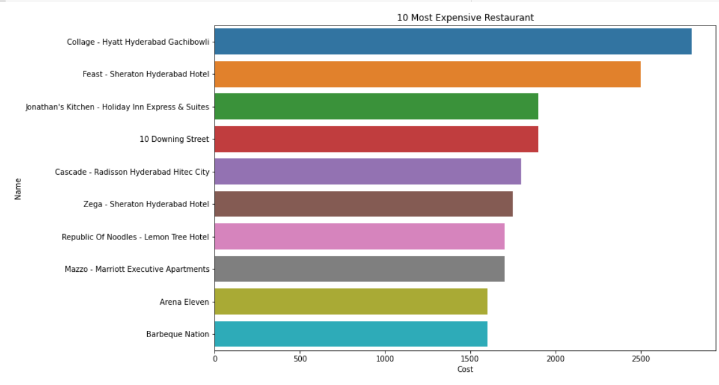
EDA- Clustering
Top 10 Most Expensive Restaurant

Slide 8
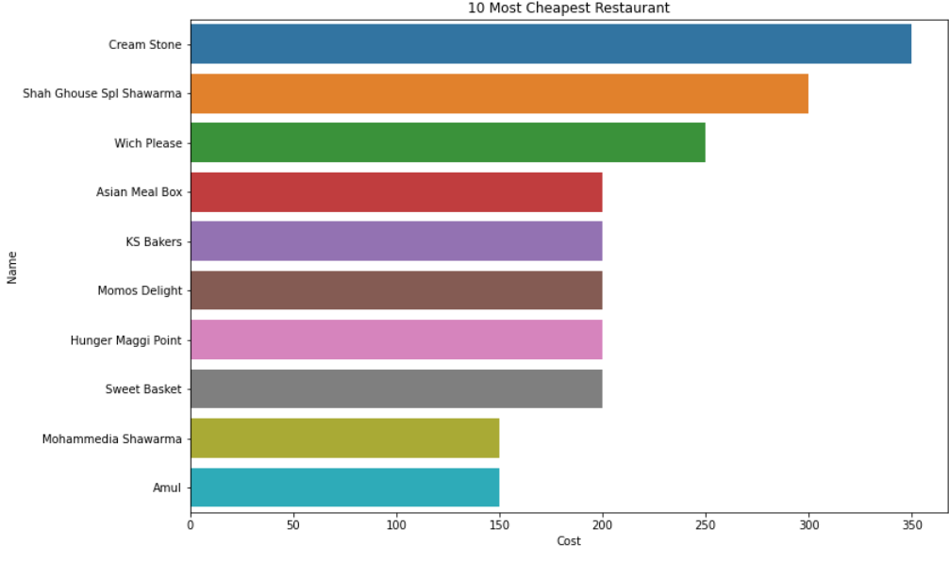
Top 10 Budget Friendly Restaurants

Slide 9
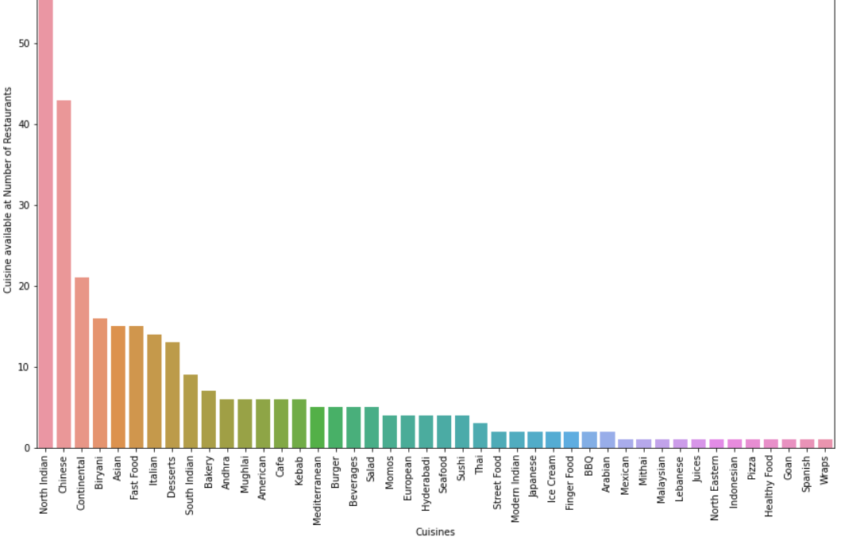
Most Popular Cuisines at Restaurants

Slide 10
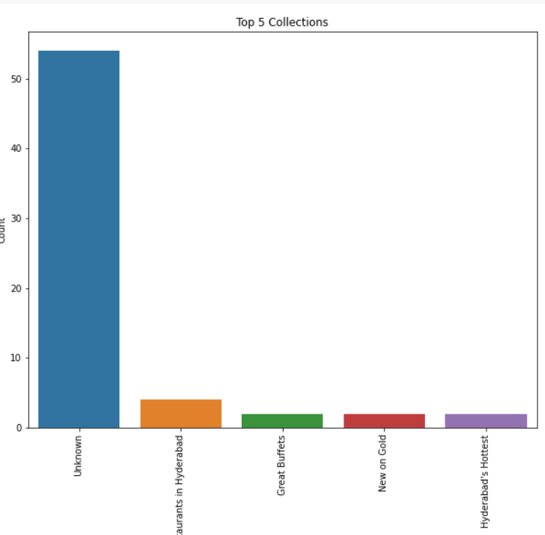
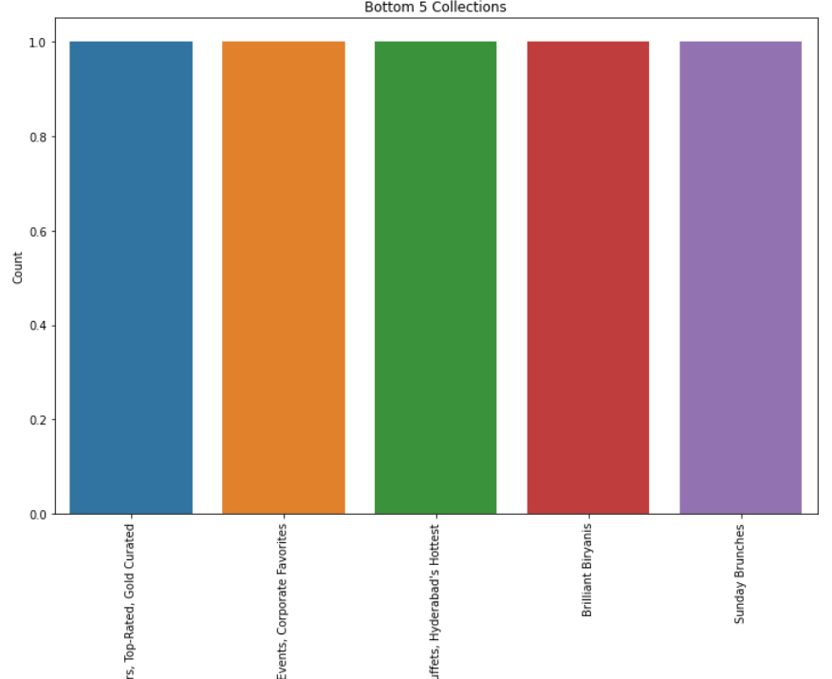
Insights From Collections
Top 5 Collections
Bottom 5 Collections

Slide 11
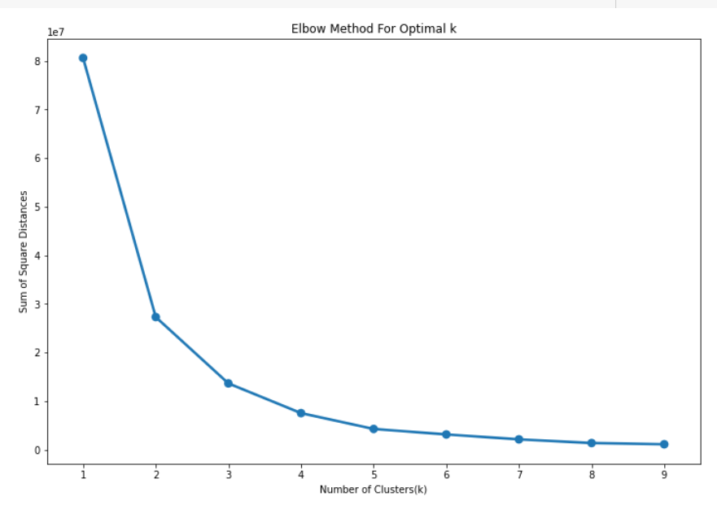
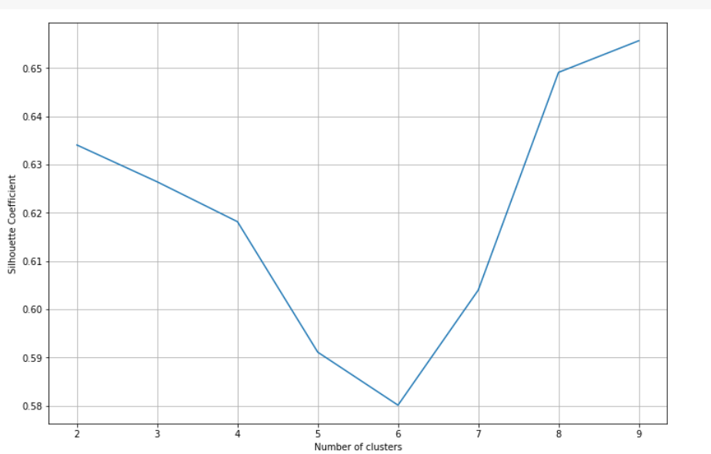
Optimal Number of Clusters
Elbow Method for optimal K
Silhouette Coefficient

Slide 12
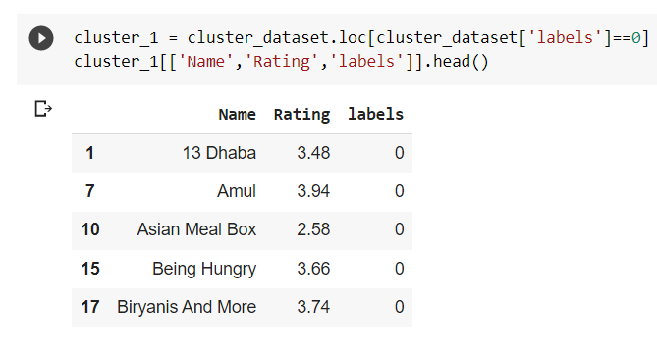
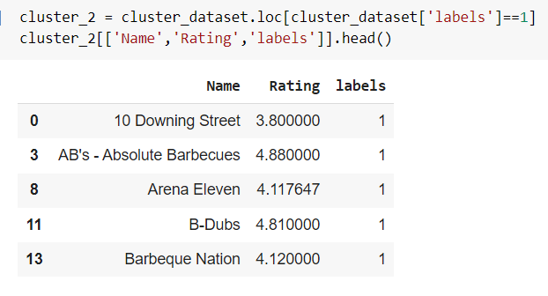
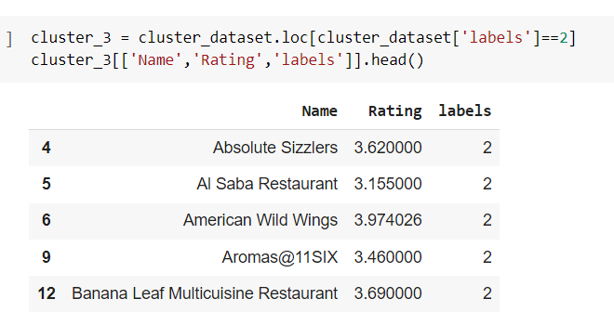
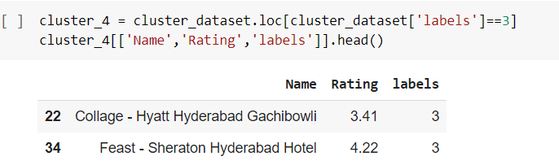
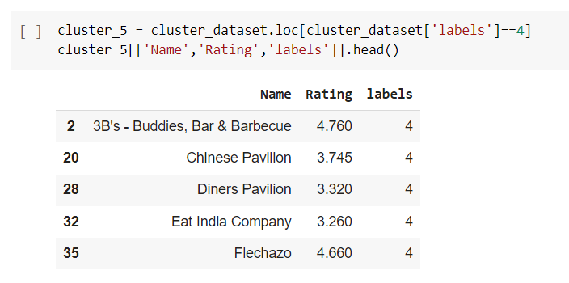
Restaurants and Ratings in different Clusters

Slide 13
Restaurants and Ratings in different Clusters
Cluster 1
Cluster 2

Slide 14
Restaurants and Ratings in different Clusters
Cluster 3
Cluster 4
Cluster 5

Slide 15
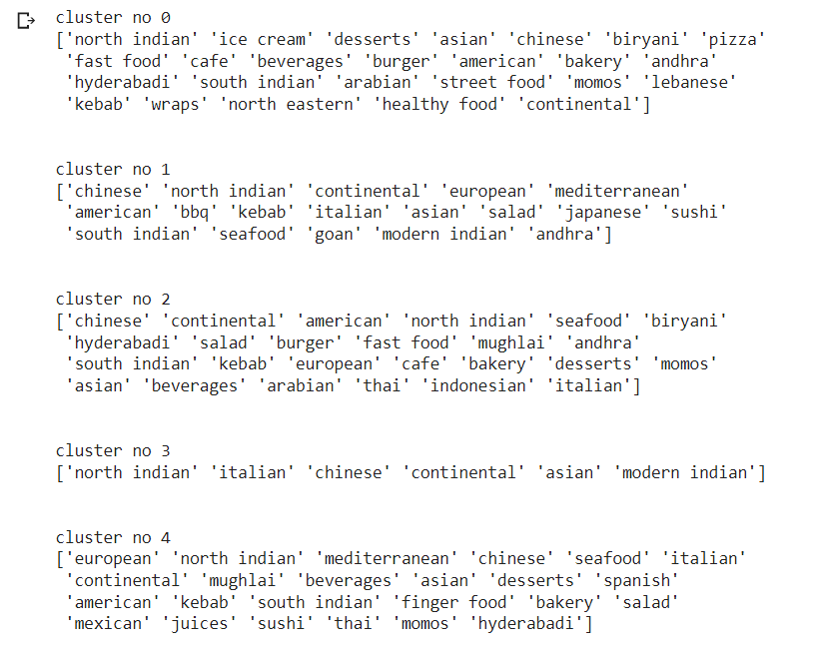
Cuisines in Clusters
North Indian, Continental and Chinese are available mostly in every Cluster.

Slide 16
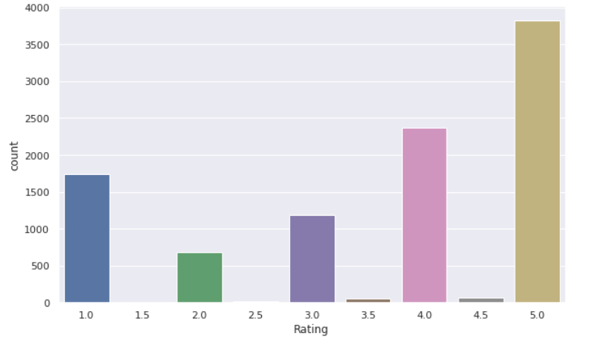
EDA- Sentiment Analysis
Ratings Analysis
We can see most number of people game rating 5 followed by 4 and 1 respectively.

Slide 17
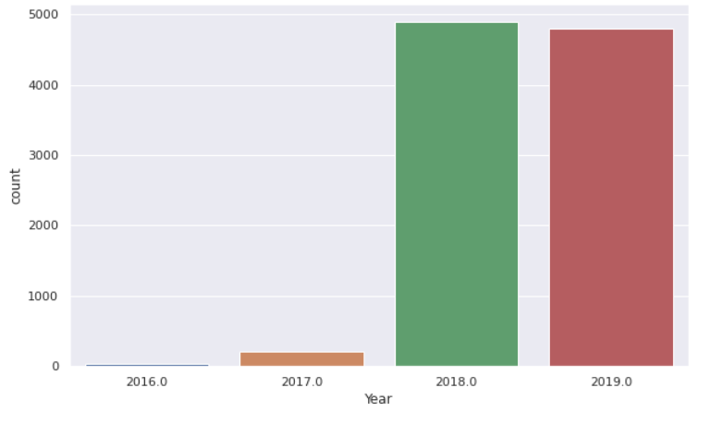
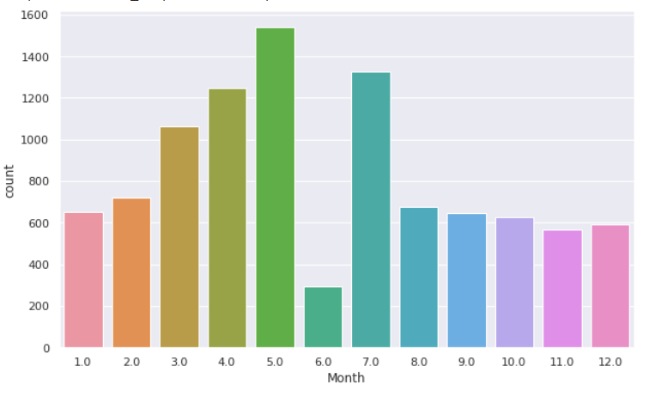
Reviews Analysis
Yearly Review Analysis
Monthly Review Analysis

Slide 18
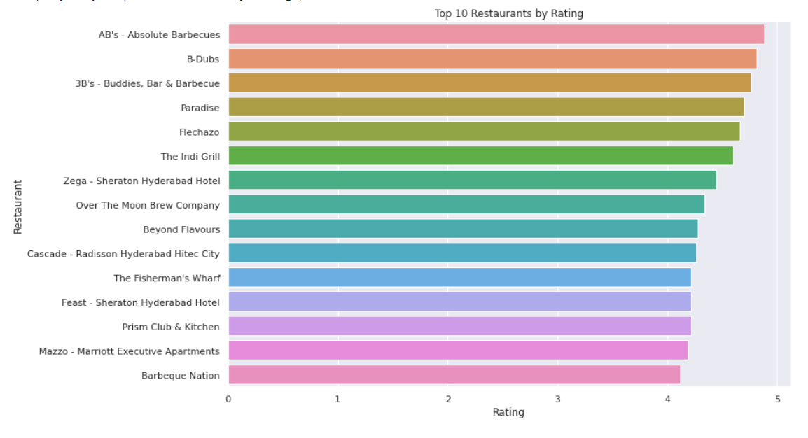
Top 10 Restaurants by Rating

Slide 19

Data Pre-Processing
Steps taken to prepare the data
Removing Punctuations
Removing Stop words
Removing # symbols and retaining the tags
Removing Emoji’s
Removing short words
Tokenization and stemming

Slide 20
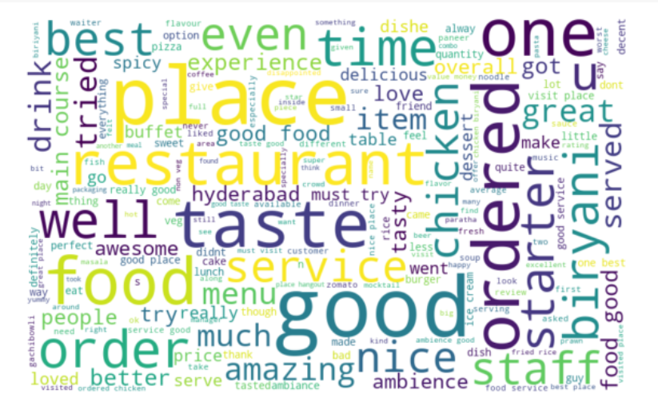
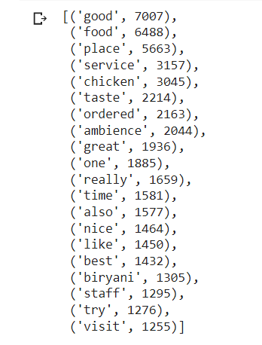
Stemming
Top words before Stemming

Slide 21
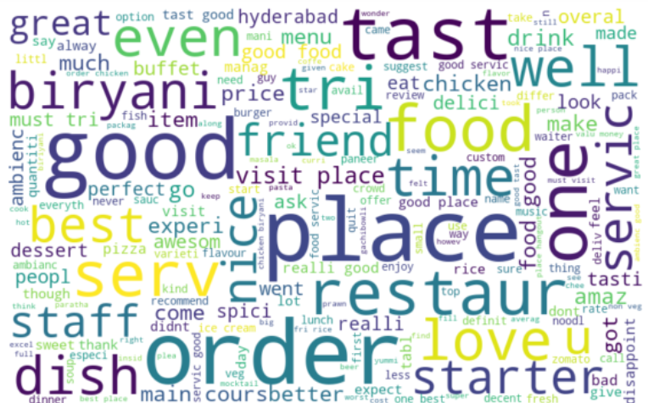
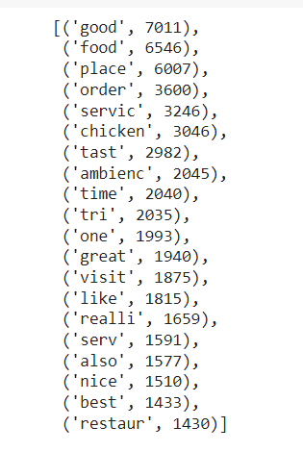
Stemming
Top words after Stemming

Slide 22
Comparison Of performance of all models
index | Model | Test accuracy | Precision | Recall | Auc - Roc Score
1 | Logistic Regression | 0.862404 | 0.769848 | 0.849409 | 0.859256
2 | Random Forest | 0.857717 | 0.706512 | 0.891892 | 0.867575
3 | CatBoost Classifier | 0.849012 | 0.700268 | 0.872222 | 0.855613
4 | XGBoost | 0.821895 | 0.597681 | 0.892144 | 0.845222
5 | K Nearest Neighbour | 0.753264 | 0.497770 | 0.762295 | 0.756314
6 | Decision Tree | 0.723468 | 0.518287 | 0.670127 | 0.707705

Slide 23

Challenges
Feature engineering.
Finding optimum number of Cluster
Text preprocessing
ML Model and Metrics

Slide 24
Conclusion
That's it! We reached the end of our exercise. Starting with loading the data so far we have done EDA, null values treatment, encoding of categorical columns, feature selection, and then model building.
For clustering, we have decided on 5 clusters after the Silhouette score plot and elbow plot where we used K means clustering algorithm.
For Sentiment Analysis we have implemented six different models to predict the sentiment of Reviews. Logistic Regression, Random Forest Classifier, Decision Tree, CatBoost Classifier, K Nearest Neighbor and Xgboost Classifier.
Logistic Regression and Random Forest model performed the best among them. In this way, we can explore more from various textual data and Reviews. Our models will try to predict the various sentiments correctly.

Slide 25
Thank You

