Slide 1
Capstone Project-3 ZOMATO RESTAURANT CLUSTERING AND SENTIMENT ANALYSIS Team members AMOL RASAM KAMALUDDIN SHAIKH SHUBHAM JHA PRETESH

Slide 2
Content

Slide 3
Problem Statement
The Project focuses on Customers and Company, we have tried to analyze the sentiments of the reviews given by the customer in the data and made some useful conclusion in the form of Visualizations.
Also, cluster the zomato restaurants into different segments. The data is vizualized as it becomes easy to analyse data at instant.
The Analysis also solve some of the business cases that can directly help the customers finding the Best restaurant in their locality and for the company to grow up and work on the fields they are currently lagging in.
This could help in clustering the restaurants into segments. Also the data has valuable information around cuisine and costing which can be used in cost vs. benefit analysis

Slide 4
Data Summary
For Clustering
Name : Name of Restaurants
Links : URL Links of Restaurants
Cost : Per person estimated Cost of dining
Collection : Tagging of Restaurants w.r.t. Zomato categories
Cuisines : Cuisines served by Restaurants
Timings : Restaurant Timings
ings
For Restaurants reviews
Restaurant : Name of the Restaurant
Reviewer : Name of the Reviewer
Review : Review Text
Rating : Rating Provided by Reviewer
MetaData : Reviewer Metadata - No. of Reviews and followers
Time: Date and Time of Review
Pictures : No. of pictures posted with review

Slide 5
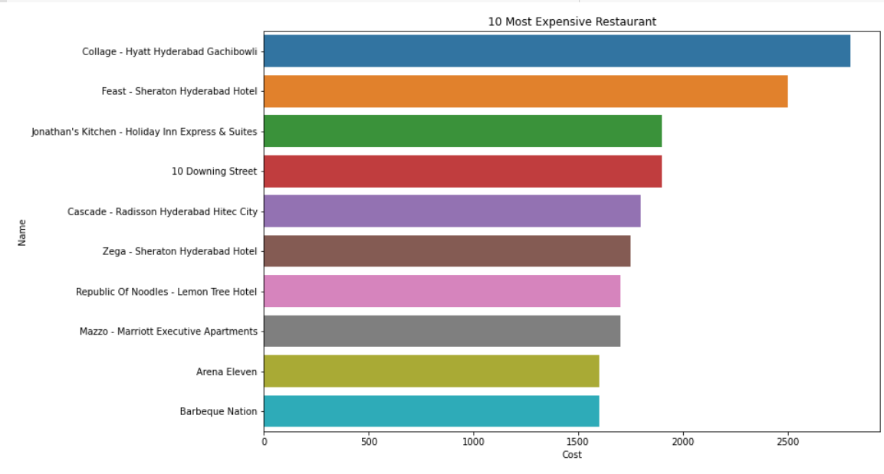
EDA- Overall Insights from Data

Slide 6
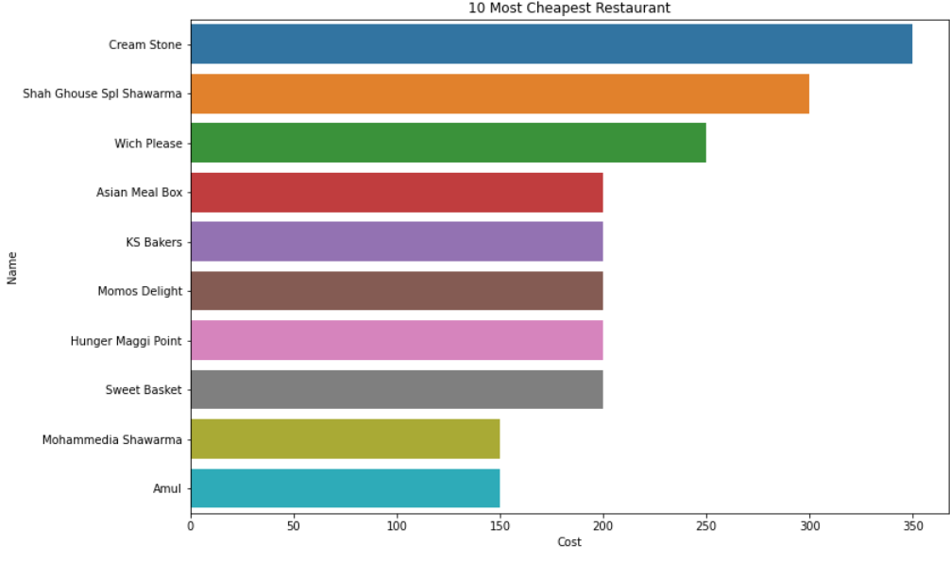
Top 10 Budget Friendly Restaurants

Slide 7
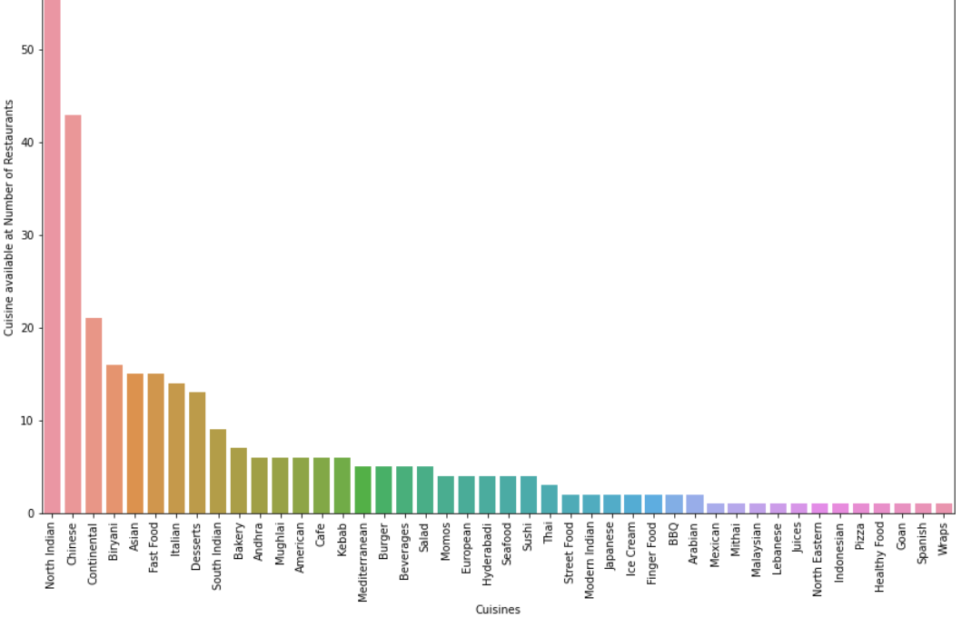
Most Popular Cuisines at Restaurants

Slide 8
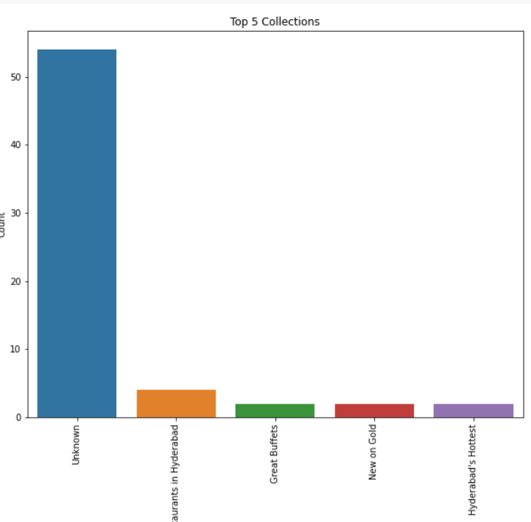
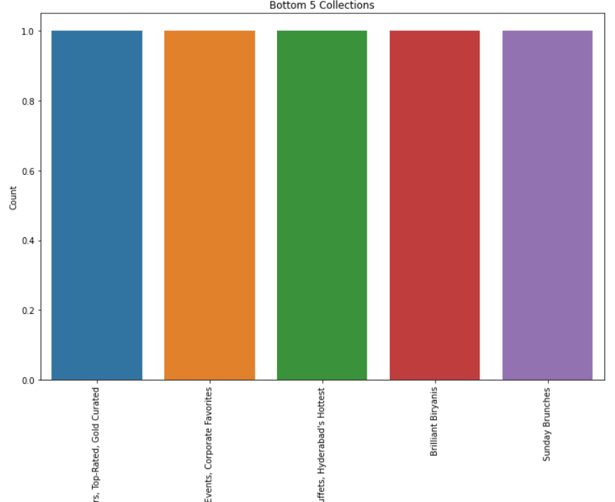
Insights From Collection Column
Top 5 Collections
Bottom 5 Collections

Slide 9
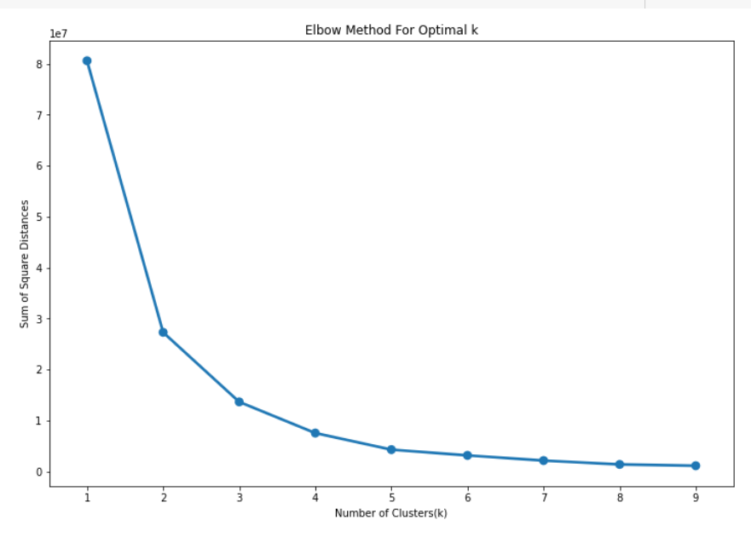
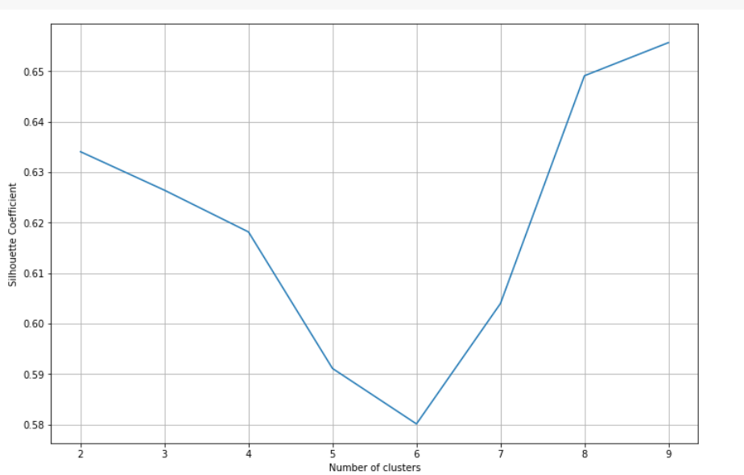
Optimal Number of Clusters
Elbow Method for optimal K
Silhouette Coefficient

Slide 10
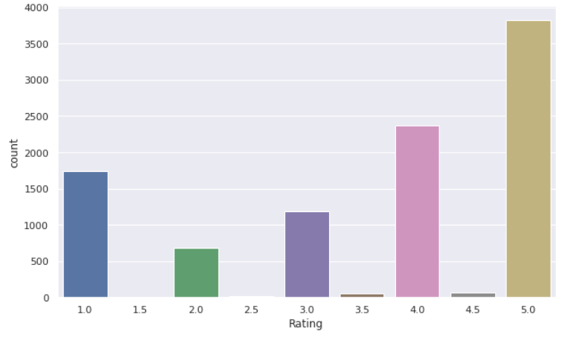
EDA on Review Data
Sentiment analysis of rating vs count – We can see most number of people game rating 5 followed by 4 and 1 respectively

Slide 11
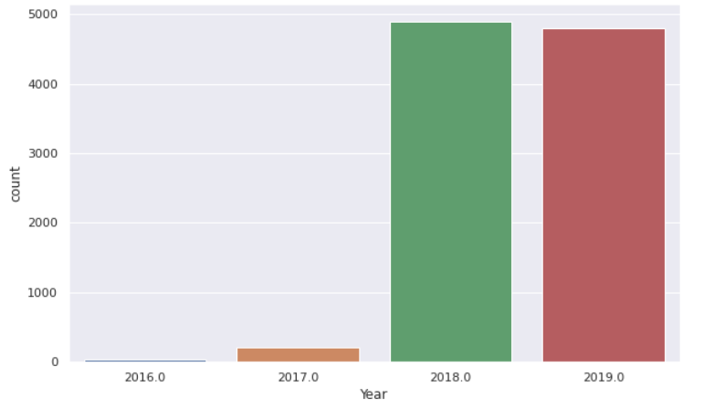
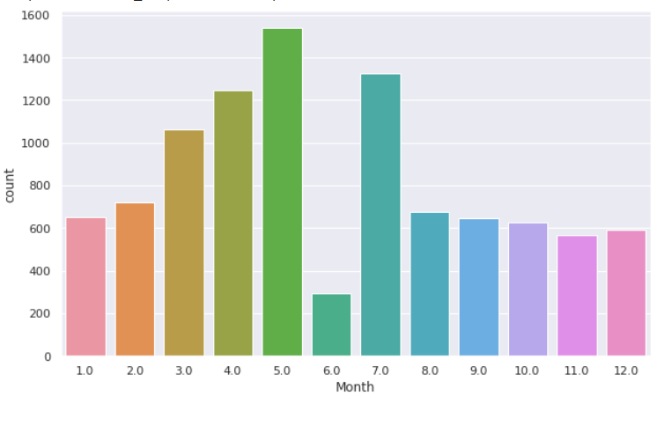
Review Data Analysis
Yearly Review Analysis
Monthly Review Analysis

Slide 12
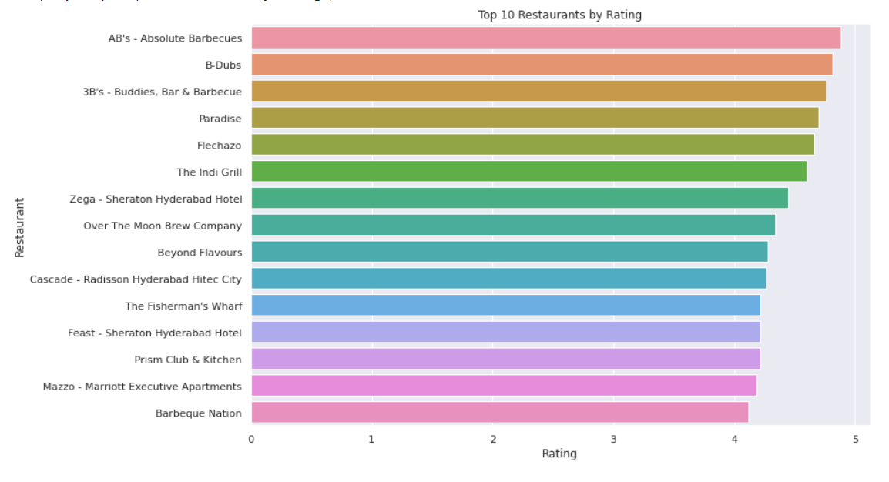
Top 10 Restaurants by Rating

Slide 13
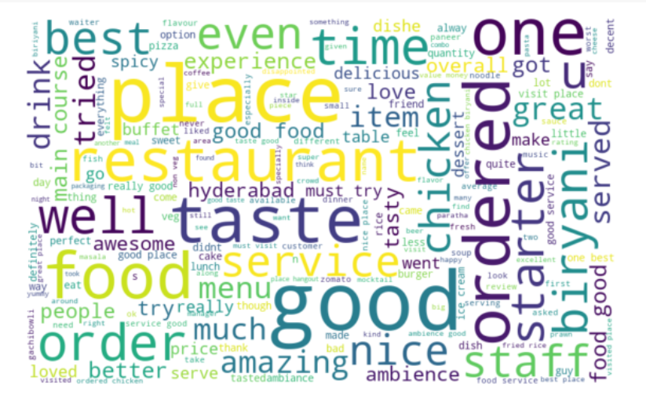
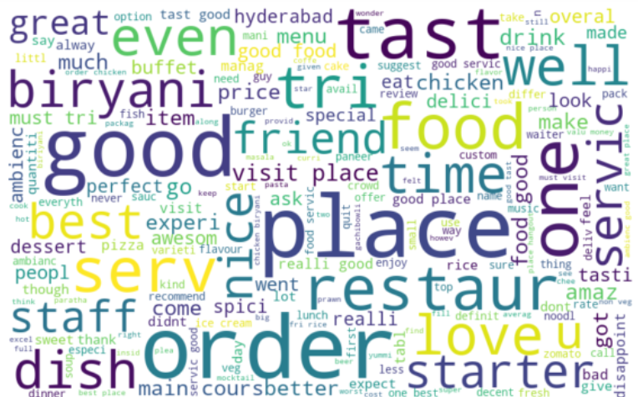
Stemming
Top words before Stemming
Top words after Stemming

Slide 14
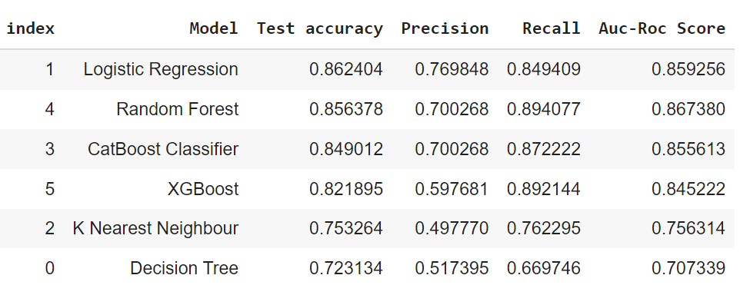
Comparison Of performance of all models

Slide 15
Challenges

Slide 16
Conclusion
That's it! We reached the end of our exercise.Starting with loading the data so far we have done EDA, null values treatment, encoding of categorical columns, feature selection, and then model building.
For clustering, we have decided on 5 clusters after the Silhouette score plot and elbow plot where we used KMeans clustering algorithm.
For Sentiment Analysis we have implemented six different models to predict the sentiment of Reviews. Logistic Regression, Random Forest Classifier, Decision Tree, CatBoost Classifier, K Nearest Neighbour and Xgboost Classifier.
Logistic Regression and Random Forest model performed the best among them. In this way, we can explore more from various textual data and Reviews. Our models will try to predict the various sentiments correctly.

